Slide 1


iFood
Marketing offer optimization

Slide 2





Problem
Currently, we send the food offers to all the users.
We want to know the user behavior, and optimize our offers
Costly
Low conversion rate
Cheaper
High conversion rate

Slide 3
Before
50.6k offers
41.5k used
EDA Data:
82% conversion rate
12.6k offers
10.3k used
Evaluation Data:
81% conversion rate
Notes:
O iFood nasceu para fazer essa revolução acontecer, saímos do mercado dominado pelo offline e partimos para transformar a forma como as pessoas pediam comida.
Encontramos a Warehouse, que fez um investimento de 3,1 MM e com essa grana toda saímos para expandir e fazer o iFood crescer.

Slide 4
Now: targeted users
12.6k
7.4k offers
6.8k used
Evaluation Data:
92% conversion rate
R$522.00 saved
Marketing cost:
Notes:
O iFood nasceu para fazer essa revolução acontecer, saímos do mercado dominado pelo offline e partimos para transformar a forma como as pessoas pediam comida.
Encontramos a Warehouse, que fez um investimento de 3,1 MM e com essa grana toda saímos para expandir e fazer o iFood crescer.

Slide 5
Ifood has 50MM users
414,678 saved marketing messages (SMS or E-mail)
Marketing campaign
1MM users
414,678 x R$0.1 + 414,678 x R$0.004 = R$43,126.0
saved
Notes:
O iFood nasceu para fazer essa revolução acontecer, saímos do mercado dominado pelo offline e partimos para transformar a forma como as pessoas pediam comida.
Encontramos a Warehouse, que fez um investimento de 3,1 MM e com essa grana toda saímos para expandir e fazer o iFood crescer.

Slide 6

Now: targeted offers
12.6k
Evaluation Data:
92% conversion rate
Projection
Randomly selected offers
67.1%
Notes:
O iFood nasceu para fazer essa revolução acontecer, saímos do mercado dominado pelo offline e partimos para transformar a forma como as pessoas pediam comida.
Encontramos a Warehouse, que fez um investimento de 3,1 MM e com essa grana toda saímos para expandir e fazer o iFood crescer.

Slide 7


Exploratory Data Analysis

Slide 8

Probably the Data were Generated Sintetically
Some data are inconsistente or wierd. There are offers that are completed with time_since_test_start = 0
Ages of 120 Years
Credit card with mean limit value of 60,000

Slide 9

User profile – without offer
“Propense” user definition
Offer received - 30
Offer received
Propense :Class = 1
Never transacted :Class = 0

Slide 10
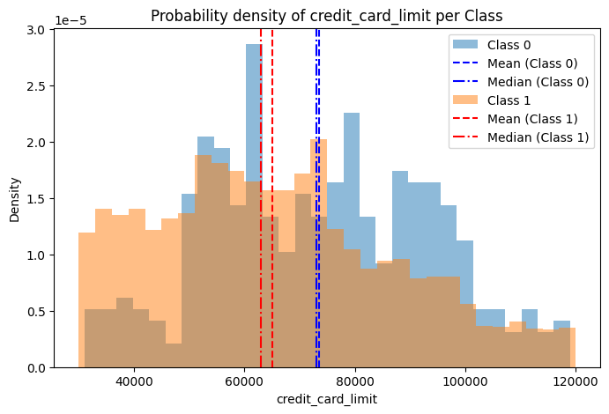
User profile – without offer
Credit Limit and Conversion: mid class uses the application more frequently

Slide 11
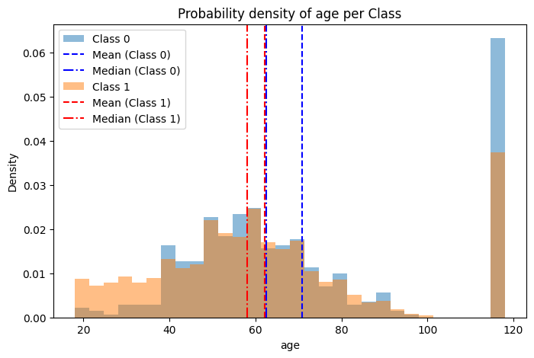
User profile – without offer
Age and Conversion: youngers transact more

Slide 12
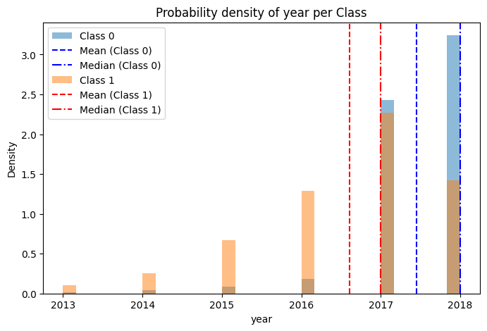
User profile – without offer
Time of using the application: newer users transact less oftren than older ones

Slide 13
User profile – without offer
Gender: plays no rule

Slide 14

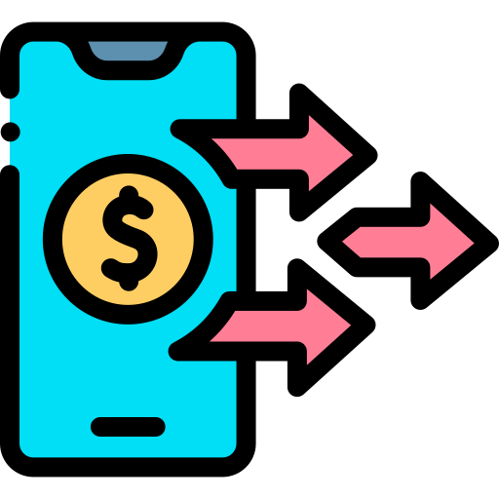

User profile – without offer
“Propense” after receiving an offer
Offer received
Offer received + Offer duration
Offer not led to transaction :Class = 0
If not inside the time window or if it doesnt follow the min value rule.
Offer led to transaction :Class = 1
If there is na offer inside the time window if the discount type is “Information”. If the offer is of type “discount” or “BOGO”, it should also be higher than min_value

Slide 15
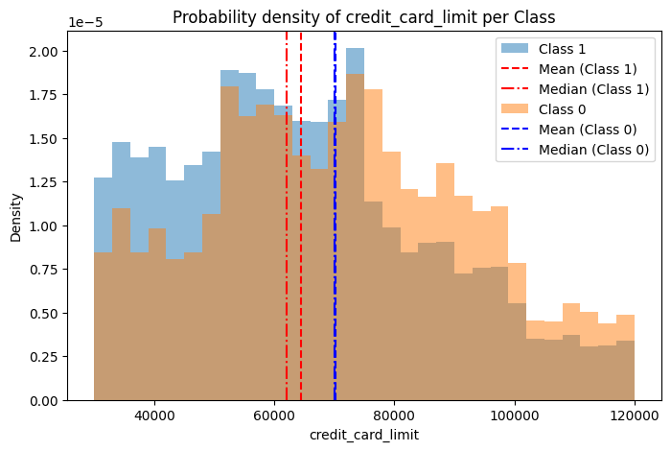
User profile – offer received
Credit Limit and Conversion: mid class uses offers more frequently

Slide 16
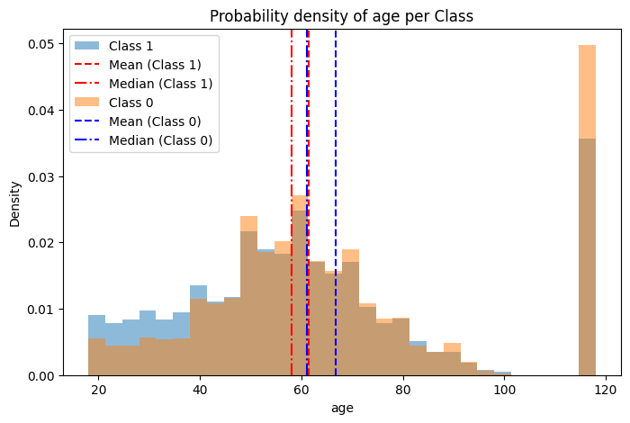
User profile – offer received
Age and Conversion: youngers accept offers better

Slide 17
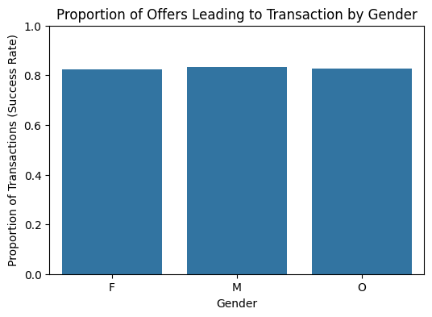
User profile – offer received
Gender: again no rule at all

Slide 18
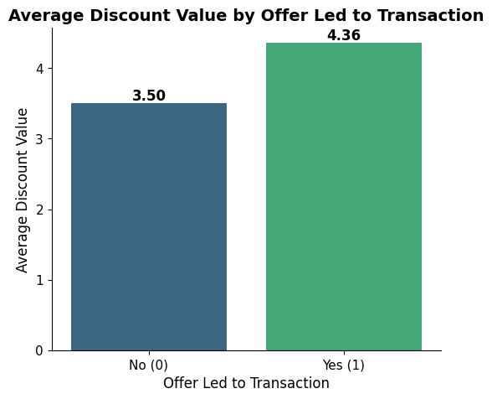
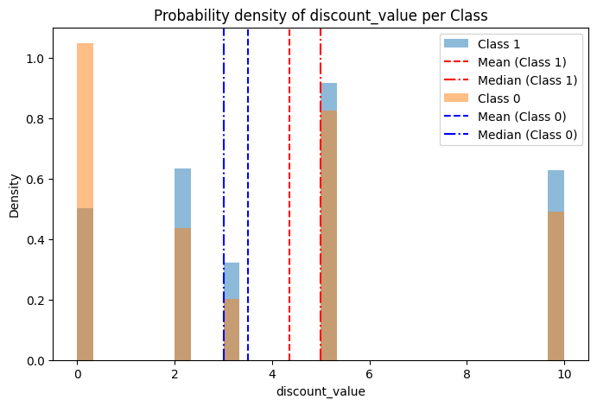
Offer characteristics
Discount value: offers with higher discount value are more likely led to transaction

Slide 19
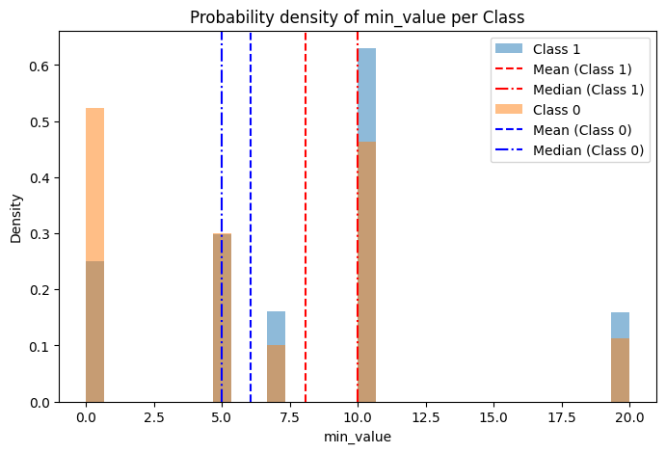
Offer characteristics
Min value: offers with higher min value result more often to a transaction

Slide 20
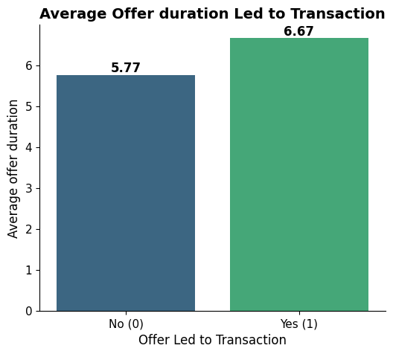
Offer characteristics
Offers duration: longer offers are more likely led to transaction

Slide 21
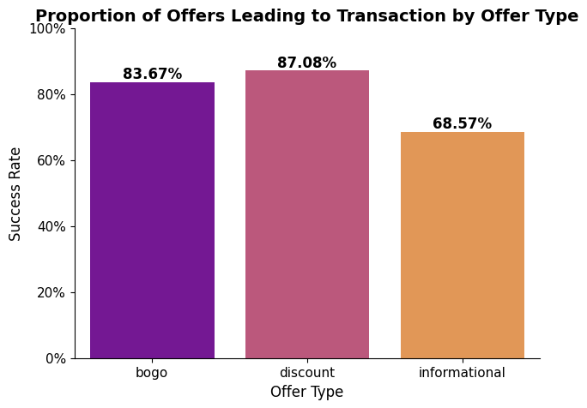
Offer characteristics
Offers type: BOGO and Discount lead to transaction more likely

Slide 22
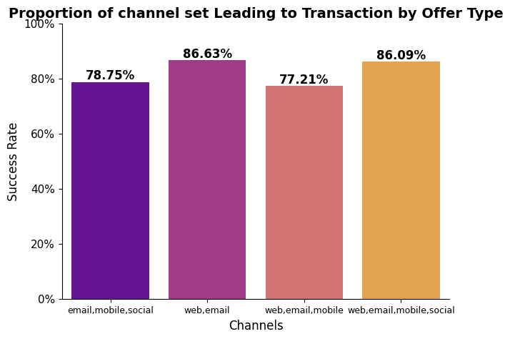
Offer characteristics
Offers channels: web and e-mail results in a higher transaction rate, mobile offers (SMS pushes) are not accepted so well

Slide 23
Offer characteristics
Offers channels: web and e-mail results in a higher transaction rate, mobile offers (SMS pushes) are not accepted so well

Slide 24
Recommendations
to Marketing Team

Slide 25
Choosing the user
Do not send offer to everyone
Target your user
Define Marketing Goal
- Goal: new transaction -> Send offers with high value and long duration for users who never transacted
- Goal: more transactions -> Send offers to those with a high probability of transaction

Slide 26
Choosing offer type
For each user:
1 - Find the probability of the transaction by changing the offer type
- P(transaction | offer type = ‘BOGO’)
- P(transaction | offer type = ‘Discount’)
- P(transaction | offer type = ‘Information’)
2 - Choose offer type which resulted in a higher transaction probability

Slide 27
Causality
Some users transact anyway
- Use the uplift model. Send the offers for those users who:
Probability of transacting with offer – Probability of transacting without offer >= some predefined threshold

Slide 28
Obrigad!
Amir.jalilifard@gmail.com

