Slide 1

Image Steganography Using Genetic Algorithm And Visual Cryptography For Secure Data Hiding And Transmission Over Network
MADE BY:-
ANKUR SALDHI 11-CSS-10
MOHAMMAD AMIR JAMIL 11-CSS-33

Slide 2
What is Steganography?
Steganography is the hiding of a secret message
within an ordinary message and the extraction of it at
its destination. Steganography takes cryptography a
step farther by hiding a message so that
no one suspects that it exists.
Ideally, anyone scanning your data will fail to know it contains secret data.

Slide 3
In modern digital steganography, data is first encrypted by the usual means and then inserted, using a special algorithm, into redundant (that is, provided but unneeded) data that is part of a particular file format such as a JPEG image.
Generally, the hidden messages will appear to be (or be part of) something else: images, articles, shopping lists, or some other cover text.

Slide 4
What is a Genetic Algorithm ?
A Genetic Algorithm is a search heuristic that mimics the process of natural selection.
This heuristic is routinely used to generate useful solutions to optimization and search problems.
Techniques used by genetic algorithms :-
inheritance, mutation, selection and crossover

Slide 5
Crossover Technique
In genetic algorithms, crossover is a genetic operator used to vary the programming of a chromosome or chromosomes from one generation to the next.
Cross over is a process of taking more than one parent solutions and producing a child solution from them.

Slide 6
Visual Cryptography
Visual cryptography is a cryptographic technique which allows visual information (pictures, text, etc.) to be encrypted in such a way that decryption becomes a mechanical operation that does not require a computer.
Visual Cryptography is a special encryption technique to hide information in images in such a way that it can be decrypted by the human vision if the correct key image is used.

Slide 7
Example(How does it works ??)
First create an image of random pixels the same size and shape as the original image.
Next, create a second image the same size and shape as the first, but where a pixel of the original image is the same as the corresponding pixel in the first encrypted image, set the same pixel of the second encrypted image to the opposite colour.
Where a pixel of the original image is different than the corresponding pixel in the first encrypted image, set the same pixel of the second encrypted image to the same colour as the corresponding pixel of the first encrypted image.

Slide 8
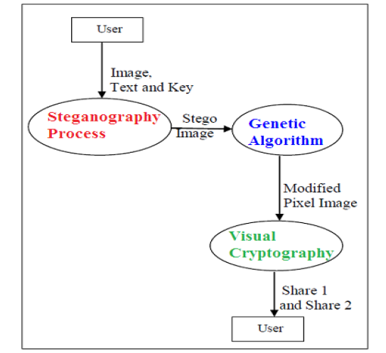
Proposed Algorithm
At Sender’s End

Slide 9
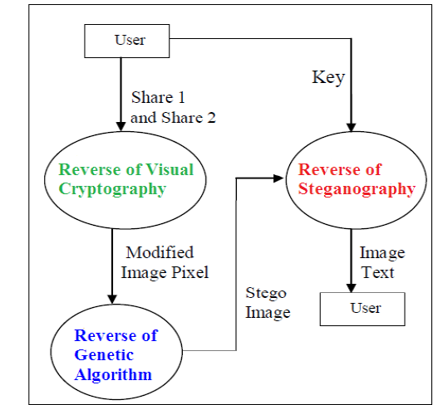
At Receiver’s End

Slide 10
Implementation
Step 1: Encode the Text with the key using XOR operation.
Step 2: Hide the text behind the image.(By replacing the red pixel of RGB tuple with the 8-bit encoded text).
Step 3: Using the “Crossover Concept” of the Genetic Algorithm, shuffle the image.

Slide 11
Implementation Continued…
Step 4: To make intrusion difficult ,we use visual cryptography on the genetically shuffled image.
Step 5: The shuffled encrypted image is transmitted over the network.

Slide 12
Implementation Continued….
At the Receiver’s end use reverse of visual cryptography to get the genetically shuffled image.
Next apply reverse shuffling algorithm to get the normal image.
From the image take out the encoded text which is embedded in the RGB pixel of image.

Slide 13
Final Result
The encoded text is decoded using decoder.
The original text as well as image is obtained at the receiver end.

Slide 14
Future Scope
Security in transmission is increased.
Security breach and intrusion will be very difficult.
May be used in transmission of important military and other defense systems for secure code transfer.

Slide 15
References
Shyamalendu Kandar, Arnab Maiti, Variable Length Key based Visual Cryptography Scheme for Color Image using Random Number, International Journal of Computer Applications . Volume 19– No.4, April 2011.
Ravindra Gupta, Akanksha Jain, Gajendra Singh, “Combine use of Steganography and Visual Cryptography for Secured Data hiding in Computer Forensics” , International Journal of Computer Science and Information Technologies, Vol. 3 (3) , 2012,4366 – 4370.
Fridrich, J., Goljan, M. and Du,R, Reliable Detection of LSB Steganography in Colour and Grayscale Images, Proceedings of ACM
Workshop volume 02, Manuscript Code: 11011on Multimedia and Security, Ottawa, October 5, 2001, pp.27-30.
Talal Mousa Alkharobi, Aleem Khalid Alvi, New Algorithm for Halftone Image Visual Cryptography, IEEE 2004.

Slide 16
Links reference
Links which provided help are as follows :
http://stackoverflow.com
http://en.wikipedia.org/wiki/Main_Page
https://docs.python.org/2/tutorial
https://www.sciencedirect.com

