Slide 1

Major Project on Image Steganography Using Genetic Algorithm And Visual Cryptography For Secure Data Hiding And Transmission Over Network
MADE BY:-
ANKUR SALDHI 11-CSS-10
MOHAMMAD AMIR JAMIL 11-CSS-33

Slide 2
Preliminaries
Steganography
Genetic Algorithm
Cross Over
Visual cryptography
IMPLEMENTATION LANGUAGE
Python

Slide 3
What is Steganography?
Steganography is the hiding of a secret message
within an ordinary message and the extraction of it at
its destination. Steganography takes cryptography a
step farther by hiding an encrypted message so that
no one suspects that it exists.

Slide 4
In modern digital steganography, data is first encrypted by the usual means and then inserted, using a special algorithm, and embedded in a particular file format such as a JPEG image(most commonly used).
Generally, the hidden messages will appear to be (or be part of) something else: images, articles, shopping lists, or some other cover text.

Slide 5
What is a Genetic Algorithm ?
A Genetic Algorithm is a search heuristic that mimics the process of natural selection.
This heuristic is routinely used to generate useful solutions for optimization and search problems.
Basic operators like Crossover and Mutation are used in genetic algorithm.

Slide 6
Why Genetic Algorithm
Unlike the older fuzzy approaches, Genetic algorithm don’t break easily even if the inputs are changed slightly.
Once the algorithm is trained ,it is faster than trivial approaches.

Slide 7
Crossover Technique
Crossover is a genetic operator used to vary a chromosome or pairs of chromosomes from one generation to the next.
Cross over is a process of taking more than one parent solutions and producing a child solution from them.

Slide 8
Visual Cryptography
Visual cryptography is a cryptographic technique which allows visual information (pictures, text, etc.) to be encrypted in such a way that decryption becomes a very difficult task for intruders.
Visual Cryptography is a special encryption technique to hide information in images in such a way that it can be decrypted if the correct key image is used.

Slide 9
Implementation
Step 1: Encode the Text with the key provided.
Step 2: Hide the encoded text behind the image.(By replacing the red pixel of RGB tuple with the 8-bit encoded text).
Step 3: Using the “Crossover Concept” of the Genetic Algorithm, shuffle the image.

Slide 10
Implementation Continued…
Step 4: To make intrusion difficult ,we use visual cryptography on the resulting image.
In Visual Cryptography, an image was broken up into n shares so that only someone with all n shares could decrypt the image, while any n − 1 shares revealed no information about the original image.
Step 5: The shuffled encrypted image is transmitted over the network.

Slide 11
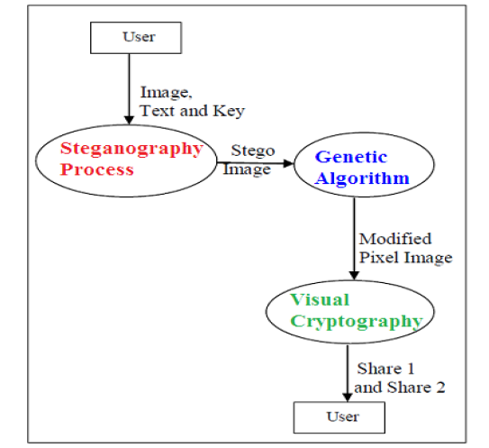
Proposed Algorithm
At Sender’s End

Slide 12
Implementation Continued….
At the Receiver’s end use reverse of visual cryptography to get the genetically shuffled image.
Next apply reverse shuffling algorithm to get the original image.
From the image take out the encoded text which is embedded in the image.

Slide 13
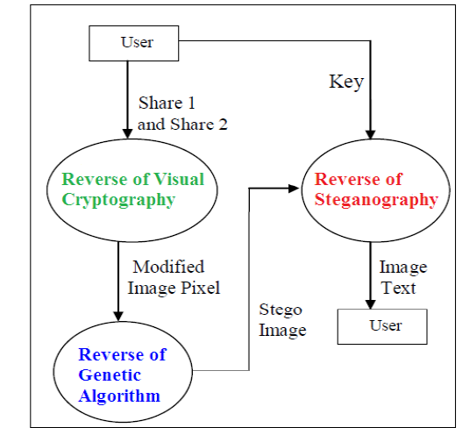
At Receiver’s End

Slide 14
Final Result
The encoded text is decoded using the key provided.
The original text as well as image is obtained at the receiver end.

Slide 15
Future Scope
Security in transmission ovet the network is increased.
Security breach and intrusion will be very difficult.
May be used in transmission of important military and other defense systems for secure code transfer.

Slide 16
References
Masoud Nosrati * Ronak Karimi on A survey on Usage of genetic Algorithm in Recent Steganography Researches.
Shyamalendu Kandar, Arnab Maiti, Variable Length Key based Visual Cryptography Scheme for Color Image using Random Number, International Journal of Computer Applications . Volume 19– No.4, April 2011.
Ravindra Gupta, Akanksha Jain, Gajendra Singh, “Combine use of Steganography and Visual Cryptography for Secured Data hiding in Computer Forensics” , International Journal of Computer Science and Information Technologies, Vol. 3 (3) , 2012,4366 – 4370.
Fridrich, J., Goljan, M. and Du,R, Reliable Detection of LSB Steganography in Colour and Grayscale Images, Proceedings of ACM
Workshop volume 02, Manuscript Code: 11011on Multimedia and Security, Ottawa, October 5, 2001, pp.27-30.
Talal Mousa Alkharobi, Aleem Khalid Alvi, New Algorithm for Halftone Image Visual Cryptography, IEEE 2004.

