Slide 1

Amirhossein Jani Dr.Haroon Abadi Islamic Azad University–Central Branch Aspect Oriented Software Development May-2021

Slide 2
Subjects
1. What is Aspect Oriented Software Development
Brief history, characteristic, cross cutting
2. Separation of concerns
Kinds of separation, Tangling & Scattering
3. Deep Dive In Aspect Oriented
Terminology, AOSD in action
4. Aspect Oriented Design Systems
Steps, Example

Slide 3
What is Aspect Oriented Software Development
1
Keywords:
Separation Of Concerns
Modularizations

Slide 4
AOSD allows multiple concerns to be expressed separately and automatically unified into working systems

Slide 5
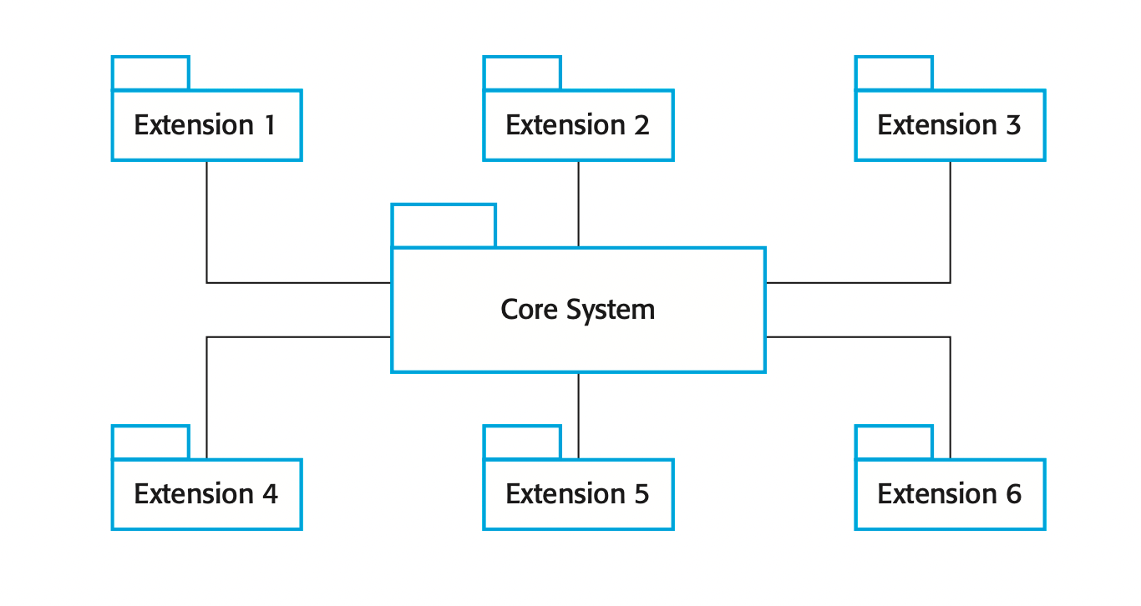
Modularizations
aspect-oriented software development (AOSD) is a software development technology that seeks new modularizations of software systems in order to isolate secondary or supporting functions from the main program's business logic

Slide 6
Aspect Oriented Software Development Introduction
AOSE is based around abstractions called aspects
important characteristic:
definition of where they should be included
implementing the cross-cutting concern
approaches to software modularization:
Subject Oriented Programming
Feature Oriented Programming
Adaptive Programming
Gregor Kiczales and Palo Alto Research Center later developed AspectJ framework which main concern is AOP

Slide 7
Cross Cutting Problems
By representing cross-cutting concerns as aspects, these concerns can be understood, reused, and modified independently, without regard for where the code is used.
OR
are aspects of the program that affects other concerns

Slide 8
Separation of concerns
2

Slide 9
Separation Of Concern
The separation of concerns is a key principle of software design and implementation. It means that you should organize your software so that each element in the program (class, method, procedure, etc.) does one thing and one thing only. You can then focus on that element without regard for the other elements in the program
concerns are really reflections of the system requirements and priorities of stakeholders in the system
It is easier to trace concerns, expressed as a requirement or a related set of requirements

Slide 10
Kinds of separation
1. Functional concerns: which are related to the specific functionality to be included in a system
2. Quality of service concerns: which are related to the non-functional behavior of a system. These include characteristics such as performance, reliability, and availability
3. Policy concerns: which are related to the overall policies that govern the use of a system. Policy concerns include security and safety concerns and concerns related to business rules.
4. System concerns: which are related to attributes of the system as a whole, such as its maintainability or its configurability.
5. Organizational concerns: which are related to organizational goals and priorities

Slide 11
Tangling and Scattering
Tangling
“twist together into a confused mass.”
Scattering
“throw in various random directions”
as several changes have to be made, this increases the chances that you will make a mistake and introduce errors into the software.

Slide 12
Deep Dive In Aspect Oriented
3

Slide 13
Terminology
# advice: The code implementing a concern.
# join point: An event in an executing program where the advice associated with an aspect may be executed.
# pointcut: A statement, included in an aspect, that defines the join points where the associated aspect advice should be executed.
# aspect: A program abstraction that defines a cross-cutting concern. It includes the definition of a pointcut and the advice associated with that concern.
# join point model: The set of events that may be referenced in a pointcut.
# weaving: The incorporation of advice code at the specified join points by an aspect weaver.

Slide 14
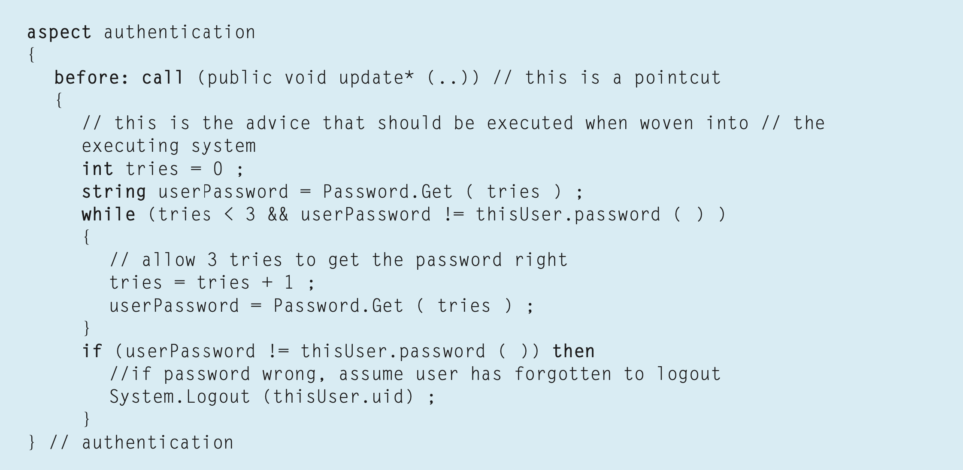
Terminology In Action
The meaning of this is that before the execution of any method whose name starts with the string update, followed by any other sequence of characters, the code in the aspect after the pointcut definition should be executed

Slide 15
Terminology In Action
The code to be executed is known as the ‘advice’ and is the implementation of the cross- cutting concern.

Slide 16
Terminology In Action
A join point is an event that occurs during the execution of a program; so, it could be a method call, the initialization of a variable, the updating of a field, etc

Slide 17
types of join points
# call events: calls to a method or a constructor
# execution events: the execution of a method or a constructor
# initialization events: class or object initialization
# data events: accessing or updating of a field
# exception events: the handling of an exception
A pointcut identifies the specific event(s) (e.g., a call to a named procedure) with which advice should be associated.

Slide 18
types of advice
1. Advice can be included before the execution of a specific method, a list of named methods, or a list of methods whose names match a pattern specification
2. Advice can be included after the normal or exceptional return from a method.
3. Advice can be included when a field in an object is modified; you can include advice to monitor or change that field.

Slide 19
Software engineering with aspects
3

Slide 20
Introduction
Aspects were originally introduced as a programming language construct but, the notion of concerns is one that really comes from the system requirements. Therefore, it makes sense to adopt an aspect-oriented approach at all stages of the system development process. In the early stages of software engineering, adopting an aspect-oriented approach means using the notion of separating concerns as a basis for thinking about the requirements and the system design. Identifying and modeling concerns should be part of the requirements engineering and design processes. Aspect-oriented programming languages then provide the technological support to maintain the separation of concerns in your implementation of the system

Slide 21
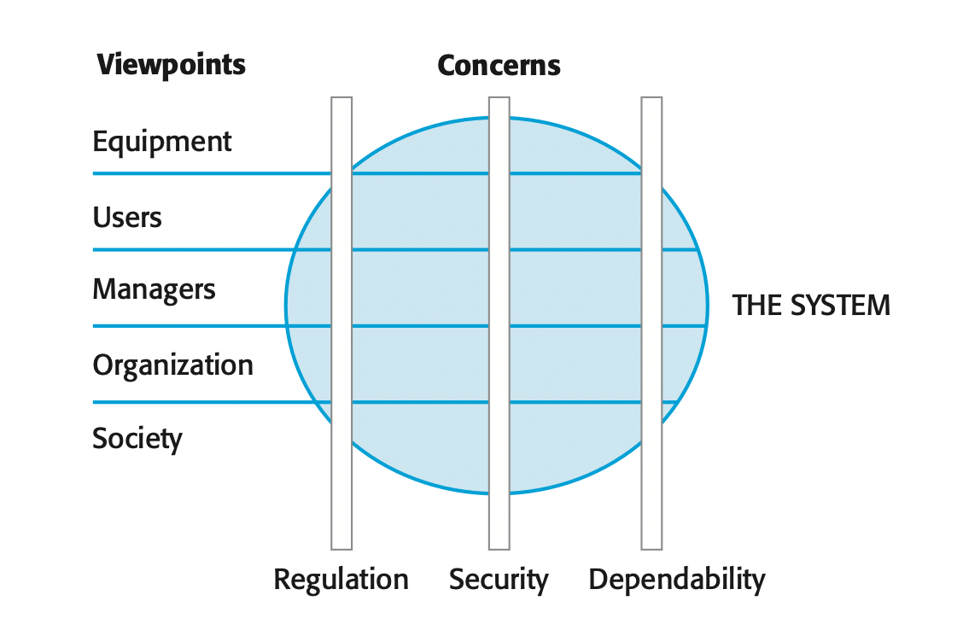
Concern-oriented requirements engineering
A viewpoint-oriented approach to requirements engineering, where each viewpoint represents the requirements of related groups of stakeholders, is one way to separate core and secondary concerns,

Slide 22
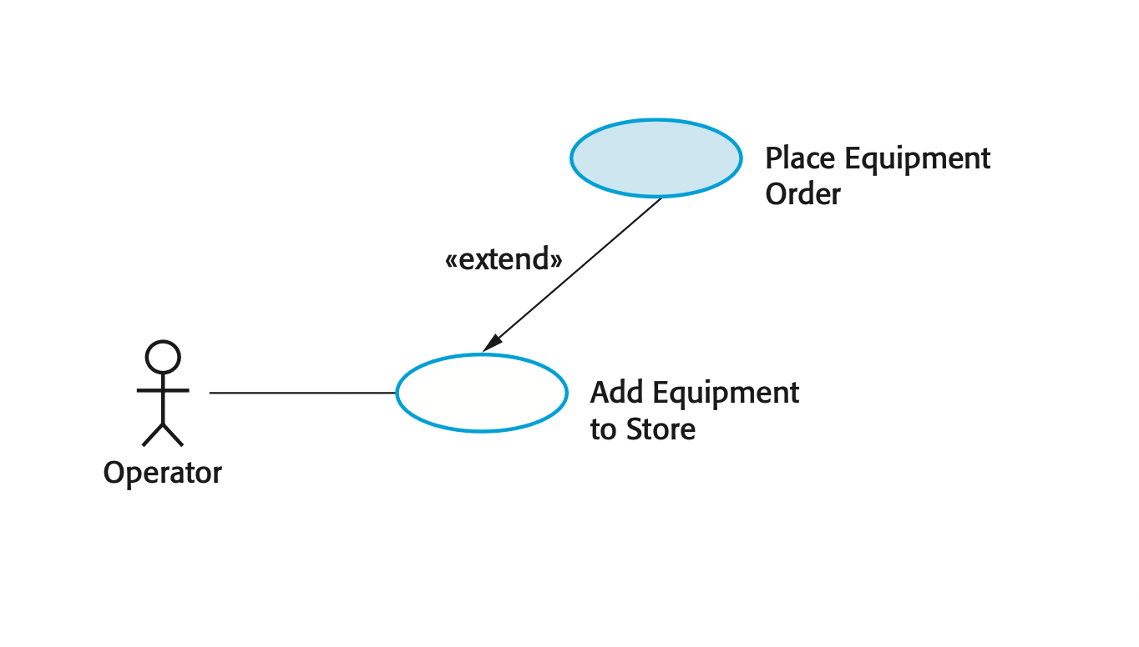
Aspect-oriented design and programming
Aspect-oriented design is the process of designing a system that makes use of aspects to implement the cross-cutting concerns and extensions that are identified during the requirements engineering process.

Slide 23
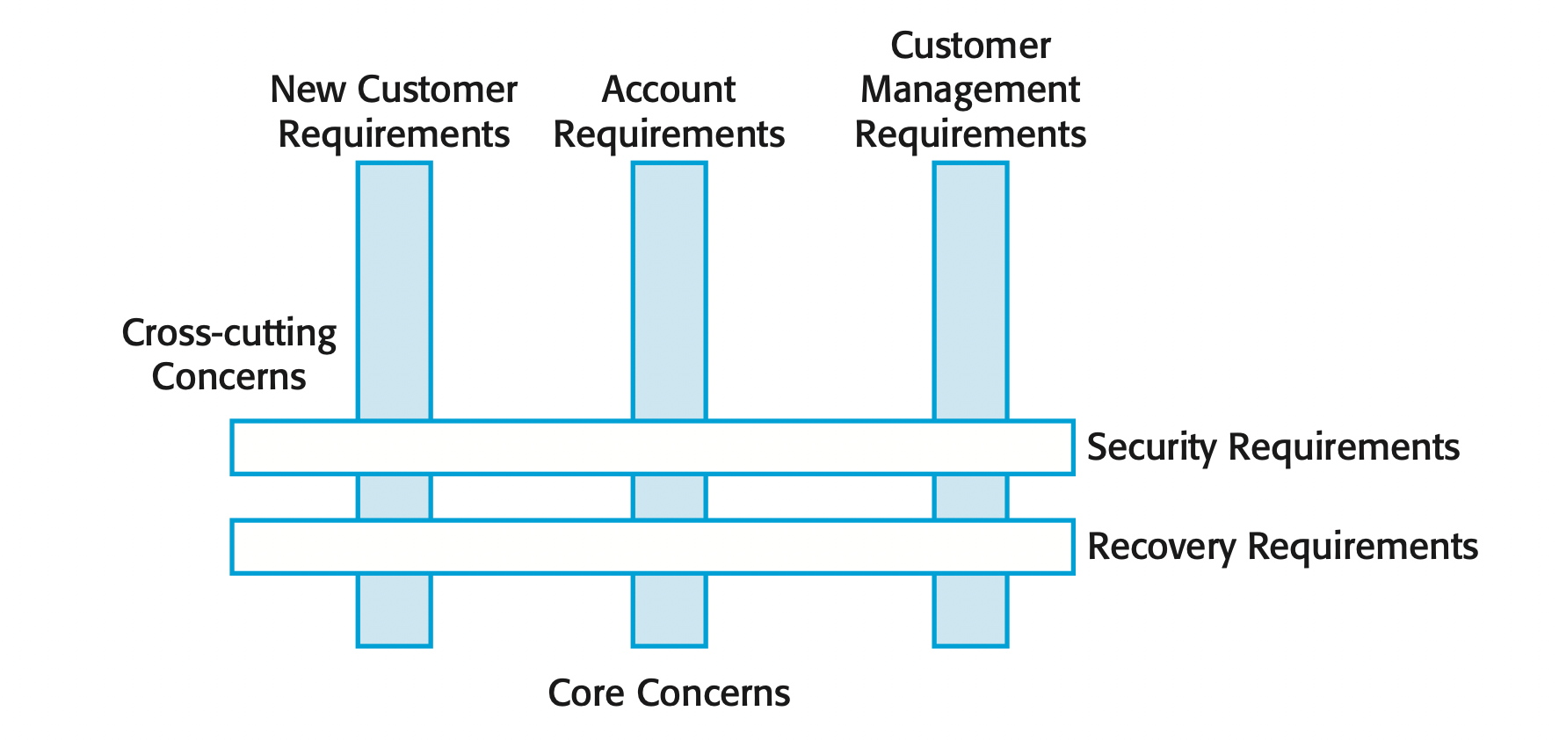
Verification and validation
For aspect-oriented systems, the processes of validation testing are no different than for any other system. The final executable program is treated as a black box and tests are devised to show whether or not the system meets its requirements.

Slide 24
Aspect Oriented Design
4

Slide 25
Steps of design a good aspect oriented program
# Core system design: you design the system architecture to support the core functionality of the system
# Aspect identification and design: Starting with the extensions identified in the system requirements, you should analyze these to see if they are aspects in themselves or if they should be broken down into several aspects.
# Composition design: At this stage, you analyze the core system and aspect designs to discover where the aspects should be composed with the core system.
# Conflict analysis and resolution: A problem with aspects is that they may interfere with each other when they are composed with the core system.
# Name design: This is an important design activity that defines standards for naming entities in the program. This is essential to avoid the problem of accidental pointcuts.

Slide 26
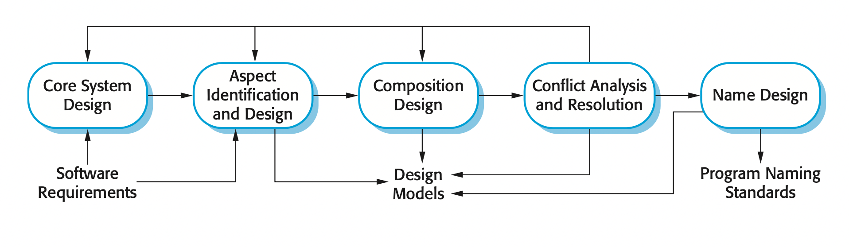
Steps of design a good aspect oriented program

Slide 27
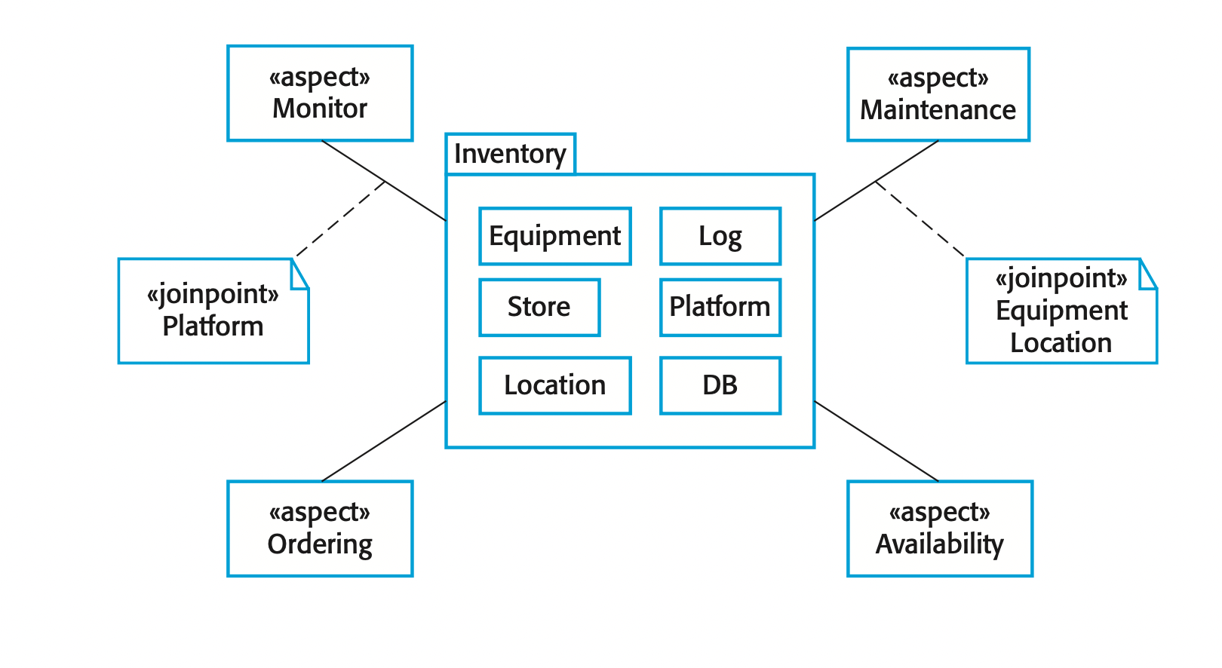
Example

