Slide 1
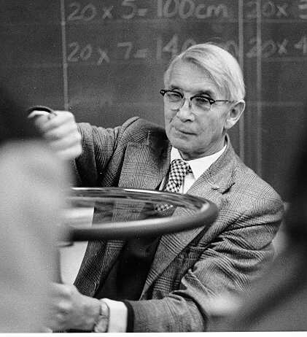
Ising Model
Dr. Ernst Ising
May 10, 1900 – May 11, 1998

Slide 2

Magnetism
As electrons orbit around the nucleus, they create a magnetic field
Paramagnetism – atoms have randomly oriented magnetic spins
- magnetic moments of atoms cancel out, no net magnetism
- many elements
Ferromagnetism – parallel alignment of magnetic spins
- Fe, Co, Ni only

Slide 3
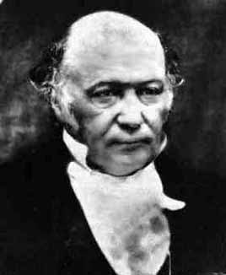
What is the Ising Model
Created by Ernst Ising as a linear model of magnetic spins
A simulation of any phenomena where each point has one of two values and interacts with its nearest neighbors only
A magnetic spin can have a value of either 1 or -1
Energy of a system is calculated using the Hamiltonian
H = - K Σ s_{i} s_{J} - B Σ s_{i}
K is a constant
s_{i} is the spin, -1 or 1, of the i^{th} particle
I and J are adjacent particles
B is the magnitude of the externally applied magnetic field
William Rowan Hamilton, 1805-1865

Slide 4
the idea behind a Monte Carlo simulation
Many systems cannot be described by equations
Many equations can not be solved
We forget about finding a solution and compile all the possible solutions and determine their probabilities
We take the solution of the highest probability
This works for systems with many individual components, because on average, they will all behave like the solution of the largest probability
We are interested in the average behavior, the most common behavior, because that’s what is predictable or controllable
Monte Carlo methods are statistical methods to find solutions of high probability

Slide 5
Metropolis Algorithm
One of Monte Carlo methods to arrive at a stable solution
Start with a random initial configuration
Suggest a change with probability p
Accept the change with probability q
Generate a random number from a random number generator of uniform distribution between 0 and 1
Let the action be carried out if the random number generated < probability of action
Reiterate process starting again by suggesting a change

Slide 6
Important Features
Accepting higher energy configurations
  Most accepted changes lead to lower energy configurations, but not all!
  Higher energy configurations are accepted, although the probability is lower.
  Important because if no higher energy configurations are accepted, the solution may get trapped in a local minimum of energy, unable to reach the global minimum
Ergodicity
  Probability of reaching any configuration from any other must be > 0
  Initial condition is random and it must be able to reach the solution which is unknown, so it must be able to reach every other possible configuration

Slide 7
An Overview of the Program
Sets up a 1-D lattice of n points
Each point in the lattice is randomly assigned a value of 1 or -1
Calculates the energy of the system according to the Hamiltonian
H = - K Σ s_{i} s_{J} - B Σ s_{i} Where J=1 , B=0
Periodic boundary conditions
- s_{n+1} = s₁
- the system becomes a circle
Picks a random point and switches its magnetic moment
Calculates the energy of the configuration

Slide 8
…program overview
Compares energy of the system with and without the change
If the energy of the perturbed system is lower, the change is accepted with probability = 1
If the energy of the perturbed system is higher, the change is accepted with probability = exp (-D/ k T)
Iterations of the routine lead to a configuration of global minimum of energy

Slide 9
The change is accepted with probability = exp (-D/ k T)
D= E2- E1
E1 = energy of current configuration
E2 = energy of perturbed configuration
(change in energy from current configuration to perturbed configuration)
k = 1.3806503*10^-23, Boltzmann’s constant
T = temperature (K)
Since E2 is bigger than E1, D is positive, k and T are also positive by nature
e is raised to a negative quantity; the expression will always yield a value between 0 and 1

Slide 10
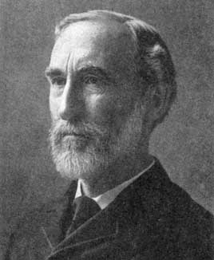
Where this probability comes from:
1902 - Gibbs derived that the expression for the
probability of an equilibrium configuration
P _{i} = 1/Z exp(-E _{i} / kT)
Z = Σ_{i} exp( – E _{i} / kT )
Z
  the partition function
  the normalizing constant, sum of all probabilities for all possible configurations.
  Most times, a near impossibility to calculate
Due to the way nature works, a system changes in small steps and does not go very far from the thermal equilibrium situation. Taking advantage of this, we will create a random change and then compare the probability of either configuration as a thermal equilibrium configuration.
P1= 1/Z exp(-E1/ kT)
P2= 1/Z exp(-E2/ kT)
P = P2/P1 = exp((E1-E2) / kT)
Josiah Willard Gibbs, 1839-1903

Slide 11
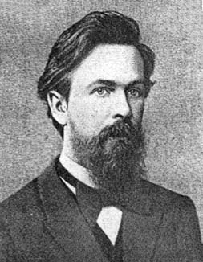
Markov Chain
The current situation depends
only on the situation one time
step before it
If the day is one time unit and
weather is a Markov process,
tomorrow's weather depends only on today’s
weather. Prior days have no influence.
The Ising model is a Markov process.
Andrei Andreyevich Markov 1856-1922

Slide 12
The Simulation

Slide 13
Ways of collecting data in the program
Plot energy of each point in the lattice at a given instant
Plot energy of system vs. time
Plot energy at steady state vs. temperature
Plot number of clusters at steady state vs. time

Slide 14
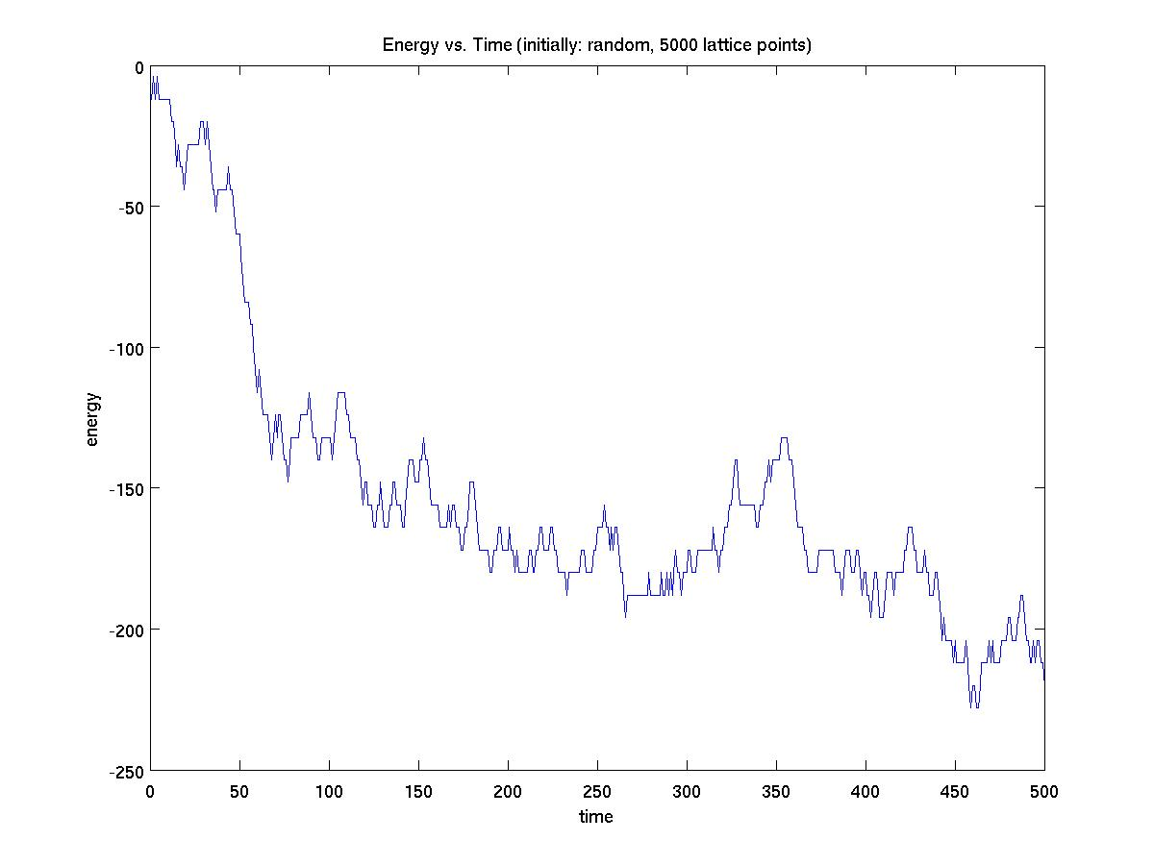


Slide 15
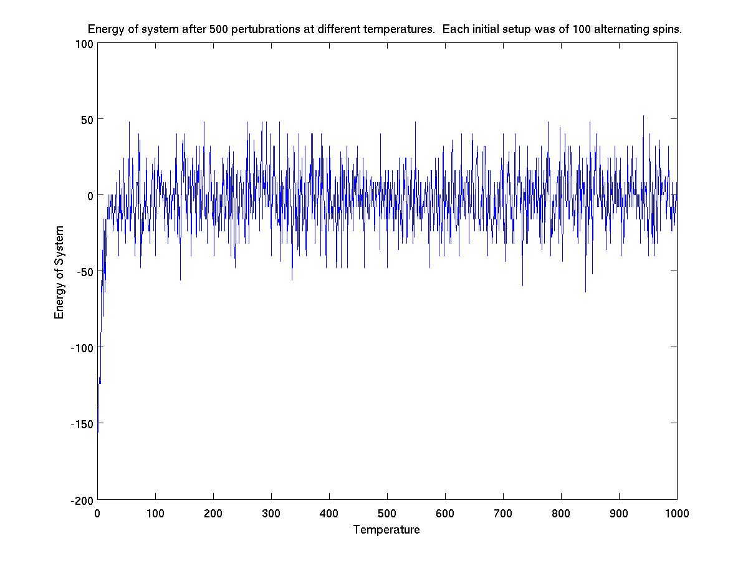

Slide 16
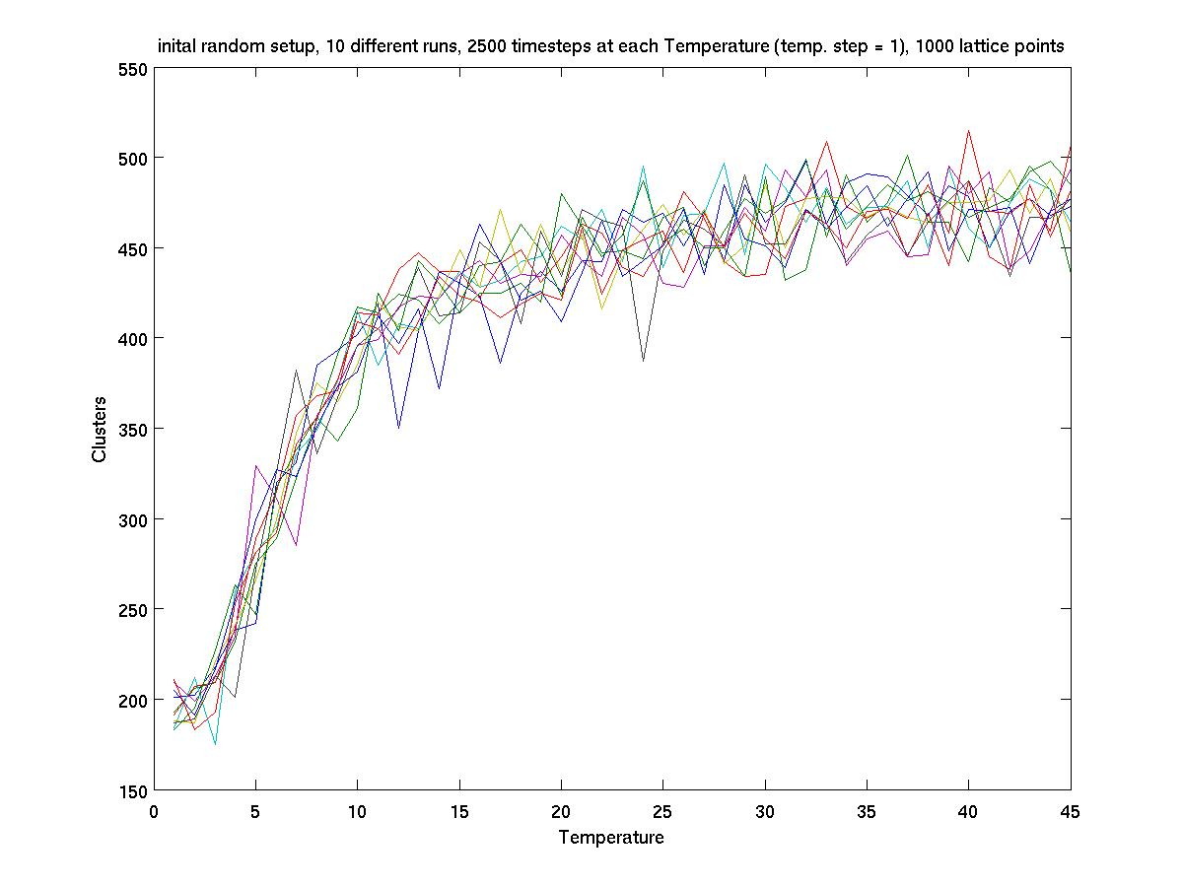

Slide 17
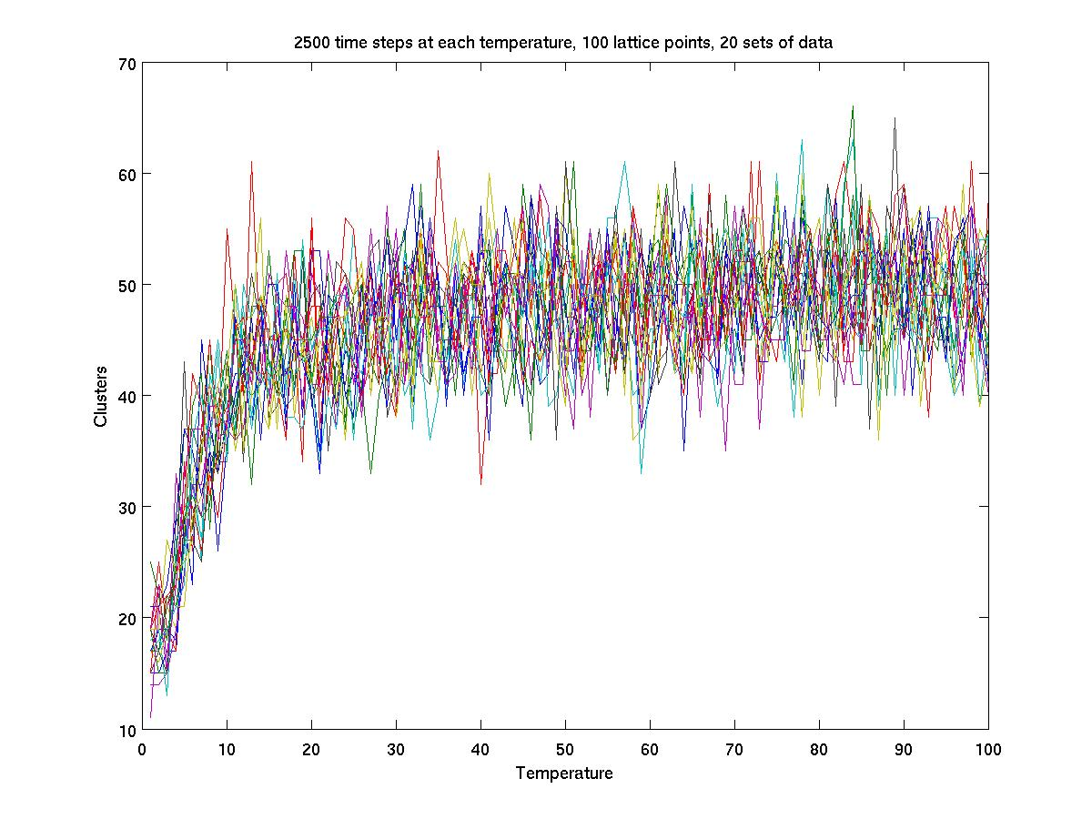

Slide 18
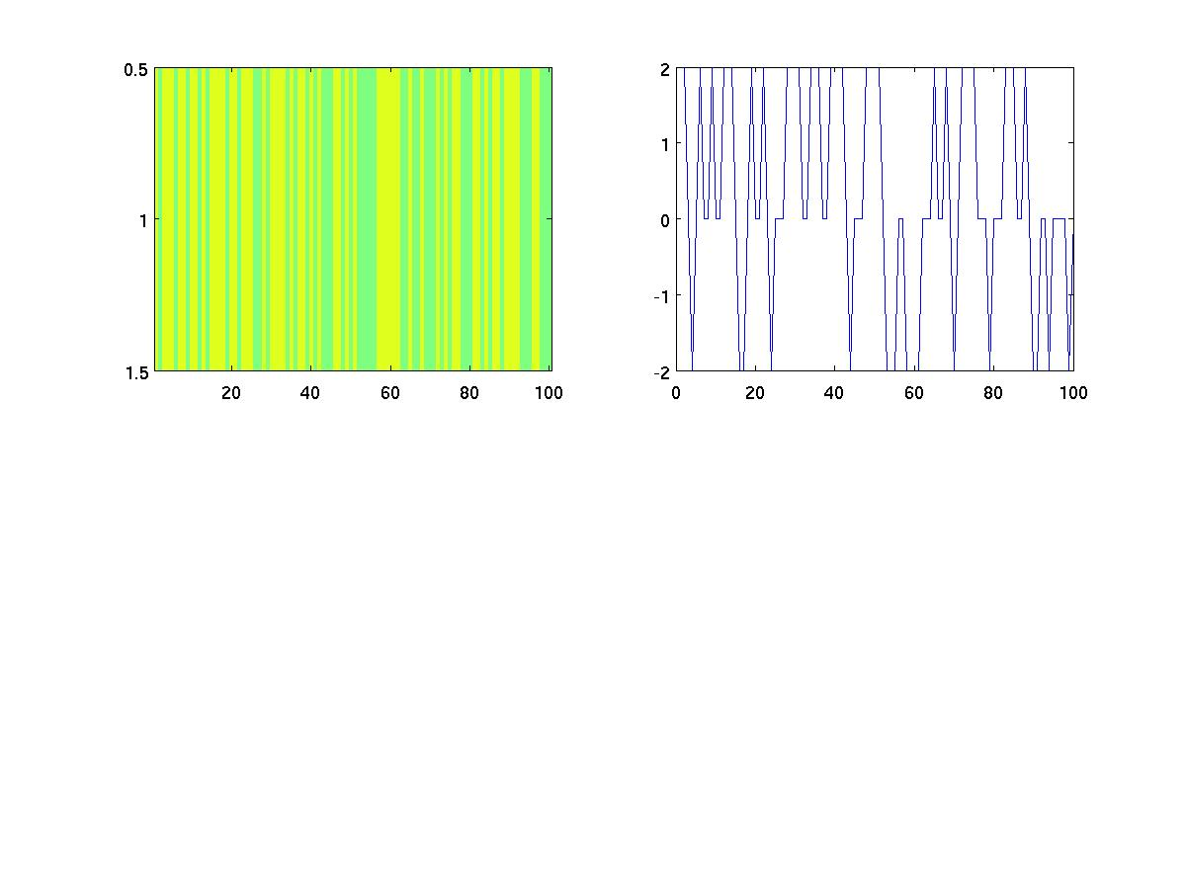
Left: A possible Ising Configuration
Right: Energy vs. lattice point for the configuration on the left

Slide 19
Observations
At low temperatures
  clusters form, alignment of spins
  low entropy
  low energy
At high temperatures
  more randomness
  high entropy
  high energy
How come ?!

Slide 20
Mathematically probability = exp (-D/ k T)
At low temperatures, probability of accepting a higher energy change is low
At high temperatures, probability of accepting a higher energy change is higher

Slide 21
Scientifically Competing factors:
Energy and Entropy
Entropy, S = a measure of disorder
Total energy, U
Free energy = energy available to do work
Helmoltz free energy, A
A = U – TS , T = Temperature
~ Most stable system has lowest possible free energy
~ 2nd law of thermodynamics: Total entropy must stay constant or increase
~ Heat energy, example of disordered energy

Slide 22

Dr. Ernst Ising
- May 10, 1900 – born in Germany
1924 – University of Hamburg, published his doctoral
thesis on linear chain of magnetic moments of 1 and -1,
and never returned to this research
He became a high school teacher
1939 – Escaped Nazi Germany to Luxembourg
1940 – Germany invaded Luxembourg
1947 – Ising came to USA and became a teacher of physics and mathematics at State Teachers College in Minot, North Dakota
1948 – became a physics professor at Bradley University, Illinois
1949 – He found out his doctoral thesis had become famous
1976 – retired from Bradley University
May 11, 1998 – He passed away.

Slide 23
The Ising Model
~ 800 papers per year are published that use the Ising model
~ areas of social behavior, neural networks, protein folding
~ between 1969-1997, more than 12,000 papers published that use the Ising model

Slide 24
References
“Andrei Andreyevich Markov.” <http://www-history.mcs.st-andrews.ac.uk/Mathematicians/Markov.html> July 11, 2006.
Barkema, G.T. and M.E.J. Newman. Monte Carlo Methods in Statistical Physics. Clarendon Press, Oxford. 1999.
“Dr. Ernst Ising.” http://www.bradley.edu/las/phy/personnel/isingobit.html July 11, 2006.
“Ernst Ising and the Ising Model.” <http://www.physik.tu- dresden.de/itp/members/kobe/isingconf.html > July 11, 2006.
“Introduction to the Hrothgar Ising Model Unit.” <http://oscar.cacr.caltech.edu/Hrothgar/Ising/intro.html> July 11, 2006
“Josiah Willard Gibbs.” <http://www-history.mcs.st-andrews.ac.uk/Mathematicians/Gibbs.html> July 11, 2006.
“Magnetism.” >http://www.materialkemi.lth.se/course_projects/HT- 2004/KK045/Magnetic%20Materials/MM%20final/magnetism.htm> July 11, 2006
“Markov Chain.” Wikipedia. <http://en.wikipedia.org/wiki/Markov_chain> July 11, 2006.
“Sir William Rowan Hamilton.” http://www-history.mcs.st-andrews.ac.uk/Mathematicians/Hamilton.html July 11, 2006.
Weirzchon, S.T. “The Ising Model.” Wolfram Research. <http://scienceworld.wolfram.com/physics/IsingModel.html> July 11, 2006.

Slide 25
Acknowledgements
Professor Mark Alber
Ivan Gregoretti

