Slide 1

Real-world Experiences
in
Scala
How I found happiness
by Amir Karimi | www.dev-frame.com
Aug 2015

Slide 2
Philosophy of Life
It's about the journey not the destination
If you want to be happy

Slide 3
Geeks Philosophy
It's about the tools not the work
If you want to be a happy developer

Slide 4
My Philosophy
I'm happy with Linux and Scala
for now

Slide 5
Bio

Slide 6
The Past
Fanatic C# Developer for 10 years
Lived in MS echo chamber
.NET CF, WinForms, WebForms, MVC, WF, WCF, WPF, Silverlight, LINQ, EF, MS SQL, VS, etc.
Love Linux: in my dreams I was developing on my own Linux machine!

Slide 7
Converting; Why?
Tired of MS echo chamber
Feel lonely
Love Linux and Open Source
To run a huge private server with less than 2GB of RAM
  Clean installation of Ubuntu server 14.04 takes less than 50MB of RAM
  Windows Server 2012 Essentials needs at least 2048MB?
To observe copyright and licensing (VS, Windows Server/Client, SQL Server, etc.)

Slide 8
My Ideal Programming Language
Open Source
Cross platform (Practically)
Ready to use with mature ecosystem (Practical)
Strongly-type / Type-safe
Lambdas / Closures => Functional (I was thinking about LINQ)
Object Oriented (Interfaces, Generics, ...)
Modern (Not Verbose: Type inference, Auto Getter/Setter, …)

Slide 9

Available ones
C# - Cross Platform (Practically)
Python / Ruby / JS - Strongly-type / Type-safe
Java - Modern (Not Verbose: Type inference, Auto Getter/Setter, …) and didn't support lambdas at the time
Go - Ready to use with mature ecosystem | Object Oriented (Interfaces, Generics, …)
Scala - What?

Slide 10
Scala Features
Type inference
Powerful Syntax
Functional
DSL
Immutable Structures
Case Classes
Pattern Matching
Implicits
Macros
Powerful Type System and Standard Library
etc.

Slide 11
Demo
Scala Features

Slide 12
Extra Bonus
Moore's law dying and the need of concurrent programming
  Facts
    First 3GHz single core CPU at 2002
    It's 13 years and there are still just 3GHz CPUs
    But with more cores (your cellphone would have 4)
    Thread blocking is very expensive
  Scala and other functional programming languages shine here
  Akka is another bonus
    Somebody created a Redis clone on top of Akka (CurioDB)
Big Data
  Spark is on top of Scala and Akka (100x faster than Hadoop)

Slide 13
My New Ecosystem
Scala
  The only available language which meet my needs
Play Framework
  Mature, Type-safe (even templates), High Velocity, Async, Iteratees, Simple to Use
MongoDB
  Open Source, Fast, Distributed, Schema Free, Not good for everything
ReactiveMongo
  Blazingly Fast, Async, Iteratees

Slide 14
Demo
Play Framework

Slide 15
Demo
MongoDB

Slide 16
Deployment Requirement
Development Machine
  JDK
  Activator (Play)
  Git (to push the binaries to the server)
  Bash
Production Server
  JRE (I don't use this server as build machine)
  Nginx (as front-end if you have more than one web apps)
  Virtualmin
    DNS
    Main Server
    Webmail
  MongoDB
  Git (as binary repository for publishing process)

Slide 17
Deployment Process
Development Machine
Production Server
Source
Bin
Bare Git Repo
“/var/webapps/[app]
service play-[app] restart

Slide 18
Show Me the Code
Deployment

Slide 19
Real-world Projects
Tehran International Book Fair
Website
Publisher Registration System
Student Coupon Selling System

Slide 20
Real-world Projects
Tehran International Book Fair (TIBF) Website
  Up to 40,000 unique visitors daily
  2,287 publishers
  361,788 books
TIBF Publisher Registration System
  Registration process of TIBF
  About 24,000,000,000 IRR ≈ 700,000$ total transactions in three weeks
TIBF Student Coupon Selling System
  With a quota system based on provinces
  More than 500 request/sec
  About 87,000,000,000 IRR ≈ 2,600,000$ total transactions in three weeks

Slide 21
Challenges
TIBF Website
  Large number of RPS on book search page
    Users can find their favorite book location
TIBF Registration System
  Complicated process on top of NoSQL database
TIBF Student Coupon Selling System
  Large number of RPS
  Large number of financial transactions
  Integration with Bank
Summary:
High availability
Large number of RPS
Complicated processes on top of NoSQL
One small server for all of them
  6 cores
  6 GB of RAM
  Non-SSD hard disk

Slide 22
Solutions – High Velocity
Play is a high velocity Framework by default
Using async/non-blocking data-access library: ReactiveMongo
Futures and Promises
Iteratees (for rendering huge data with minimum resource usage: RAM or CPU)
Everything is perfect; even didn't need caching!

Slide 23
Solutions – NoSQL
Manage relationships asynchronously
  Get fair information → Get registration information → Get basic information → …
    All non-block
  Repeat data
    Fairs in which the exhibitor is registered
    Registered exhibitors for each fair
  Search
    Generate keywords on CUD, don't use RegEx
NoSQL is not suitable for a system with complex relationships
Reports are painful but amazingly fast
  Need a job to collect data into another collection
  For real-time reports, data should be collected on CUD events

Slide 24
Solutions - Integration
Scala is on top of JVM with a huge high quality libraries
  I needed Rijndael-256 which is not common and is not implemented in Java standard libraries
    Bouncycastle
Also used
  Play's WS as web service client
  Scalaxb to generate WSDL classes (they didn't support REST)
  Again everything is async

Slide 25
Libraries and Tools - 100% Free
OS
  Linux (server and development)
IDE and Tools
  Activator
  Scala IDE
  RoboMongo
  Git
DB
  MongoDB
Front-end Server
  Nginx
Framework Libraries
  Play Framework
  ReactiveMongo
  Macwire (compile-time DI)
  Silhouette (authentication)
  Scrimage (image resizing)
  Persianutils by Bahman Movaghar
  Bouncycastle
  Xcala; my own application library
  etc.

Slide 26
Well Done!
Common
  Full-stack development
  Full async architecture (top to bottom)
  Very good RAM usage except for exporting Excel files
TIBF Website
  Less than 100ms responses on peak times
TIBF Registration System
  Most of the publishers were happy
  Most of the operators were happy
  I was agile to implement real-time requests in minutes or hours
TIBF Coupon System
  Boom! Things didn't go well
  Although about 5,000 successful purchases have been done in a couple of hours...

Slide 27
Failure
After lunching the TIBF coupon website, all websites seemed down
but the system load was OK!
Incomplete payments started to show up
  Verified payments without having invoices marked as paid
  Double payments
Stress
  Loneliness
  Failure

Slide 28

Failure
I Failed :(((((
Bad feeling about Scala
Feels like someone is pouring ice water on my head
A weird kind of relief
Everything got quiet

Slide 29
Didn't Give Up
Took a break, got relaxed and focused
Checked the bandwidth
Checked the server disk speed
Checked the logs
  Nginx: Too many open files
Checked the connections
  netstat -na | grep :80 | wc -l
    About 4,000 open connections!
Google
  Default OS limitation for open files is 4,000
  There is a simple solution for “Too many open files”
  It was a victory! I could have reach to the OS limits on a small server

Slide 30

Fix
Add “fs.file-max” to “/etc/sysctl.conf”
Set soft and hard limits in “/etc/security/limits.conf” for Nginx and the user by which Play apps are running
Set “worker_rlimit_nofile” in “/usr/local/nginx/conf/nginx.conf”
The server begin responding but the RAM was still too low
  Exporting Excel files for operators eats the RAM
  The laptop I used for this presentation has
  more RAM than the server did (6GB)
6GB
3M$

Slide 31
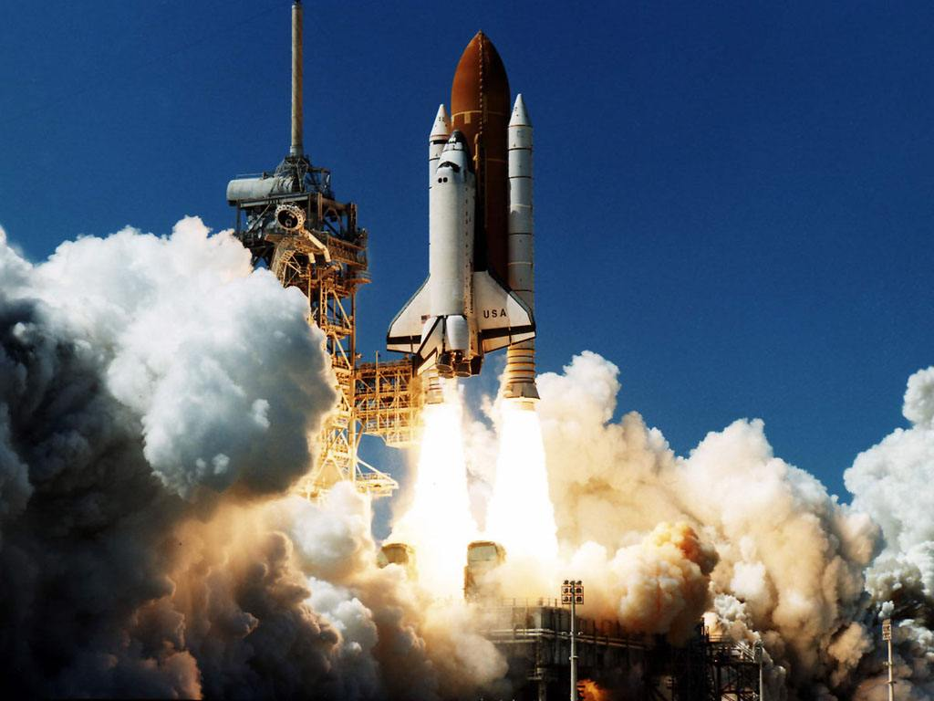
Final Relief
They gave me a giant server
  120 Core
  128 GB of RAM
I used at most lest than 1% of this server resources!
Although again I increased the default OS limitation on number of open files
And their network got a serious problem

Slide 32
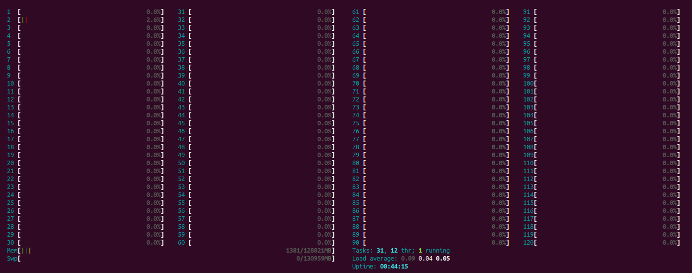
Servers; Old / New

Slide 33
Bonus Demo
Iteratees in Action

Slide 34
Bonus Demo
Speed in Action

Slide 35
Thank you
Build amazing things with your lovely tools
Iran-SUG => Iranian Scala User Group
Amir Karimi <a.karimi.k@gmail.com>
@4m1rk
www.dev-frame.com

