Slide 1

PENALTIES AND REWARDS FOR FAIR LEARNING IN PAIRED KIDNEY EXCHANGE PROGRAMS
Algorithmic Game Theory
Spring 2024
Dr. M A Fazli
Zahra Sechin matouri, Amir Kasaei

Slide 2

Kidney Exchange Program (KEP)
incompatible patient-donor pair
altruistic donor
matching incompatible pairs
fair algorithm
most possible survivals in long term

Slide 3
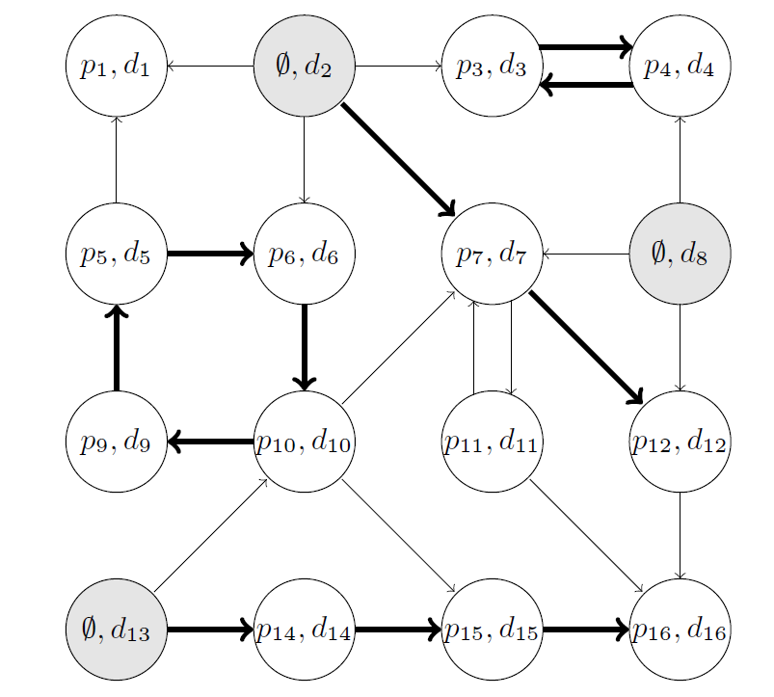

Static Graph Model
directed graph G = (V,A) - exchange graph
node i ∈ V
patient-donor pair → $i=\{p_{i}, d_{i}\}$
non-directed anonymous donor (NDAD) altruistic donor → $i=\left\{∅, d_{i}\right\}$
arc (i, j) ∈ A if the kidney of donor $d_{i}$ is compatible with patient $p_{j}$
Figure 1: An exchange graph and a feasible set of transplants

Slide 4
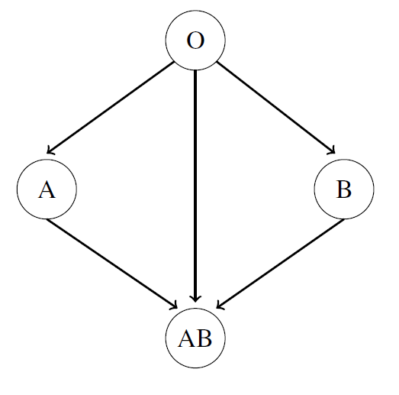
Compatible Arc
blood-group compatibility
antibodies and antigens
The larger the number of types of antibodies in the patient the less likely a donor will be compatible with that patient
cPRA
easy-to-match patients have a cPRA close to zero
hard-to-match patients close to one
Figure 2: Blood Group compatibility

Slide 5
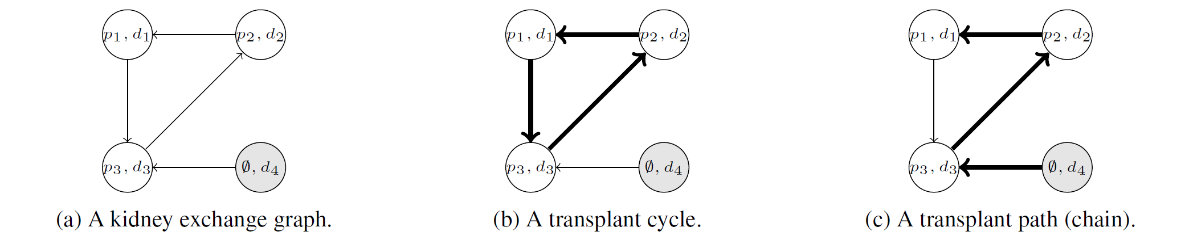
Feasible Set in Exchange Graph
Figure 3: Illustration of feasible exchanges for a KEP
A valid directed cycle: only of patient-donor pairs
A valid directed path: exactly one altruistic donor at the source of the path

Slide 6
what transplants (arcs) should be selected?

Slide 7
optimize health care outcomes
maximize the number of transplants, but it is questionable!
multi-criteria decision problem
prioritize patients who are easy-to-match (not fair)
optimize an objective in the short-term may not optimize the objective over the long-term
add weights (rewards) to prioritize certain types of exchanges.

Slide 8
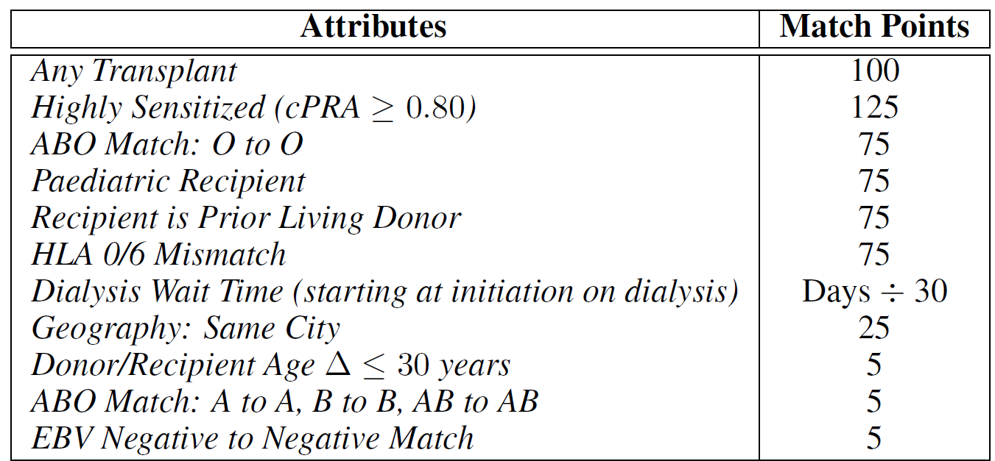

what is the best choice of weights?
myopic:
$w_{i}=1$for every patient-donor pair and $w_{i}=0$for every altruistic donor
Canadian KPD program:
expert-defined weights
learned weights:
learnt internally by the system to optimize some performance objective (group fairness)
Table 1: The KPD point system

Slide 9

A Dynamic Model
static model only encompasses onetime period
but KEP is dynamic with exchanges calculated at regular time intervals (4 months)
in time t there is an exchange graph $G_{t}=(V_{t},A_{t})$

Slide 10

A Dynamic Model
blood type probabilities of donors and patients:
$$P(A,B,AB,O)=(0.46, 0.42, 0.09, 0.03)$$
cPRA rate intervals probabilities:
$$P\left(\left(0, 0\right), \left(0.01, 0.50\right), \left(0.51, 0.94\right), \left(0.95, 0.96\right), \left(0.97, 1\right)\right)=\left(0.24, 0.29, 0.24, 0.10, 0.13\right)$$
84 types of nodes, distinguished by blood type and cPRA interval
generate the new nodes with associated type
generate the arcs
excluded arc $(i,j)$ from the exchange graph with probability equal to the cPRA rate of the patient $p_{j}$

Slide 11
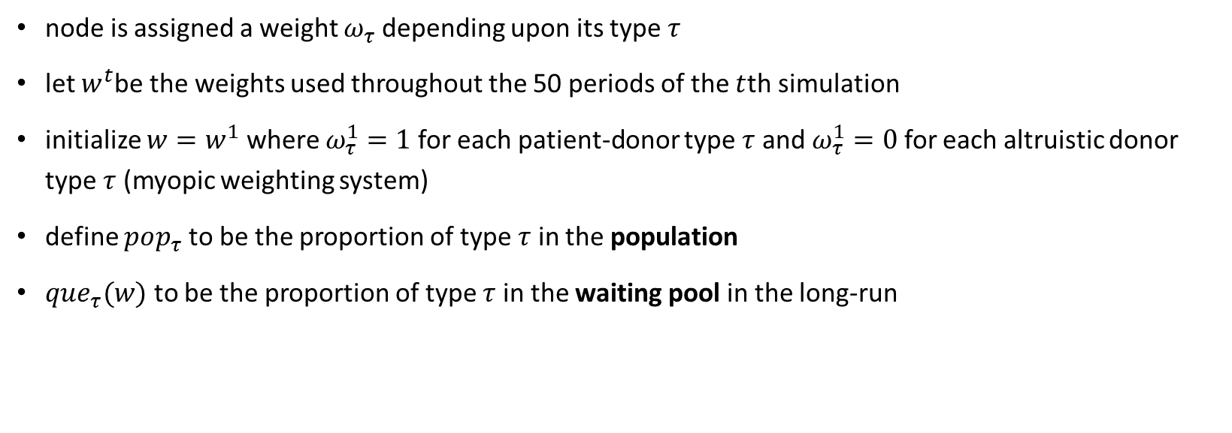
Fair Learning Algorithms (Optimizing Weights)
node is assigned a weight $ω_{τ}$ depending upon its type $τ$
let $w^{t}$be the weights used throughout the 50 periods of the $t$th simulation
initialize $w=w^{1}$where $ω_{τ}^{1}=1$for each patient-donor type $τ$ and $ω_{τ}^{1}=0$ for each altruistic donor type $τ$ (myopic weighting system)
define $pop_{τ}$ to be the proportion of type $τ$ in the population
$que_{τ}(w)$ to be the proportion of type $τ$ in the waiting pool in the long-run

Slide 12

Fair Learning Algorithms
$ω_{τ}^{t+1}=f(\frac{que_{τ}\left(w^{t}\right)}{pop_{τ}})$
where f(x) is an update function monotonically increasing in x
two classes of update function:
linear: $f\left(x\right)=1+\frac{x}{a}$ $a∈\{1,2\}$
exponential: $f\left(x\right)=\left(a+1\right)−ae^{x}$ $a∈\{1,3,5,7,9\}$

Slide 13


Experiment
50 random simulations
each lasting for 50 matching rounds
each round for 4 months → each simulation takes 200 months
position-indexed chain-edge formulation to calculate the optimal choice of transplants
maximum cycle lengths ($C≤5$) and maximum path lengths ($P≤20$)

Slide 14
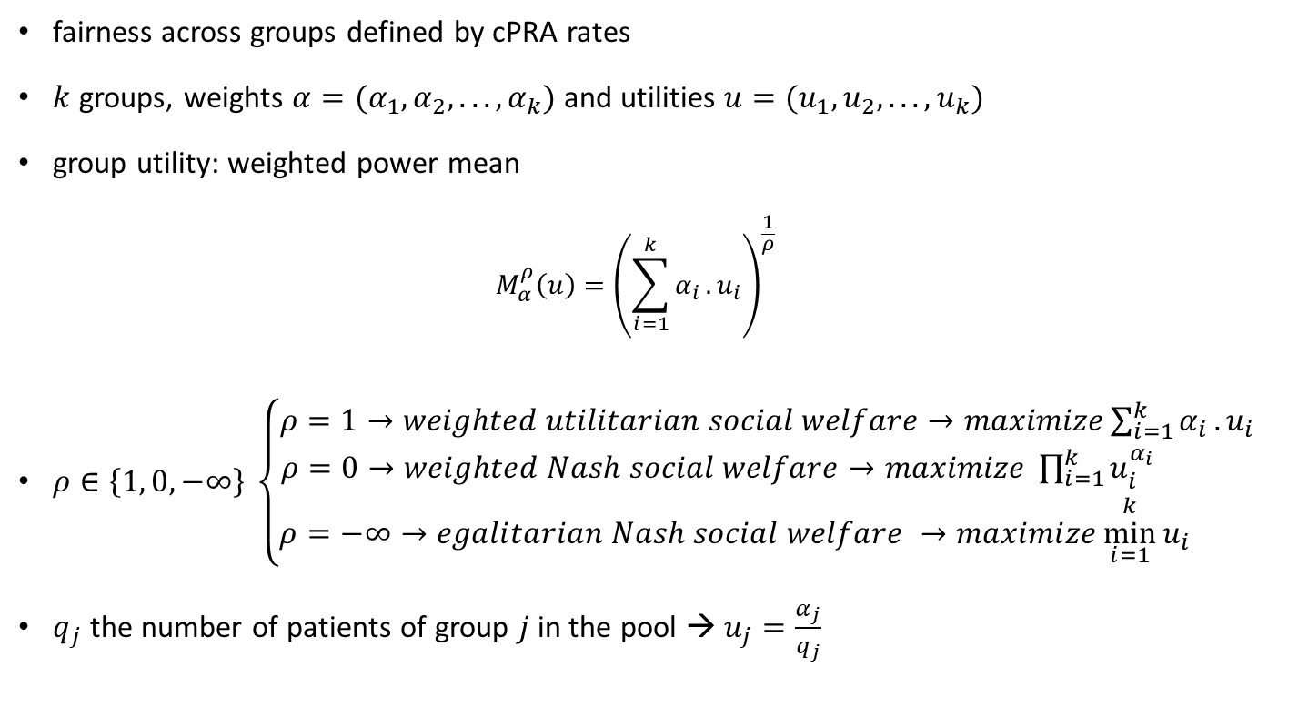
Measure of Fairness
fairness across groups defined by cPRA rates
$k$ groups, weights $α=(α_{1}, α_{2}, . . . , α_{k})$and utilities $u=(u_{1}, u_{2}, . . . , u_{k})$
group utility: weighted power mean
$$M_{α}^{ρ}\left(u\right)={\left(\sum_{i=1}^{k}{α_{i}}.u_{i}\right)}^{\frac{1}{ρ}}$$
$ρ∈\left\{1, 0,−∞\right\} \left\{\begin{aligned}ρ=1→weighted utilitarian social welfare→maximize\sum_{i=1}^{k}{α_{i}}.u_{i} \\ ρ=0→weighted Nash social welfare→maximize \prod_{i=1}^{k}{u_{i}^{α_{i}}} \\ ρ=−∞→egalitarian Nash social welfare →maximize\underset{i=1}{\overset{k}{min}}{u_{i} }\end{aligned}\right.$
$q_{j}$ the number of patients of group $j$ in the pool → $u_{j}=\frac{α_{j}}{q_{j}}$

Slide 15
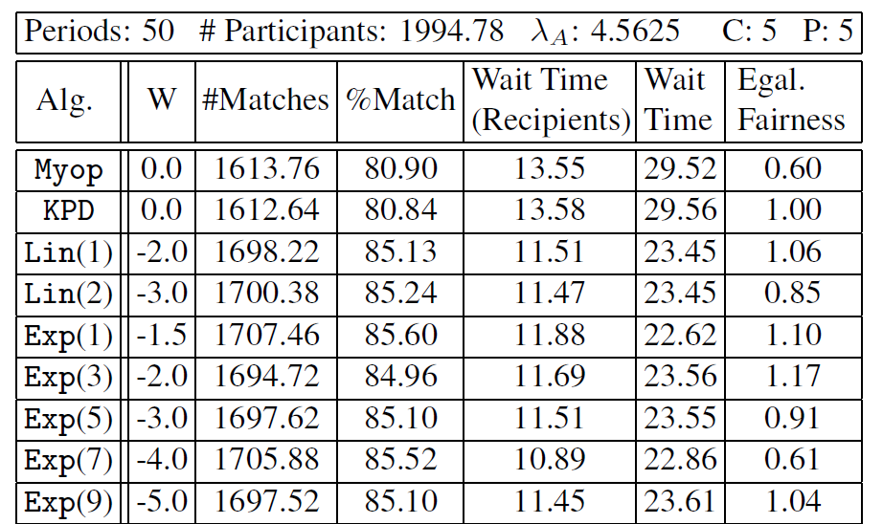

Results
three main criteria:
Number of Transplants: the total number of transplants over the 50 time periods
Waiting Times: the average wait time of each transplant recipient in months
Group Fairness
all seven of the learning algorithms outperform the myopic
Four of the them outperform the KPD algorithm for every single criteria
remaining three outperform the KPD algorithm on every criteria except egalitarian fairness
algorithm Exp(1) leads to a 6% increase in the number of transplants
decrease of 24% in the average waiting time and
improvement of 10% and 21% in egalitarian fairness measure
Table 2: Performances of the transplant algorithms

Slide 16
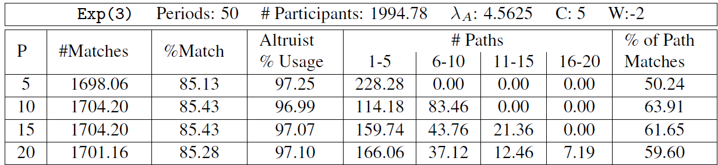
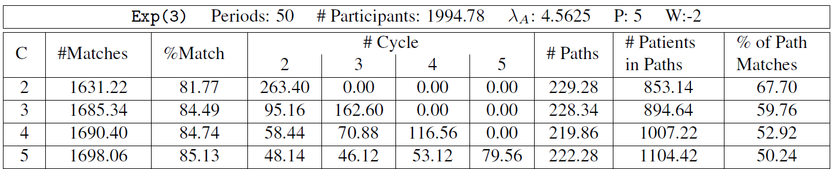
Cycle and Path Length
There is negligible hypothetical benefit in allowing for paths of length greater than 5
It is very important to allow for cycles of length 3. The hypothetical improvements with cycles length of 4 or 5 are marginal
Table 3: The impact of constraining path lengths
Table 4: The impact of constraining cycle lengths

Slide 17
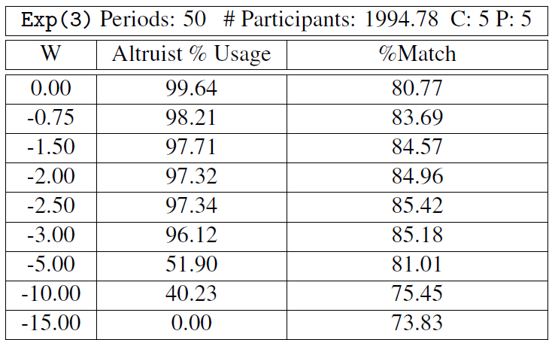
Altruistic Weights
negative node weight to an altruistic donor
an altruistic donor will only be used when the resultant benefit is significant
Assigning an appropriate negative weight (price) to each altruistic donor is fundamental in the determining the quality of outcomes
Table 5: The effect of varying the weight of altruistic donors

Slide 18
Thank You!

