Slide 1
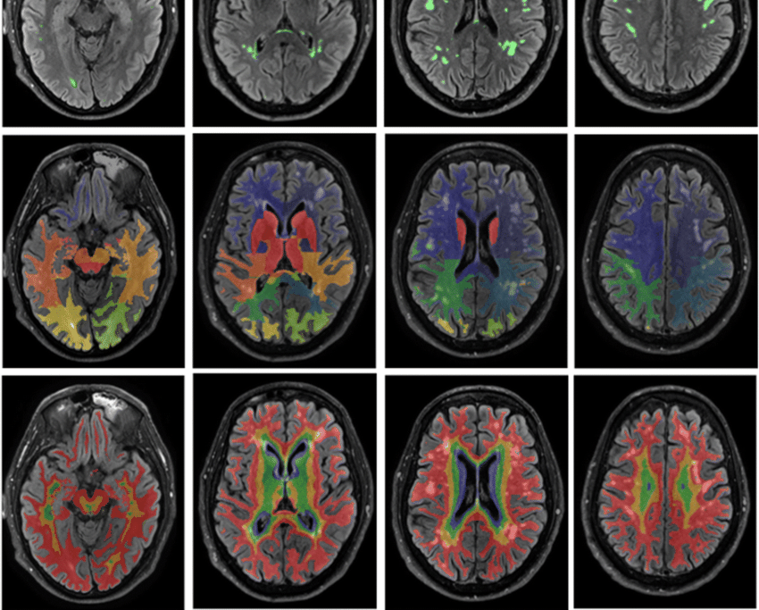
DBTrans: A Dual-Branch Vision Transformer for Multi-Modal Brain Tumor Segmentation
Intelligent Analysis of
Biomedical Images
Fall-2023
Seyed Amir Kasaei
Prof. M H Rohban

Slide 2
Introduction Glioma lesion segmentation
U-Net based
lack of global understanding of images for convolution operation
struggle to model the dependencies between distant features and make full use of the contextual information
Transformer
self-attention mechanism (can capture long-range dependencies)
When applying 2D models, 3D images need to be sliced along one dimension (may lead to the loss of local information)
difficulty capturing global interaction information while effectively encoding local information (just stack modalities (equally treated) and pass them through a network)

Slide 3
DBTrans A novel encoder-decoder model for multi-modal medical image segmentation
Dual-Branch Encoder-Decoder
two types of window-based attention mechanisms
Shifted Window-based Multi-head Cross Attention
Shifted Window-based Multi-head Self Attention
in parallel to dual-branch encoder layers
Both local and global feature extraction
Designed for 3D medical images, avoiding the information loss caused by data slicing

Slide 4
DBTrans Contribution
two attention mechanisms to model close-window and distant-window dependencies without any extra computational cost.
an extra path to facilitate the decoding process in addition to traditional skip-connection (Shifted-W-MCA-based global branch)
strengthening the fusion effect of the multi-modal information from a global perspective by improving channel attention

Slide 5
Methodology
Dual-Branch Encoder

Slide 6
Architecture

