Slide 1

An I/O Efficient Version of Dijkstra’s Algorithm
Massive data algorithm
SUT - spring 2024
Dr. Abam
amir kasaei

Slide 2
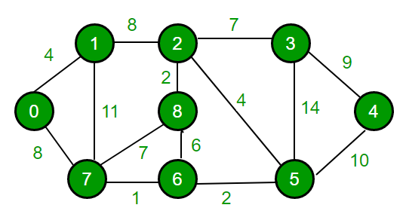

Dijkstra’s Algorithm
tests every neighbors $w$ of current vertex $v$ whether it has been finished before updating the distance
$v$ is finished when the final distance of $v$ from s is calculated, and all its neighbors added into priority queue
this takes one $I/O$ per an edge → $O(\left|E\right|)$ $I/O$ in total
How to avoid this??
Figure 1: Dijkstra graph

Slide 3
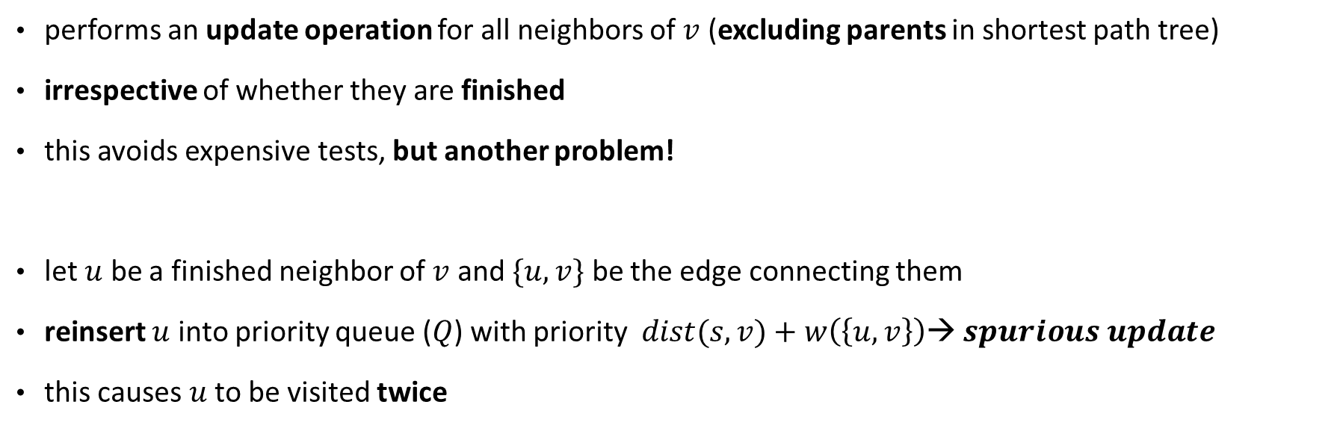
A Shortest Path Algorithm
performs an update operation for all neighbors of $v$ (excluding parents in shortest path tree)
irrespective of whether they are finished
this avoids expensive tests, but another problem!
let $u$ be a finished neighbor of $v$ and $\{u, v\}$ be the edge connecting them
reinsert $u$ into priority queue ($Q$) with priority $dist(s,v)+w\left(\left\{u,v\right\}\right)$→ $spurious update$
this causes $u$ to be visited twice

Slide 4
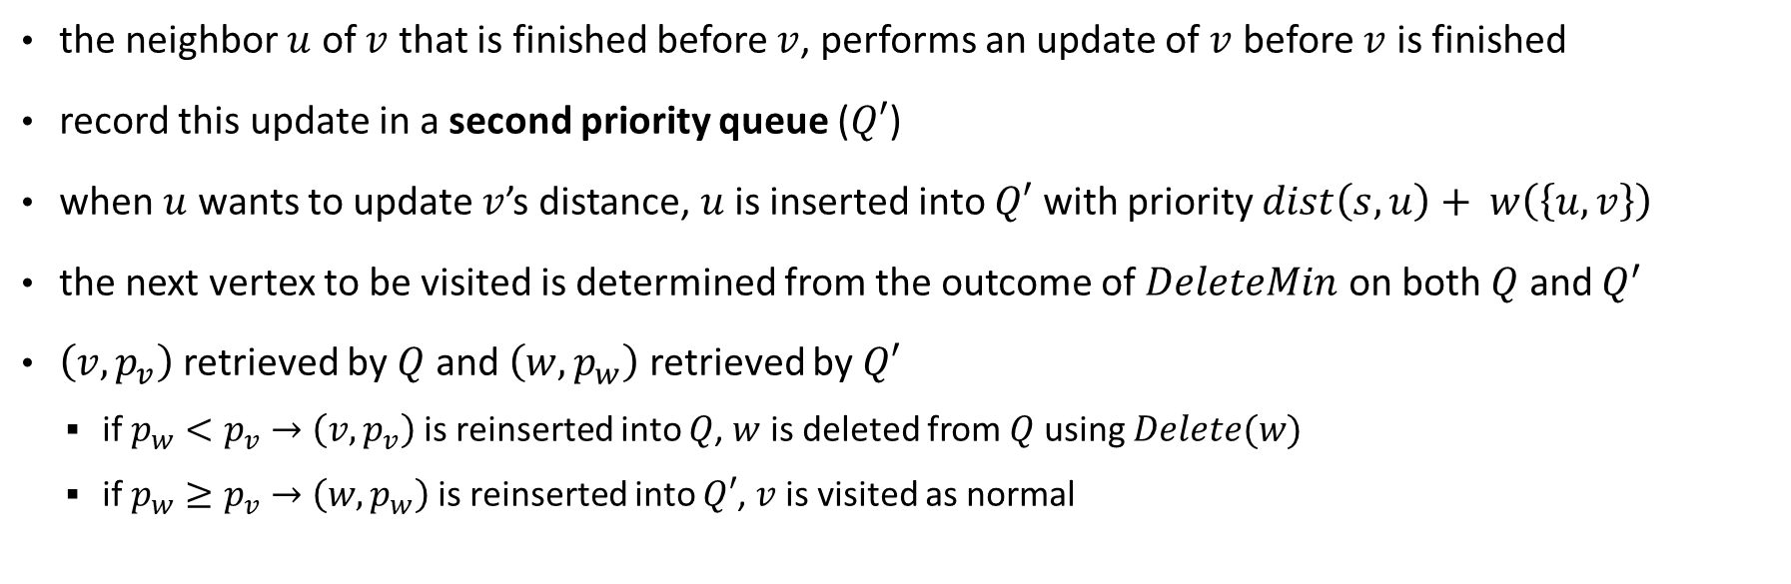
Avoid Spurious Updates
the neighbor $u$ of $v$ that is finished before $v$, performs an update of $v$ before $v$ is finished
record this update in a second priority queue ($Q′$)
when $u$ wants to update $v$’s distance, $u$ is inserted into $Q′$ with priority $dist\left(s,u\right)+ w\left(\left\{u,v\right\}\right)$
the next vertex to be visited is determined from the outcome of $DeleteMin$ on both $Q$ and $Q^{′}$
$\left(v,p_{v}\right)$ retrieved by $Q$ and $\left(w,p_{w}\right)$ retrieved by $Q′$
if $p_{w}<p_{v}→$ $\left(v,p_{v}\right)$ is reinserted into $Q$, $w$ is deleted from $Q$ using $Delete(w)$
if $p_{w}≥p_{v}→$ $\left(w,p_{w}\right)$ is reinserted into $Q′$, $v$ is visited as normal

Slide 5


Lemma
consider $v$ and a neighbor $u$ that is finished before $v$ so $v$ performs $spurious update$on $u$
denote $spurious update$as A, deletion of copy of $u$ as B and $DeleteMin$ operation on copy of $u$ as C
we need to prove that B happens after A but before C
Assume all vertices has different distances from source
$dist\left(s,u\right)<dist(s,v)$ because u is finished first
B happens after A because A happens when $v$ is retrieved from $Q$ with priority $dist(s,v)$ and B happens when copy of $u$ is retrieved from $Q’$ with priority $dist\left(s,u\right)+w\left(\left\{u,v\right\}\right)$
$dist\left(s,u\right)+w\left(\left\{u,v\right\}\right)<dist\left(s,v\right)+w\left(\left\{u,v\right\}\right)→$ B happens before C
A Spurious update is deleted before the targeted entry can be retrieved using $DeleteMin$ operation

Slide 6
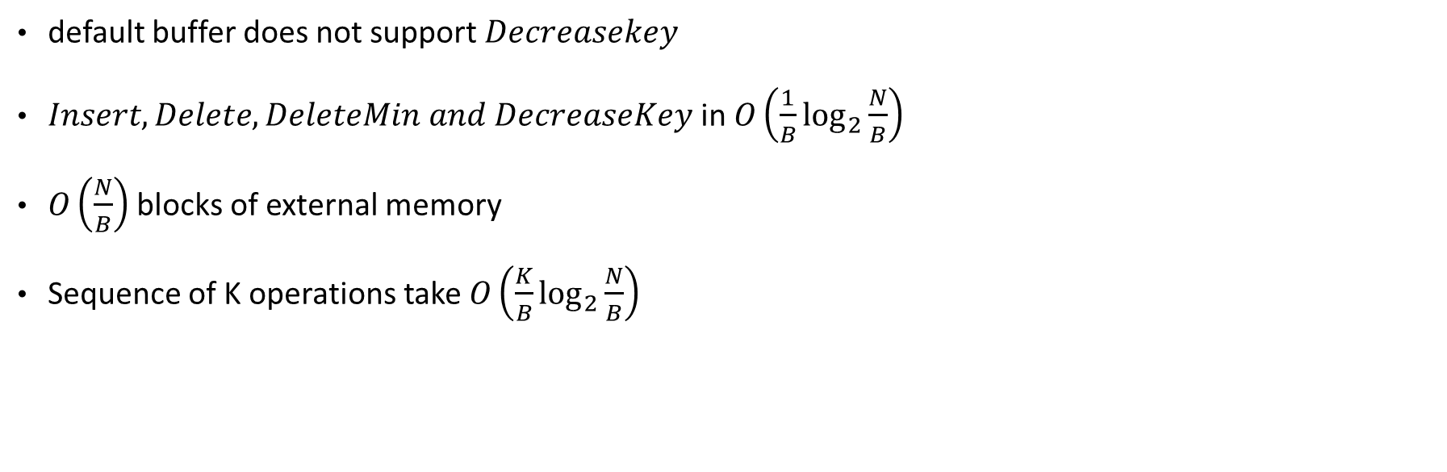
External Tournament Tree
default buffer does not support $Decreasekey$
$Insert, Delete, DeleteMin and DecreaseKey$in $O\left(\frac{1}{B}\log_{2}{\frac{N}{B}}\right)$
$O\left(\frac{N}{B}\right)$ blocks of external memory
Sequence of K operations take $O\left(\frac{K}{B}\log_{2}{\frac{N}{B}}\right)$

Slide 7
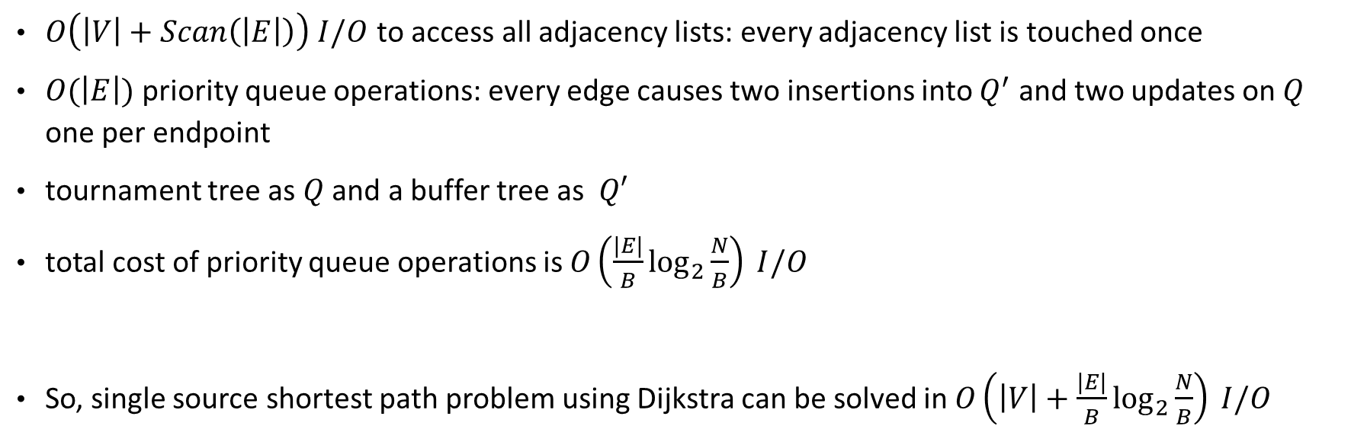
Analysis
$O\left(\left|V\right|+Scan\left(\left|E\right|\right)\right) I/O$ to access all adjacency lists: every adjacency list is touched once
$O(\left|E\right|)$ priority queue operations: every edge causes two insertions into $Q^{′}$ and two updates on $Q$ one per endpoint
tournament tree as $Q$ and a buffer tree as $Q′$
total cost of priority queue operations is $O\left(\frac{|E|}{B}\log_{2}{\frac{N}{B}}\right) I/O$
So, single source shortest path problem using Dijkstra can be solved in $O\left(\left|V\right|+\frac{|E|}{B}\log_{2}{\frac{N}{B}}\right) I/O$

Slide 8
Thank You!

