Slide 1
Axes of new Coordination System

Slide 3

$$a_{1}x_{1}+a_{2}x_{2}≤b$$
Yes
No

Slide 4
$$X_{2}$$
$${X′}_{2}$$
$${X′}_{1}$$
$$x_{2}$$
$${x′}_{1}$$
$${x′}_{2}$$
$$θ$$
$$x_{1}$$
$$X_{1}$$

Slide 5

$a_{1}x_{1}$+$a_{2}x_{2}=b$
$$b_{1}$$
$$θ$$

Slide 6

$a_{1}x_{1}$+$a_{2}x_{2}=b$
$$b_{2}$$
$$θ$$

Slide 7

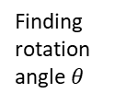
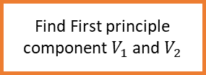
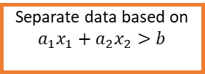
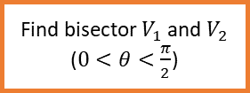
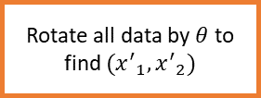

Divide data set to $S_{1}$ and $S_{2}$ based on labels
Find First principle component $V_{1}$ and $V_{2}$
Finding rotation angle $θ$
Find bisector $V_{1}$ and $V_{2}$ ($0<θ<\frac{π}{2}$)
Rotate all data by $θ$ to find $({x^{′}}_{1},{x^{′}}_{2})$
Apply standard ID3 to new data
Do pruning based on Validation set
Extract $a_{1},a_{2}$ and $b$
All leafs are pure
Separate data based on
$$a_{1}x_{1}+a_{2}x_{2}>b$$
Pure subset
Stop!
Impure subset
Divide it again!

Slide 8
(1)
(3)
(4)
(2)

Slide 9
PCA
PCA
$$θ$$

