Slide 1
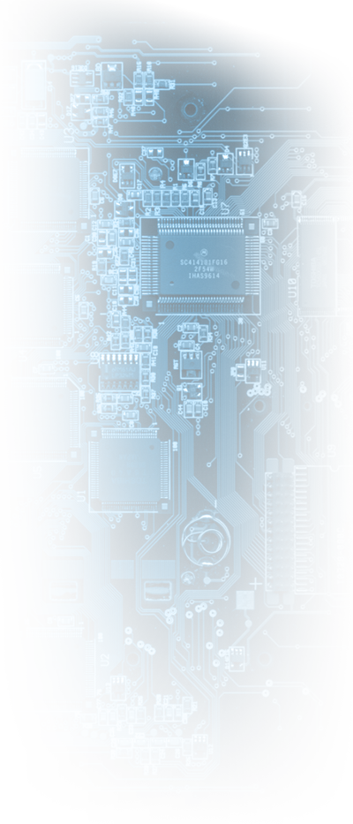


A Real HBSD Capable DTN Router
Amir Krifa, Amir.Krifa@sophia.inria.fr
Chadi Barakat, Chadi.Barakat@sophia.inria.fr

Slide 2
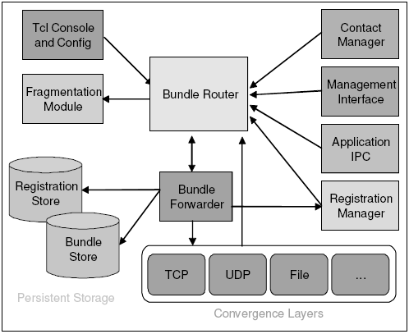
HBSD Capable Router Connection to DTN2
HBSD External Router
UDP Multicast Channel
based on XML/SAX
DTN2 Forwarder

Slide 3
HBSD External Router Building Blocks
Maintain Network Description (Nodes, Links, …)
Maintain/ Exchange Network Statistics
Manage local, persistent storage of bundles
Load Configuration
Save Log
Make Decisions (Scheduling, Drop, Forwarding, …)
Receive/
Dispatch Events (XML-SAX)
Send
Requests vi an UDP Multicast Channel
DTN2 Daemon

