Slide 1
ICR - Identifying Age-Related Conditions
Workshop in ML and Data Analysis​

Slide 2
Agenda
Project Overview​
Data Details​
Data difficulties​
Target Results​
Initial Models attempts​
Data Preprocessing​
Advanced Methods​
Best Attempts ​
Future Improvements​

Slide 3
Project overview
617
56
Binary
Predict
Total number of observations in Train Data.​
The number of Health-Related characteristics considered in the study.​
The target variable. 1 indicating a positive observation and 0 otherwise.​
The goal is to predict specific medical condition based on health-related data.​

Slide 4
Data details
Train Data
Test Data
Characteristics​
Class
617 partially observed data points​
Each observation has 56 anonymized health characteristics
400 partially observation​
All characteristics are numeric except for EJ column​
EJ is categorical with values 'A' or 'B'
Binary target​
1 for positive observation​
0 for negative observation

Slide 5
Example data & submission
Id ​ | AB ​ | AF ​ | AH ​ | .. ​ | .. ​ | EJ ​ | .. ​ | .. ​ | Class ​
000ff2bfdfe9 ​ | 0.209377 ​ | 3109.03329 ​ | 85.200147 ​ | 22.394407 ​ | 8.138688 ​ | A ​ | .. ​ | .. ​ | 1 ​
Probability of being classify as sick (1) or healthy (0)​
Id ​ | 1 ​ | 0 ​
000ff2bfdfe9 ​ | 0.75 ​ | 0.25 ​

Slide 6
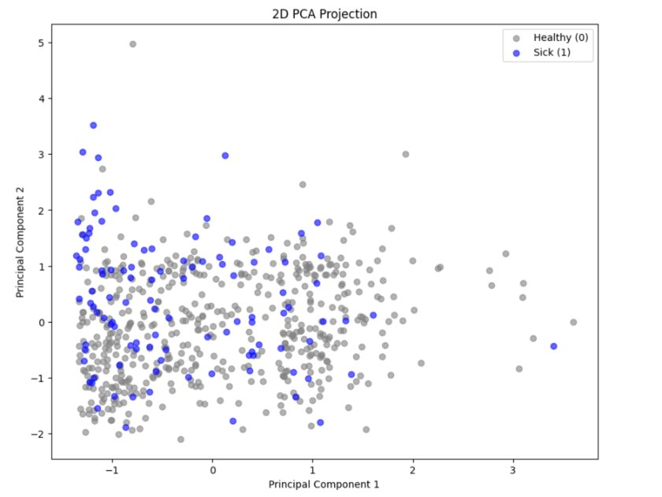
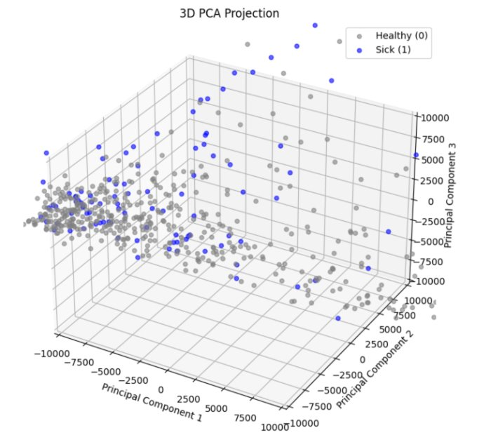
Data difficulties
Data can't be separate easily (56 dimensions).
Even after using PCA, reducing data dimension to 2 or 3.
Moreover, small dataset, as in this scenario, can easily lead to overfitting.

Slide 7
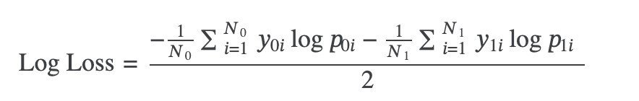
Target results
Initial Goal​
Achieve a score below 0.5 using own models and ideas​
Intermediate Goal​
Use existing solutions and make improvements​
Aim to reach the top 500​
Ultimate Goal​
Break into the top 250​
TOP ​ | Score (<) ​
100 ​ | 0.38190 ​
250 ​ | 0.40344 ​
500 ​ | 0.42292 ​

Slide 8
Initial Models attempts​
KNN
Kmeans
Neural Networks
Random Forest
Explored K-Nearest Neighbors (KNN) models with various k values to predict class probabilities.​
Best results: 0.783​
Attempted K-means clustering but found it less effective compared to other methods.​
Best results: 4.1​
Experimented with Neural Networks, facing challenges like overfitting and suboptimal results.​
Best results: 0.741​
Utilized Random Forest algorithm, focusing on decision tree aggregation for more reliable outcomes.​
Best results: 0.442​

Slide 9
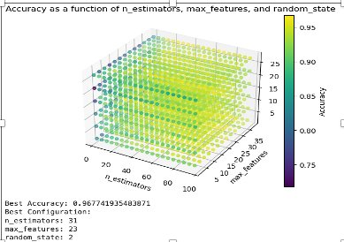
Random Forest improvements​
selecting the best values for n_estimators, max_features, and random_state (after train_test_split)​
Improved from 0.5 to 0.442​

Slide 10
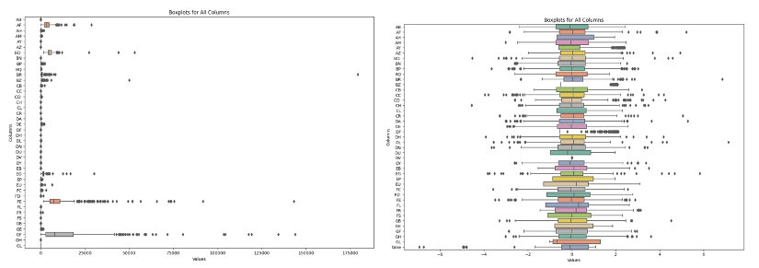
preprocessing
Column Variance Considerations​
High variance can indicate effective classification potential​
Low variance columns are often removed to avoid noise​
Correlation and Classification​
Retain columns with strong correlation to specific classes​
Remove columns without significant connection to avoid noise​
Use transformers to handle the data better and identify different patterns ​
Handling Missing Values​
Implement smart techniques to manage missing data​
Assigning Unique Values​
Ensure 'A' and 'B' strings in EJ column are unique​

Slide 11
Advanced Methods Overview​
Experimentation with Random Forest​
Basic and manual configurations​
Adoption of advanced boosting methods​
CatBoost​
LightGBM​
XGBoost​
TabPFN​

Slide 12
Boost
XGBoost​
LightGBM
CatBoost
Powerful, efficient, and scalable implementation of gradient boosting​
Primarily used for structured/tabular data​
Features like regularization and tree pruning reduce overfitting​
Results:​
0.58 / 0.41
LightGBM Characteristics:​
Fast and efficient gradient boosting library​
Uses histogram-based learning​
Employs leaf-wise tree growth for speed and accuracy​
Results:​
0.47 / 0.47
Gradient boosting library​
Optimized for datasets with categorical features​
Key Features:​
Minimal preprocessing required​
Robust to overfitting​
Minimal parameter tuning needed​
Results:​
0.44 / 0.25

Slide 13
Tabpfn
Neural Network-Based Model​
Designed for tabular data​
Utilizes Prior Knowledge​
Incorporates probabilistic approaches​
Generalizes Well Across Datasets​
Achieves high accuracy with minimal configuration​
Results:​
0.44 / 0.28​

Slide 14
Best attempts​
Combining models with balanced weights
combined all four methods and predicted using the average prediction across them
use 'balanced' weights.
Best results: 0.42​
TabPFN with higher weight
TabPFN was the most reliable model
configured TabPFN with a higher weight compared to the others
Best results: 0.398
Better transformer
improved the preprocessing by using a more effective transformer
ensured both the training and test data used the same scaler
Best results: 0.387 – 121st place
After prediction re-weight
further fine-tuning and incorporating a reweight function for final processing after prediction
Best results: 0.355 11th place

Slide 15
Future improvements
Better preprocessing​
Better models configurations
Fine tuning for predictions
To avoid over-fitting and enhanced models results, preprocessing is crucial
Every person in the competition, remove about 10 columns that considered ‘bad’ and distracting
Finding the best columns to learn from can lead to significant improvement
After changing max depth prop in CatBoost model and number of components in TabPFN model I improve my best result from 0.4 to 0.38
Finding the best configuration, in addition to find the best weight combining all 4 models, may lead to even better results
After all previous steps, another fine tuning can be implemented
Duo to unbalanced train data (80% labeled as 0), our models tend to mistake (positive false)
Reweighting prediction improved my results from 0.38 to 0.355
Consider even more complex and advanced reweighting function, can make a great improvement

Slide 16
Results summary
Result
0.783
0.741
0.442
0.44
0.42
0.398
0.387
0.368
0.363
0.362
0.355
Configuration
KNN
N-Networks
Random Forest
TabPFN
4 models
4 models + balanced weights
Better transformer
Best XG depth loop
Reweight function
Best CatBoost depth
Best TabPFN configurations

