Slide 1
Cross-System Social Web User Modeling Personalization of Recommender Systems
Amirmasood Sheidayi
Supervisor: Dr. Elaheh Homayounvala

Slide 2
Introduction
What is Recommender System?
What is personalization, and what does personalized recommender systems mean?
How does user modeling define?
What is cross-system user modeling?

Slide 3
The cold start problem in isolated user modelling
user modeling
behavior prediction
Personali-zation
Improve RS
cold start problem
cold start causes by sparse data at initialization that heads to an incorrect prediction from user behavior and so untrue personalization and recommendations.

Slide 4
Cross-system user modeling
Use other social media data
Access to public data of users
Fetch implicit, explicit and inferable data
Aggregate social media data

Slide 5
Overview of actions
Use the most popular social network platforms
Alleviate the cold start problem
Introducing a new feature for mitigating the cold start problem
Create a dataset
collect data
prediction
select features
cold start

Slide 6


Actions of creating the dataset
5k source data
data restoration
aggregation
prediction
speed and accuracy
mine data
improve personalization of recommender systems

Slide 7
Final dataset
300 common final record
Select a limited number of features from the dataset

Slide 8
Sample fetched of dataset feature
YouTube | Twitter
subscriber count | follower count
list of uploaded videos | list of followers
captions of uploaded videos | followings count
thumbnails of uploaded videos | list of followings
likes/dislikes of a video | list of tweets
about section of a channel | list of people who liked a tweet
list of links in the about section | list of people who replied to a tweet
joined date | join date of a user
total view count | birthday of a user
total uploaded video count | list of tweets which user has liked
location | list of media(picture/videos) which user has published

Slide 9
Challenges of collecting data
Due to privacy policy, there is not data with actual person specification (e.g., Name, E-mail, etc.)
Different social media API restrictions
No feasibility of using questionnaire
The time-consuming task of gathering and restoring data

Slide 10
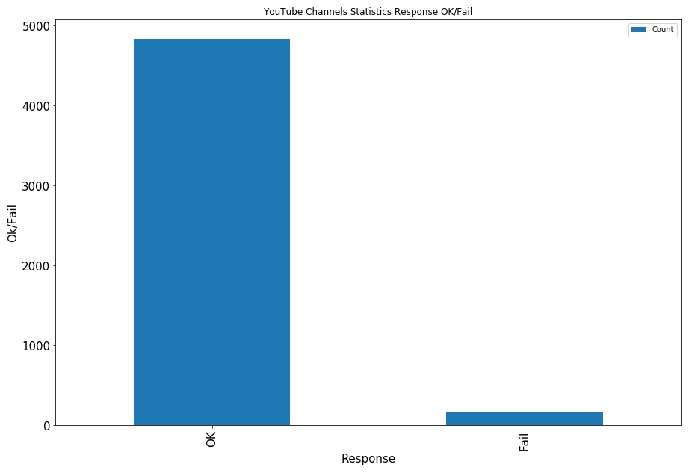
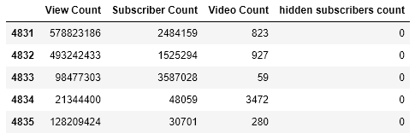
YouTube data
Video Count
Subscriber Count
Video Count
Hidden Subscriber Count
Response Status:
OK
Fail

Slide 11
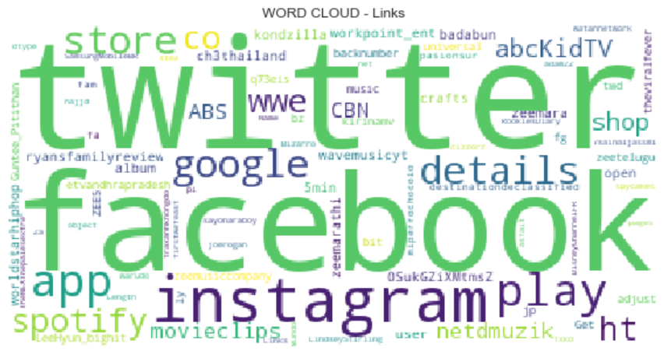
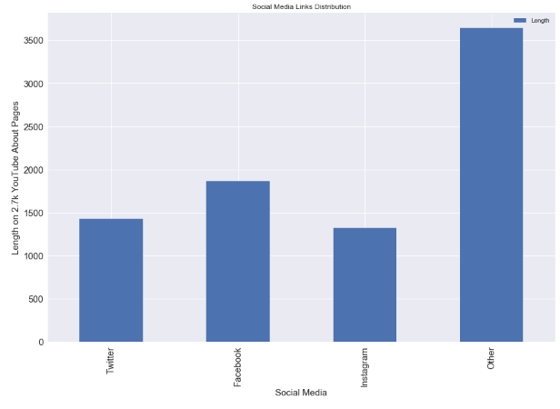
Aggregating data
Word Cloud of Links on
About page of YouTube Channels
Social Media Links Distribution
Twitter
Facebook
Instagram
Other

Slide 12
Selecting Features
Twitter followers
YouTube subscriber count
Total YouTube view count
The difference of view count and a subscriber count of YouTube
Total uploaded video count of YouTube

Slide 13
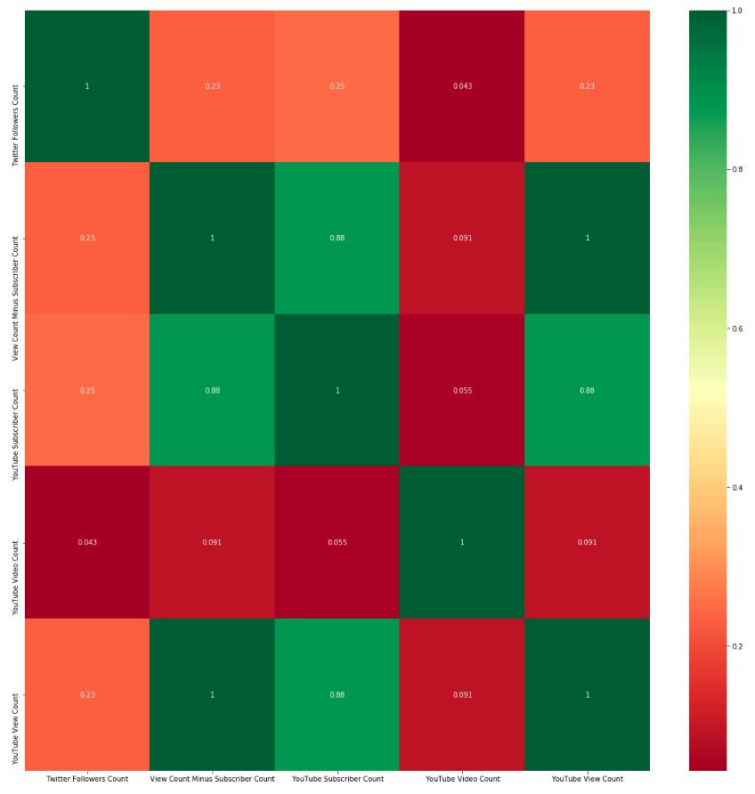
Feature Correlation Heat chart
The close connection between subscriber count and total view count on YouTube
Near no connection between uploaded video count and view count on a YouTube Channel
Same importance between Twitter follower count and YouTube subscriber count

Slide 14
Output Prediction via Regression Algorithm
Predication on view count
Average view count of 3,550,524,704.7
Max Residual Error at 104.61
Mean Absolute Error at 27.27
Mean Running Time 372 milliseconds

Slide 15
Outcome
Tolerable time and precision of the regression algorithm
Ability to use results in flat and stereotype user modeling
Near no connection between uploaded video count and view count on a YouTube Channel

Slide 16
Outcome
Ability to utilize personalized recommender systems on freshly begun YouTube channels
Twitter Followers
Prediction of total YouTube view count
YouTube Subscribers
Capability to substitute Twitter follower count instead of subscriber count for freshly began YouTube channels to alleviate cold start problem

Slide 17
Suggestions
Check the content of images, videos, and texts of Tweets and videos
Check YouTube links in a Tweet
Check based on YouTube channel classification
Check videos and tweets head to head
Add other common social media
Creating a system for collecting users' public data for application on other social media

Slide 18
Thanks.

