Slide 1
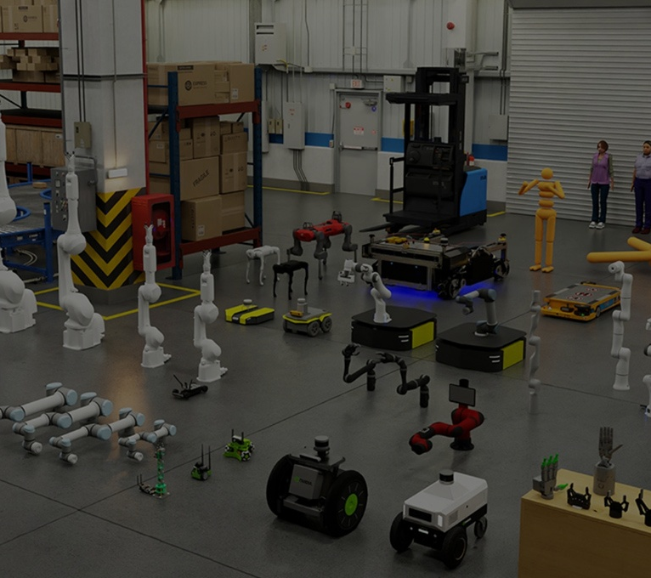
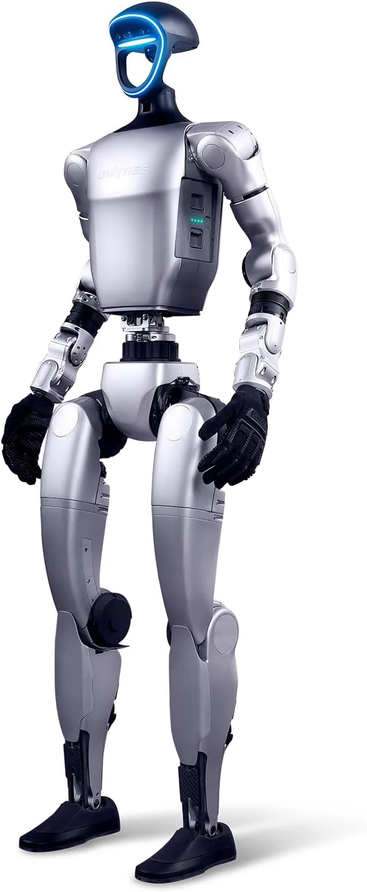
ZERO-SHOT
SEGMENTATION
FOR ROBOTIC
PERCEPTION
Foundation Model Segmentation for Robotic Scenes
Subgroup I2: Zero-Shot Segmentation Benchmark for Robotic Perception (Simulation)
Student: AmirMahdi Matin - 5884715
Can promptable foundation models provide reliable zero-shot object masks for robotic perception in challenging simulated scenes?
Visual sources: NVIDIA Isaac Sim; Unitree G1
Notes:
Start from robotic motivation: a robot needs object masks before it can grasp, avoid, track, inspect, or reason about objects. The project tests segmentation not as a standalone computer vision demo, but as a candidate perception module in robotic cognition.

Slide 2

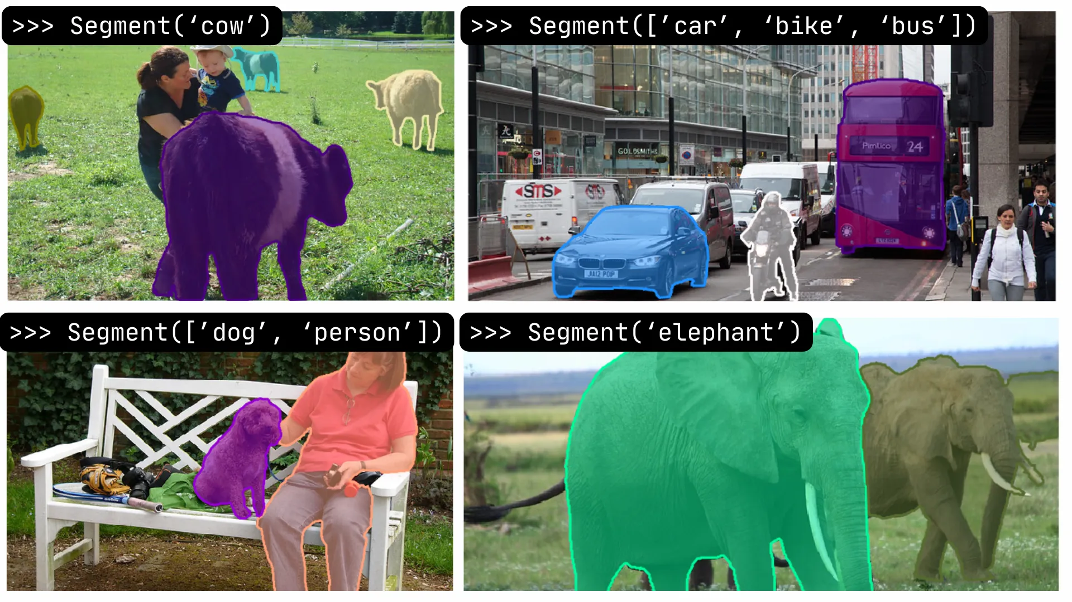
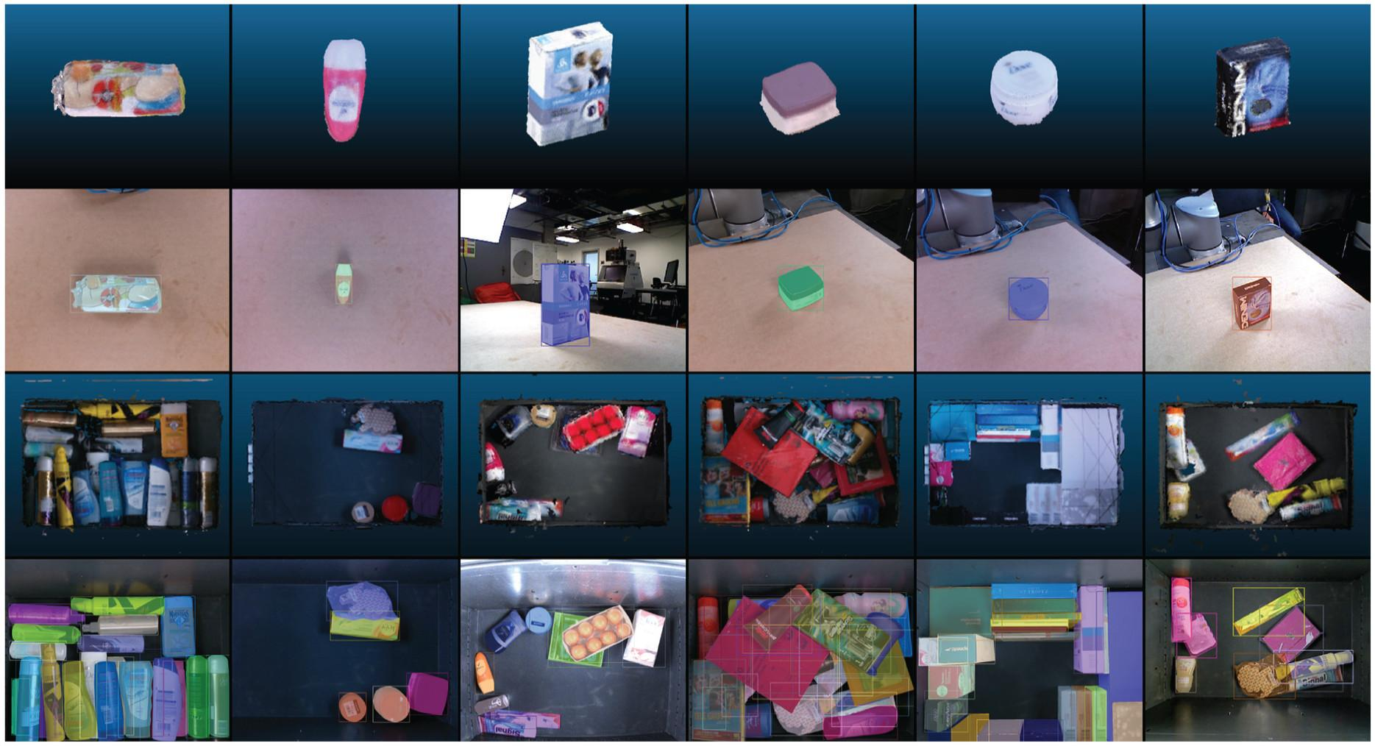
The Foundation Model Promise vs. the Robotic Reality Gap
Promptable segmentation works impressively in general images, but robotic scenes add embodiment, clutter, materials, and latency constraints.
Foundation Model Promise
Robotic Reality Gap
Clutter and occlusion
Transparent and reflective materials
Small parts
Robot-body visibility
Real-time constraints
Point / box / mask prompts
Broad zero-shot transfer
High-quality object masks
Research need: evaluate segmentation as embodied, action-relevant perception, not only as a generic image task.
Model promise vs. robotic reality
Sources: SAM prompt examples; OCID clutter dataset
Notes:
Use this slide to position the project. Foundation models can generate impressive masks, but the supervisor should see why robotic scenes require a different evaluation: material effects, embodied viewpoints, clutter, motion, and real-time constraints.

Slide 3
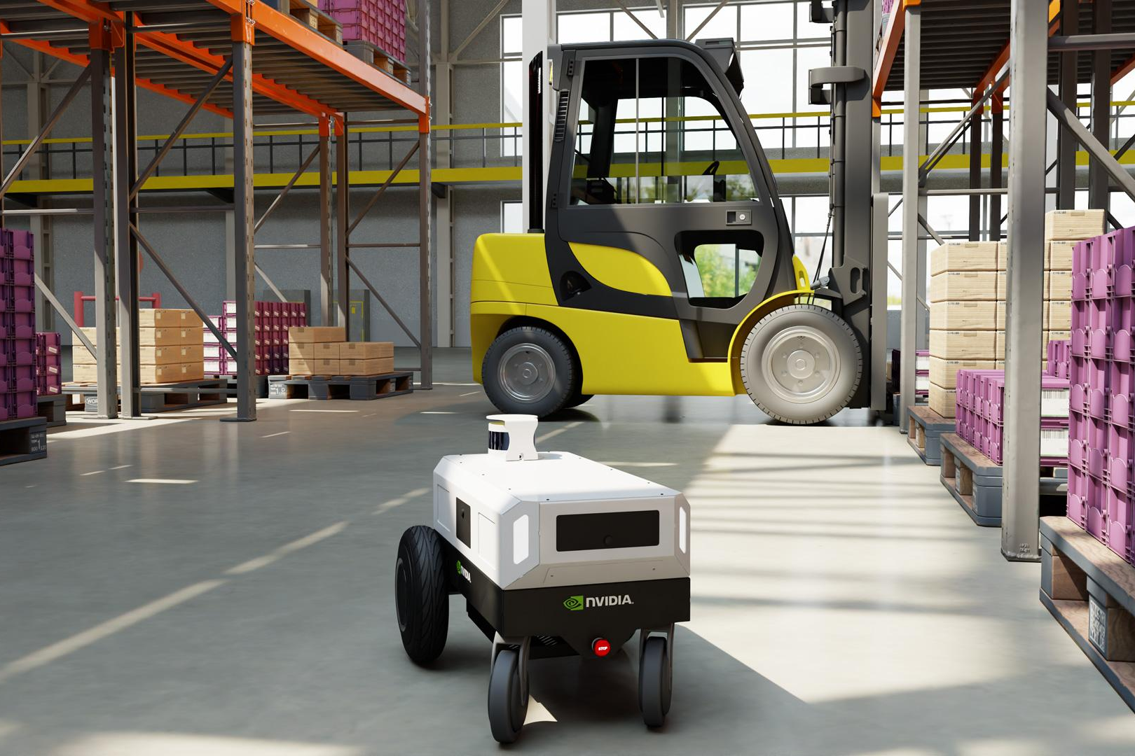
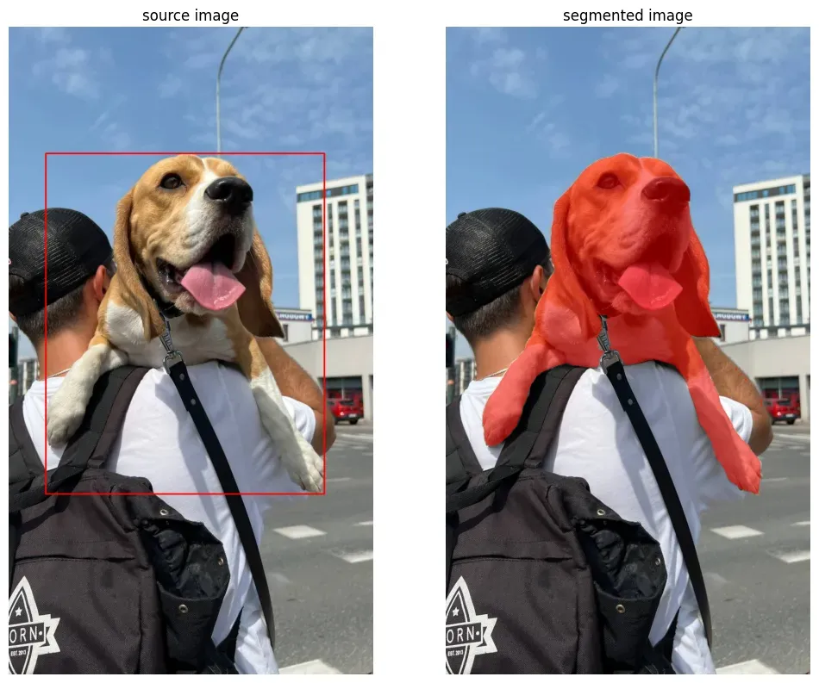
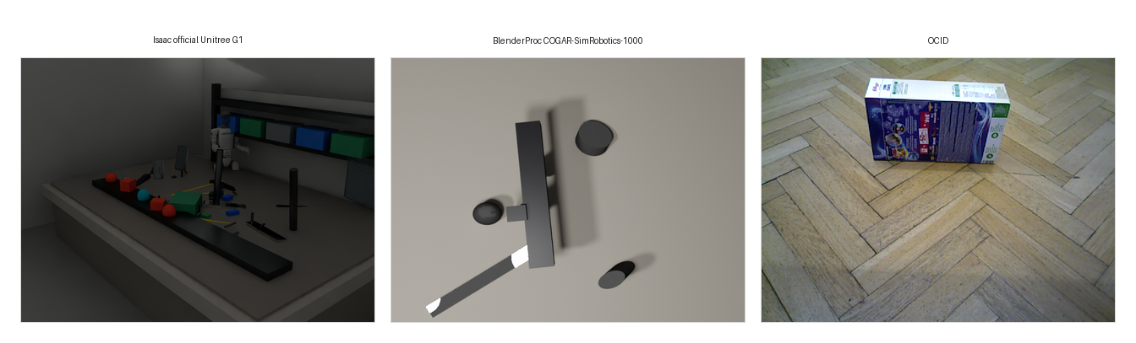
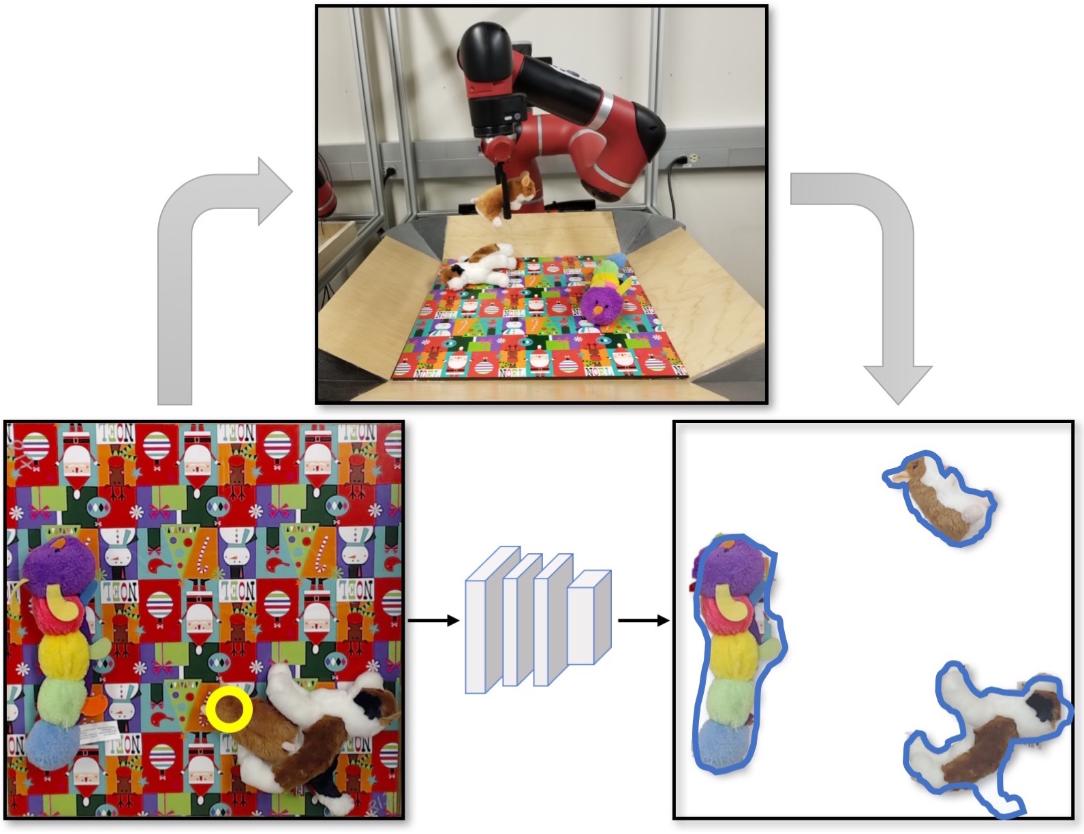
Why Segmentation Matters for Robotic Cognition
Masks become object-level interfaces between perception and action.
Sensor input
RGB/RGB-D observations from robot-centered scenes
Object mask
Pixel-level foreground regions for target objects
Object region
Object candidates for tracking, grasping, or inspection
Task reasoning
Action selection, manipulation, navigation, and monitoring
Segmentation is a cognitive interface: bad masks can become bad grasps, unsafe navigation, or broken object tracking.
Perception-to-action interpretation
Notes:
Explain segmentation as more than visualization. In a cognitive architecture, masks can feed object representations, attention, grasp planning, tracking, and action choice. That is why quality and speed matter together.

Slide 4

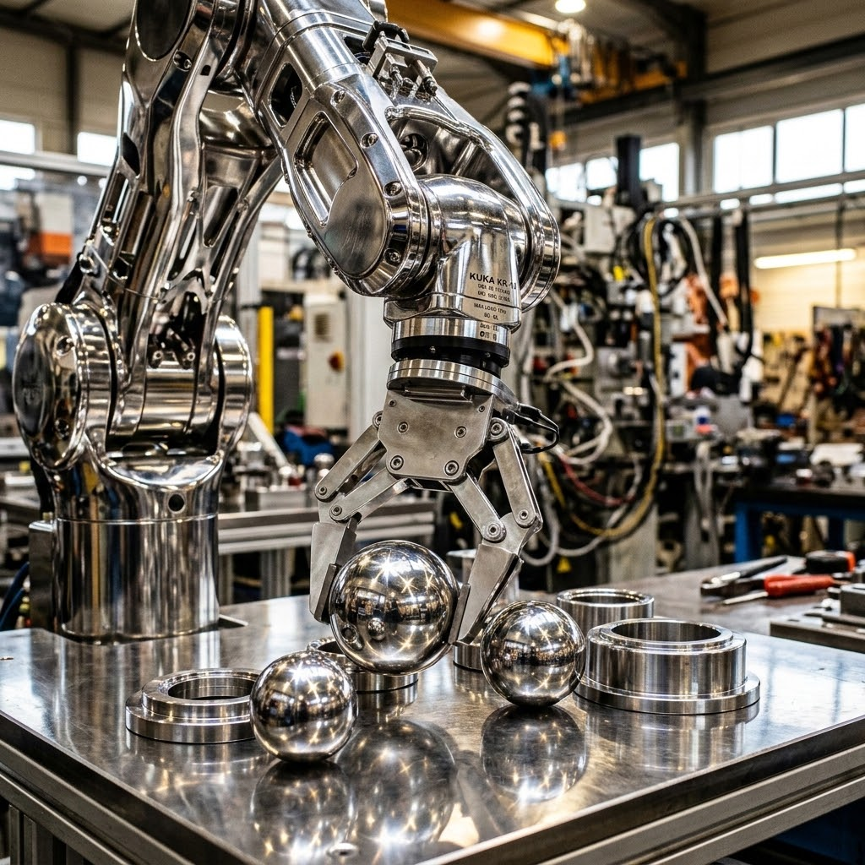
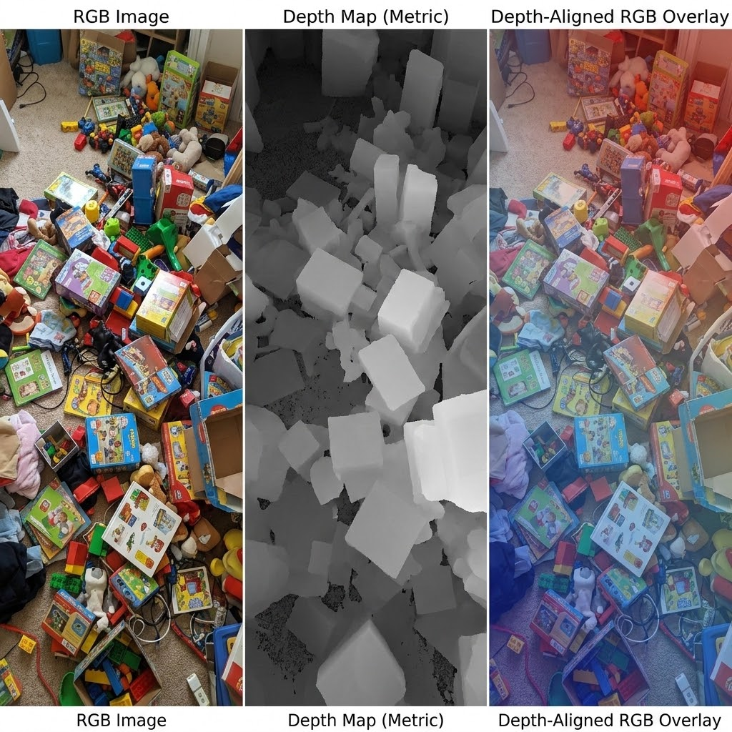
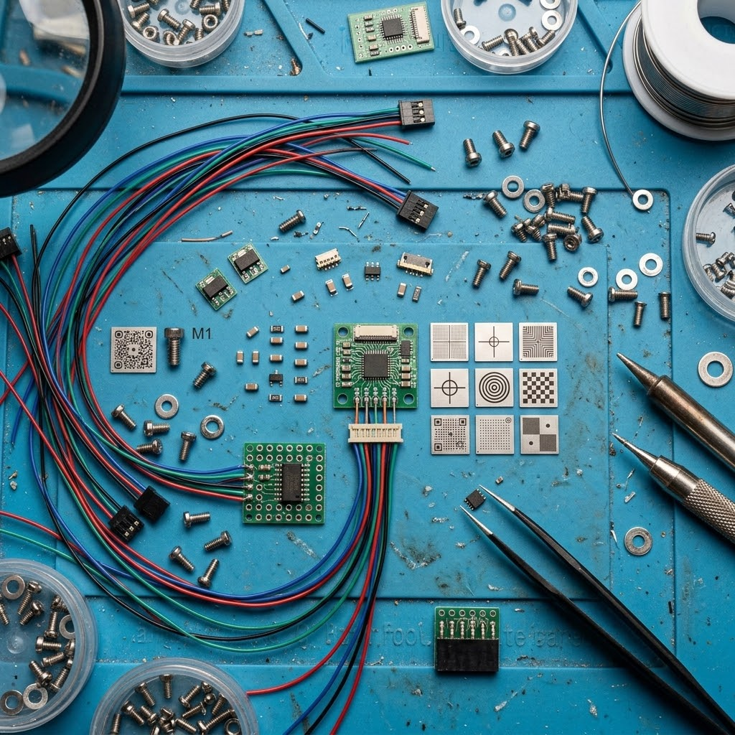
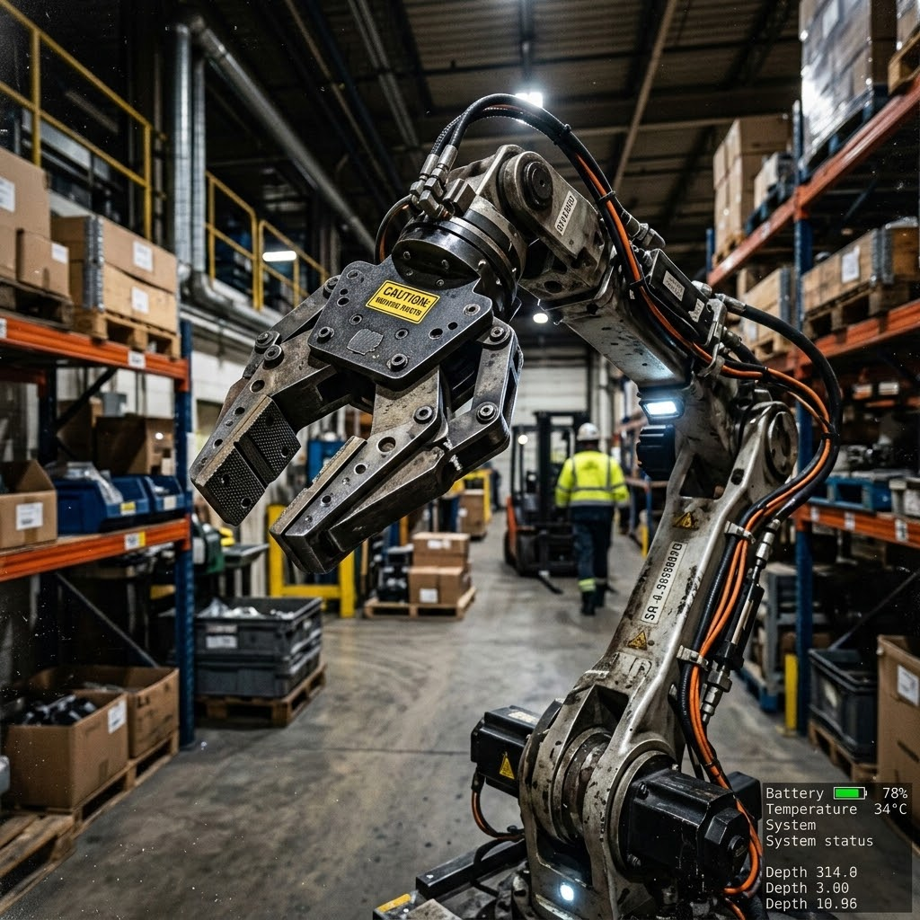
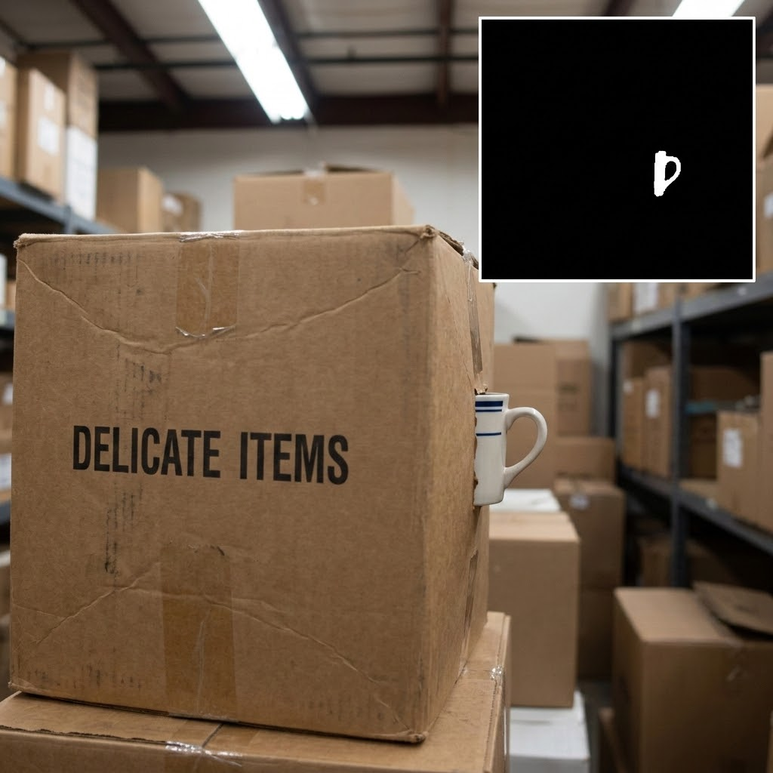
Research Problem: Robotic Scenes Are Visually Hostile
Ordinary segmentation benchmarks understate embodied failure conditions.
Transparent glass
Weak boundaries and background pass-through
Reflective materials
Specular highlights confuse edge cues
Dense clutter
Object merging and over-segmentation
Small parts
Tiny targets are easily missed
Robot visibility
Self-robot pixels create false positives
Occlusion gap
Incomplete masks under occlusion
The benchmark stresses transparent, reflective, occluded, small, dynamic, robot-centered, and cluttered conditions.
Robotic challenge groups
Project failure assets + source visual examples
Notes:
Introduce the failure categories before showing numbers. This prevents the presentation from becoming a model leaderboard and connects the project to embodied robotics.

Slide 5
State of the Art: Evolution of Segmentation Models
The field has shifted from task-specific supervised models to promptable foundation segmentation and lightweight deployment variants.
Classical / Supervised
Task-specific training on labeled data
Mask R-CNN
DeepLabV3+
YOLOv8-seg
Promptable Foundation
Point, box, mask prompts; SAM2 extends to video
SAM
SAM2
Note: SAM3 adds text & exemplar prompting
Lightweight Edge
Lower latency and resource requirements
FastSAM
MobileSAM
EfficientSAM
Zero-shot visual generality does not guarantee safe embodied robotic perception.
Model family positioning
Sources: SAM, SAM2, FastSAM, MobileSAM, EfficientSAM papers/repos
Notes:
Use this slide only to situate the models. Avoid deep architecture details. The point is that models have different assumptions: training data, prompt availability, inference speed, and deployment profile.

Slide 6
Research Gap: General Segmentation ≠ Robotic Perception
Robotic perception is situated, action-relevant, and time-constrained.
≠
Generic image segmentation
image → mask
Robotic cognitive perception
sensor → attention → mask → object state → action
Contribution: a controlled benchmark linking mask quality, challenge robustness, speed, and model-selection logic for robotic use cases.
Research gap and contribution
Notes:
This is the transition from literature to your contribution. The gap is not that segmentation models are missing. The gap is knowing when these models can be trusted inside a robot perception-action loop.

Slide 7
Research Formulation: Four Testable Imperatives
An empirical benchmark of quality, robustness, deployability, and recommendation logic.
storage
1. Datasets
Isaac G1
BlenderProc
OCID
psychology
2. Models + prompts
SAM-family
point / box / auto
baselines
analytics
3. Metrics
mIoU · Boundary F1
Mask AP
FPS
lightbulb
4. Interpretation
failure modes
COGAR mapping
recommendations
Main hypotheses: box prompts outperform point/automatic masks; heavy SAM-family models maximize quality but cost speed; lightweight variants improve deployability with robustness trade-offs.
Experimental formulation
Notes:
Frame the project as a scientific evaluation rather than a demo. The benchmark tests specific hypotheses about prompting, quality, speed, lightweight variants, supervised baselines, and challenge categories.

Slide 8
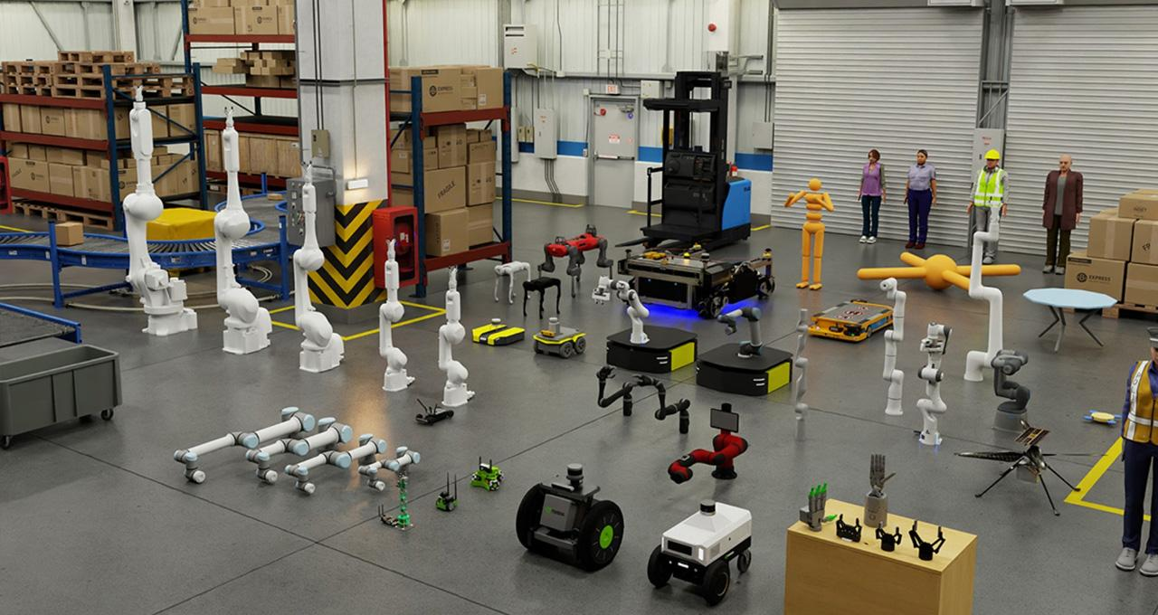
Dataset and Simulation Design
Dataset and Simulation Design
Simulation enables controlled rare-case evaluation; OCID adds real clutter reference.
Simulation enables controlled rare-case evaluation; OCID adds real clutter reference.
Isaac official Unitree G1
Synthetic / Isaac Sim
1000 images
Robot-centered simulation benchmark
BlenderProc COGAR-SimRobotics-1000
Synthetic / BlenderProc
1000 images
Secondary controlled benchmark
OCID
Real RGB-D clutter
2390 images
Real-world domain-gap reference
SYNTHETIC
CONTROLLED
SYNTHETIC
CONTROLLED
REAL
DOMAIN-GAP REF
Isaac official Unitree G1
Isaac Sim
1,000 images
Robot-centered simulation benchmark
BlenderProc COGAR-1000
BlenderProc
1,000 images
Secondary controlled benchmark
OCID
Real RGB-D clutter
~2.3k labeled samples
Real-world domain-gap reference
Challenge groups: reflective, transparent, occluded, small-part, dynamic, and cluttered robot scenes.
Challenge groups: reflective, transparent, occluded, small-part, dynamic, and cluttered robot scenes.
Dataset design
Sources: Isaac Sim, Unitree, BlenderProc, OCID, project datasets
Sources: Isaac Sim, project datasets, OCID
Notes:
Emphasize why simulation is useful: controlled generation of difficult conditions and dense annotations. OCID is not the main benchmark but an external real-world clutter reference.

Slide 9
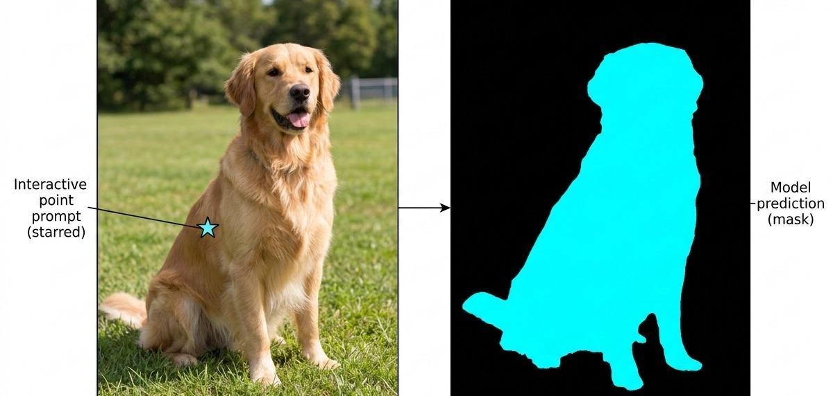
Benchmark Protocol: Prompts, Models, Metrics
Oracle-prompt evaluation isolates mask quality when a target cue is available.
Point prompt
Target cue from one pixel
Box prompt
Target cue from bounding box
Automatic masks
Model proposes masks without a target cue
Models
SAM ViT-H/B · SAM2 · FastSAM · MobileSAM · EfficientSAM · YOLOv8-seg · Mask R-CNN · DeepLabV3+
Metrics
mIoU · Boundary F1 · Mask AP/AP50/AP75 · per-category IoU · GPU/CPU FPS
Boundary Note
Point/box prompts are oracle prompts; real robots need detector, tracker, planner, human instruction, or task prior.
Evaluation protocol
Sources: SAM prompt modalities; project protocol
Notes:
Be careful with overclaiming. Point and box prompt results do not prove full autonomy. They measure mask quality when an upstream cue exists. Automatic mask generation is more autonomous but harder in cluttered robotic scenes.

Slide 10
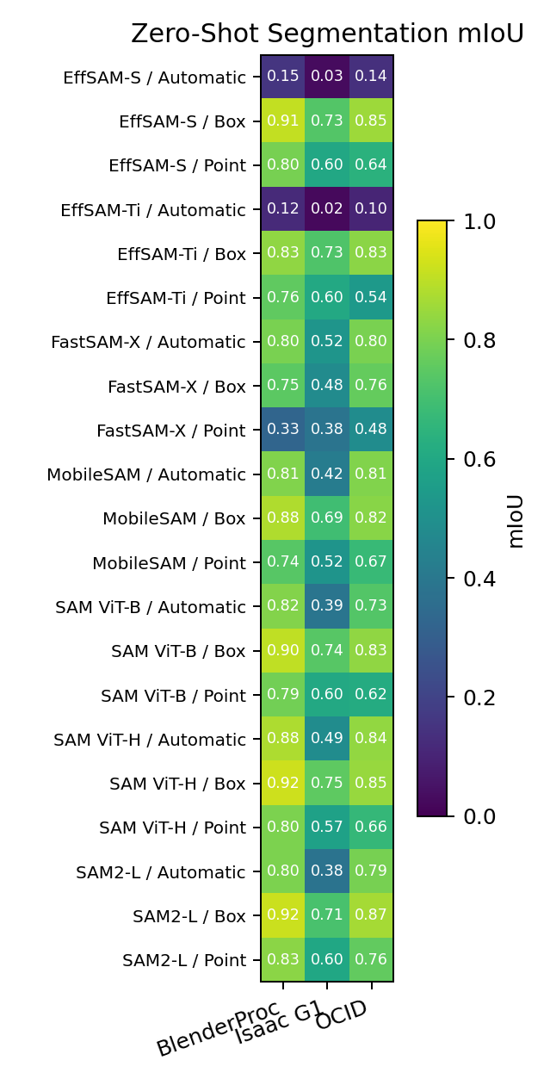
Imperative I: Mask Quality
Mask Quality: Strong, but Dataset-Dependent
Prompted foundation models can produce strong masks, but performance varies across robotic datasets.
0.923
SAM ViT-H box
BlenderProc
0.752
SAM ViT-H box
Isaac G1
0.883
MobileSAM box
BlenderProc
0.824
MobileSAM box
OCID
Box prompts are strong, but dataset difficulty changes the ranking.
High mIoU is promising, but robotic value also depends on robustness and speed.
Quantitative accuracy
Project figure: zero_shot_miou_heatmap.png
Notes:
Show one accuracy figure and only the key numbers. Explain that SAM ViT-H box is strongest in the controlled BlenderProc setting, but Isaac G1 is harder. MobileSAM shows a practical trade-off, especially when speed matters.

Slide 11
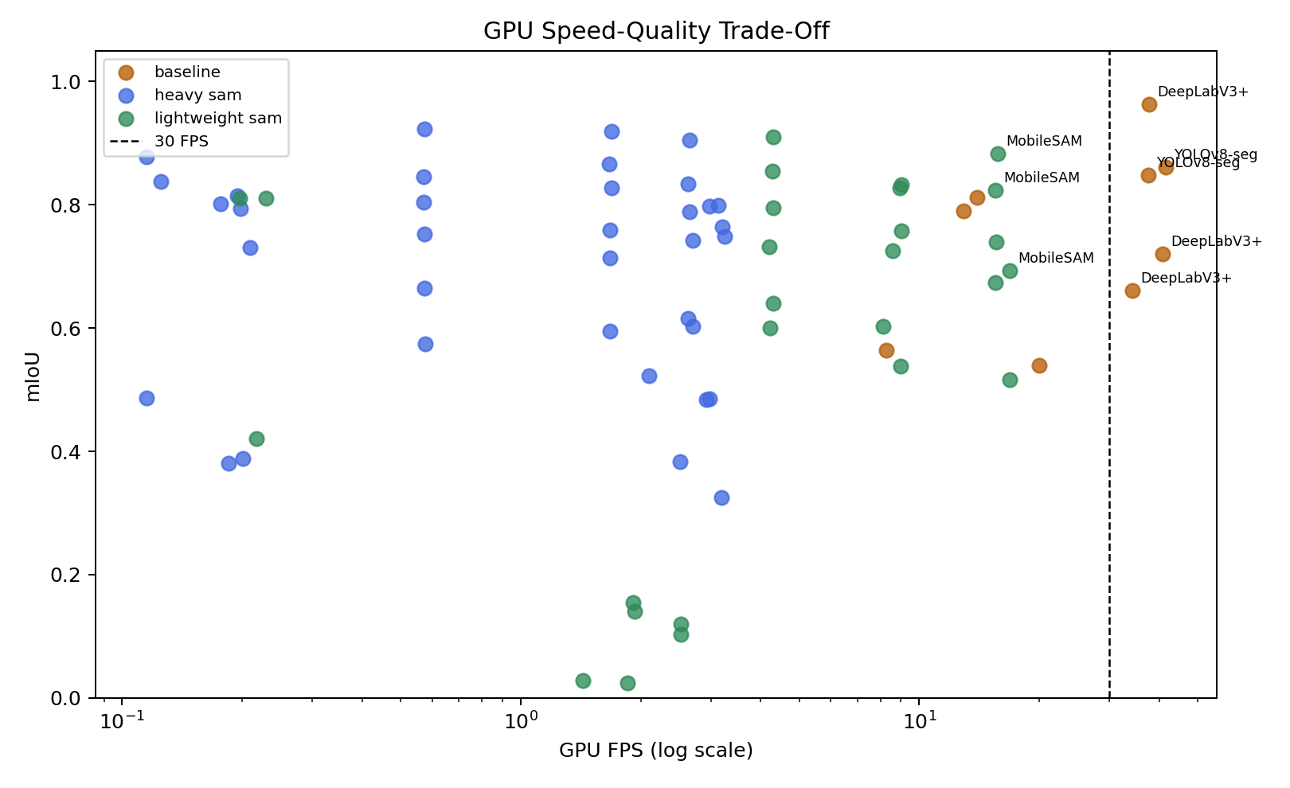
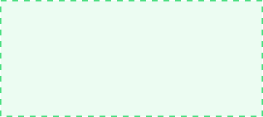
The Latency Reality: Accuracy Is Not Enough
Robotic deployment requires joint evaluation of mask quality and inference speed.
0.574 FPS
SAM ViT-H box
High fidelity, poor latency
robotically attractive
41.647 FPS
YOLOv8-seg
Real-time capable
37.811 FPS
DeepLabV3+ on OCID
Fast supervised baseline
30 FPS
real-time region
A high-quality mask is not robotically useful if it arrives too late for the perception-action loop.
Speed-quality trade-off
Project figure: cuda_speed_quality_scatter.png
Notes:
Make the deployment point explicit. Heavy SAM-style models can provide strong masks but may be too slow for real-time loops. Supervised models can be fast, but only when training data matches the task.

Slide 12

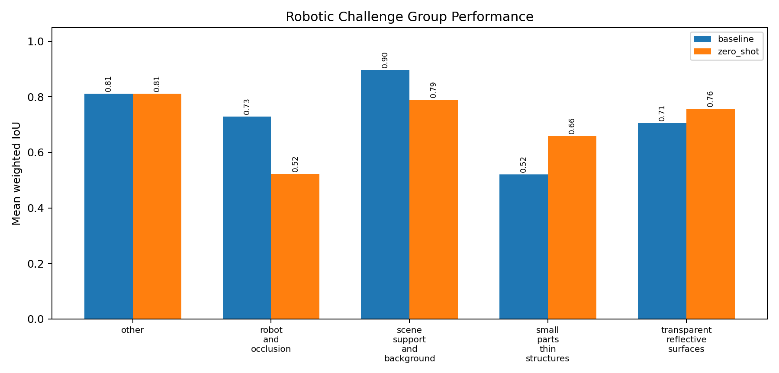
Challenge-Group Vulnerabilities
Average scores hide material-specific and embodiment-specific failures.
Transparent Objects
Weak/missing boundaries → unreliable grasp estimation
Reflective Surfaces
Highlight-edge confusion → false object edges
Small Parts
Missed regions → target disappears from system
Occlusion
Incomplete masks → unstable tracking
Dynamic Body
Self-scene confusion → robot body confused with target
The failure category can matter more than the average leaderboard rank. Per-condition evaluation reveals dangerous robotic failures hidden in average scores.
Challenge robustness
Project figure: challenge_group_weighted_iou.png

Slide 13
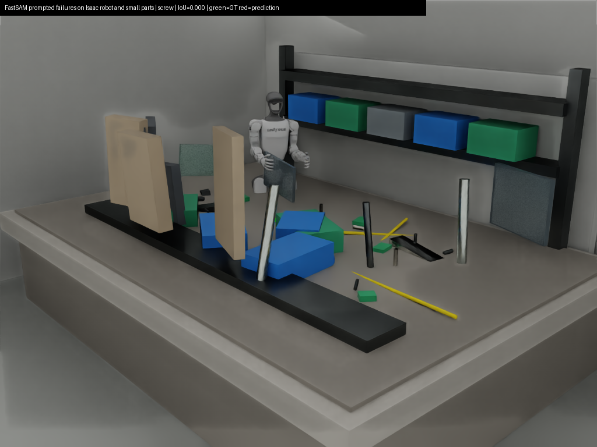
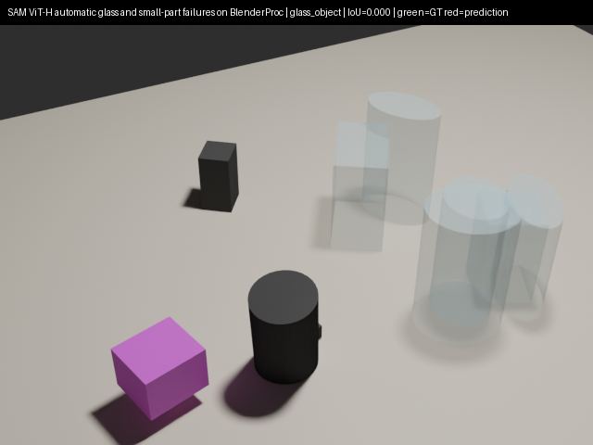

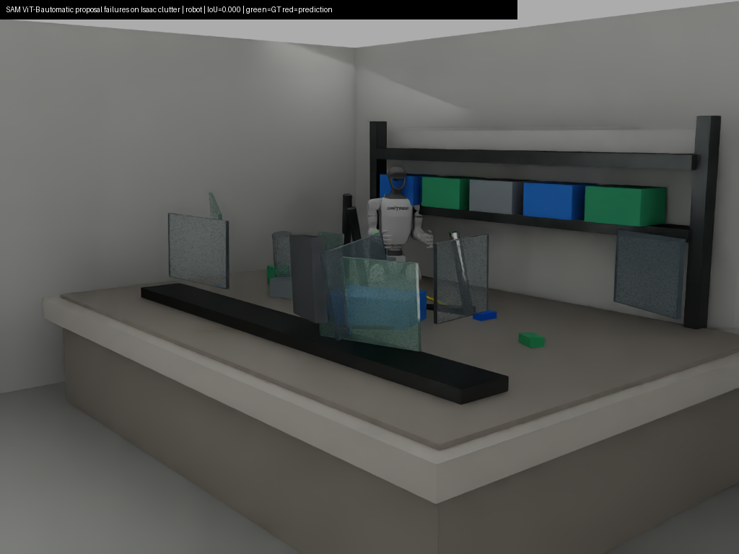
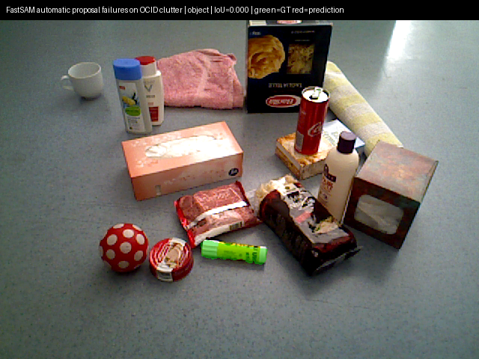

Failure Mode Analysis: Where Models Break
Qualitative failures explain the robotic risk behind the metrics.
MISSED TARGET
Small part failure
Failure: tiny screw / connector missed
Risk: target may disappear from object representation
WEAK BOUNDARY
Transparent object failure
Failure: weak boundary; background bleed
Risk: unreliable grasping or collision estimation
SELF-OBJECT MERGE
Robot-body interference
Failure: self-robot pixels merge with scene
Risk: robot confuses own body with targets
OBJECT MERGE
Real clutter and occlusion
Failure: nearby objects merge; incomplete masks
Risk: tracking, grasping, or counting failure
Small mask errors can become large robotic errors: missed grasps, unsafe motion, broken tracking, or incorrect object memory.
Notes:
This slide is especially important for the supervisor. Use it to connect visual failure modes to robotic consequences: grasping, collision avoidance, object tracking, and task reasoning.

Slide 14

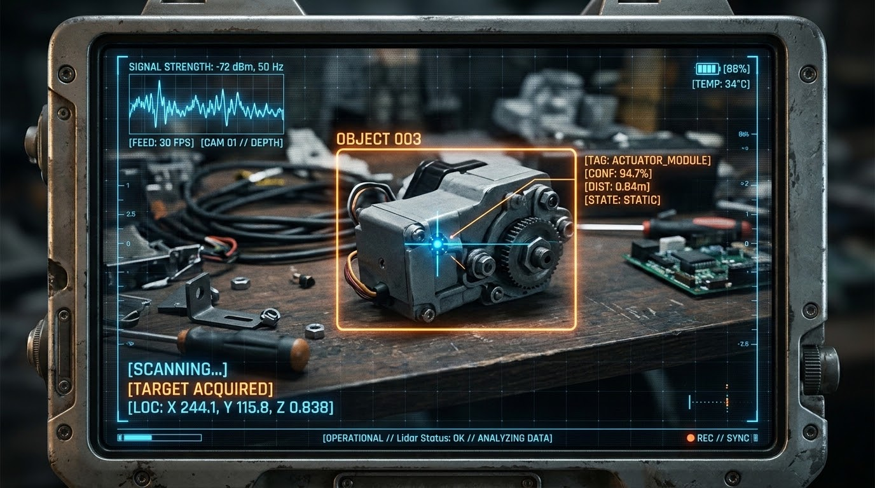
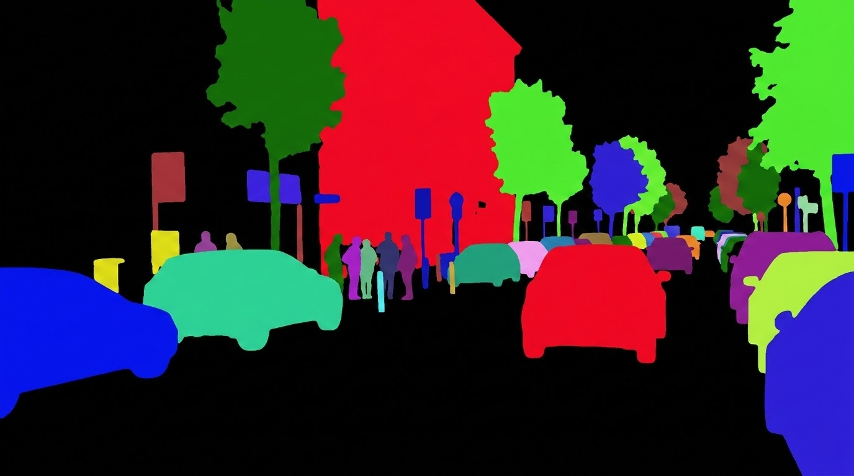
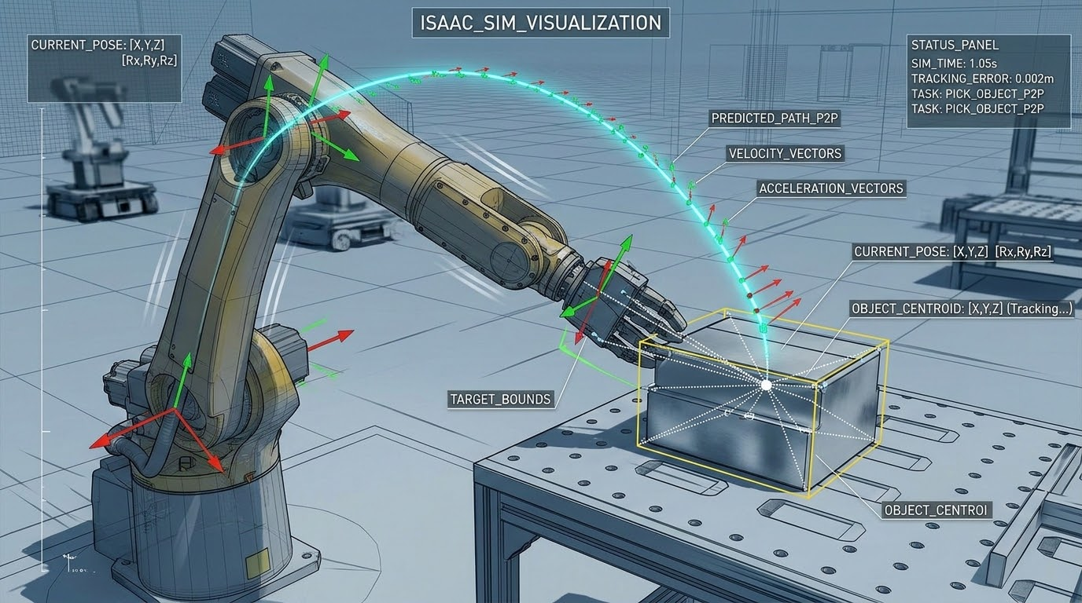
Cognitive Approach: Segmentation as a Perception Module
Segmentation links visual input, attention, object representation, and action selection.
Perception-to-action flow
Embodiment
Attention
Representation
Action Loop
Robot-centered scene
Point / box cue
Mask → object region
Grasp · track · navigate
COGAR link: Masks act as perceptual structures for attention, memory, object reasoning, and action selection.
Notes:
This slide makes the COGAR link explicit. Explain segmentation as a perception module inside an embodied cognitive architecture, not as an isolated computer vision task.

Slide 15
Conclusions & Model-Selection Blueprint
The best segmentation model depends on the robotic task, prompt availability, robustness requirement, and latency budget.
Robotic Scenario Recommended Direction Why It Works: Required Caution
Offline / High Mask Quality SAM / SAM2 (box prompts) Strongest mask fidelity Slow, needs reliable cue
Prompt-Guided Manipulation Box-prompted SAM models Strong target masksUpstream detector required
Real-Time GPU Perception YOLOv8-seg / DeepLabV3+ High FPS (with data) Weak zero-shot transfer
Edge Deployment MobileSAM / EfficientSAM Quality-speed balance Drops in clutter / small parts
Prompts are prerequisites
High performance often assumes an upstream cue.
Physics defeats averages
Transparent, reflective, and small objects remain difficult.
Speed is a constraint
Latency limits closed-loop perception and action.
Foundation segmentation is useful for robotic perception, but only when prompt source, failure checks, and latency constraints are designed into the perception-action loop.
Notes:
End with a balanced conclusion. Do not say SAM solves robotic perception. Say that foundation segmentation is a useful perception module when prompts, validation, deployment constraints, and failure checks are handled carefully.

Slide 16
Thank You for your attention.
COGNITIVE ARCHITECTURES FOR ROBOTICS
AmirMahdi Matin
5884715

