Slide 1
Mutable Vs. Immutable Infrastructure

Slide 2
What is infrastructure to begin with?
Definition: Infrastructure refers to the underlying physical and virtual resources required to support IT environments, including servers, storage, networking, and cloud resources.
Types of Infrastructure:
Physical (On-premises): Hardware-based systems managed on-site, offering full control and high customization, introduced to provide dedicated computing resources before cloud computing existed.
Virtualized: Abstracted resources through hypervisors or containers, allowing better resource utilization and scalability, introduced to reduce hardware dependency and improve flexibility.
Cloud (IaaS/PaaS): On-demand, scalable resources provided by cloud platforms like AWS, introduced to support global scalability, cost-efficiency, and automation through Infrastructure as Code (IaC).

Slide 3
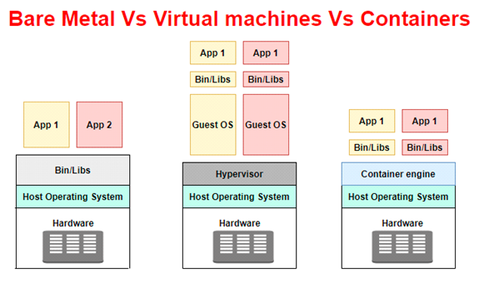

Slide 4
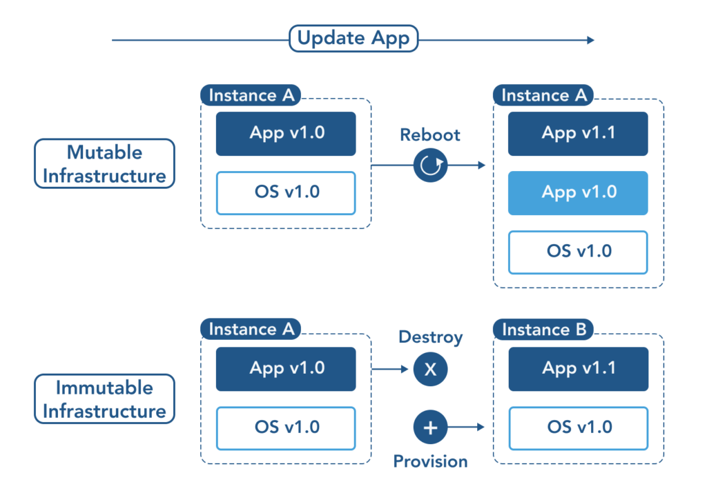

Slide 5
Pros & Cons of Immutable Infrastructure
Pros:
Consistency & Reliability: Systems are always in a known state; no configuration drift.
Simpler Rollbacks: To update or rollback, just deploy a new instance.
Improved Security: Immutable systems are less prone to configuration drift, reducing vulnerabilities.
Cons:
More Resources: Every update requires spinning up new instances, which can consume more resources.
Less Flexibility: Not ideal for environments where rapid, ad-hoc changes are needed.

Slide 6
Pros & Cons of Mutable Infrastructure
Pros:
Flexibility: Allows for in-place changes or hotfixes without needing to redeploy.
Resource Efficiency: Can update and patch live systems without starting from scratch.
Cons:
Configuration Drift: Changes made over time can lead to inconsistencies between environments.
Complexity: Managing updates and tracking configurations can become cumbersome over time.
Why Both Are Still Used:
Immutable is favored in cloud-native environments and DevOps pipelines, where consistency and automation are key.
Mutable is still used for legacy systems, quick fixes, or environments where in-place updates are preferred.

Slide 7
Immutable vs mutable Infrastructure in Today’s World
Immutable Infrastructure:
Used in cloud-native environments, microservices, and CI/CD pipelines.
Adopted by platform engineers who value consistency and frequent deployments.
Typical use case: Containerized applications where entire containers or VM images are deployed in place of patching.
Mutable Infrastructure:
Still commonly used in legacy systems, bare-metal servers, or environments that require rapid hotfixes.
Chosen when organizations need in-place updates and patches.
Typical use case: On-premises systems that are costly or difficult to replace frequently.

Slide 8
Tools & Technologies
Immutable Infrastructure:
Terraform & Pulumi: Infrastructure as Code (IaC) tools for declaratively managing infrastructure.
Docker & Kubernetes: Used to deploy immutable containers and orchestrate services.
Packer: For creating immutable machine images for cloud platforms or virtualization environments.
Mutable Infrastructure:
Ansible, Puppet, Chef: Configuration management tools used to update and patch existing infrastructure in-place.
SSH + Scripts: Traditional methods of manually logging into servers and applying updates.
KubeSpray : in-place modifications and updates for on-premises k8s clusters.

