Slide 1
Imperative Vs. declarative Approach

Slide 2
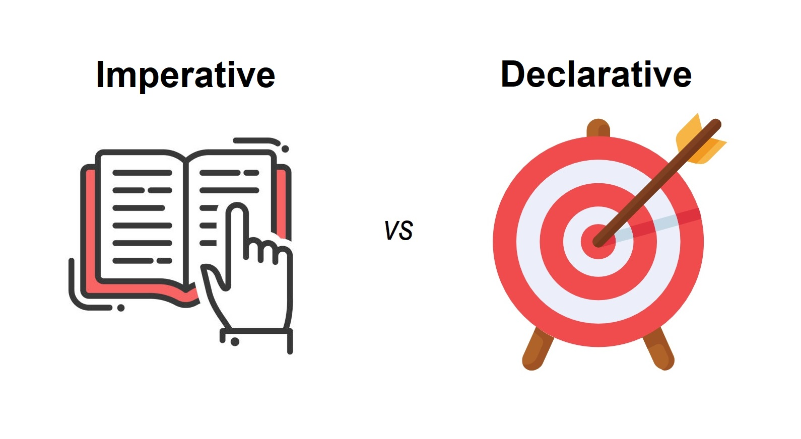
One-liner Introduction
in imperative you're dictating instructions, and in declarative the system knows enough to figure out instructions on its own

Slide 3
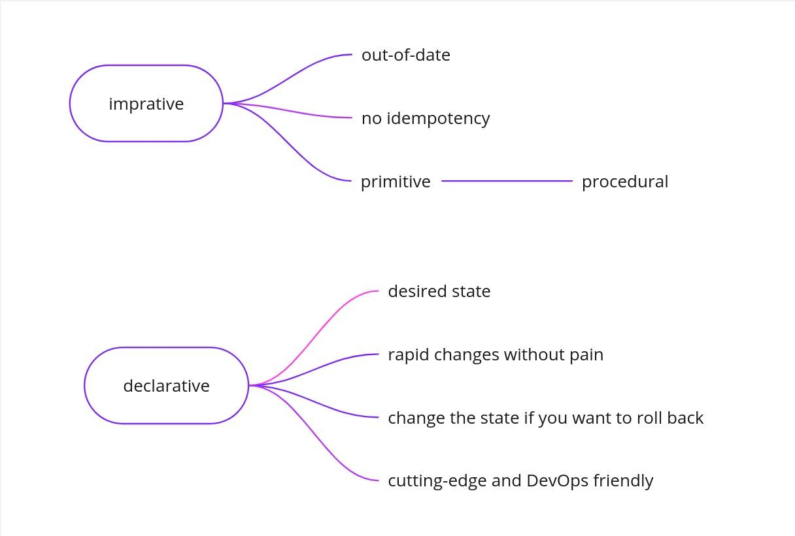

Slide 4
Tools That Can Be Used in Both Imperative and Declarative Ways
Docker
Imperative: docker run -d -p 80:80 nginx
Declarative: Dockerfile
Ansible
Imperative: ansible all -m apt -a "name=nginx state=present" -b
Declarative: Writing playbooks to ensure a desired state is met.
Kubernetes
Imperative: kubectl run nginx --image=nginx --replicas=3
Declarative: Using manifests (.yaml) files to define the desired state of the cluster.

Slide 5
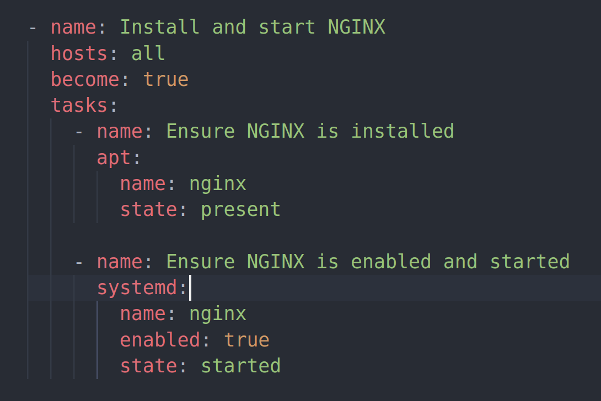
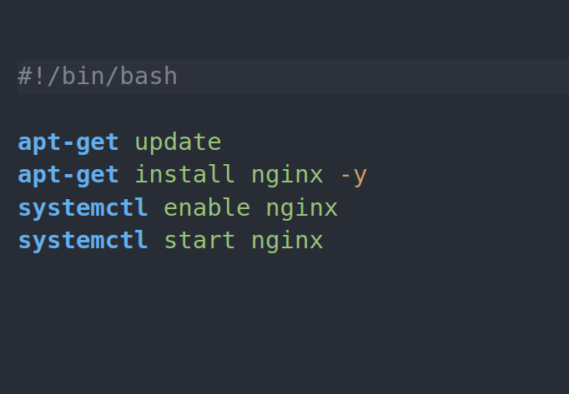
Bash script Vs Ansible playbook

