Slide 1
What is Ansible?

Slide 2
One-liner Introduction
Ansible is written in Python and uses YAML to make it easy to learn and use. It works by connecting to nodes and pushing out small programs called modules, which are then executed and removed when finished.
Ansible’s main strengths are simplicity and ease of use. It also has a strong focus on security and reliability, featuring minimal moving parts. It uses OpenSSH for transport (with other transports and pull modes as alternatives), and can be installed on most operating systems with Python installed.

Slide 3
What it’s used for
Configuration management
Application deployment
Provisioning
Network automation
Patching systems
Improving security and compliance

Slide 4
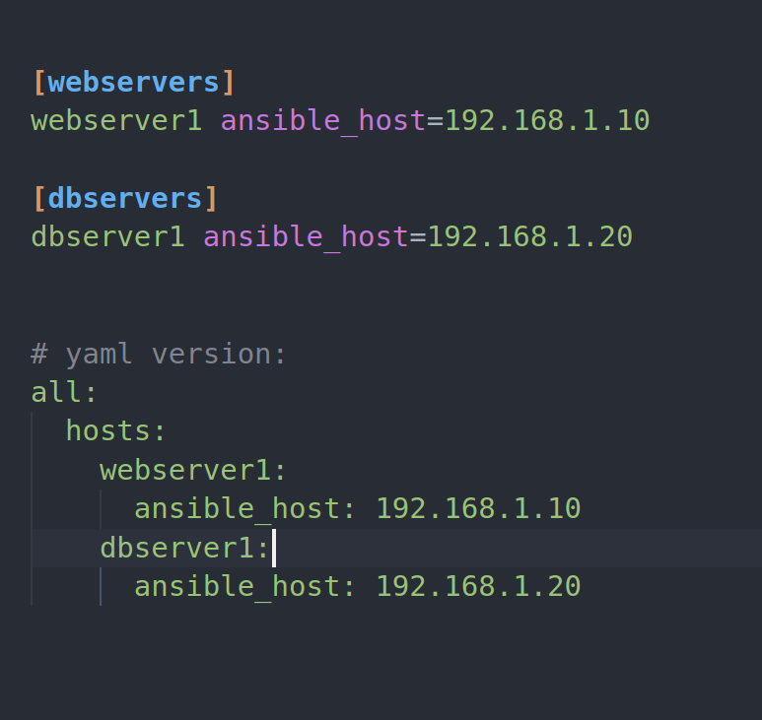
What inventories look like

Slide 5
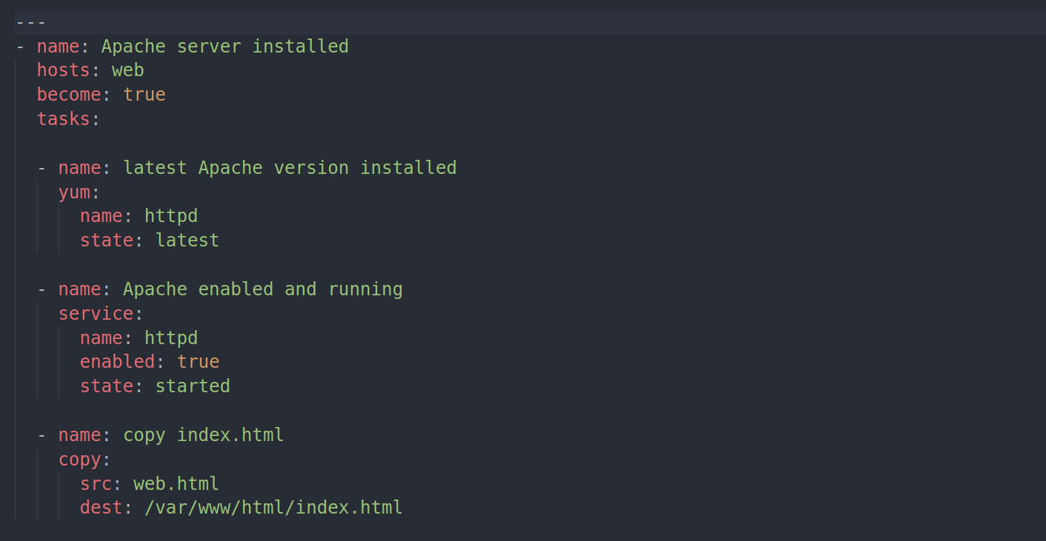
Sample Ansible playbook

