Slide 1
Ansible Vs. Terraform
The differences between CM & IaC

Slide 2
What they are used for
Terraform (IaC):
Provisioning
Creating, Destroying or Updating Resources (Vms, LB, Network)
Cloud
Immutable infra
Ansible (CM):
Configuring Already provisioned servers and services
On-premises
Mutable infra

Slide 3
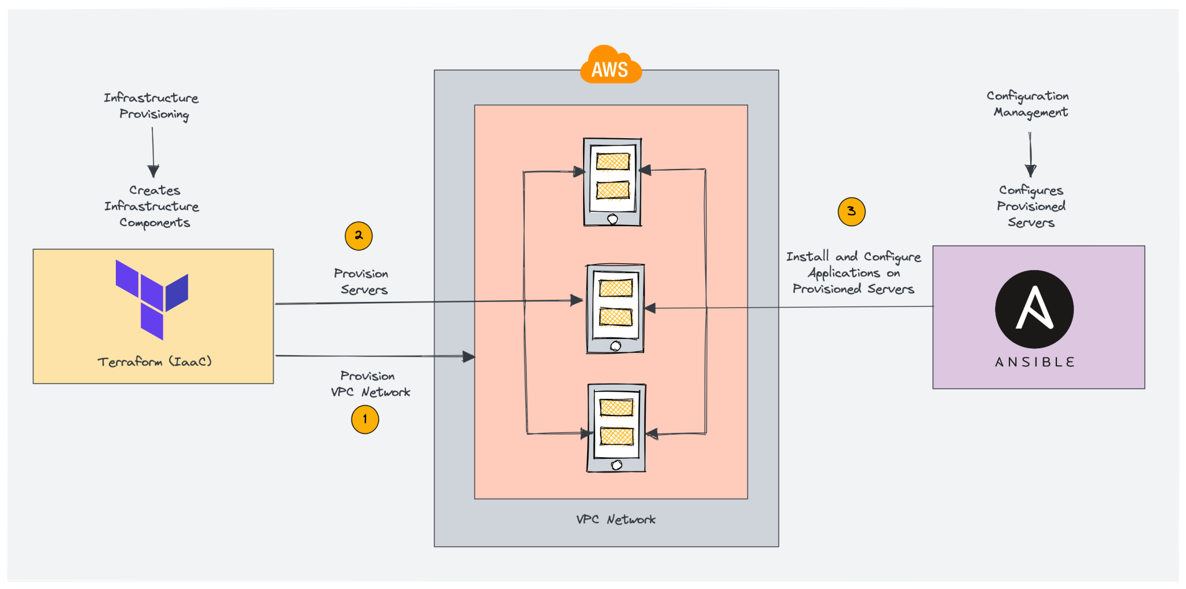
The IaC Workflow

Slide 4
State Management :
Ansible (Stateless):
Does not track past states
Ensures idempotency: applies desired configuration without worrying about previous state
Terraform (Stateful):
Maintains a state file to track the current infrastructure
Compares current and desired states for accurate updates
Uses state for resource reconciliation

Slide 5
Execution and Protocols :
Ansible:
- Push-based execution through SSH & API
- Manages systems via playbooks and explicit task orchestration
Terraform:
- Pull-based: reads current infrastructure state from provider APIs
- Manages resources through declarative code and an implicit resource graph

Slide 6
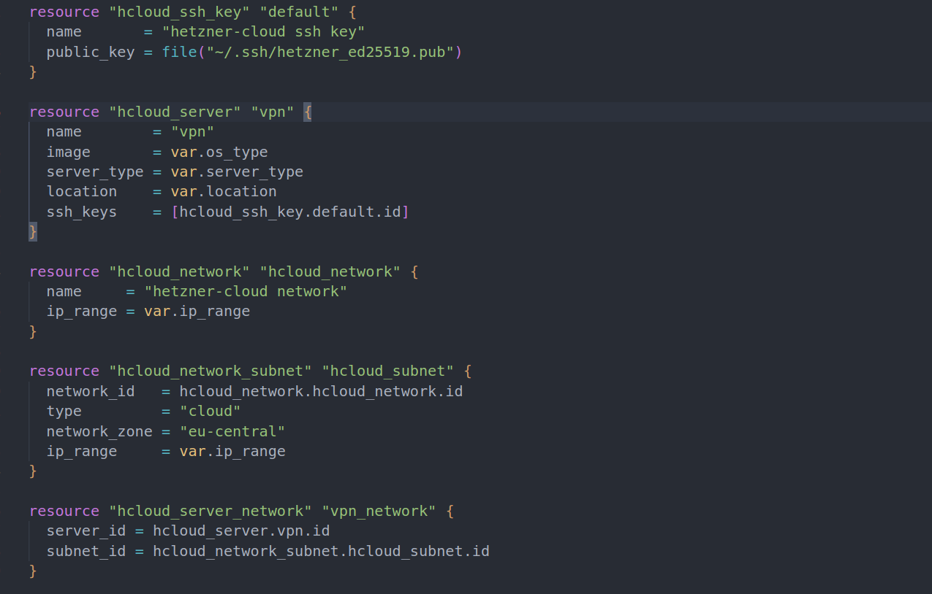
1. Create a VM with Terraform

Slide 7
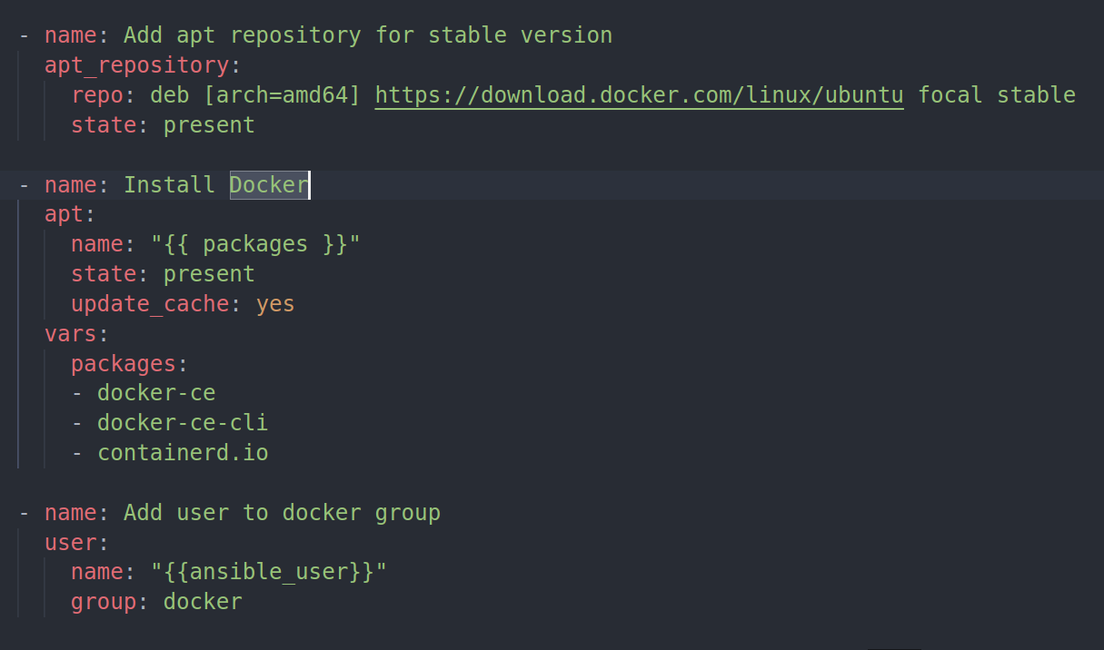
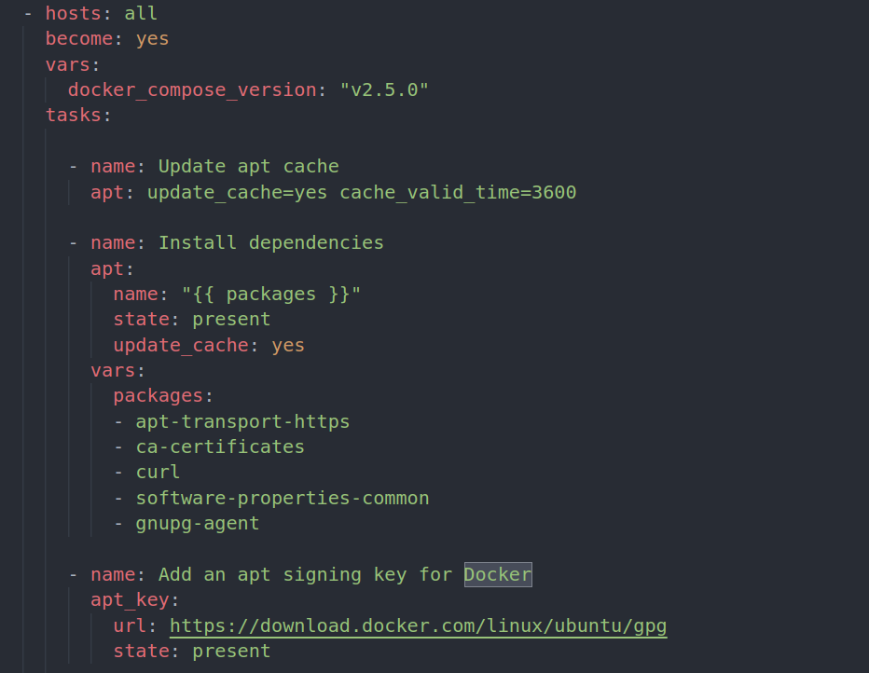
2. Install Docker with Ansible

Slide 8
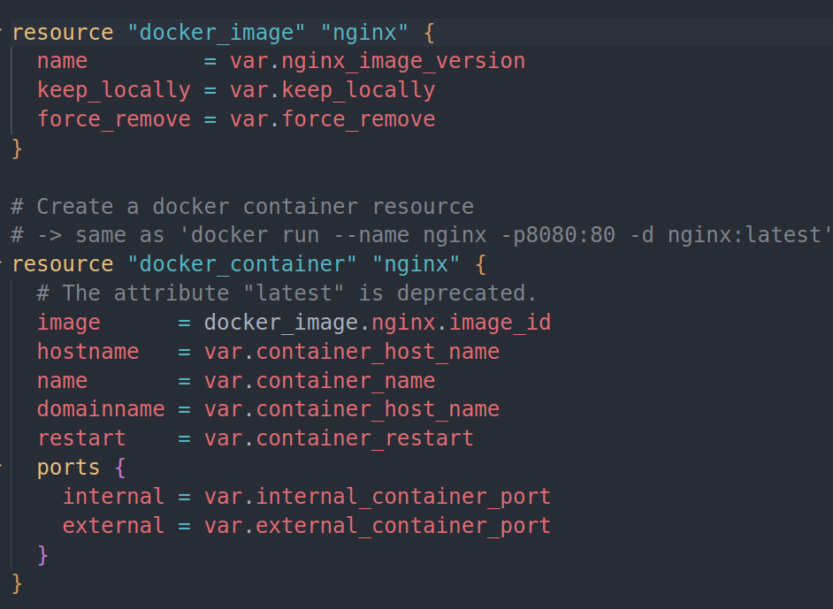
3. Run Docker Containers with Terraform

