Slide 1
Push vs. Pull Methods
Exploring different tools in IaC

Slide 2
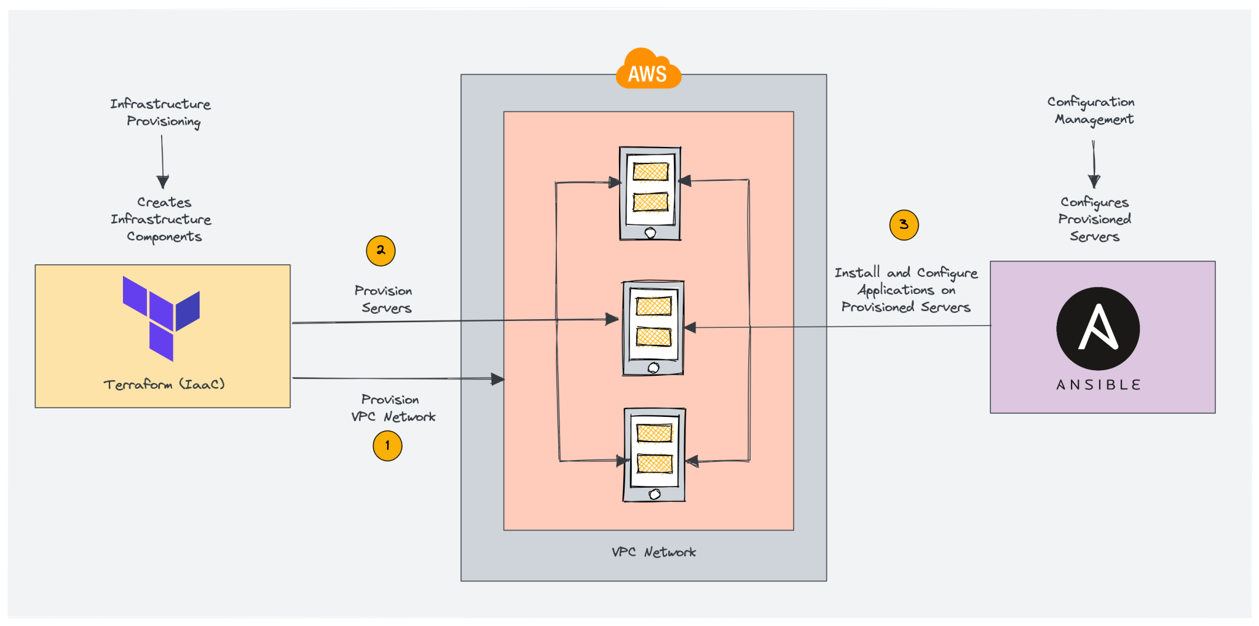
Infrastructure as code Workflow

Slide 3
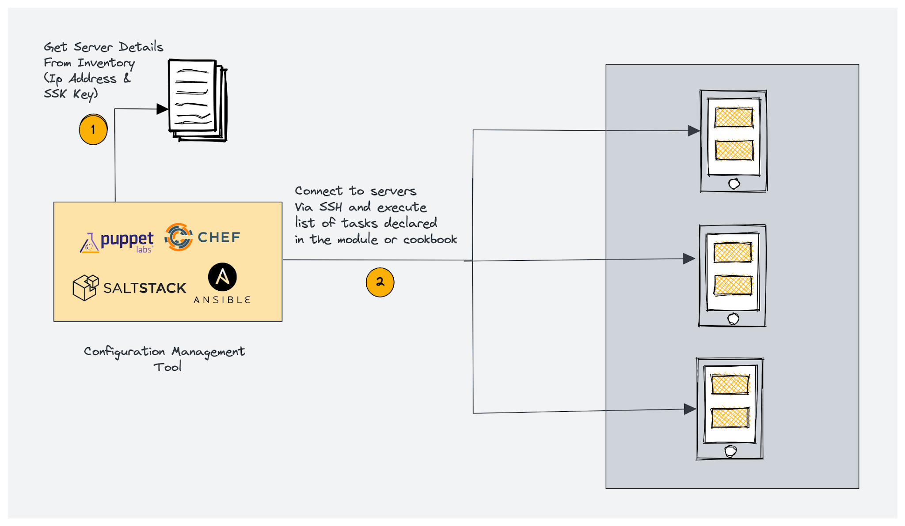
Configuration Management tools workflow

Slide 4
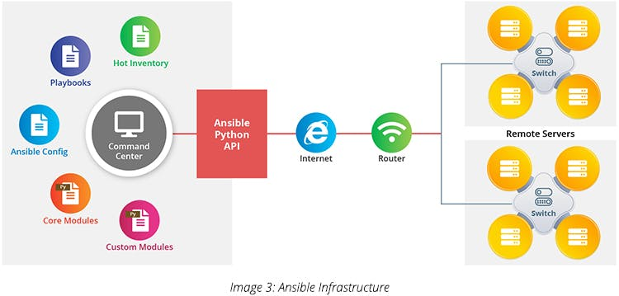
Ansible (2012):

Slide 5
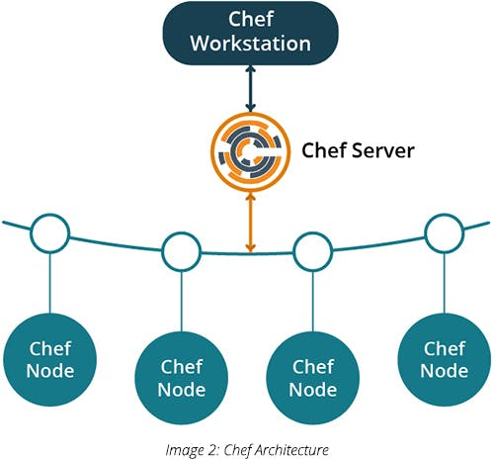
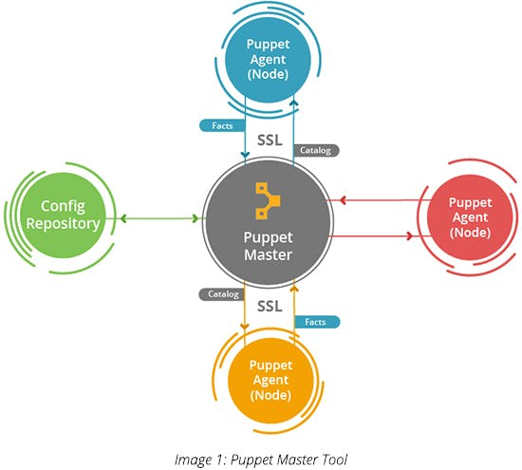
Puppet (2005) and Chef (2008):

Slide 6
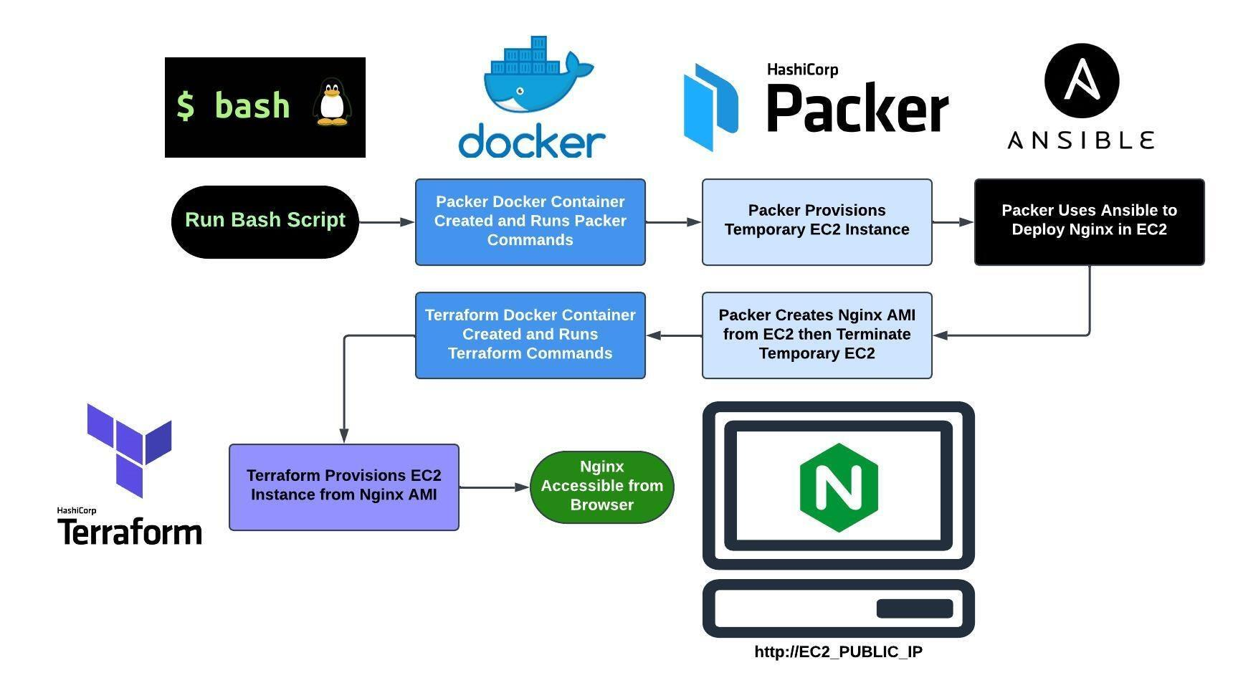
Packer (2013)

Slide 7
Manual Drift!
Somebody changes the configuration manually out of nowhere and you end up with a drift !
Cons of Push Method
No inherent state validation (risk of drift).
Difficulties in scaling to large environments.
Pros of Pull Method
Self-healing (clients pull desired state).
Better suited for large-scale environments.
State validation ensures compliance and consistency.

