Slide 1
Testing

Slide 2
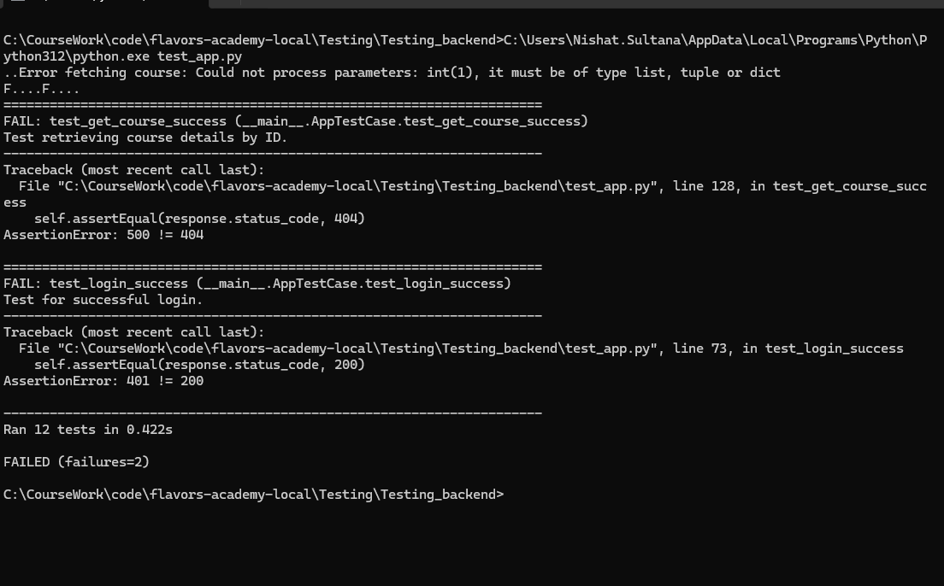
Backend testing

Slide 3
Backend testing results explanation
Here’s an explanation of the two test failures you encountered:1. Failure in test_get_course_successError Message: AssertionError: 500 != 404Test Purpose: This test is intended to check that the application returns a 404 status code when a course with the specified ID is not found.Cause of Failure: The actual response status code is 500, indicating a server error rather than a 404, which is typically a "not found" error. This suggests that there might be an issue in the backend logic, such as a missing parameter, database issue, or unhandled exception when querying for the course ID.Resolution: Check the endpoint logic for /api/courses/1 in app.py to ensure it handles cases where the course ID does not exist. You may need to add proper exception handling and return a 404 if the course is not found.2. Failure in test_login_successError Message: AssertionError: 401 != 200Test Purpose: This test aims to verify that the application returns a 200 status code for a successful login when valid credentials are provided.Cause of Failure: The response code returned is 401, indicating "Unauthorized," which usually means the credentials provided for login are incorrect or that the user account has not been set up correctly in the database.Resolution: Ensure that the test setup includes valid login credentials for student@example.com or confirm that the signup for this user is successful and persists in the database. Additionally, verify that the login endpoint correctly authenticates the user.These failures generally indicate issues with either backend handling or test data setup. Checking and updating the database and endpoint logic to handle these cases will help resolve these errors.

