Slide 1
Data driven

Slide 2
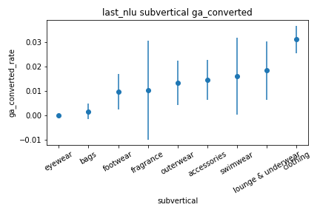
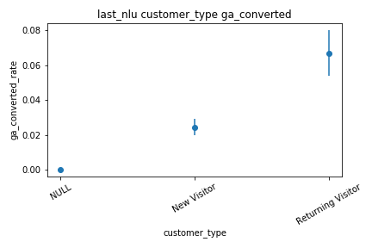
NLU breakdown
Data info
Dates : 01/07/19-10/9/19
Retailer: 429
Volume: 30K rows

Slide 3
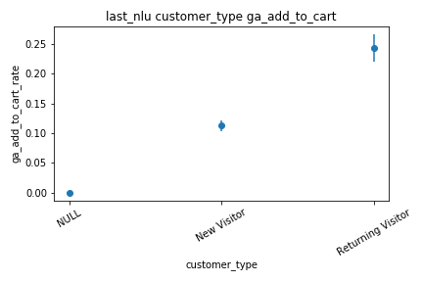
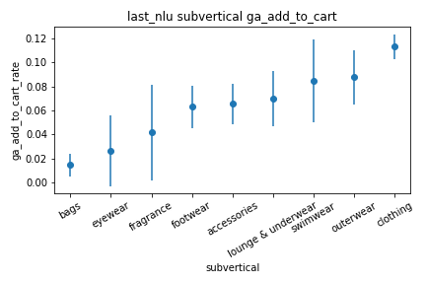
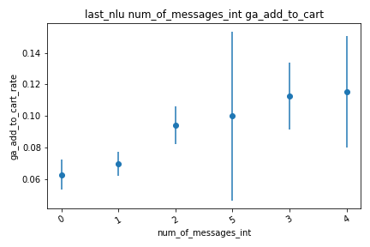
Main insights derived from these plots:
Direction of impact are as expected.
Convs with two msg’s and above
have a significant higher chance of adding to cart

Slide 4
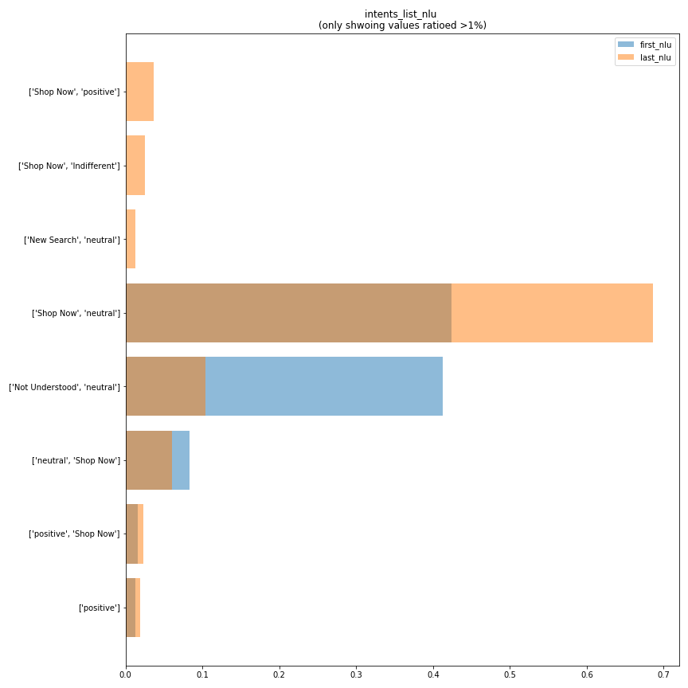
Data info
Dates : 01/07/19-10/9/19
Retailer: 429
Volume: 10K rows
*(only convs with 2+ msg’s)
These plots can be useful for:
A measure of performance.
For instance we want less conv’s to end in miss understood
Let’s us see how do conversations start and how do they end
in regard to our nlu understanding

Slide 5
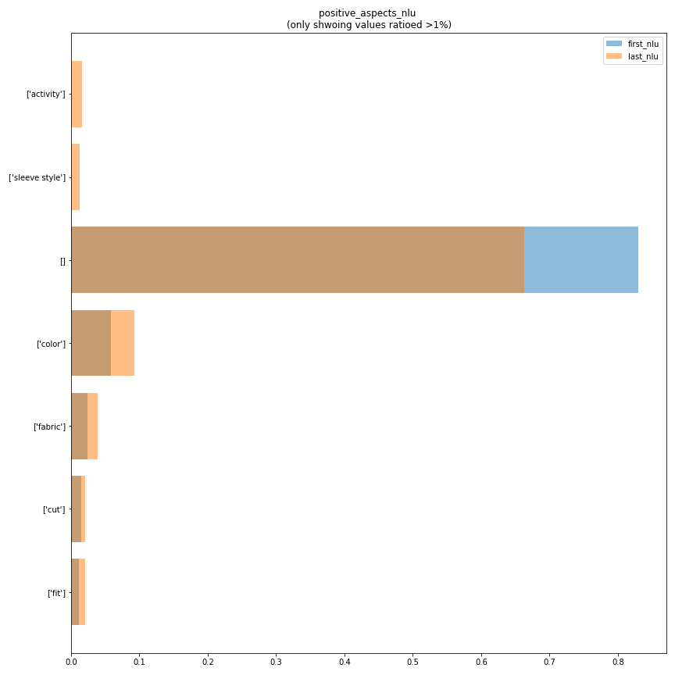
Here we can see that no users start by asking for sleeve.
This is for op but same goes for us polo.
Full op report task
Full us polo report task

Slide 6
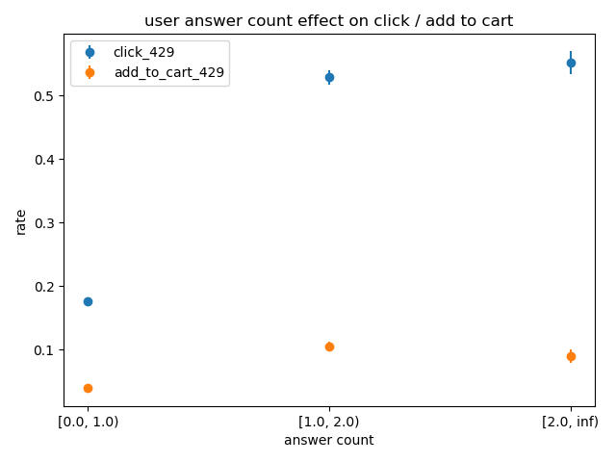
Question - answer
Data info
Dates : 01/07/19-10/9/19
Retailer: 429
Volume: 321K rows 70k convs
*(only convs with 2+ msg’s)

Slide 7
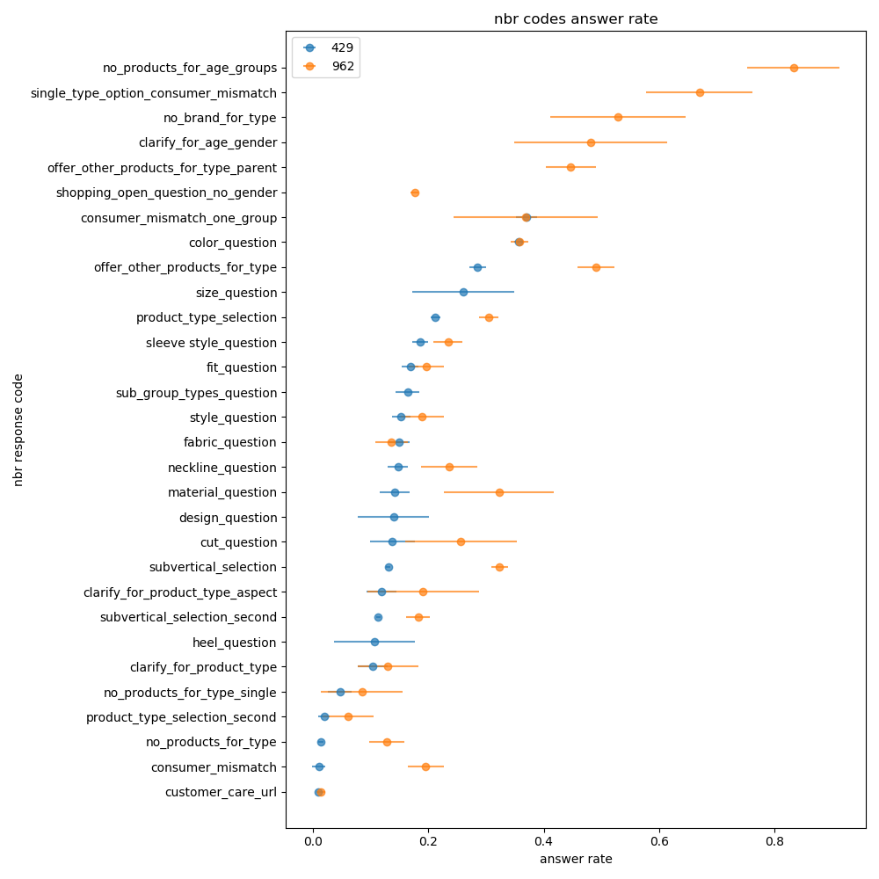
Poorly answered in depth (down > top):
Cc : frustration, not understood, sub1 > sub2 > cc
Cm: uspolo –equals to gender
op– asks for woman, gets boys/men
Npt: short convs.
I believe this visualization should be constantly monitored in
the dashboard.
Letting product detect under performing questions or changes early on.
I think that currently the dashboard search dosent support question code. Letting product have an overview on question performance, and the ability to search for conversations that include the question and filter by answer, would be powerful.

Slide 8
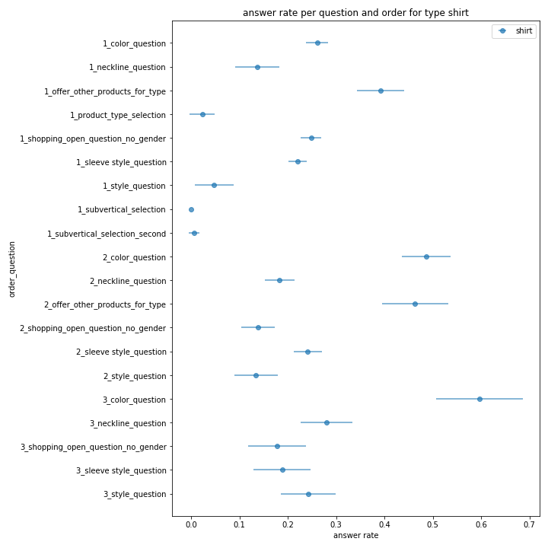
Is “offer_other” better then “sleeve_style” as first question for shirt? No, because these conv’s starting points are different.
We would like set the ordering of questions as a distribution allowing us to dynamically change the order towards the optimum (because we believe the preferences change like weather or user pool).

Slide 9
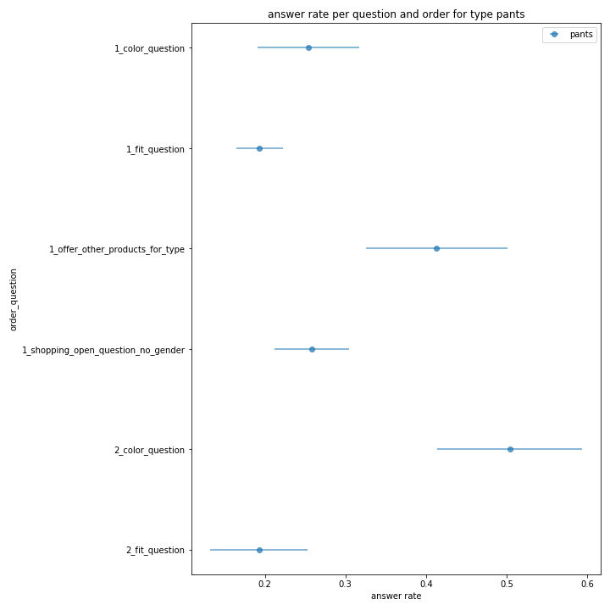

Slide 10
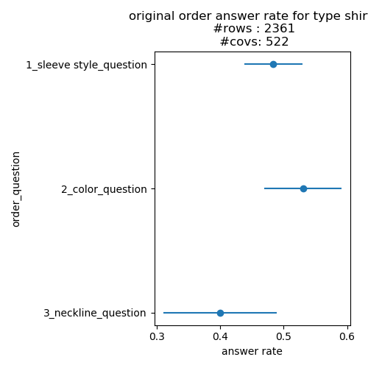
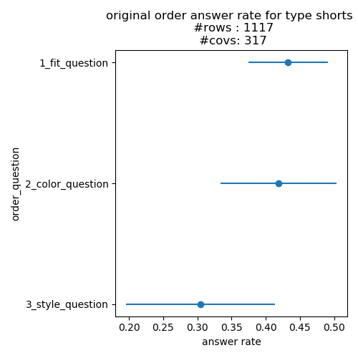
Original order

Slide 11
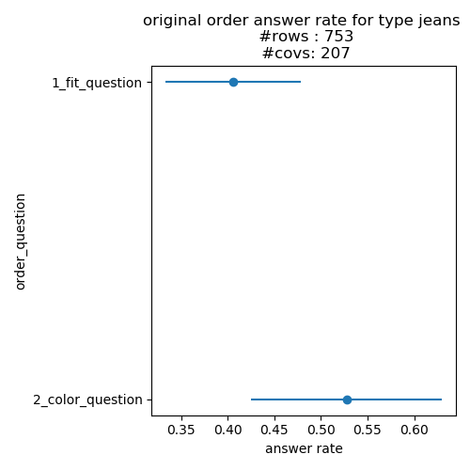
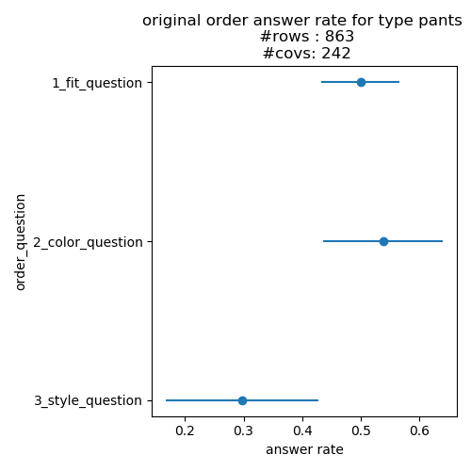

Slide 12
Takeaway points
We must measure and monitor answer rate per question in the db and dashboard. AR will be relevant in all verticals (groceries and fashion), and it will be our way to measure features impact.
Our biggest asset is data. Labeled data. A question answered, and product clicked, are positive user generated labels.
Feature toggle. The more we can mark early on (specific features used, specific set of default question asked) in db the easier research and analysis will be.
Response distribution instead of static.

