Slide 1
Dress Codes auto rules generation

Slide 2
Objective
We want to create interpretable rules that map product to dress codes.
can be used for queries, be humanly readable
However, most DS/ML/AI models are either black boxes and/or not easily interpretable contains numerical parameters that do not look like “natural language” rules.
Some models however, like Association Rules And decision Trees do have interpretability and were therefore examined.

Slide 3
Examples of rules
example of good rule:
if shirt is red and fabric is silk then dress code is dressy casual.
Example of less interpretable code:
If 0.8 * I(color = red) + 0.1 * I (fabric = silk) > 0.75 then dressy casual

Slide 4
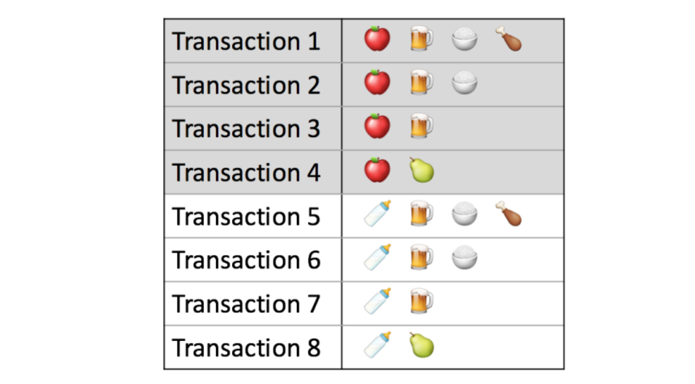
Association Rules/Market basket Analysis
Association rules analysis is a technique to uncover how items are associated to each other.
¾ when you buy an apple you buy
A beer also
Apple → beer with confidence 0.75

Slide 5
Association Rules/Market basket Analysis
In our case aspects and dress codes of a product are like items
In a basket.
Product 1 : t- shirt, color white, casual
Product 2 : t-shirt ,color pattern, v neck, casual
Product 3 : button down shirt, color white, business formal
Rule : t-shirt-→ casual with 100% confidence.

Slide 6
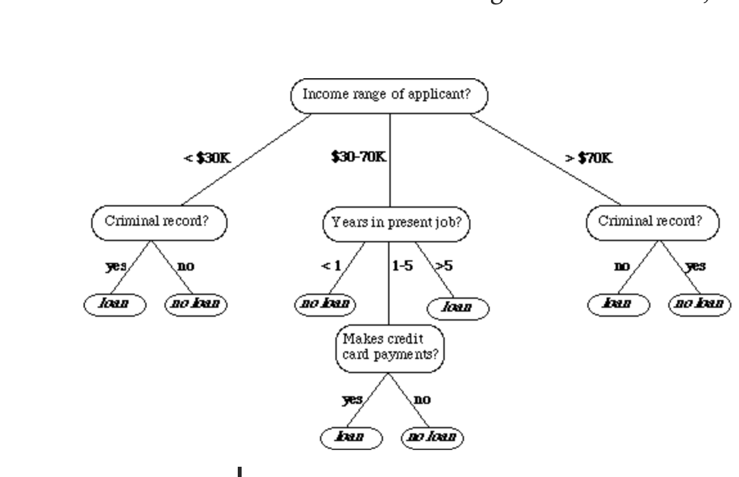
Decision Tree For loan/not loan
Rule Extracted: if income range is bellow 30K and no criminal record. → give loan

Slide 7
Decision Rules pipeline
Pre-process: Create dataset from retailer products aspects and tag them by dress_code
Run decision tree and extract rules per gender,parent_type,dress_code
Post process : Generate readable rules from decision tree output

Slide 8
Touy Example - Casual Dress codes Dataset for shirts.
Create data from product aspects
T-shirt | button down shirt | color white | color red | color pattern | dress code
1 | 0 | 1 | 0 | 0 | (1) casual
1 | 0 | 0 | 1 | 0 | (1) casual
0 | 1 | 0 | 0 | 1 | (1) casual
0 | 1 | 1 | 0 | 0 | (0) business formal

Slide 9
Generate Decision Tree Model
t-shirt
yes
no
casual
Button down shirt
Color red
color pattern
casual
Business formal
Dressy casual

Slide 10
Extract Rules From Tree
Rule 1: if t-shirt then casual
t-shirt
yes
no
casual
Button down shirt
Color red
pattern
casual
Business formal
Dressy casual

Slide 11
Association rules vs Decision Tree
Association Rules
Pros: Association rules don’t need fixed length
Cons :Much Harder to tune . May crerate hundreds rules or none.
Tree
Need additional pre processing, must be of fixed length (# columns),
More Robust, no need to tune per product.
Decision was made to use tree for rules + general stats.

Slide 12
Decision Tree Rules Results
Retailer | Type | Dress code | No automation | Type/aspect combo automation aspects | With full positive type automation aspects | Diff rules | Diff stats
pei | pants | casual | 636 | 636 | 641 | 0 | 5
 |  | dressy casual | 629 | 629 | 629 | 0 | 0
 |  | business formal | 31 | 31 | 529 | 0 | 498
 |  | active | 2 |  | 38 | no data | 36
 |  | creative black tie | 36 | 36 | 593 | 0 | 557
 |  | cocktail | 35 | 35 | 35 | 0 | 0
 |  | business casual | 35 | 35 | 592 | 0 | 557
 |  | black tie | 0 |  | 0 | no data | 0
 |  | white tie | 0 |  | 0 | no data | 0
 |  | festive | 35 | 35 | 35 | 0 | 0
 |  | beach | 5 | 5 | 598 | 0 | 593
* Rules don’t help
* Stats based upon gender and product types seem to help

Slide 13
Stats Results

Slide 14
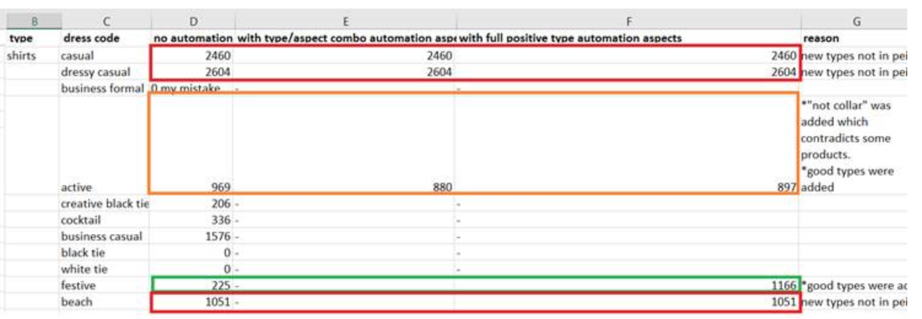
Results
In red – tools didn’t make any change.
In Orange – tool did an minor change.
In Green – tool did a major change.
Full positive type tool –
Around 23 types were found in her research and were missing from the tool.
Out of 32 good types the tool has provided, only 19 were new (weren’t found in her initial manual research).
Combos Tool (decision tree) –10% was new data she could use.

Slide 15
Discussion
Expand dataset to rows that includes occasions but not dress codes from product that contains 1-1 mapping from occasions to dress codes. Currently festive occasions which do not have dress codes will be added to the dataset.
Stats file (Edited by Yarden) red not good, yellow too general. Also percentages are checked to see if their proportion makes sense.
Rules Doseem to help.

Slide 16
Next steps
Picking more significant aspects
Finding better methods than stats
Extending festive group

