Slide 1
Q1

Slide 2
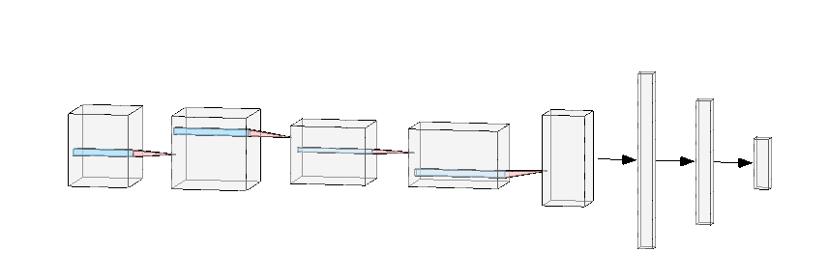
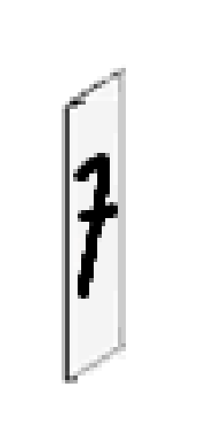
Linear
Input image
Conv Layer
Conv Layer
Max Pool
Conv Layer
Max Pool
Linear
Output Layer
[1x28x28]
In channels: 1
Out channels: 16
Kernel: 3x3
Padding: 1
In channels: 16
Out channels: 32
Kernel: 3x3
Padding: 1
Kernel: 2x2
Stride: 2
In channels: 32
Out channels: 64
Kernel: 3x3
Padding: 1
[1x10]
Kernel: 2x2
Stride: 2
In features: 300
Out features : 10
+ ReLu
+ ReLu
+ ReLu
In features: 3136
Out features : 300
+ SoftMax
Output:
[16x28x28]
Output:
[32x28x28]
Output:
[32x14x14]
Output:
[64x28x28]
+ ReLu
Output:
[64x7x7]
Output:
[1x300]
Output:
[1x10]
* Sizes written in Pytorch format

Slide 3
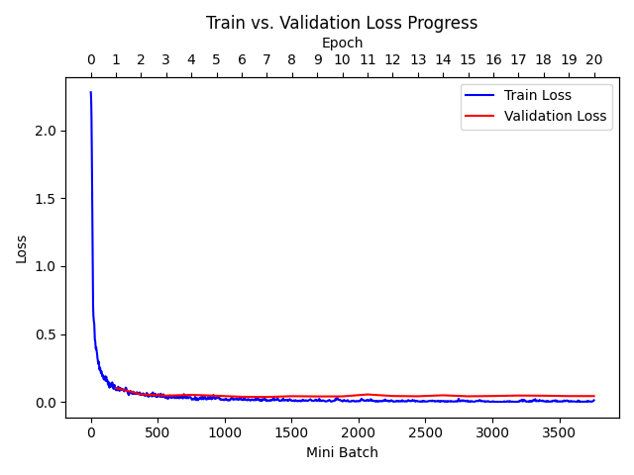
q1

Slide 4
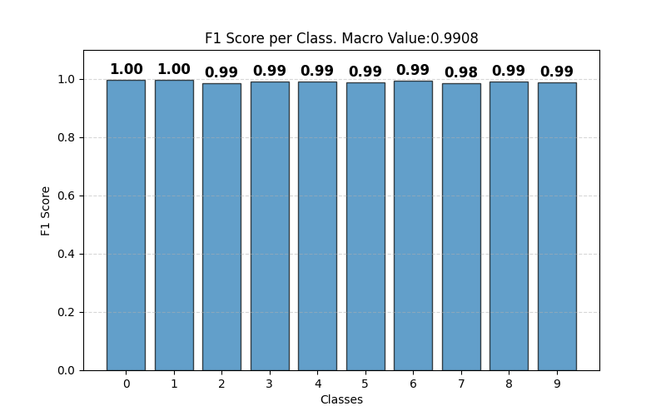
q1

Slide 5
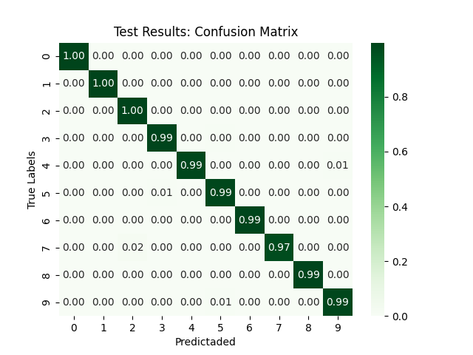
q1

Slide 6
Q2

Slide 7
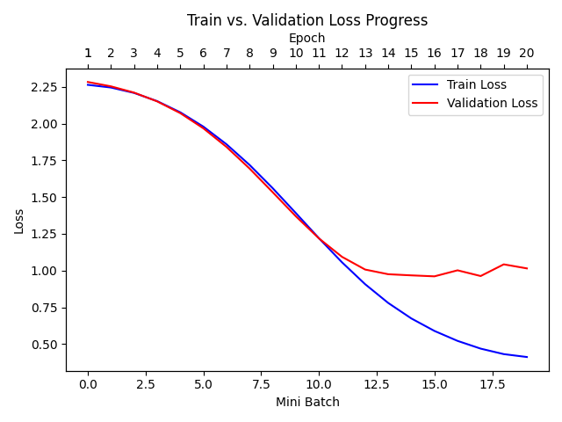
q2

Slide 8
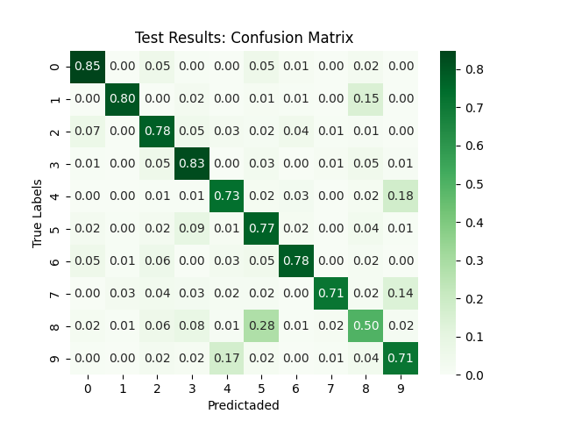
q2

Slide 9
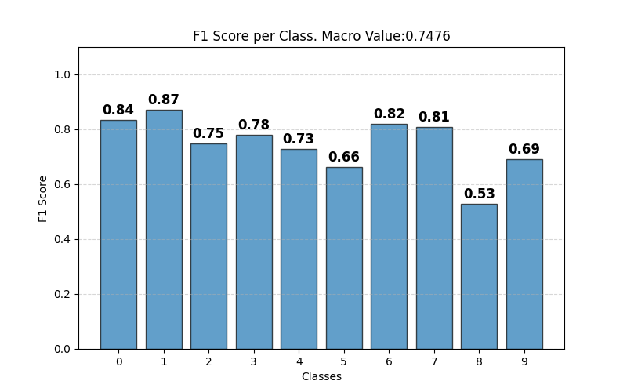
q2

Slide 10
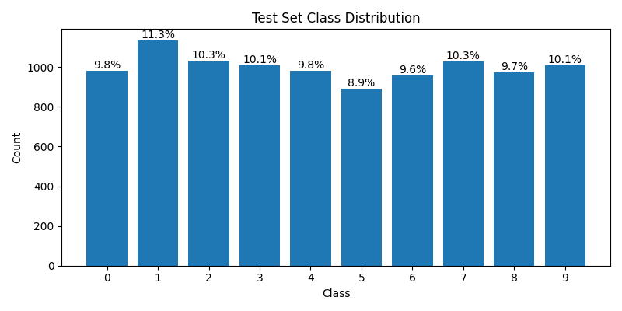
q2

Slide 11
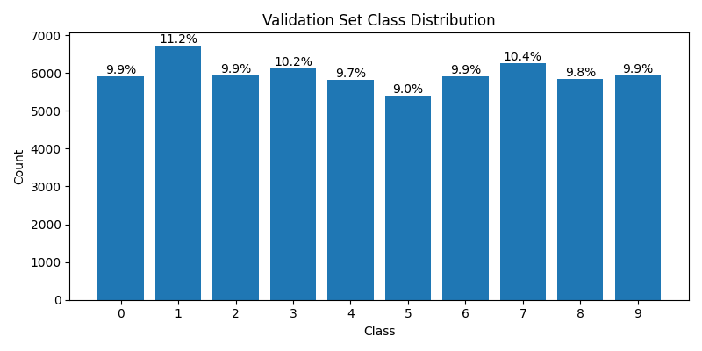
q2

Slide 12
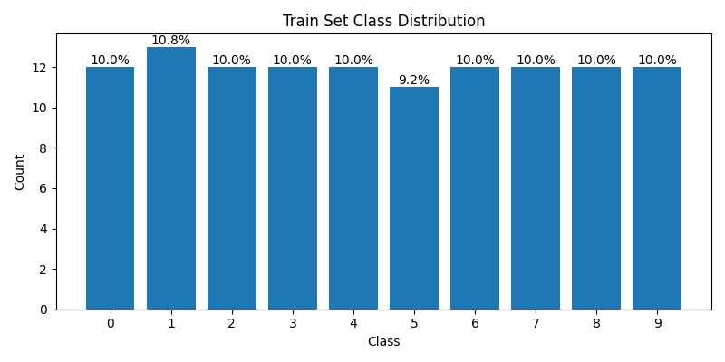
q2

Slide 13
Q3

Slide 14
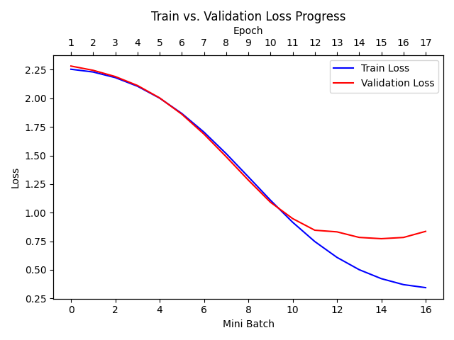
Q3-EARLY STOP
Best Model

Slide 15
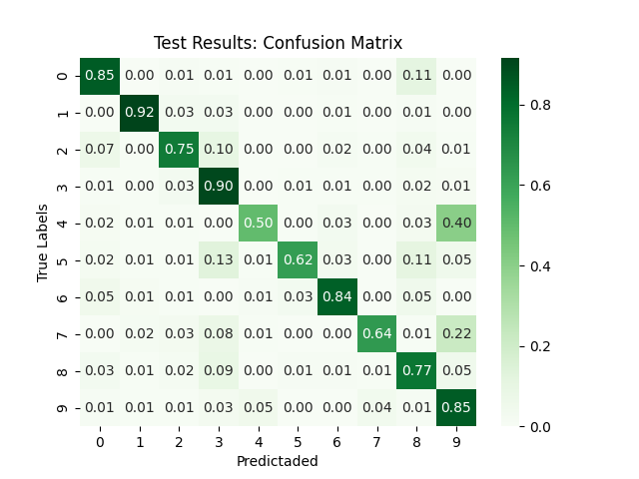
Q3-EARLY STOP

Slide 16
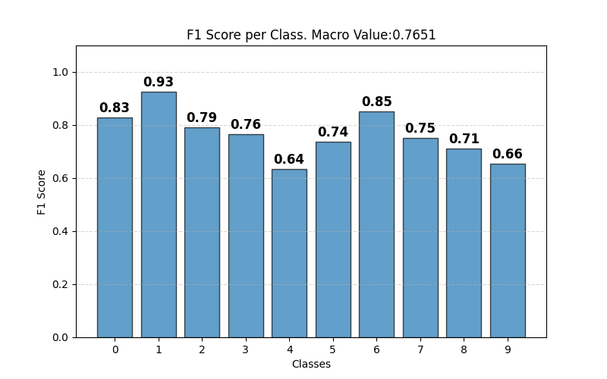
Q3-EARLY STOP

Slide 17
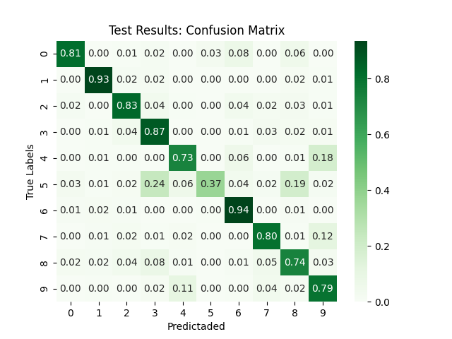
Q3-dropout

Slide 18
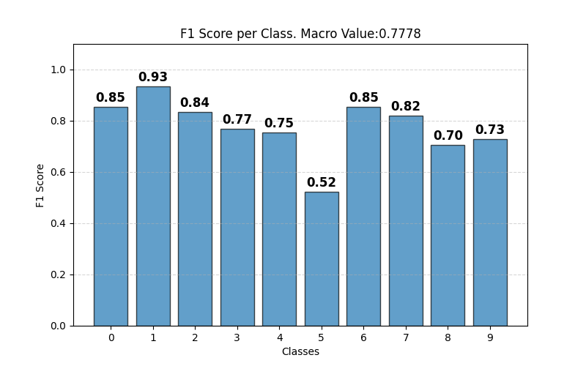
Q3-dropout

Slide 19
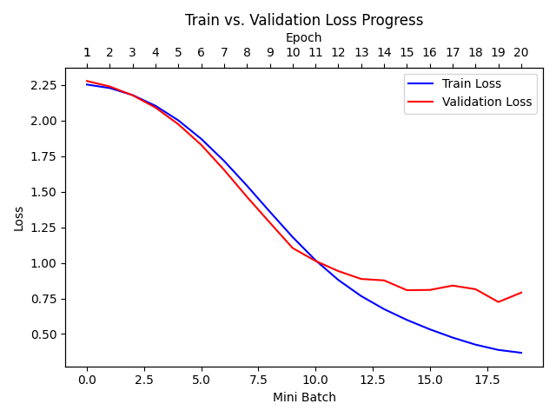
Q3-dropout

Slide 20
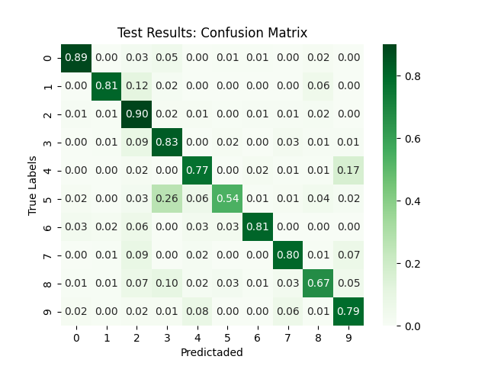
Q3-l2 1e-4

Slide 21
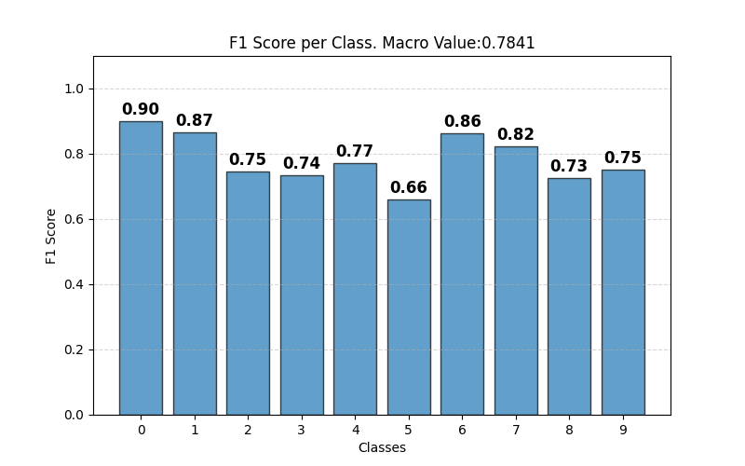
Q3-l2 1e-4

Slide 22
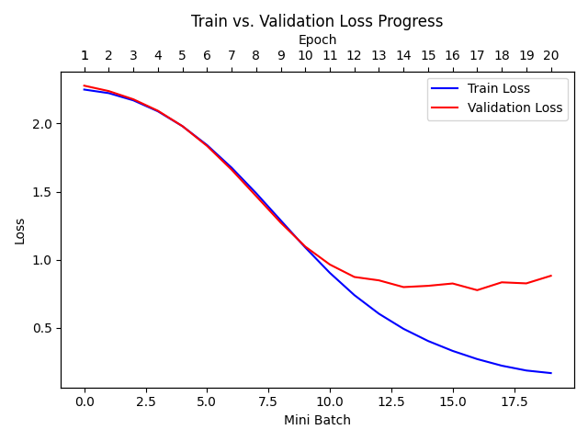
Q3-l2 1e-4

Slide 23
Q4

Slide 24
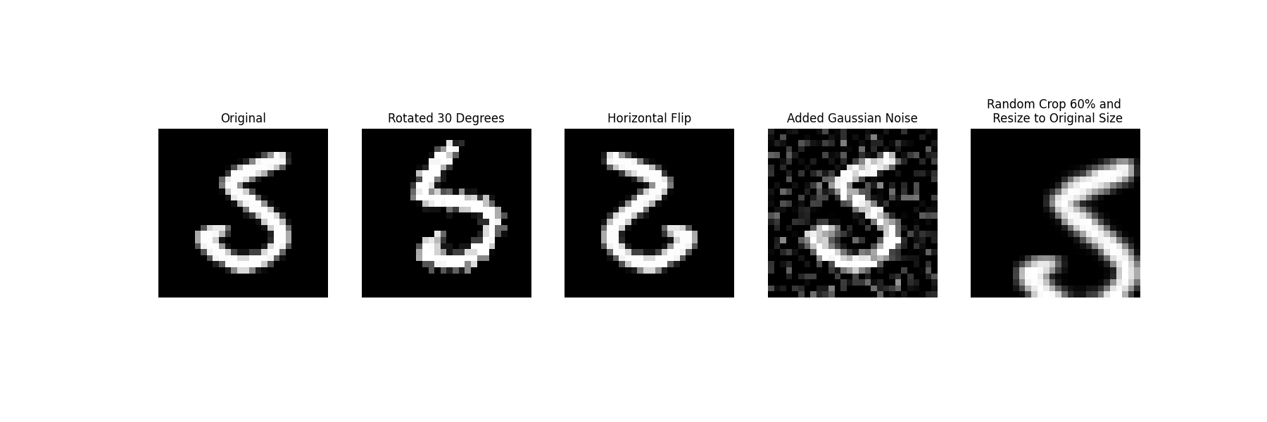

Slide 25
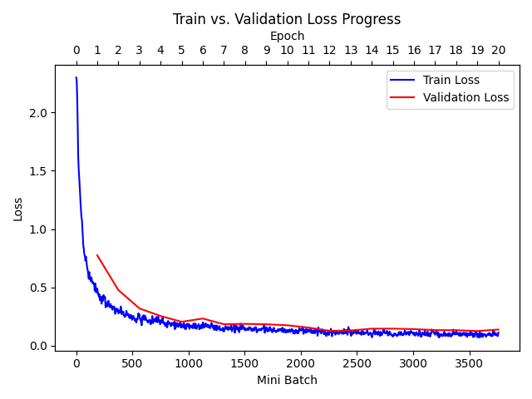

Slide 26


Slide 27
