Slide 1


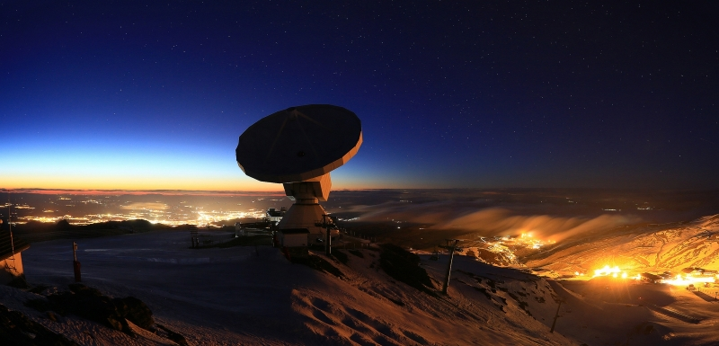
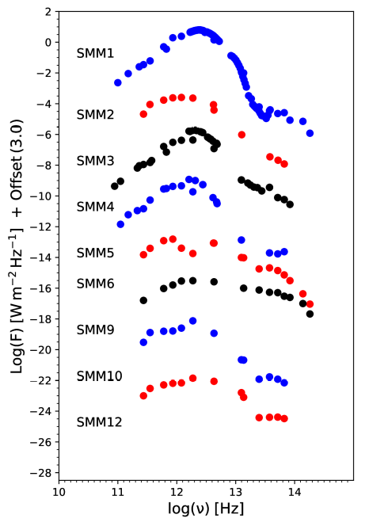
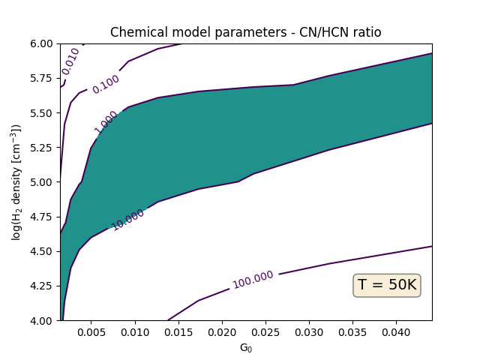
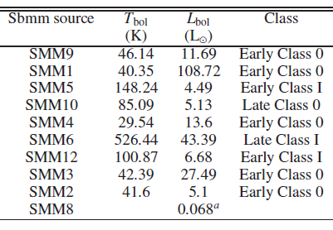
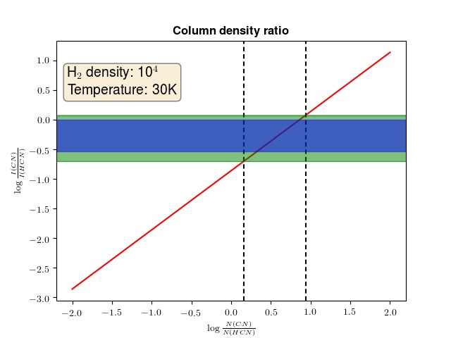
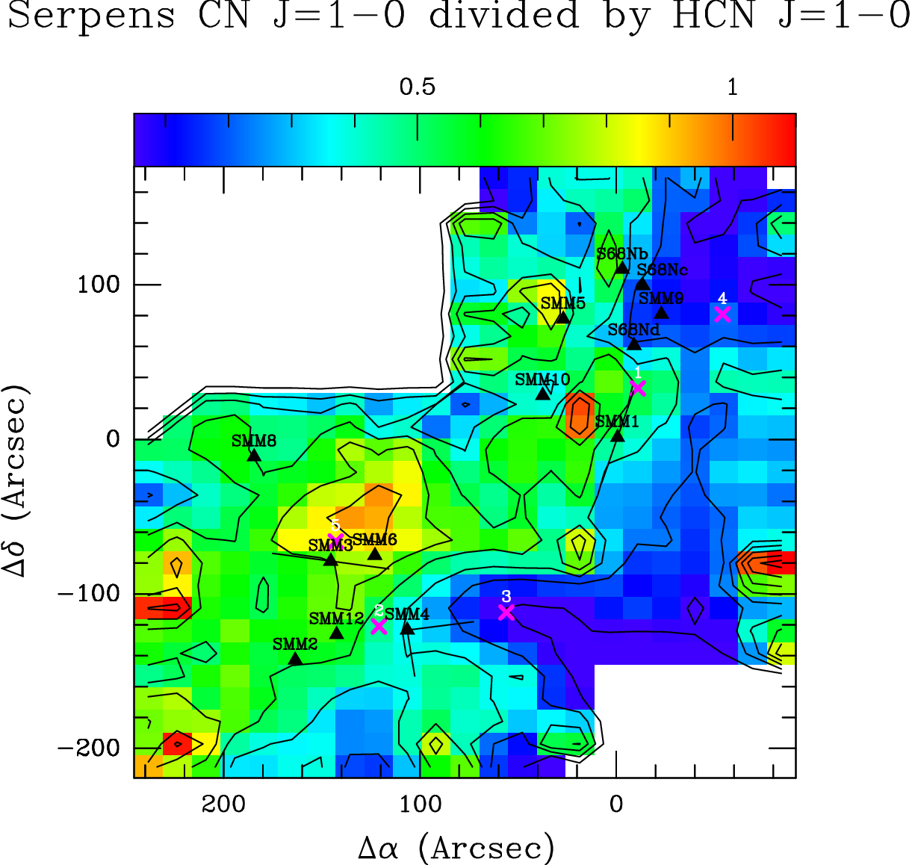
Molecular emission around low-mass protostars in the Serpens Main with IRAM 30m
A. Mirocha^{1,2}, A. Karska², L. E. Kristensen³, M. Gronowski⁴, M. Figueira⁵, M. Gładkowski^{2,6}, M. Żółtowski²
¹Astronomical Observatory, Jagiellonian University, ul. Orla 171, 30-244 Kraków, Poland; ²Centre for Astronomy, Faculty of Physics, Astronomy and Informatics, Nicolaus Copernicus University, ul. Grudziądzka 5, 87-100 Toruń, Poland; ³Centre for Star and Planet Formation, Niels Bohr Institute and Natural History Museum of Denmark, University of Copenhagen, Øster Voldgade 5-7, DK-1350 Copenhagen K, Denmark; ⁴Faculty of Physics, University of Warsaw, ul. Pasteura 5, 02-093 Warszawa, Poland; ⁵National Centre for Nuclear Research, ul. Pasteura 7, 02-093 Warszawa, Poland; ⁶Nicolaus Copernicus Astronomical Center, ul. Rabiańska 8, 87-100 Toruń, Poland
Questions
Where are molecules dissociated in molecular outflows?
What are the typical UV fields in Class 0/I protostars?
What is the influence of UV radiation on the surroundings of low-­mass protostars?
Observations
Spectra are obtained using IRAM 30m single dish antenna
Targeted lines: HCN, CN, CS and their isotopologues
CN/HCN:
UV field tracer
HCN CN + H
Serpens Main
Molecule | Freq. [GHz] | Beam size [arcsec]
HCN 1-0 | 88.63 | 28
CN 1-0 | 113.49 | 22
CS 3-2 | 146.96 | 16
C³⁴S 3-2 | 144.62 | 16
H¹³CN 2-1 | 86.34 | 29
H¹³CN 1-0 | 172.68 | 14
UV
Conclusions
CN/HCN ratio is higher around more envolved low-­mass protostars
N(CN)/N(HCN) ratio does not depend strongly on excitation conditions
Nahoon astrochemical model shows that an additional UV radiation of a few percent of the average in the ISM is required
The UV radiation cannot be neglected in models of star formation
SED analysis
Astrochemical model
Nahoon code calculates abundances of 474 species
In low temperature regime abundances of CN/HCN not depend strongly on temperature
CN/HCN column density ratio
RADEX set of models
Column density ratio covers the range of 1-10 irrespectively of the gas parameters
CN/HCN spatial distribution
AM, AK and MG are supported by the Polish National Science Center grants 2013/11/N/ST9/00400 and 2016/21/D/ST9/01098.

