Slide 1
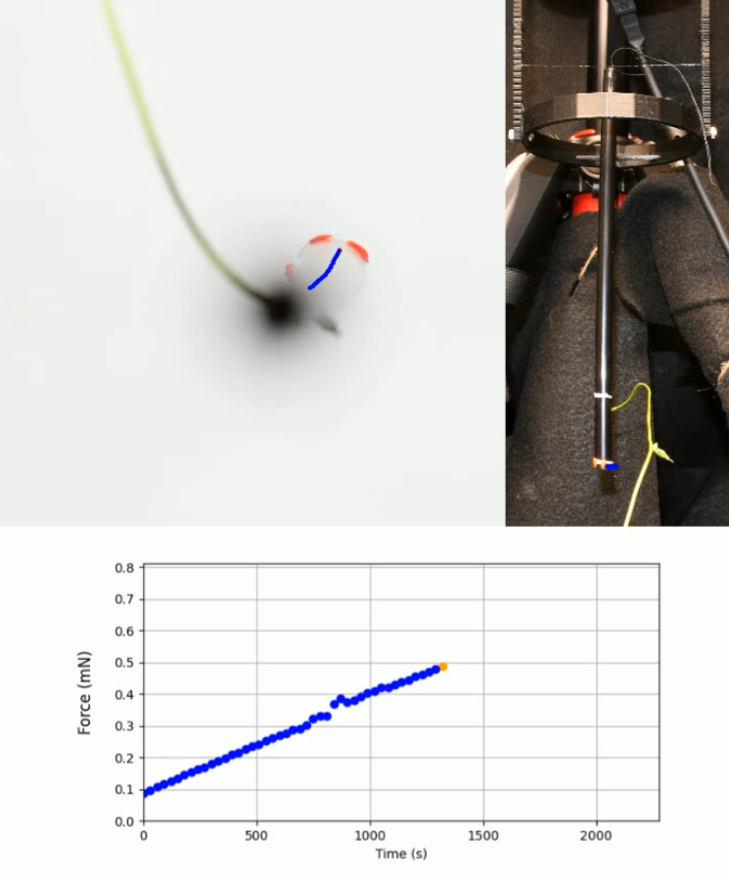
A
B
1 cm
1 cm
C

