Slide 1



Data Visualization with D3.js
Trainer: Amir Othman
Website:www.tertiarycourses.com.my
Email: sales2@tertiaryinfotech.com

Slide 2
Agenda
Module 1. Get Started
- What is D3.js?
- Downloading and installing D3
- First D3 code
Module 2. Basics of D3.js
- Selecting Elements
- Controlling HTML
- Modifying Attributes
- Modifying CSS
- Data Binding

Slide 3
Agenda
Module 3. Basic SVG Graphics
- SVG Canvas
- Basic SVG Shapes
Module 4. Scales & Axes
- Scales
- Linear Scale
- Axis
- Parse Date
- Time Scale
- Ordinal Scale

Slide 4
Agenda
Module 5. Events & Transitions
- Events
- Transitions

Slide 5
Prerequisites
Basic knowledge of HTML, CSS and Javascript are required.
Text editor (Sublime Text, Atom, Vim, etc.)
Web server (Apache, NGINX, etc.)
  CLI
  GUI: Fenix

Slide 6
Module 1
Introduction

Slide 7

D3 Website
https://d3js.org/

Slide 8
What is D3.js?
D3 stands from Data-Driven Documents
D3 is a JavaScript library
D3 allows you to bind data to a Document Object Model (DOM)
D3 allow you to apply data-driven transformations to the document.
D3 helps you bring data to life using HTML, SVG, and CSS.

Slide 9
D3 Code
var svg = d3.select("body").append("svg").attr("height","100%").attr("width","100%");
svg.append("rect").attr("x","100").attr("y","100").attr("width","200").attr("height","200").attr("fill","red");

Slide 10
D3 Quick-dive

Slide 11
Module 2
Basic of D3

Slide 12
Selecting Elements

Slide 13
Selecting Elements
d3.select("p");
d3.selectAll("p");

Slide 14
Chaining
d3.select("p")
.text("Today is Sunday")
.style("color","blue")
.style("background-color","yellow");

Slide 15
Selecting Descendent Elements
d3.select("#chart").select(".item").text("Hello");

Slide 16
Ex: Selection
Change every 4th item to "D3 Selection"
<li class='item'>Module 1: Introduction</li>
<li class='item'>Module 2: Basics of D3</li>
<li class='item'>Module 3: D3 Graphics</li>
<li class='item'>D3 Selection</li>
<li class='item'>Module 5: D3 Data Manipulation</li>
….
Time: 2 min

Slide 17
Controlling HTML

Slide 18
Add HTML to Selection
d3.selectAll('.item')
.html('<strong>Hello</strong>')

Slide 19
Append Selection
d3.selectAll('.item')
.append("div")
.html('<strong>hello</strong>')
d3.selectAll('.item')
.append("span")
.html('<strong> hello</strong>')

Slide 20
Ex: Append
Append a paragraph after the bullet list
"I am learning D3 today"
Time: 2 mins

Slide 21
Ex: Selection, Append, HTML
Create a list of fruits below for following items using D3 append & html
. Apple
. Orange
. Pineapple
. Durian
. Mango
. Peach
. Grape Time: 5 mins

Slide 22
Modifying Attributes and CSS

Slide 23
Add Attribute
d3.selectAll('.item')
.attr('width','200px')
.attr('height','200px')
.attr('class','highlight')

Slide 24
Add Style
d3.selectAll('.item')
.style('color','green')

Slide 25
Add Multiple Styles
d3.selectAll('.item:nth-child(2n)')
.style({
'background': '#268BD2',
'padding': '10px',
'margin' : '5px',
'color' : '#EEE8D5'
})

Slide 26
Add Class
d3.selectAll('.item')
.classed('highlight',true)

Slide 27
Add Multiple Classes
d3.selectAll('.item')
.classed({
'highlight': true,
'item': false,
'bigger':true
})

Slide 28
Data Binding

Slide 29
Data Binding
Data is specified as an array of values
Each value is passed as the first argument (d) to selection functions
With the default join-by-index, the first element in the data array is passed to the first node in the selection, the second element to the second node, and so on.

Slide 30
Enter
Data numbers greater than element numbers. Enter will create missing elements
var a = [1,4,9,16,25,36];
d3.selectAll("p")
.data(a)
.enter().append("p")
.text(function(d) {return d;});

Slide 31
Ex: Enter
var a = ["Ally","Belinda","Jane","Alfred","Kevin"];
Auto create a list for the name above

Slide 32
Hint to Exercise
d3.select("body")
.append("ul")
d3.selectAll("li")
.data(a)
.enter().append("li")
.text(function(d) {return d;});

Slide 33
Exit
Data numbers less than element numbers.
Exit will remove extra elements
var a = [1,4,9];
d3.selectAll("p")
.data(a)
.text(function(d) {return d;})
.exit().remove("p");

Slide 34
Ex: Exit
var a = ["Ally","Belinda","Jane","Alfred","Kevin"];
Auto create a list for the name above

Slide 35
Hint to Exercise
var a = [1,2,3,4,5];
d3.selectAll("p")
.data(a)
.enter().append("p")
.text(function(d) {
return "The square of "+d+" is "+(d*d);}
);

Slide 36
Index Input to Function
d3.selectAll("li")
.text(function(d,i) {
return "The square of "+i+" is "+(i*i);}
);

Slide 37
Hint to Exercise
var a = [1,4,9,16,25,36];
d3.selectAll("p")
.data(a)
.enter().append("p")
.text(function(d,i) {
return "The square of "+ (i+1) + " is " + d}
)

Slide 38
JSON Data
var person = [
{name:"Allly",height:160},
{name:"Belinda",height:155},
{name:"Jane",height:170},
{name:"Alfred",height:170},
{name:"Kevin",height:175},
{name:"John",height:140}
];

Slide 39
Binding Data to JSON Data
d3.selectAll("p")
.data(person)
.enter().append("p")
.text(function(d) {
return d.name + " height is " + d.height;}
);

Slide 40
Module 3
Basic SVG Graphics

Slide 41
What is SVG
SVG stands for Scalable Vector Graphics
Add vector graphics support to HTML5
SVG is HTML Like.
Can be styled through CSS

Slide 42
SVG Canvas
var svg = d3.select("body")
.append("svg")
.attr("height","100%")
.attr("width","100%");

Slide 43

Line
svg.append("line")
.attr("x1","0")
.attr("y1","200")
.attr("x2","400")
.attr("y2","0")
.attr("stroke","black")
.attr("stroke-width","3");
How would one draw a visualization with line?

Slide 44

Rectangle
svg.append("rect")
.attr("x","100")
.attr("y","100")
.attr("height","100")
.attr("width","50")
.attr("fill","red");
How would one draw a visualization with rect?

Slide 45
Hint to Exercise
svg.selectAll("rect")
.data(a)
.enter().append("rect")
.attr("x",function(d,i){return 30+i*50;})
.attr("y",function(d,i){return 50-d})
.attr("width","30")
.attr("height",function(d,i){return d;})
.attr("fill","red");

Slide 46

Circle
svg.append("circle")
.attr("cx","100")
.attr("cy","100")
.attr("r","20")
.attr("fill","black");

Slide 47

Ex : Circle
Create 3 circles with radius with radius 5, 11 and 18

Slide 48
Hint to Exercise
svg.selectAll("circle")
.data(a)
.enter().append("circle")
.attr("cx",function(d,i){return 50+i*50;})
.attr("cy","50")
.attr("r",function(d,i){return d;})
.attr("fill","black");

Slide 49
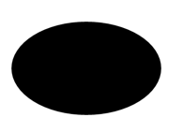
Ellipse
svg.append("ellipse")
.attr("cx","100")
.attr("cy","100")
.attr("rx","80")
.attr("ry","50")
.attr("fill","black");

Slide 50

Ex : Ellipse
Create 3 ellipse with x radius with radius 5, 11 and 18 and fixed y radius of 5

Slide 51
Hint to Exercise
svg.selectAll("ellipse")
.data(a)
.enter().append("ellipse")
.attr("cx",function(d,i){return 50+i*100;})
.attr("cy","50")
.attr("rx",function(d,i){return d;})
.attr("ry",5)
.attr("fill","black");

Slide 52

Text
svg.append("text")
.attr("x","100")
.attr("y","100")
.attr("font-size","20")
.attr("color","red")
.text("Hello World");

Slide 53
Module 4
Scales & Axes

Slide 54
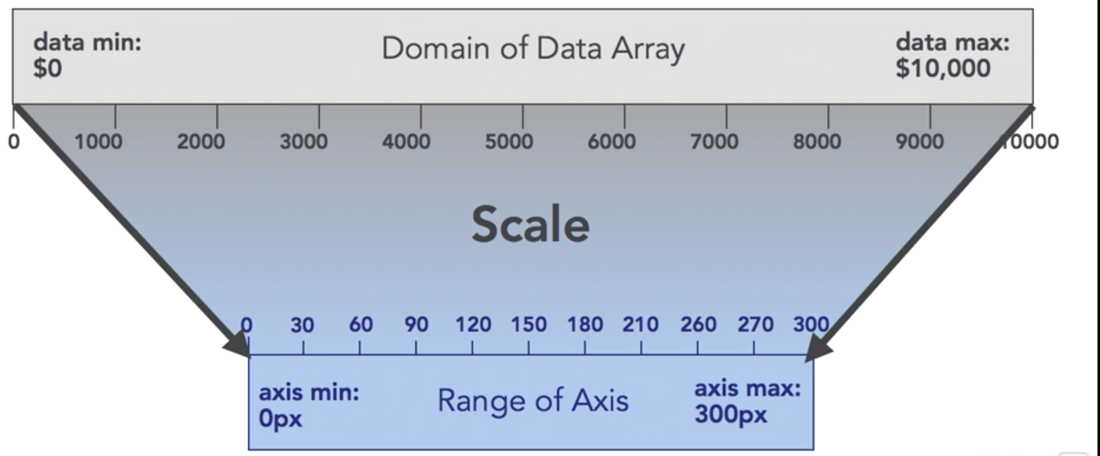
Scales
Scales are functions that map from an input domain to an output range.

Slide 55
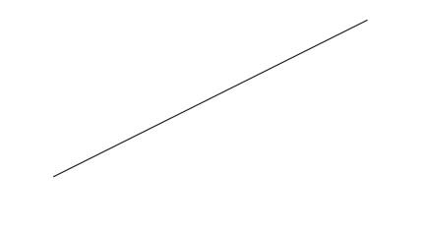
Linear Scale
var width = 400;
var height = 200;
var xS = d3.scaleLinear()
.domain([0,5])
.range([0,width]);
var yS = d3.scaleLinear()
.domain([0,10])
.range([height,0]);

Slide 56
Hint to Exercise
svg.selectAll("circle")
.data(pts)
.enter().append("circle")
.attr("cx",function(d,i){return xS(d.x);})
.attr("cy",function(d,i){return yS(d.y);})
.attr("r","3");

Slide 57
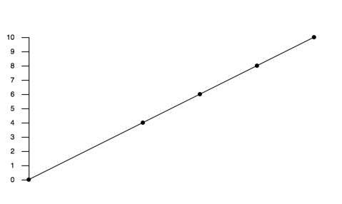
Axis
var yAxis = d3.axisLeft(yS)
.ticks(10)
.tickPadding(10)
.tickSize(10);
var chart = svg.append("g")
.attr("transform","translate(50,50)");
chart.append("g")
.call(yAxis);

Slide 58
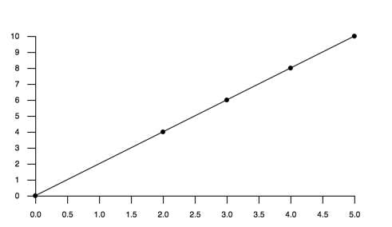
Ex : Axis
Add x-axis to the straight line curve
Time: 10 mins

Slide 59
Hint to Exercise
var xAxis = d3.axisBottom(xS)
.tickPadding(10)
.tickSize(10)
.ticks(10);
chart.append("g")
.attr("transform","translate(0,200)")
.call(xAxis);

Slide 60
Parse Date
var parseDate = d3.timeParse("%Y");

Slide 61
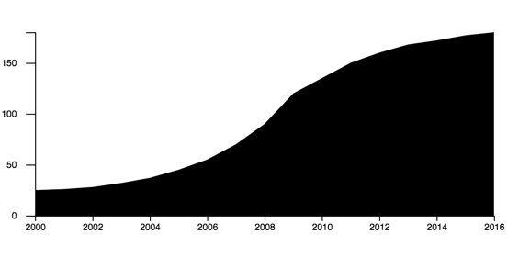
Time Scales
var x = d3.scaleTime()
.domain([parseDate('2000'),parseDate('2016')])
.range([0,width]);

Slide 62
Ordinal Scales
var dataArray = [5,11,18];
var dataDays = ['Mon','Wed','Fri'];
var x = d3.scaleBand()
.domain(dataDays)
.range([0,170]);

Slide 63
Ordinal Scales Axis
var xAxis = d3.axisBottom(x);
svg.selectAll("rect")
.data(dataArray)
.enter().append("rect")
.attr("height",function(d,i){ return d*15; })
.attr("width","50")
.attr("x",function(d,i){ return 60*i; })
.attr("y",function(d,i){ return 300-(d*15); });

Slide 64
Module 5
Events & Animation

Slide 65


On Mouseover and Mouseout
.on("mouseover", function() {
d3.select(this)
.style("opacity","0.5")
.attr("fill", "blue");
})
.on("mouseout", function() {
d3.select(this)
.style("opacity","1")
.attr("fill", "red");
})

Slide 66

Ex : Mouse Over and Out
Draw 3 red circles, when mouse over change to blue and mouse out change back to red.
Time: 10 mins

Slide 67
Hint to Exercise
svg.selectAll('circle')
.on("mouseover", function(){
d3.select(this)
.attr("fill", "blue");
})
.on("mouseout", function(){
d3.select(this)
.attr("fill", "red");
});

Slide 68
On Click
svg.append("rect")
.attr("fill","red")
.on("click", function() {
d3.select(this)
.style("opacity","0.5")
.attr("fill", "blue");
})

Slide 69
Transition
svg.append("rect")
.attr("x","100")
.attr("y","100")
.attr("height","100")
.attr("width","100")
.style("fill","red")
.transition().duration(2000).delay(1000)
.style("fill","blue");

Slide 70

Ex : Transition
Create a transition to move the rect 300px to the right
Time: 10 mins

Slide 71
Hint to Exercise
svg.append("rect")
.attr("x","100")
.attr("y","100")
.attr("height","100")
.attr("width","100")
.attr("fill","red")
.transition().duration(2000).delay(1000)
.attr("transform","translate(300,0)");

Slide 72


Ex: Transitions
Add an animation to expand the circle radius from 10 to t0
Time: 5 mins

Slide 73
Hint to Exercise
function animate(){
d3.select(this)
.transition()
.duration(1000)
.attr("r", 50)
};

Slide 74
Resources
Examples - https://bl.ocks.org
D3 in Depth - d3indepth.com
D3 Tips and Tricks -http://freecomputerbooks.com/D3-Tips-and-Tricks.html
D3 API Reference - https://github.com/d3/d3/blob/master/API.md

Slide 75

Summary
Parting Message

Slide 76


Q & A
Feedback https://goo.gl/EDezXH

Slide 77
Thank You!
Amir Othman
011-369 789 24
othman.amir@gmail.com

