Slide 1
Chapter 10: One- and Two-Sample Tests of Hypotheses:
Consider a population with some unknown parameter θ. We are interested in testing (confirming or denying) some conjectures about θ. For example, we might be interested in testing the conjecture that θ = θ_{o}, where θ_{o} is a given value.
10.1-10.3: Introduction +:
· A statistical hypothesis is a conjecture concerning (or a statement about) the population.
· For example, if θ is an unknown parameter of the population, we may be interested in testing the conjecture that θ > θ_{o} for some specific value θ_{o}.
· We usually test the null hypothesis:
H_{o}: θ = θ_{o} (Null Hypothesis)
Against one of the following alternative hypotheses:

Slide 2

H₁:
θ ≠ θ_{o}
θ > θ_{o}
θ < θ_{o}
(Alternative Hypothesis
or Research Hypothesis)
· Possible situations in testing a statistical hypothesis:
 | H_{o} is true | H_{o} is false
Accepting H_{o} (Do not reject) | Correct Decision | Type II error (β)
Rejecting H_{o} | Type I error (α) | Correct Decision
Type I error = Rejecting H_{o} when H_{o} is true
Type II error = Accepting H_{o} when H_{o} is false
P(Type I error) = P(Rejecting H_{o} | H_{o} is true) = α
P(Type II error) = P(Accepting H_{o} | H_{o} is false) = β

Slide 3
· The level of significance of the test:
α = P(Type I error) = P(Rejecting H_{o} | H_{o} is true)
· One-sided alternative hypothesis:
H_{o}: θ = θ_{o} or H_{o}: θ = θ_{o}
H₁: θ > θ_{o} H₁: θ < θ_{o}
· Two-sided alternative hypothesis:
H_{o}: θ = θ_{o}
H₁: θ ≠ θ_{o}
· The test procedure for rejecting H_{o} (accepting H₁) or accepting H_{o} (rejecting H₁) involves the following steps:
1. Determining a test statistic (T.S.)
2. Determining the significance level α
3. Determining the rejection region (R.R.) and the acceptance region (A.R.) of H_{o} .
R.R. of H_{o} depends on H₁ and α

Slide 4
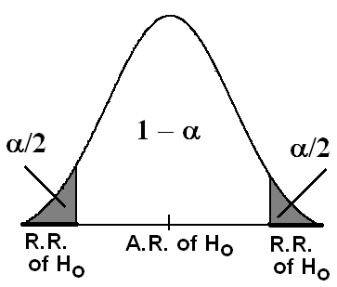
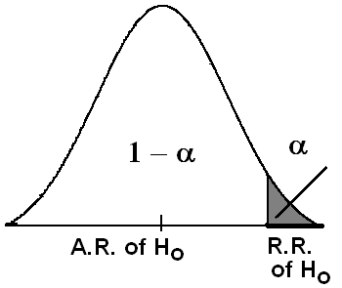
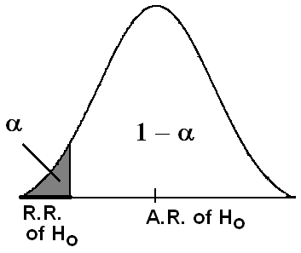
· H₁ determines the direction of the R.R. of H_{o}
· α determines the size of the R.R. of H_{o}
H₁: θ ≠ θ_{o}
Two-sided alternative
H₁: θ > θ_{o}
One-sided alternative
H₁: θ < θ_{o}
One-sided alternative
4. Decision:
We reject H_{o} (accept H₁) if the value of the T.S. falls in the R.R. of H_{o} , and vice versa.

Slide 5

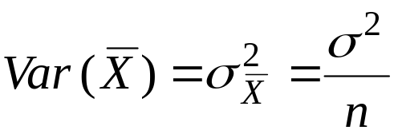
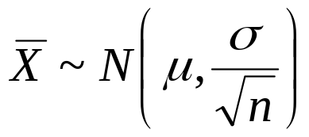
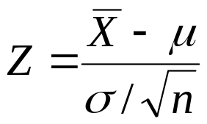
10.5: Single Sample: Tests Concerning a Single Mean (Variance Known):
Suppose that X₁, X₂, …, X_{n} is a random sample of size n from distribution with mean μ and (known) variance σ².
Recall:
⇔
Test Procedure:

Slide 6
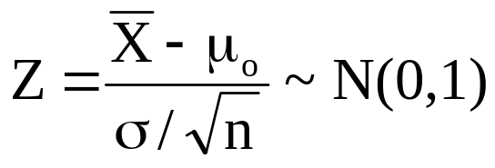
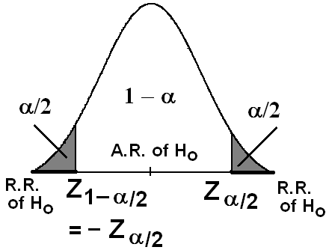
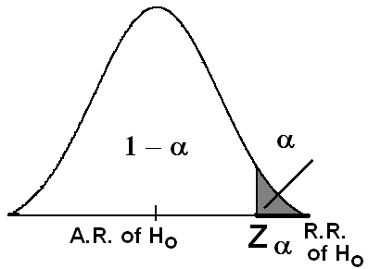
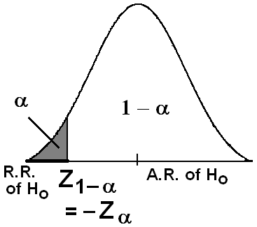
Hypotheses
H_{o}: μ = μ_{o}
H₁: μ ≠ μ_{o}
H_{o}: μ = μ_{o}
H₁: μ > μ_{o}
H_{o}: μ = μ_{o}
H₁: μ < μ_{o}
Test Statistic (T.S.)
R.R.and A.R.
of H_{o}
Decision:
Reject H_{o} (and accept H₁) at the significance level α if:
Z > Z _{α/2}
or Z < − Z _{α/2}
Two-Sided Test
Z > Z _{α}
One-Sided Test
Z < − Z _{α}
One-Sided Test

Slide 7

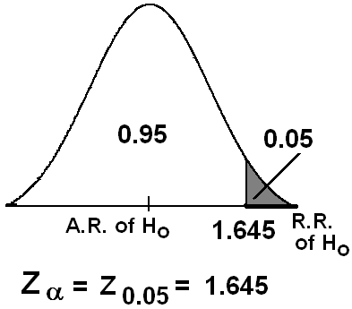
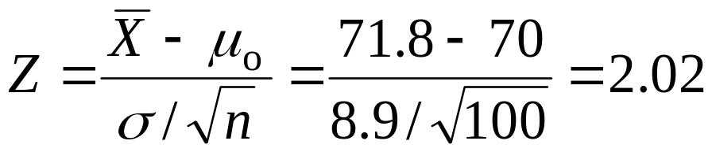
Example 10.3:
A random sample of 100 recorded deaths in the United States during the past year showed an average of 71.8 years. Assuming a population standard deviation of 8.9 year, does this seem to indicate that the mean life span today is greater than 70 years? Use a 0.05 level of significance.
Solution:
.n=100, =71.8, σ=8.9
μ=average (mean) life span
μ_{o}=70
Hypotheses:
H_{o}: μ = 70
H₁: μ > 70
T.S. :

Slide 8
Level of significance:
α=0.05
R.R.:
Z _{α}=Z_{0.05}=1.645
Z > Z _{α} =Z_{0.05}=1.645
Decision:
Since Z=2.02 ∈R.R., i.e., Z=2.02>Z_{0.05}, we reject H_{o} at α=0.05 and accept H₁: μ > 70. Therefore, we conclude that the mean life span today is greater than 70 years.
Example 10.4:
A manufacturer of sports equipment has developed a new synthetic fishing line that he claims has a mean breaking strength of 8 kilograms with a standard deviation of 0.5 kilograms. Test the hypothesis that μ=8 kg against the alternative that μ≠8 kg if a random sample of 50 lines is tested and found to have a mean breaking strength of 7.8 kg. Use a 0.01 level of significance.

Slide 9
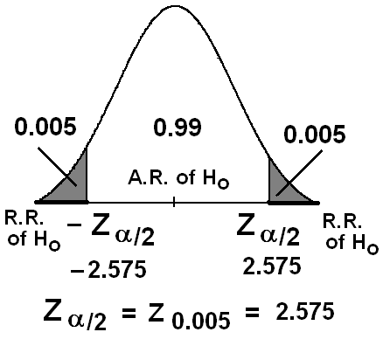
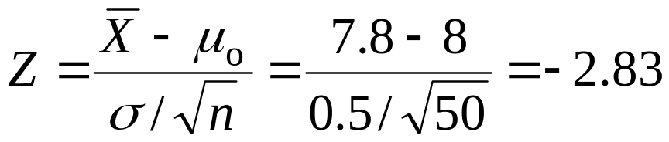
Solution:
.n=50, =7.8, σ=0.5,
α=0.01, α/2 = 0.005
μ= mean breaking strength
μ_{o}=8
Hypotheses:
H_{o}: μ = 8
H₁: μ ≠ 8
T.S. :
Z _{α/2}=Z_{0.005}=2.575 and − Z _{α/2}= −Z_{0.005}= −2.575
Decision:
Since Z= −2.83 ∈R.R., i.e., Z= −2.83 < −Z_{0.005}, we reject H_{o} at α=0.01 and accept H₁: μ ≠ 8. Therefore, we conclude that the claim is not correct.

Slide 10
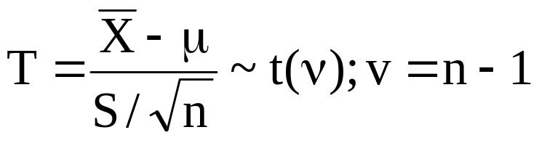
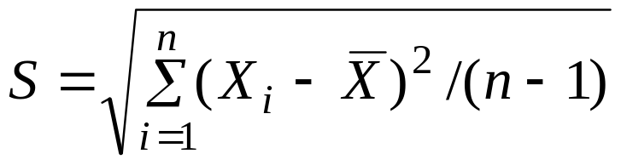
10.7: Single Sample: Tests on a Single Mean (Variance Unknown):
Suppose that X₁, X₂, …, X_{n} is a random sample of size n from normal distribution with mean μ and unknown variance σ².
Recall:
Test Procedure:

Slide 11
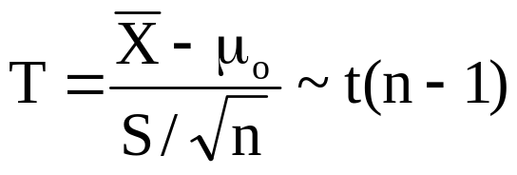
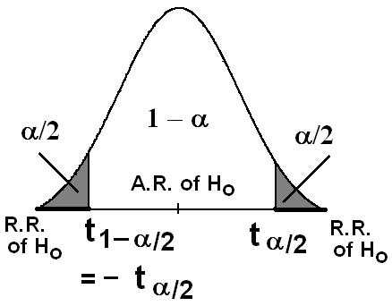
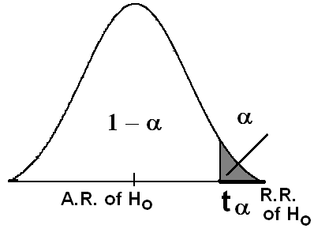
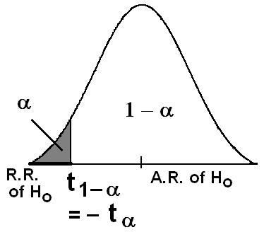
Hypotheses
H_{o}: μ = μ_{o}
H₁: μ ≠ μ_{o}
H_{o}: μ = μ_{o}
H₁: μ > μ_{o}
H_{o}: μ = μ_{o}
H₁: μ < μ_{o}
Test Statistic (T.S.)
R.R.and A.R.
of H_{o}
Decision:
Reject H_{o} (and accept H₁) at the significance level α if:
T > t _{α/2}
or T < − t _{α/2}
Two-Sided Test
T > t _{α}
One-Sided Test
T < − t _{α}
One-Sided Test

Slide 12
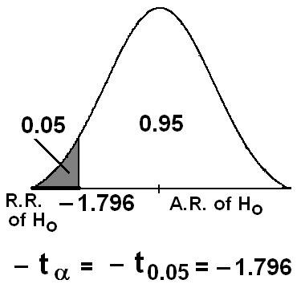
Example 10.5:
… If a random sample of 12 homes included in a planned study indicates that vacuum cleaners expend an average of 42 kilowatt-hours per year with a standard deviation of 11.9 kilowatt-hours, does this suggest at the 0.05 level of significance that the vacuum cleaners expend, on the average, less than 46 kilowatt-hours annually? Assume the population of kilowatt-hours to be normal.
Solution:
.n=12, =42, S=11.9, α=0.05
μ=average (mean) kilowatt-hours annual expense of a vacuum cleaner
μ_{o}=46
Hypotheses:
H_{o}: μ = 46
H₁: μ < 46
T.S. :

Slide 13
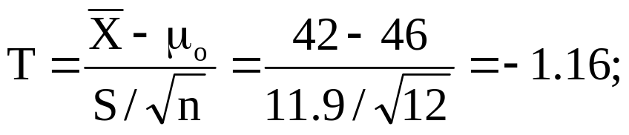
ν=df= n−1=11
− t _{α/2}= − t_{0.05}= −1.796
Decision:
Since T=−1.16∉R.R. (T=−1.16∈A.R.), we do not reject H_{o} at α=0.05 (i.e, accept H_{o}: μ = 46) and reject H₁: μ < 46. Therefore, we conclude that μ is not less than 46 kilowatt-hours.

Slide 14


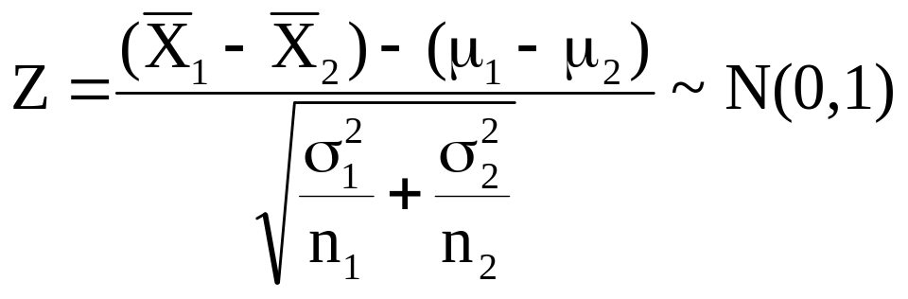
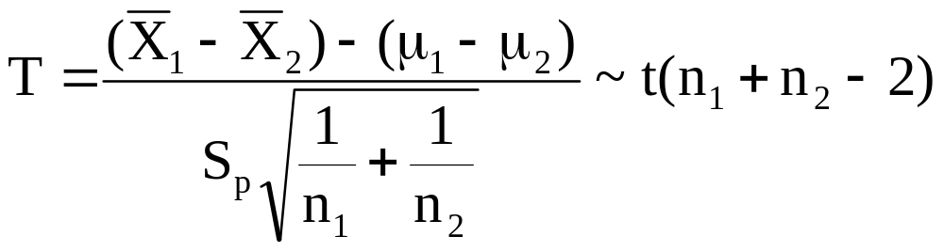
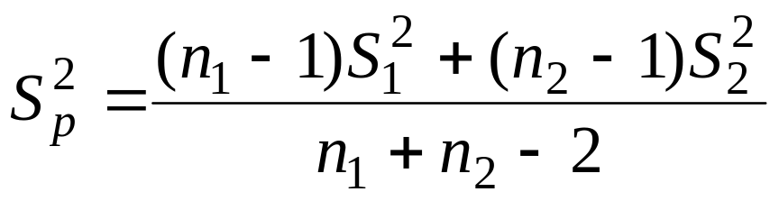
10.8: Two Samples: Tests on Two Means:
Recall: For two independent samples:
If and are known, then we have:
If and are unknown but = =σ², then we have:
Where the pooled estimate of σ² is

Slide 15

The degrees of freedom of is ν=n₁+n₂−2.
Now, suppose we need to test the null hypothesis
H_{o}: μ₁ = μ₂ ⇔ H_{o}: μ₁ − μ₂ = 0
Generally, suppose we need to test
H_{o}: μ₁ − μ₂ = d (for some specific value d)
Against one of the following alternative hypothesis
H₁:
μ₁ − μ₂ ≠ d
μ₁ − μ₂ > d
μ₁ − μ₂ < d

Slide 16
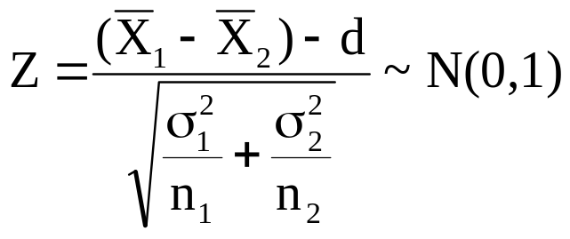
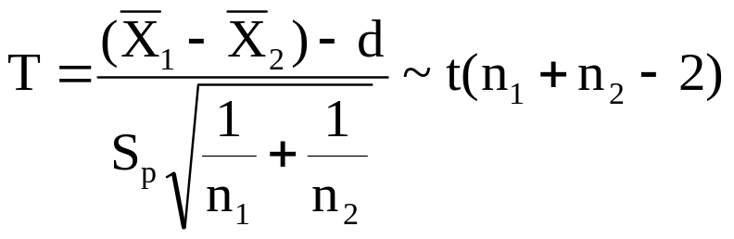
Hypotheses
H_{o}: μ₁ − μ₂ = d
H₁: μ₁ − μ₂ ≠ d
H_{o}: μ₁ − μ₂ = d
H₁: μ₁ − μ₂ > d
H_{o}: μ₁ − μ₂ = d
H₁: μ₁ − μ₂ < d
Test Statistic (T.S.)
{if and are known}
{if = =σ² is unknown}

Slide 17
R.R.and A.R.
of H_{o}
or
or
or
Decision:
Reject H_{o} (and accept H₁) at the significance level α if:
T.S. ∈ R.R.
Two-Sided Test
T.S. ∈ R.R.
One-Sided Test
T.S. ∈ R.R.
One-Sided Test

Slide 18
Example10.6:
An experiment was performed to compare the abrasive wear of two different laminated materials. Twelve pieces of material 1 were tested by exposing each piece to a machine measuring wear. Teen pieces of material 2 were similarly tested. In each case, the depth of wear was observed. The samples of material 1 gave an average wear of 85 units with a sample standard deviation of 4, while the samples of materials 2 gave an average wear of 81 and a sample standard deviation of 5. Can we conclude at the 0.05 level of significance that the mean abrasive wear of material 1 exceeds that of material 2 by more than 2 units? Assume populations to be approximately normal with equal variances.

Slide 19
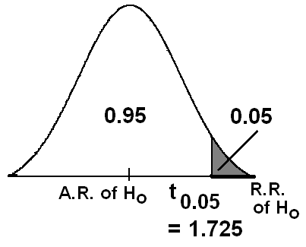


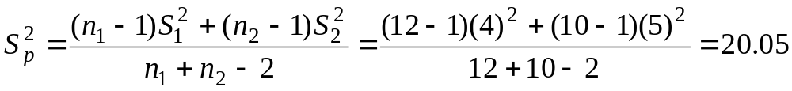
Solution:
Material 1 material 2
n₁=12 n₂=10
=85 =81
S₁=4 S₂=5
Hypotheses:
H_{o}: μ₁ = μ₂ + 2 (d=2)
H₁: μ₁ > μ₂ + 2
Or equivalently,
H_{o}: μ₁ − μ₂ = 2 (d=2)
H₁: μ₁ − μ₂ > 2
Calculation:
α=0.05

Slide 20
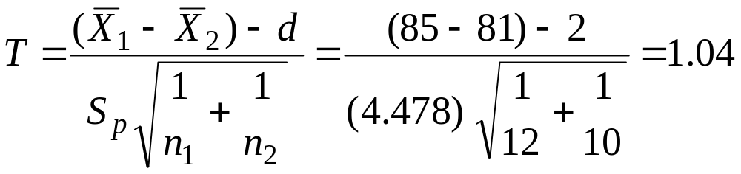
S_{p}=4.478
ν= n₁+n₂−2=12+10 −2 = 20
t_{0.05} = 1.725
T.S.:
Decision:
Since T=1.04 ∈A.R. (T=1.04< t_{0.05} = 1.725), we accept (do not reject) H_{o} and reject H₁: μ₁ − μ₂ > 2 at α=0.05.

Slide 21
A P -value is the lowest level (of significance) at which the observed value of the test statistic is significant.
The P-value approach has been adopted extensively by users of applied statistics.

Slide 22
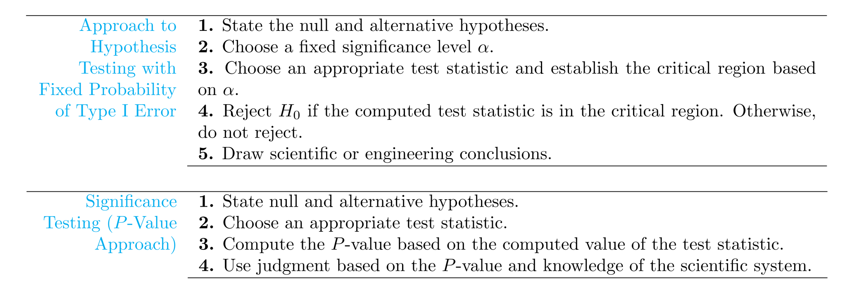


Slide 23
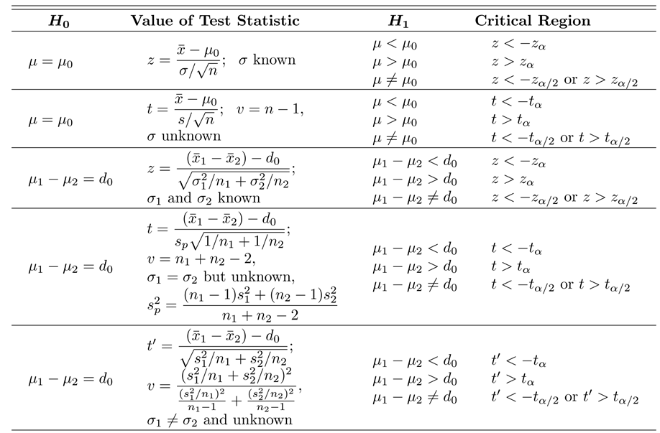

Slide 24
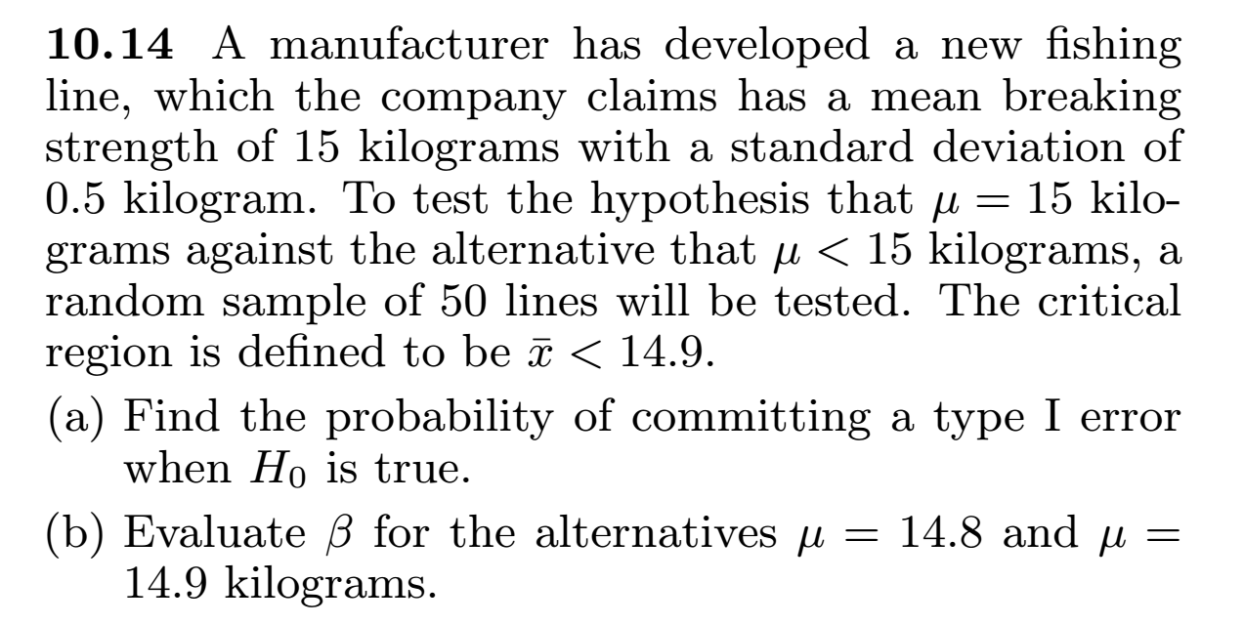

Slide 25
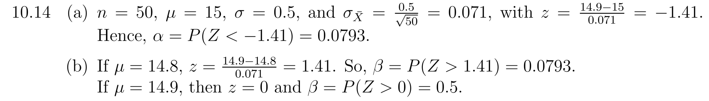

Slide 26
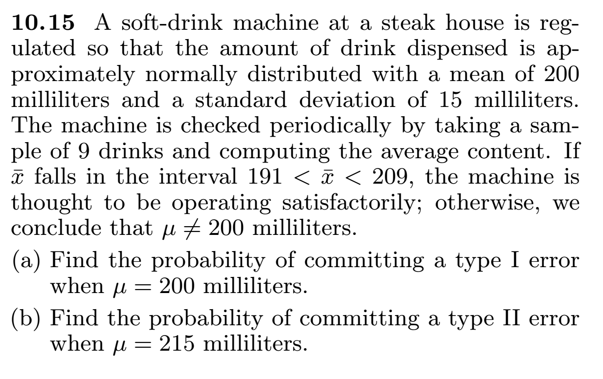

Slide 27
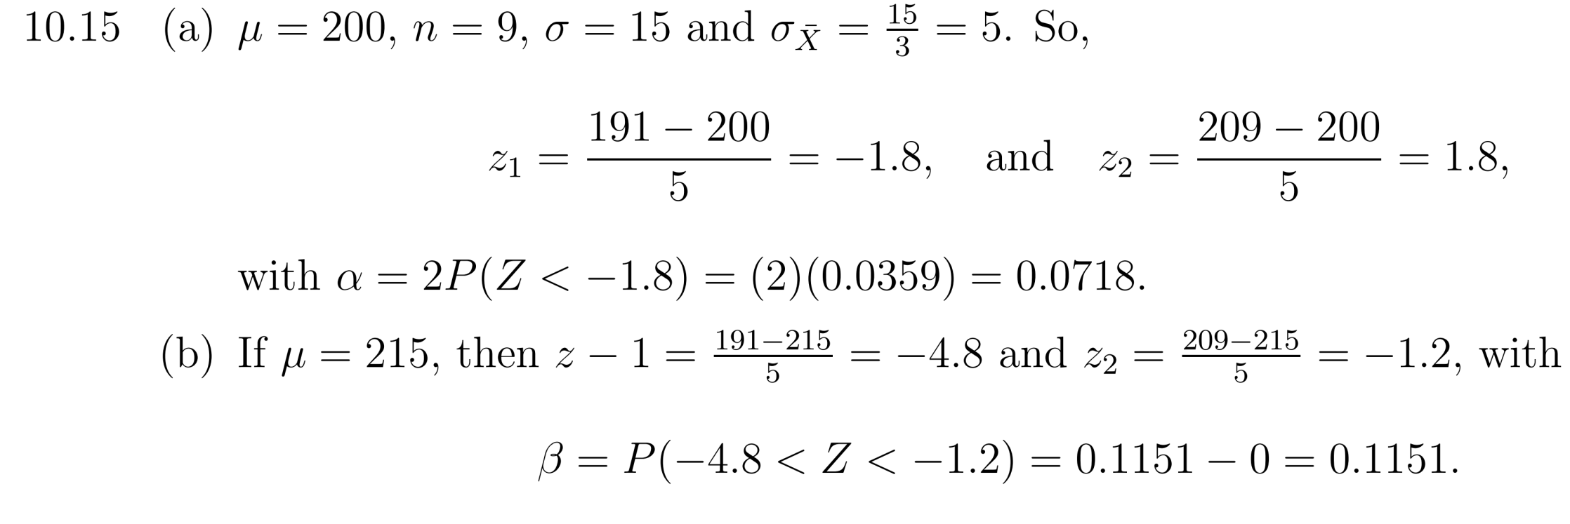

Slide 28
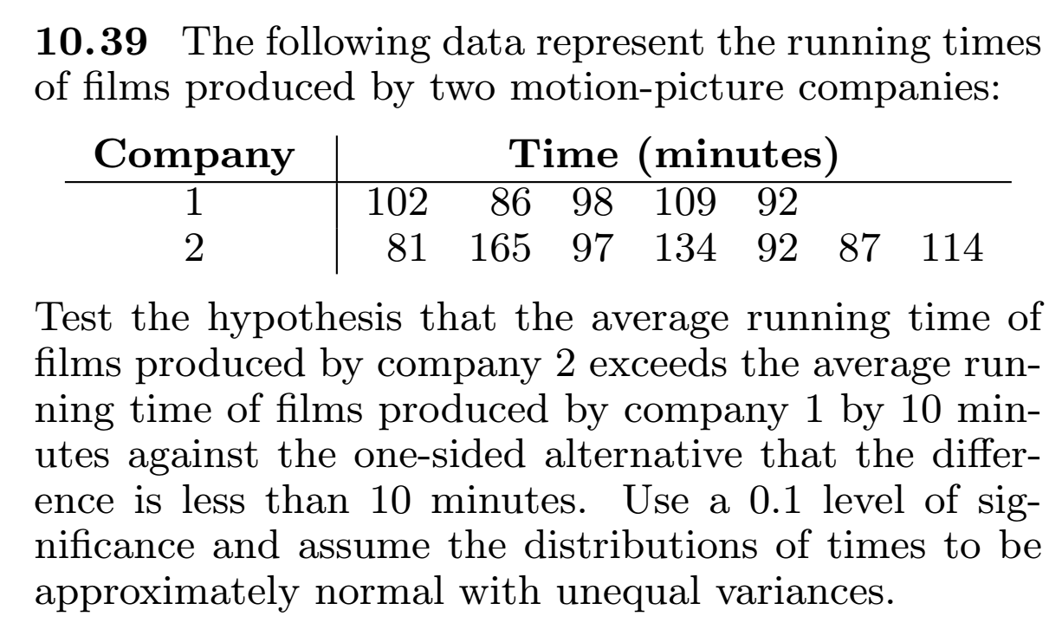

Slide 29
