Slide 1
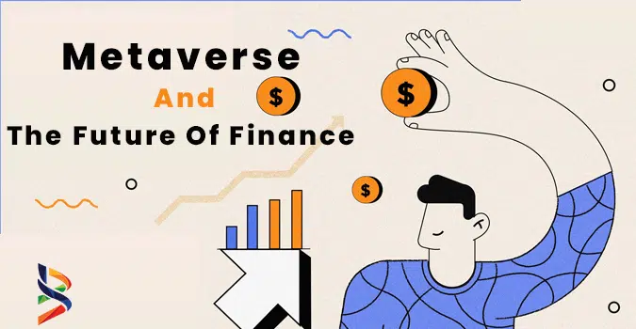
Financial Aspects of Metaverse
Amir Pirhosseinloo
April 2023
https://www.brisklogic.co/metaverse-and-the-future-of-finance/

Slide 2
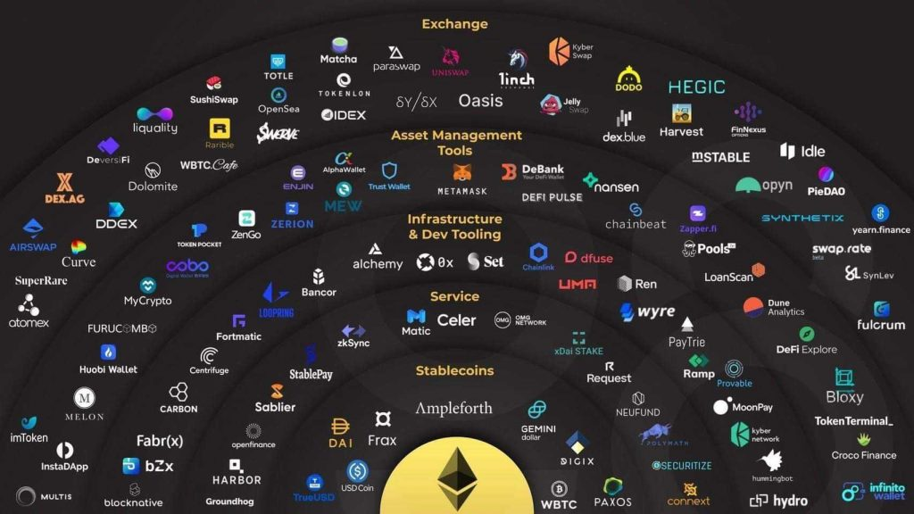
Metaverse and DeFi
DeFi
ICO
Airdrop
NFT
...
https://www.coolwallet.io/what-is-defi-guide-to-decentralized-finance/

Slide 3
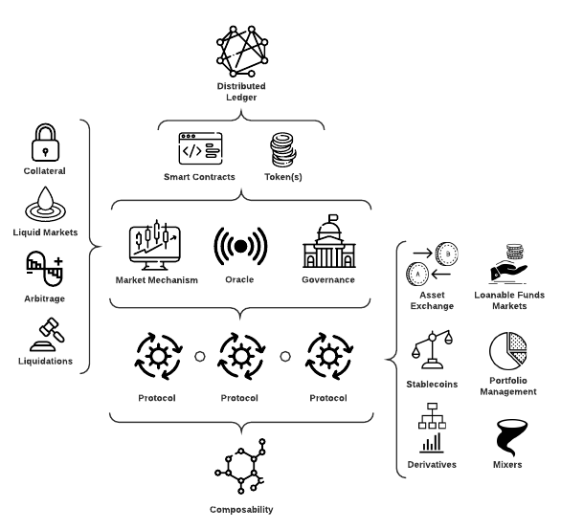
DeFi
Smart Contracts
Atomicity
Composability
Oracles
Governance
DEX
Loans
Overcollateralized
Flash Loan
Security
Technical
Economic
Werner, Sam M., et al. "Sok: Decentralized finance (defi)." arXiv preprint arXiv:2101.08778 (2021).

Slide 4
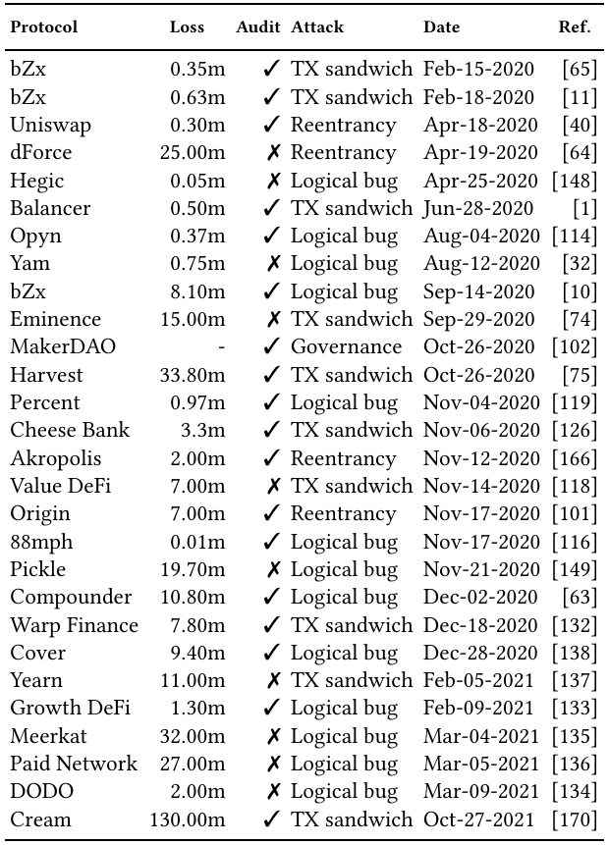
Werner, Sam M., et al. "Sok: Decentralized finance (defi)." arXiv preprint arXiv:2101.08778 (2021).

Slide 5

ICO
Team
White Paper + Source Code
Token Type
Platform
Social Media
VC support
KYC
Rating Systems
Property Rights
Campaign time
Held Tokens
Market Sentiment
https://previews.123rf.com/images/301librarians/301librarians1912/301librarians191200023/136220583-banner-initial-coin-offering-concept-ico-startup-blockchain-cryptocurrency-crowdfunding.jpg
Moxoto, Ana Claudia De, Paulo Melo, and Elias Soukiazes. "Initial Coin Offering (ICO): a systematic review of the literature." (2021).

Slide 6
Airdrop
Uber
"Cold Start" Problem
Fiat vs Currency
Current Use vs Past Activity
Goals: Marketing & Decentralization
Liquidity
Security
Governance
Community
Token Types
Exchange Token
Utility Token
Security Token
Categories
Task-Based
Retrospective
Allen, Darcy WE, Chris Berg, and Aaron M. Lane. "Why airdrop cryptocurrency tokens?." Journal of Business Research 163 (2023): 113945.

Slide 7
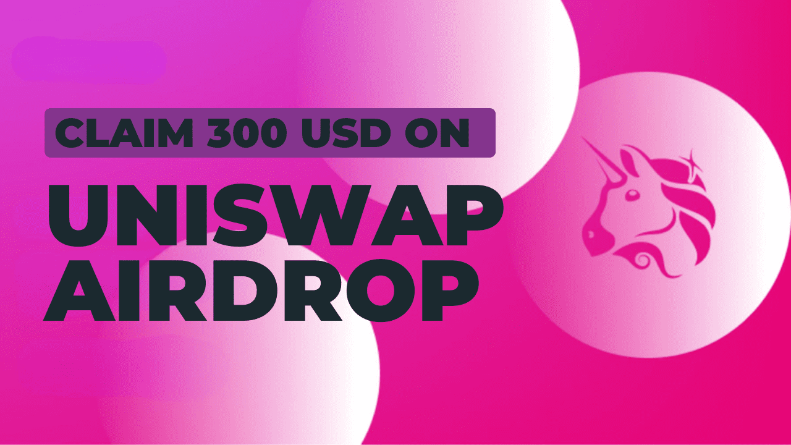
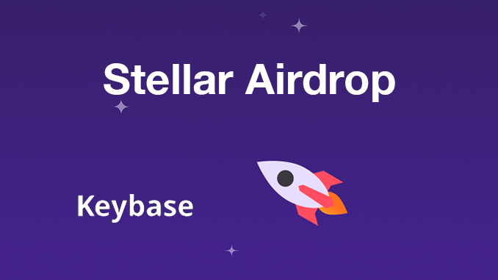
Airdrop Samples
Stellar (XLM)
blockchain.com
Keybase
Goal: Marketing
Uniswap (UNI)
In response to Sushiswap
Osmosis
Type: Task-Based (Staking, Providing Liquidity, Voting, Trading)
https://cryptobullsclub.com/how-to-claim-300-usd-on-uniswap-airdrop-ultimate-guide/
https://block-builders.de/stellar-airdrop-im-wert-von-rund-120-millionen-us-dollar-fuer-alle-nutzer-von-keybase/
Allen, Darcy WE, Chris Berg, and Aaron M. Lane. "Why airdrop cryptocurrency tokens?." Journal of Business Research 163 (2023): 113945.

Slide 8

NFT
Decentraland NFTs
https://criptokio.com/en/news/decentraland-mana-emotes-animated-version-nfts/
Kräussl, Roman, and Alessandro Tugnetti. "Non-fungible tokens (NFTs): A review of pricing determinants, applications and opportunities." Applications and Opportunities (May 17, 2022) (2022).

Slide 9
References
Werner, Sam M., et al. "Sok: Decentralized finance (defi)." arXiv preprint arXiv:2101.08778 (2021).
Moxoto, Ana Claudia De, Paulo Melo, and Elias Soukiazes. "Initial Coin Offering (ICO): a systematic review of the literature." (2021).
Allen, Darcy WE, Chris Berg, and Aaron M. Lane. "Why airdrop cryptocurrency tokens?." Journal of Business Research 163 (2023): 113945.
Kräussl, Roman, and Alessandro Tugnetti. "Non-fungible tokens (NFTs): A review of pricing determinants, applications and opportunities." Applications and Opportunities (May 17, 2022) (2022).

