Slide 1
RESTAURANT MENU/ORDER MANAGEMENT SYSTEM

Slide 2
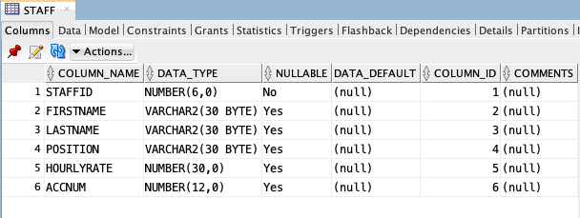
Staff Database
create table STAFF (
STAFF_ID number (6) NOT NULL,
STAFF_FIRSTNAME varchar2 (20) NOT NULL,
STAFF_LASTNAME varchar2 (20) NOT NULL,
STAFF_POSITION varchar2 (20) NOT NULL,
SALARY number (10) NOT NULL,
HOURLY_RATE number (10) NOT NULL,
BANKACC_NO number (6) NOT NULL);

Slide 3
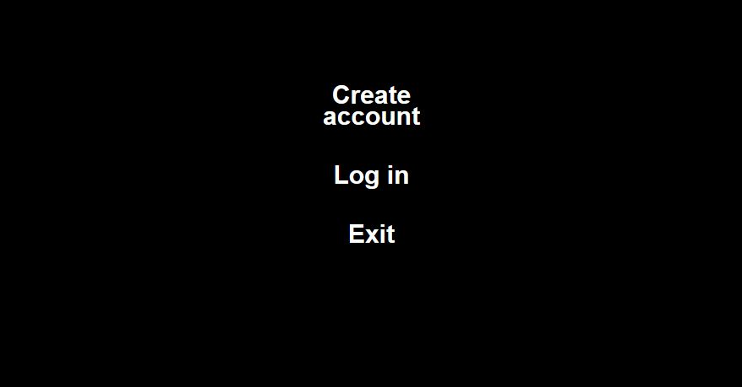
Staff Module Demo
In staff module, only staffs of MAMAKHUT can gain access to adjust the menu. However, they are required to create an account under their managers (unless they’ve already done so, then they’ll need to log in instead).

Slide 4
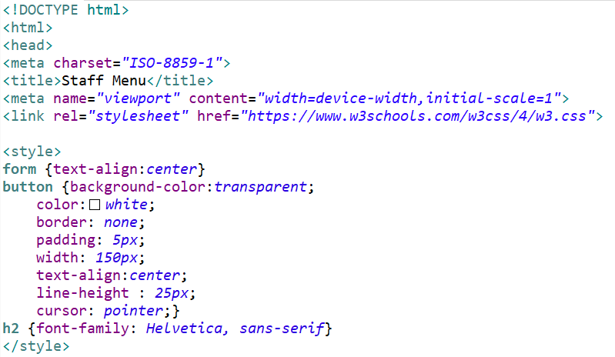
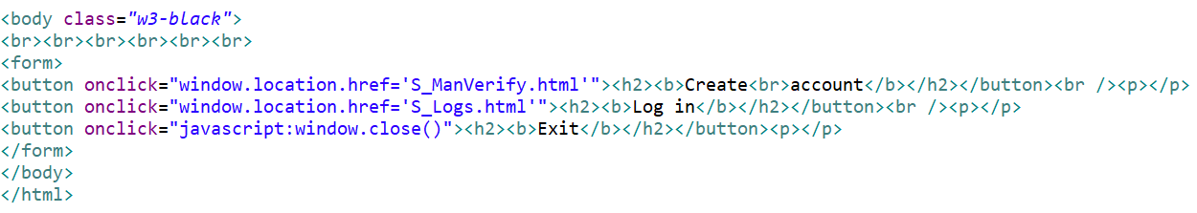
Staff Menu Source Code (S_Menu.html)

Slide 5
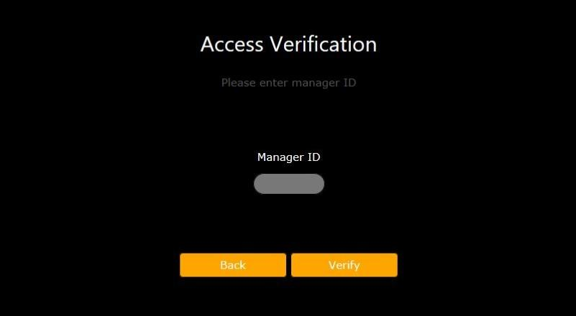
Once the staff clicked/pressed on the Create Account button, they’ll be taken to an interface that requires access verification from their manager (Manager ID). this is to ensure that all accounts are well recorded within the database.

Slide 6
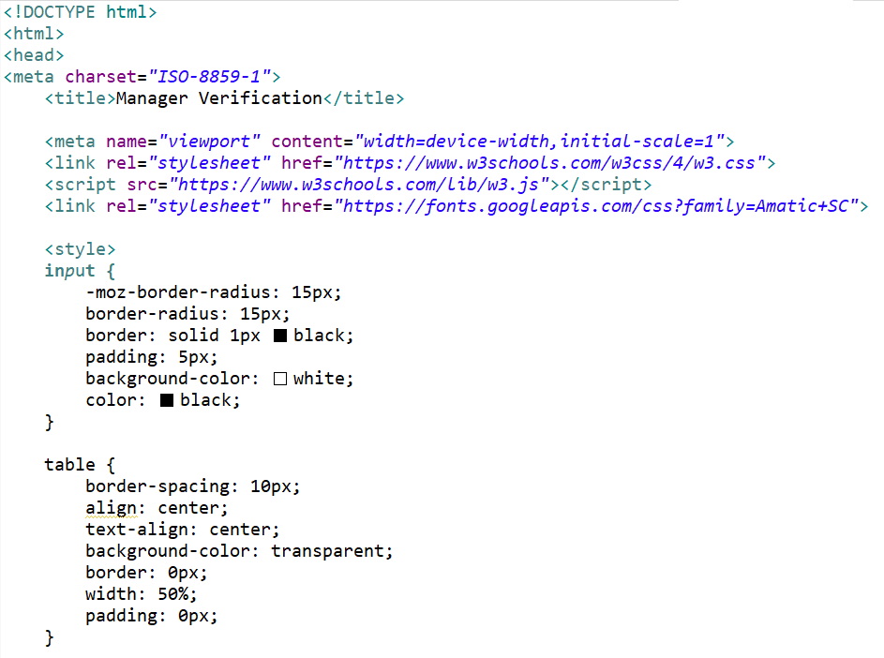
Staff Access Verification Source Code (S_ManVerify.html…)

Slide 7
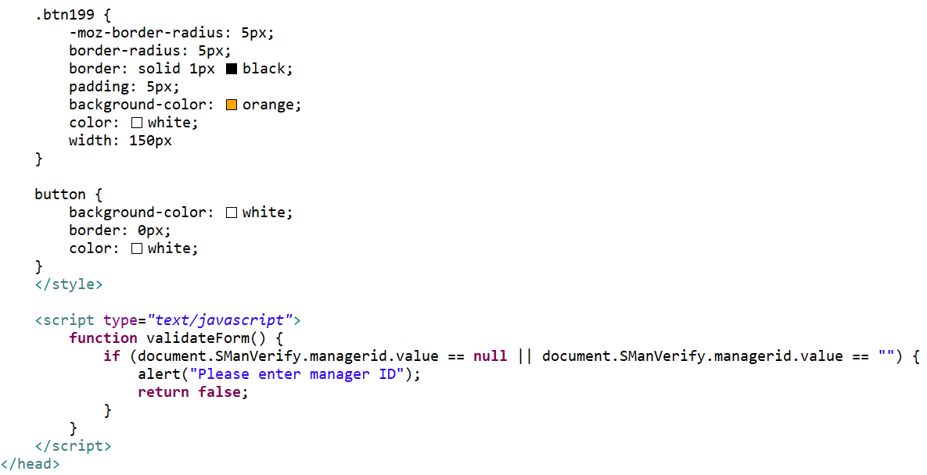
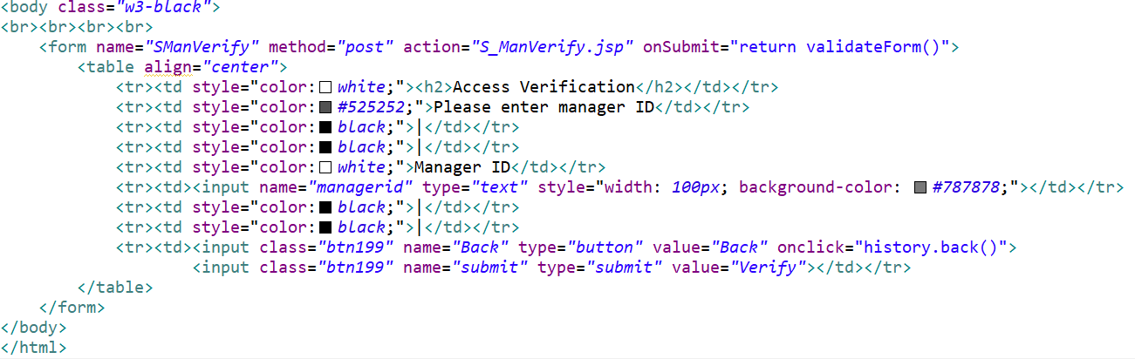

Slide 8
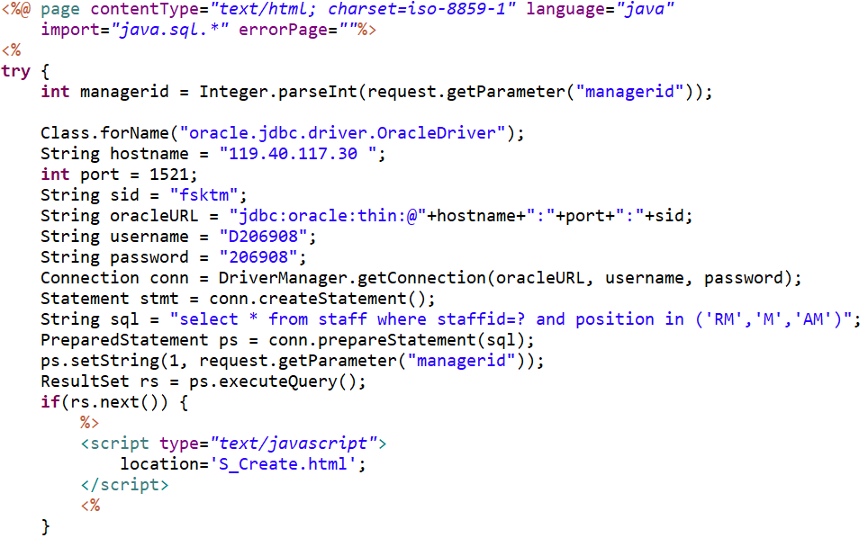
(...& S_ManVerify.jsp)

Slide 9
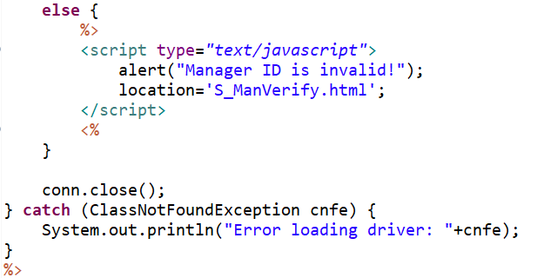

Slide 10
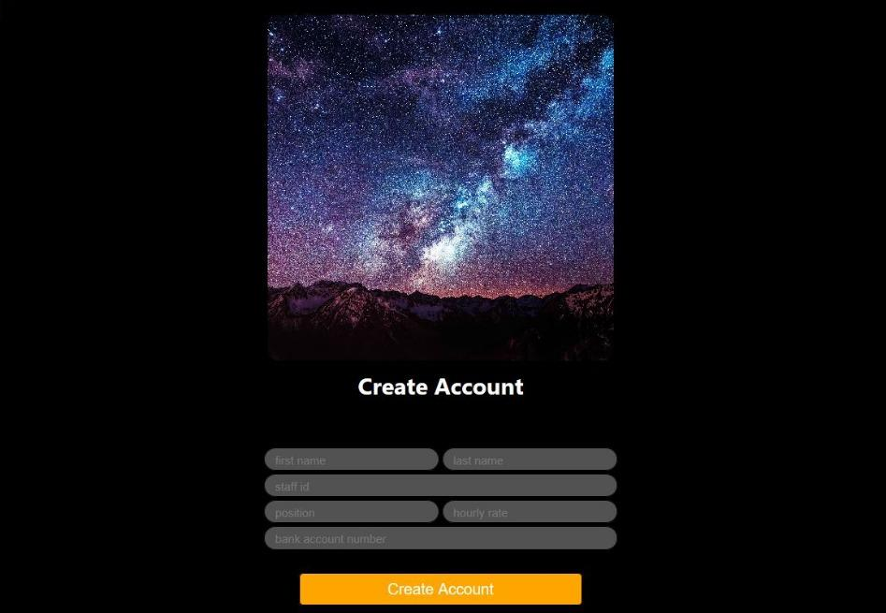
After gaining access from the verification page, newly appointed staffs are now able to fill in their information (first name, last name, staff ID, position, hourly rate, and bank account number). Their staff IDs are given by their managers.

Slide 11
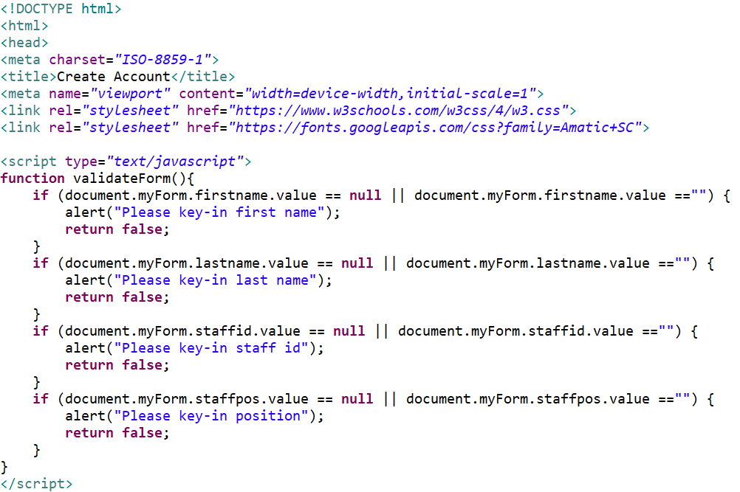
Staff Create Account Source Code (S_Creates.html….)

Slide 12
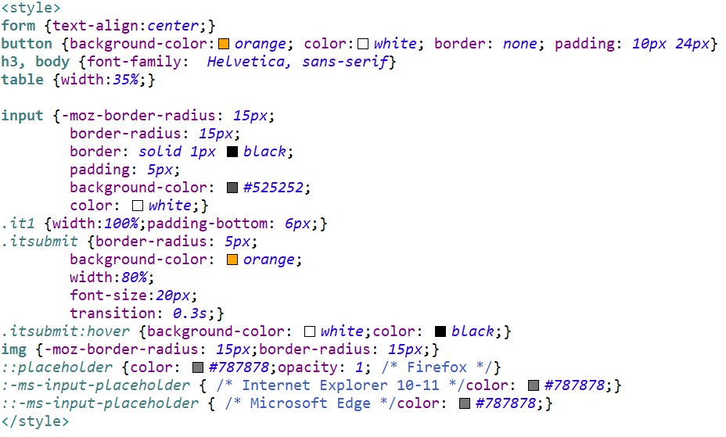

Slide 13
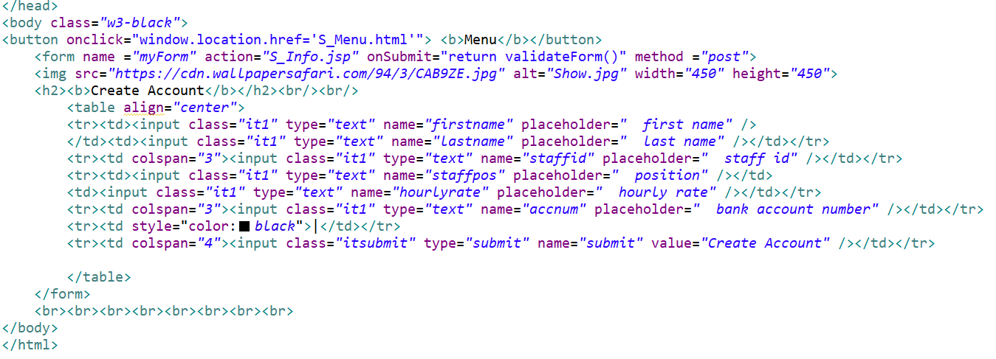

Slide 14
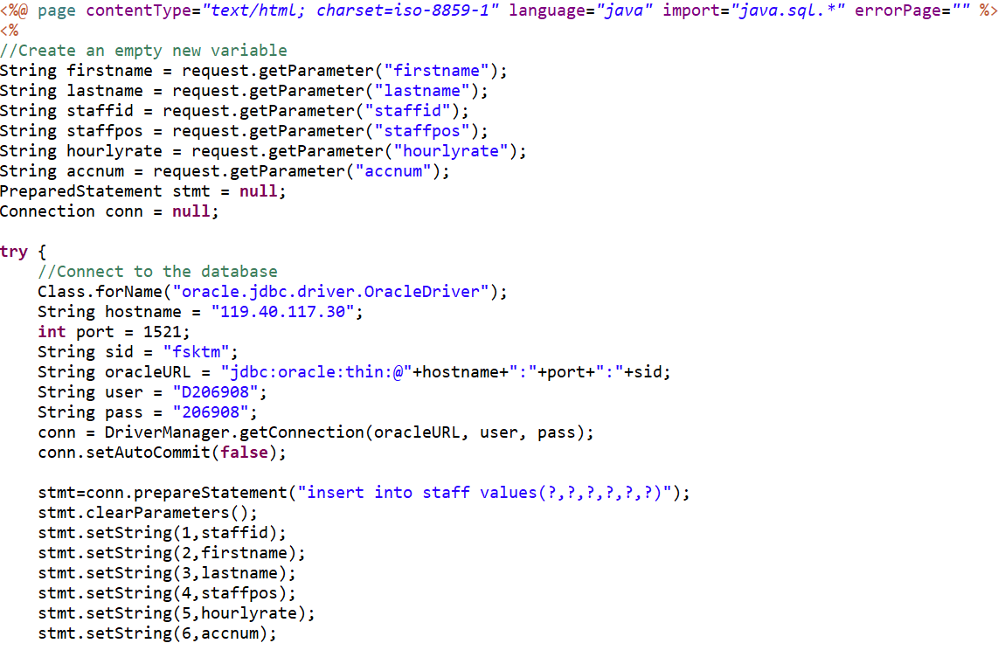
(...& S_Info.jsp)

Slide 15
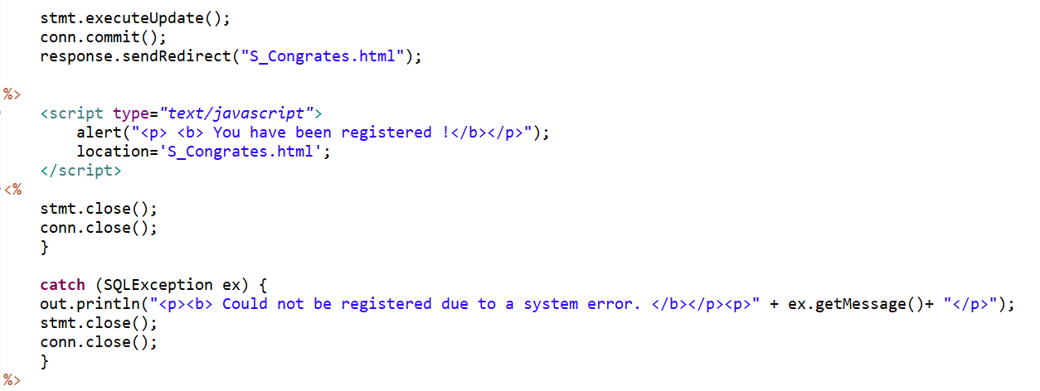

Slide 16
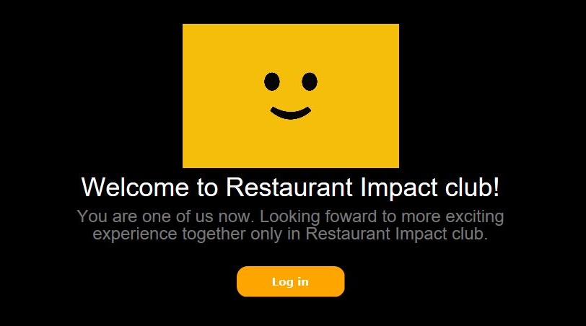
Right after they’ve completely filled in the form, this page will show up, congratulating them for successfully creating their accounts and officially becoming staffs of MAMAKHUT.

Slide 17
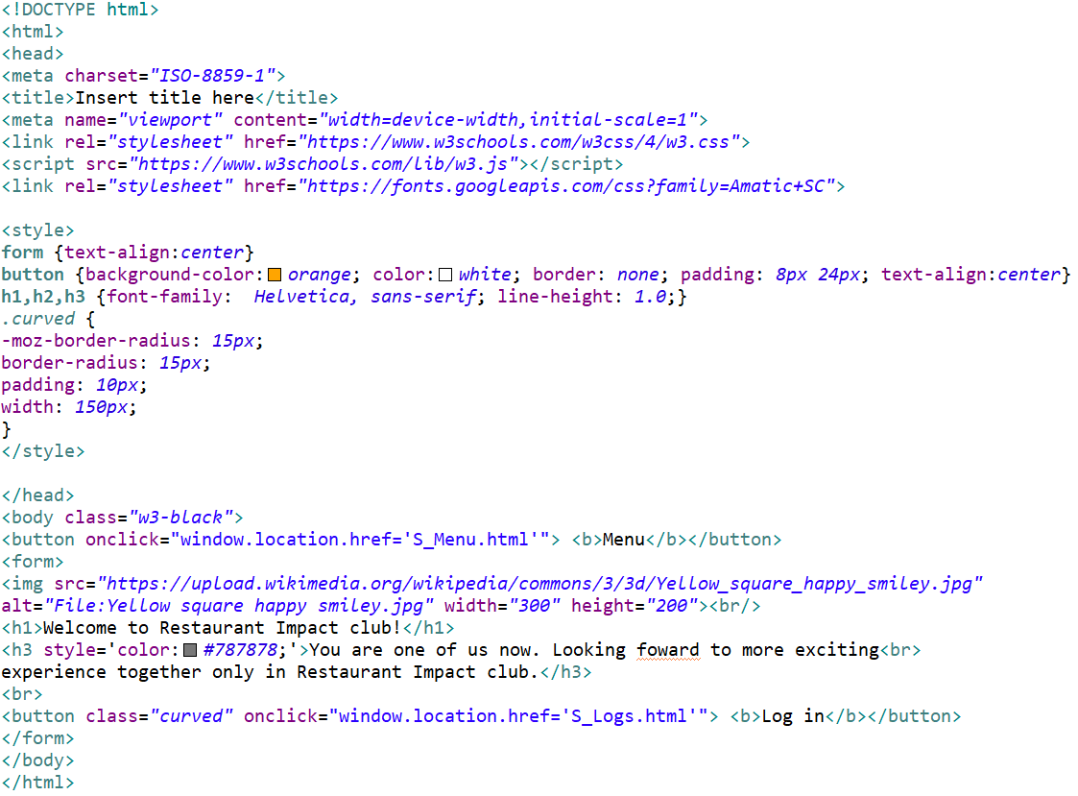
Staff Congratulations Source Code (S_Congrates.html)

Slide 18
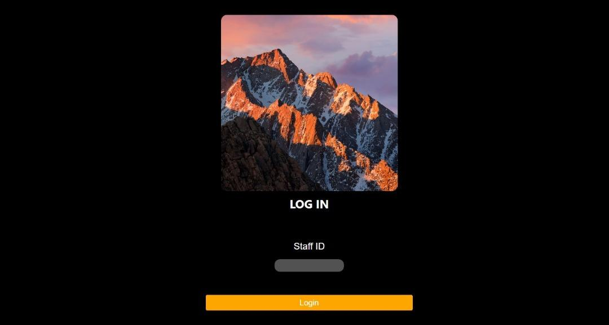
For staffs that have already created their accounts. This page allows them to log in using their staff ID. If they fail to insert their staff ID, they will not be able to continue from this interface.

Slide 19
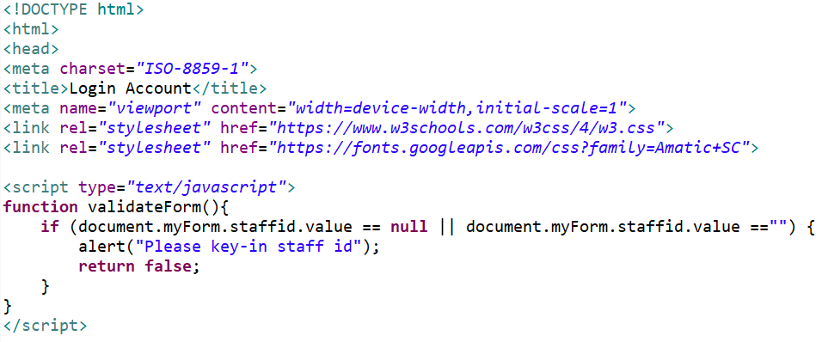
Staff Log In Source Code (S_Logs.html…)

Slide 20
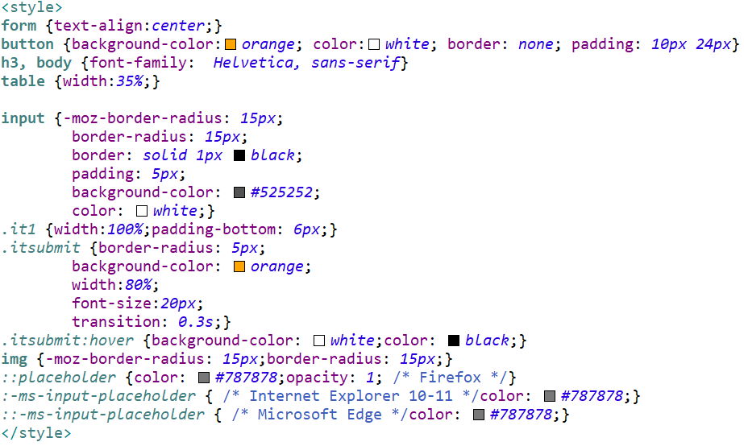

Slide 21
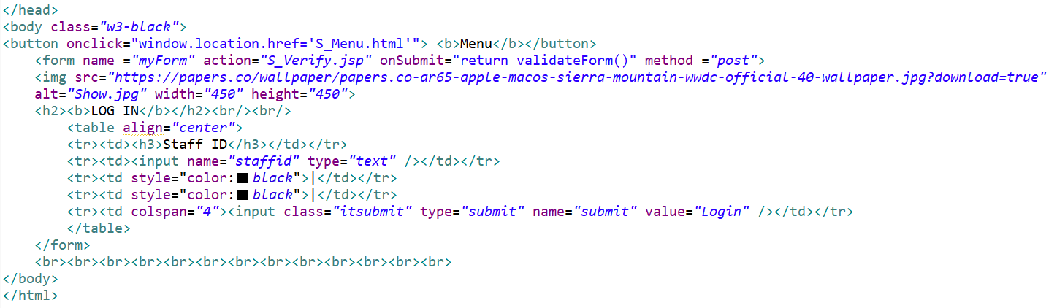

Slide 22
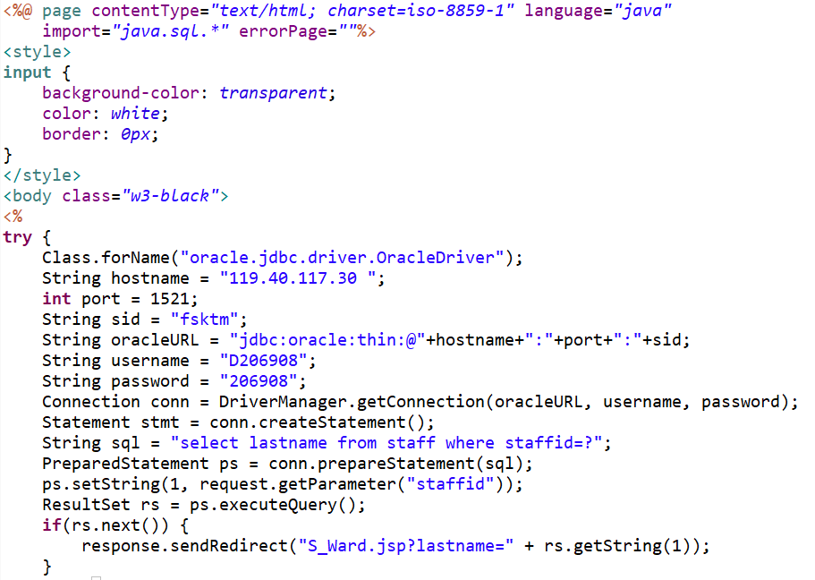
(...& S_Verifyjsp)

Slide 23
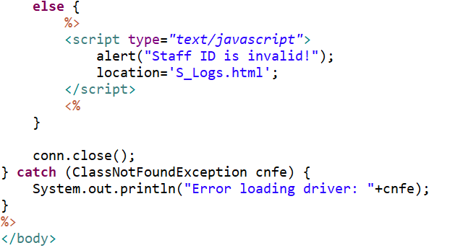

Slide 24
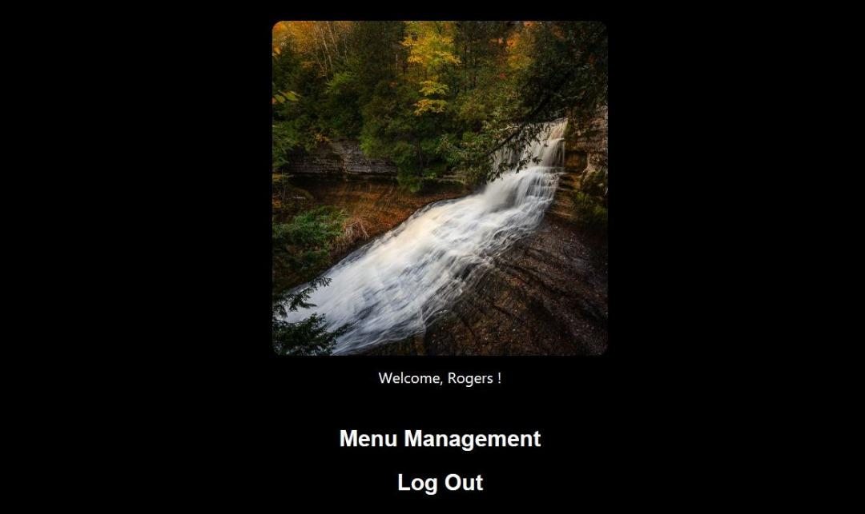
This page will show itself once staffs have successfully imputed their staff ID. Now, they are able to continue to menu management or log out.

Slide 25
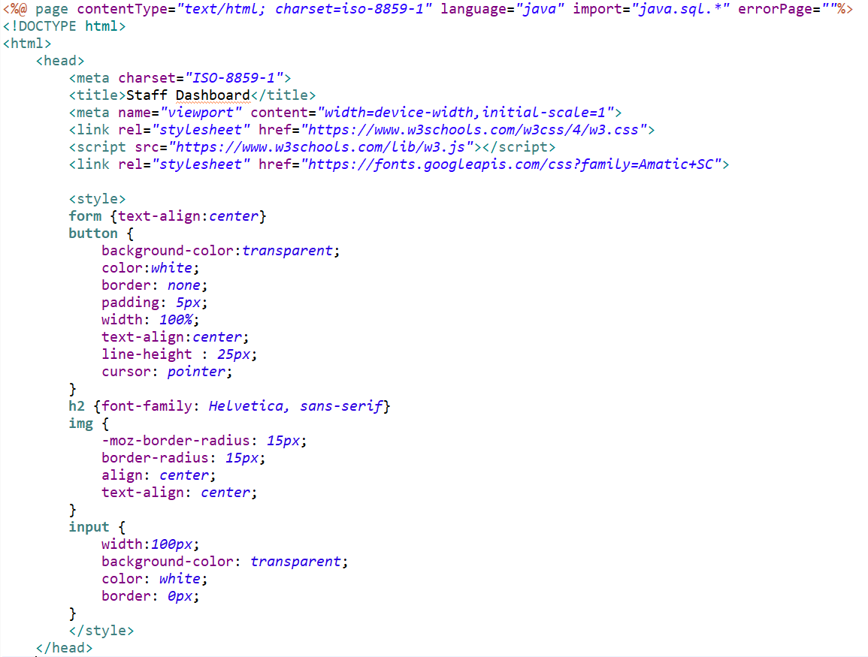
Staff Verified Source Code (S_Ward.jsp)

Slide 26
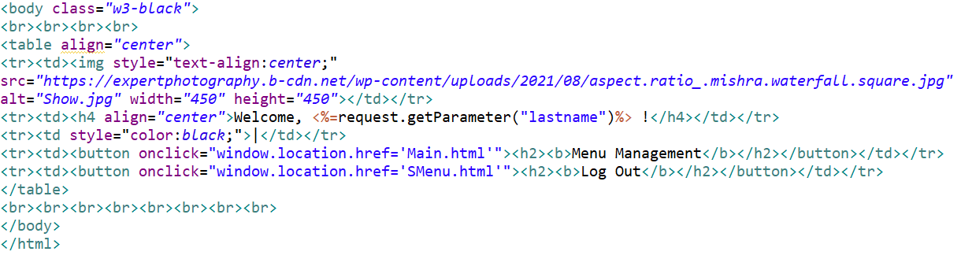

Slide 27
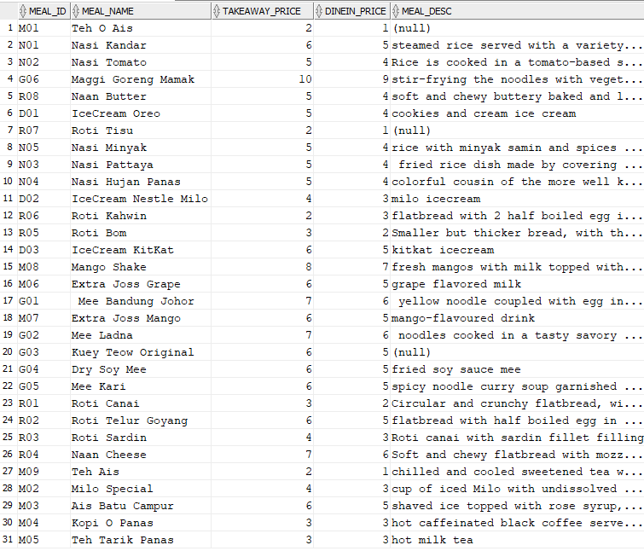
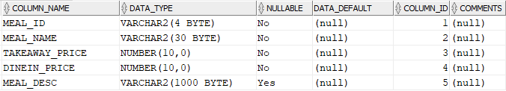
Menu Management Database
All data of meal are stored inside MEAL table
The ID for meal ID is created specifically to classified each meal to their category of menu.
For example, M01 for ‘minuman’, N01 for ‘nasi’,
G01 for ‘goreng’, R01 for ‘roti’ and D01 for ‘dessert’.
This is being done so that we can retrieve the data in group of category.

Slide 28
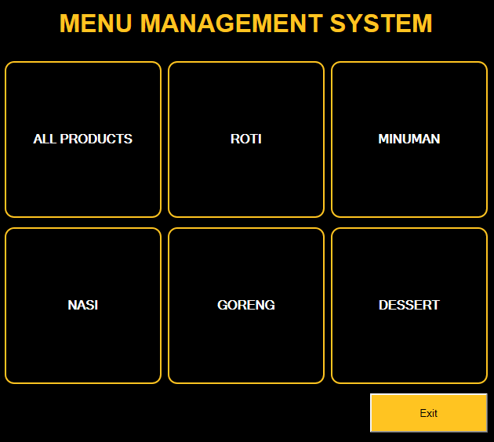
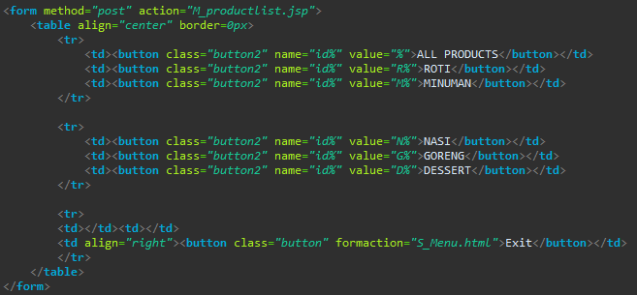
Menu Management Main Menu
(M_Main.html)
Each of these button is given the name “id%” with the value as such (%,R%,M%,N%,G%,D%). This is being done so that it can be retrieved from the database based on their category.

Slide 29
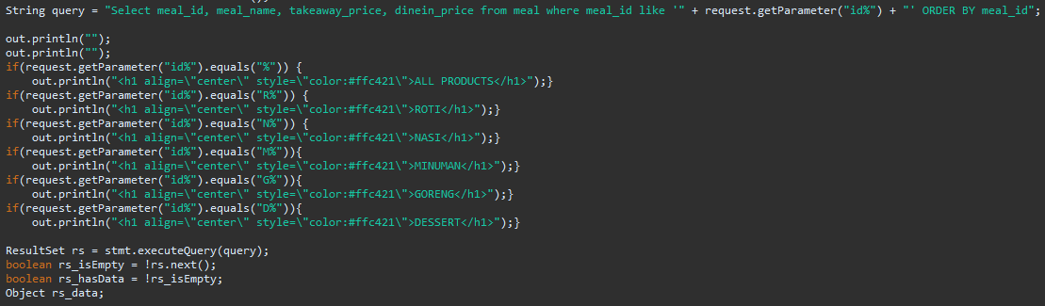
Menu Management Product List
(M_productlist.jsp)
The value from the previous button is being carried to M_productlist.jsp by the form action from M_Main.html.
In this case, user will choose to click on “ROTI” so, the value R% is being carried to this jsp file.
Before the query is being execute, the jsp file will first display the heading according to the category chosen.
In this case, the condition is comparing the value of parameter with the name ‘id%’ whether it is equal to R%.
Since the condition is true, the heading ROTI will be shown.

Slide 30
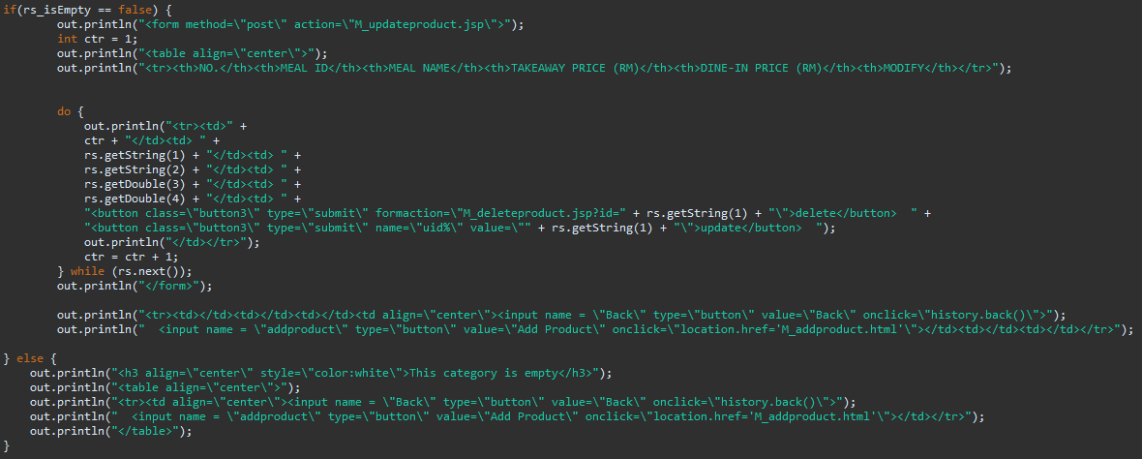
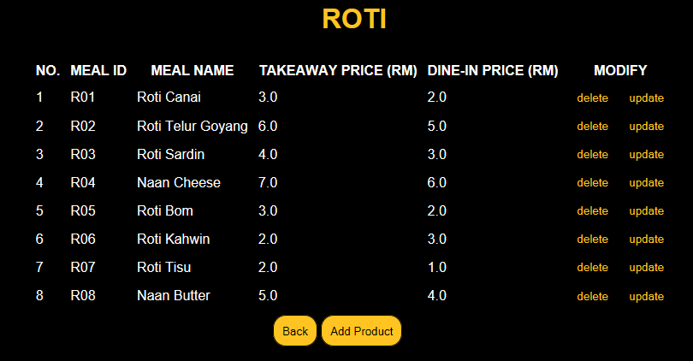
Menu Management Product List (M_productlist.jsp)
The product list is being displayed inside a table so that it can easily be seen but before that, the file check whether the query brings any value so that if it does not, the file will not accidentally request for a value even if it’s empty and it will result to an error occur. The delete button have a specific form action because a specific meal id is required to delete its data. The same situation with update button, it will need specific meal id to be targeted.

Slide 31
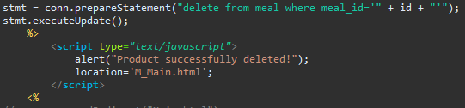
Menu Management Product Delete
(M_deleteproduct.jsp)
Firstly, the query will retrieve the meal ID from previous page. The id will be used inside the query statement. After the statement has been executed, the alert message will appear says that “Product successfully deleted!”. Then, the file will redirect user back to M_Main.html.

Slide 32
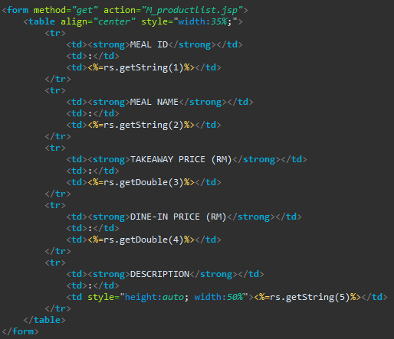
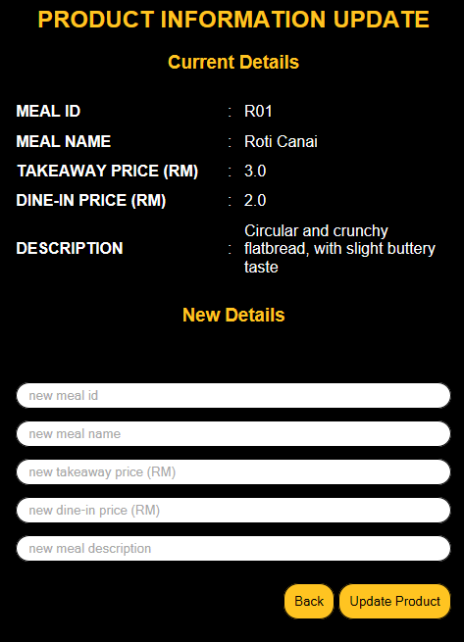
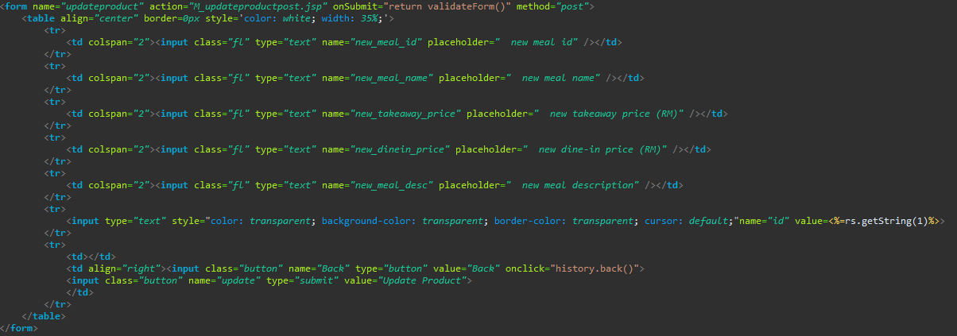
Menu Management Product Update (M_updateproduct.jsp)
Before anything, a query of (“Select meal_id, meal_name, takeaway_price, dinein_price, meal_desc from meal where meal_id='" + request.getParameter("uid%") + "'") is being executed to retrieve the data from MEAL table with the specific meal ID. This is to show user the current details of the meal and allow them to compare with the new details they about to modify.
This table is to display the current details that being retrieve from the database. Meanwhile, the table at the bottom contain textfields to receive input from the user and update the data to the database. On submit, this form will redirect to validateForm() function to validate each textfields whether they have value or not. Next, We can see that meal ID is still being carried to the next page (M_updateproductpost.jsp). This is for the query to execute the update statement with the targeted meal ID.

Slide 33

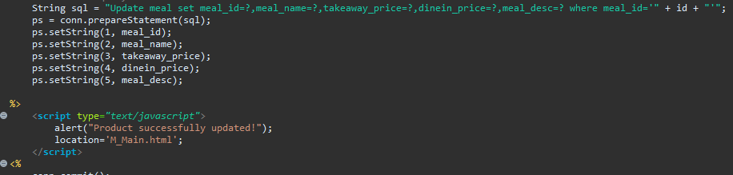
Menu Management Product Update
(M_updateproductpost.jsp)
Firstly, these variables are being declared with the value from the previous form.
Next, the sql statement is being executed updating each column with their value from previous form. After that, an alert message pop up notifying the user that “Product successfully updated!” and redirect user to M_Main.html.

Slide 34
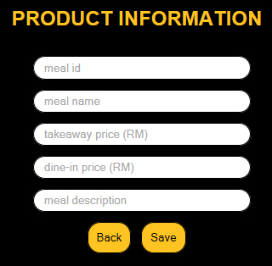
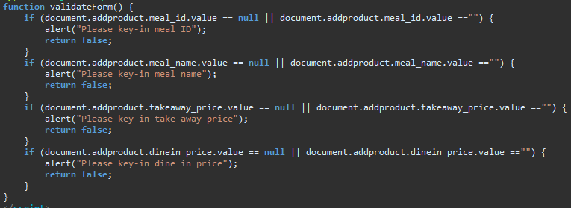
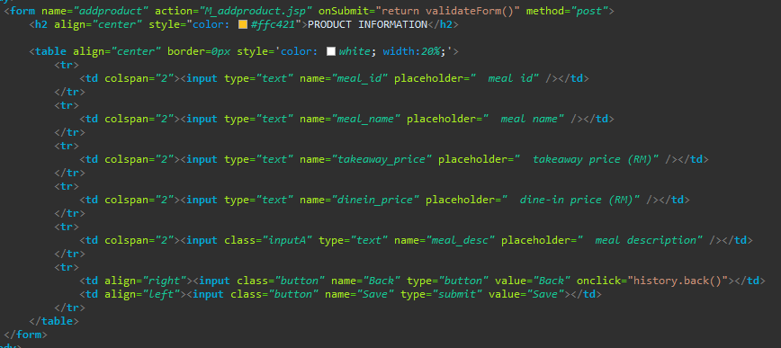
Menu Management Add Product
(M_addproduct.html)
This file contains textfields inside a table to receive inputs from the user regarding the new meal details. On submit, the form will redirect to validateForm() function to observe whether each textfield has been filled or not. We can see that there is no validation for meal description. This is to allow user to add product comfortably in any kind of situation. The meal description can always be updated after it has been created.

Slide 35

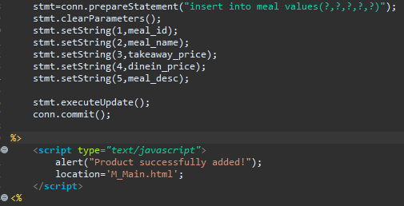
Menu Management Add Product
(M_addproduct.jsp)
Firstly, these variables are being declared with the value from the previous form.
Next, the sql statement is being executed inserting each column with their value from previous form. After that, an alert message pop up notifying the user that “Product successfully added!” and redirect user to M_Main.html.

Slide 36
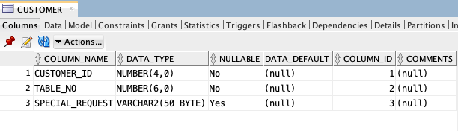
Web Ordering Database
create table CUSTOMER (
CUSTOMER_ID number (4) NOT NULL ,
TABLE_NO number (6) NOT NULL,
SPECIAL_REQUEST varchar2 (50));

Slide 37
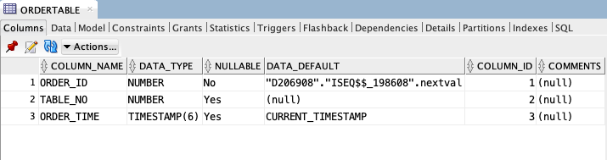
Web Ordering Database
CREATE TABLE ORDERTABLE (
order_id NUMBER GENERATED BY DEFAULT ON NULL AS IDENTITY,
table_no NUMBER,
order_time TIMESTAMP DEFAULT CURRENT_TIMESTAMP);

Slide 38
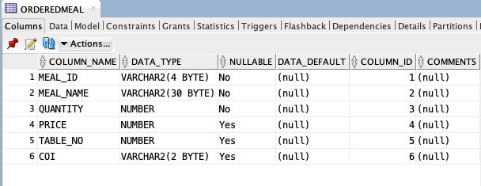
Web Ordering Database
CREATE TABLE ORDEREDMEAL (
id NUMBER GENERATED BY DEFAULT ON NULL AS IDENTITY,
meal_id varchar2(4) NOT NULL,
meal_name varchar2(30) NOT NULL,
quantity number NOT NULL,
Price number NOT NULL,
Table_No varchar2 (6) ,
COI varchar2 (2));

Slide 39
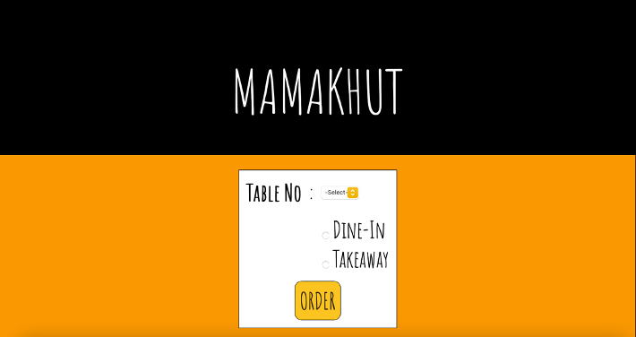
Web-Ordering Module Demo
In web-ordering module, we designed it for the customers to make their orders. Customers will be directed to the MAMAKHUT interface that will provide functionality for customers to key in :
Table number
Preferences to dine-in or takeaway

Slide 40
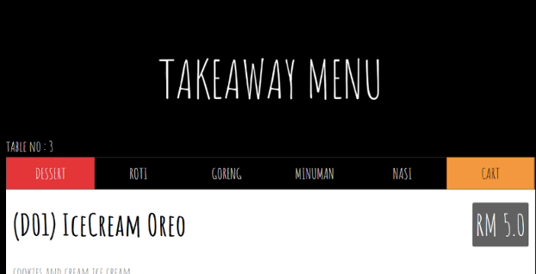
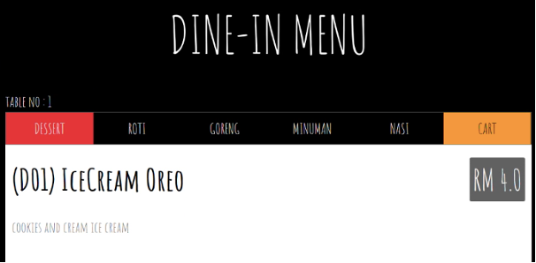
Based on the customers preferences, they will be assist to either TakeAway Menu or Dine-In Menu. The only difference between these menu is the price of every product.
In the menu list, every product has been divided into its own categories such as dessert, roti, goreng, minuman and nasi. Customers are able to go through the complete details of menu as we have provided the details like mealID, mealname, takeaway or dine-in price and meal description. On the right side of the page, cart column is displayed to collect every orders that customer has been added.
After the customers have decided on what to choose, customers are able to place their orders. This module provides functionality for the customers to :
Choose amount of product
Add to cart

Slide 41
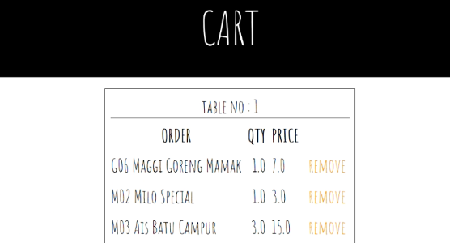

In the cart list, a receipt with table number will be displayed. The receipt will list down the ordered product including the quantity and cumulative price. We also provide remove functionality so that customers are able to remove any product that they want in case there is any change of mind.
Below the receipt, we provide back and confirm button functionality so that customers can add more products in their cart by simply clicking the back button which will then assist them to the menu list back. Once the customers satisfied with their order, they can click the confirm button.

Slide 42


The customer's order will be sent to the restaurant kitchen once they click the confirm button. The customer's order will be displayed on the order chit, much like in the cart list, with the table number, meal ID, meal name, amount of each product with the price, and the total price of the order.

Slide 43
Web Ordering System Source Code
add2cart_dinein.jsp
<%@ page contentType="text/html; charset=iso-8859-1" language="java" import="java.sql.*" errorPage=""%>
<%
String message = null;
String meal_id = request.getParameter("meal_id");
String meal_name = request.getParameter("meal_name");
int table_no = Integer.parseInt(request.getParameter("tableNum"));
String COI = "DI";
//double qty = Double.parseDouble(request.getParameter("quantity"));
//double price = Double.parseDouble(request.getParameter("price"));
double price = Double.parseDouble(request.getParameter("price"));
double qty = Double.parseDouble(request.getParameter("quantity"));
double totalprice = price * qty;
PreparedStatement stmt = null;
Connection conn = null;
try {
//Connect to the database
Class.forName("oracle.jdbc.driver.OracleDriver");
String hostname = "119.40.117.30";
int port = 1521;
String sid = "fsktm";
String oracleURL = "jdbc:oracle:thin:@"+hostname+":"+port+":"+sid;
String user = "D206908";
String pass = "206908";

Slide 44
conn = DriverManager.getConnection(oracleURL, user, pass);
conn.setAutoCommit(false);
stmt =conn.prepareStatement("insert into orderedmeal (meal_id,meal_name,quantity,price,table_no,COI) values(?,?,?,?,?,?)");
stmt.clearParameters();
stmt.setString(1,meal_id);
stmt.setString(2,meal_name);
stmt.setDouble(3,qty);
stmt.setDouble(4,totalprice);
stmt.setInt(5,table_no);
stmt.setString(6,COI);
stmt.executeUpdate();
conn.commit();
response.sendRedirect("menulist_dinein.jsp?table_no=" + table_no);
stmt.close();
conn.close();
} catch (SQLException ex) {
out.println("<p><b> Could not be registered due to a system error. </b></p><p>" + ex.getMessage()+ "</p>");
stmt.close();
conn.close();
}
%>

Slide 45
add2cart_takeaway.jsp
<%@ page contentType="text/html; charset=iso-8859-1" language="java" import="java.sql.*" errorPage=""%>
<%
String message = null;
String meal_id = request.getParameter("meal_id");
String meal_name = request.getParameter("meal_name");
int table_no = Integer.parseInt(request.getParameter("tableNum"));
String COI = "TA";
//double qty = Double.parseDouble(request.getParameter("quantity"));
//double price = Double.parseDouble(request.getParameter("price"));
double price = Double.parseDouble(request.getParameter("price"));
double qty = Double.parseDouble(request.getParameter("quantity"));
double totalprice = price * qty;
PreparedStatement stmt = null;
Connection conn = null;
try {
//Connect to the database
Class.forName("oracle.jdbc.driver.OracleDriver");
String hostname = "119.40.117.30";
int port = 1521;
String sid = "fsktm";
String oracleURL = "jdbc:oracle:thin:@"+hostname+":"+port+":"+sid;
String user = "D206908";
String pass = "206908";
conn = DriverManager.getConnection(oracleURL, user, pass);
conn.setAutoCommit(false);

Slide 46
stmt =conn.prepareStatement("insert into orderedmeal (meal_id,meal_name,quantity,price,table_no,COI) values(?,?,?,?,?,?)");
stmt.clearParameters();
stmt.setString(1,meal_id);
stmt.setString(2,meal_name);
stmt.setDouble(3,qty);
stmt.setDouble(4,totalprice);
stmt.setInt(5,table_no);
stmt.setString(6,COI);
stmt.executeUpdate();
conn.commit();
response.sendRedirect("menulist_takeaway.jsp?table_no=" + table_no);
stmt.close();
conn.close();
} catch (SQLException ex) {
out.println("<p><b> Could not be registered due to a system error. </b></p><p>" + ex.getMessage()+ "</p>");
stmt.close();
conn.close();
}
%>

Slide 47
deleteproductfromcart.jsp
<%@ page language="java" contentType="text/html; charset=ISO-8859-1"
pageEncoding="ISO-8859-1"%>
<%@page import="java.sql.*,java.util.*"%>
<%
String id = request.getParameter("id");
int table_no = Integer.parseInt(request.getParameter("table_no"));
PreparedStatement stmt = null;
Connection conn = null;
try {
Class.forName("oracle.jdbc.driver.OracleDriver");
String hostname = "119.40.117.30";
int port = 1521;
String sid = "fsktm";
String oracleURL = "jdbc:oracle:thin:@"+hostname+":"+port+":"+sid;
String user = "D206908";
String pass = "206908";
conn = DriverManager.getConnection(oracleURL, user, pass);
conn.setAutoCommit(false);
stmt = conn.prepareStatement("delete from orderedmeal where meal_id='" + id + "'");
stmt.executeUpdate();
response.sendRedirect("menulist_dinein.jsp?table_no=" + table_no);
conn.commit();
} catch(Exception e) {
stmt.close();
conn.close();
System.out.print(e);
e.printStackTrace();
}
%>

Slide 48
midsubmitorder.jsp
<%@ page contentType="text/html; charset=iso-8859-1" language="java" import="java.sql.*" errorPage=""%>
<%
String message = null;
int table_no = Integer.parseInt(request.getParameter("table_no"));
PreparedStatement stmt = null;
Connection conn = null;
try {
//Connect to the database
Class.forName("oracle.jdbc.driver.OracleDriver");
String hostname = "119.40.117.30";
int port = 1521;
String sid = "fsktm";
String oracleURL = "jdbc:oracle:thin:@"+hostname+":"+port+":"+sid;
String user = "D206908";
String pass = "206908";
conn = DriverManager.getConnection(oracleURL, user, pass);
conn.setAutoCommit(false);

Slide 49
stmt =conn.prepareStatement("insert into ordertable (table_no) values(?)");
stmt.clearParameters();
stmt.setInt(1,table_no);
stmt.executeUpdate();
conn.commit();
response.sendRedirect("submitorder.jsp?table_no=" + table_no);
stmt.close();
conn.close();
} catch (SQLException ex) {
out.println("<p><b> Could not be registered due to a system error. </b></p><p>" + ex.getMessage()+ "</p>");
stmt.close();
conn.close();
}
%>

Slide 50


Order Retrieval System Module Demo
Order retrieval system module is designed with the functionality to be used by restaurant employees. As this module assists employees with order placed by customers with table number, choice of interest, meal id, meal name and quantity; employees are able to keep track with every orders from time to time. This module provides the functionality for employees to :
Retrieve order from the database
Update every order placed by customers
Provide list of orders according to the time
Delete the orders that has been completed
Once every order has been completed and removed by restaurant employees, the order retrieval system will display a notice whereby no order can be retrieved from the database as customers did not placed any order for the time being.

Slide 51
Order Retrieval System Source Code
O_MainOrder.jsp
if(rs_isEmpty == false) {
int prevtable = rs.getInt(1);
out.println("<div id=\"order\" class=\"w3-container
w3-white w3-padding-32\">");
out.println("<form method=\"POST\" action=\"O_deleteorder.jsp\">");
out.println("<table align=\"center\">");
out.println("<tr><td colspan=\"2\">" + rs.getString(7)+ "</td><td>"
+ rs.getInt(6) + "</td></tr>");
out.println("<tr><td colspan=\"2\" align=\"center\" style='border-bottom:1px
solid black!important;border-top:1px solid black!important;'>TABLE "
+ rs.getInt(1) + "</td>"+ "<td style='border-bottom:1px solid
black!important;border-top:1px solid black!important'>
[ " + rs.getString(5)+ " ]</rd></tr>");
out.println("<tr><th>ID</th><th>NAME</th><th>QTY</th></tr>");
O_MainOrder.jsp source code works to display a list of order from data that has been retrieved from orderedmeal database. Order will be displayed according to the time. Once every order has
Been removed, order retrieval system will show a notice with “there is no current order” to notify restaurant employee about the orderedmeal status

Slide 52
Order Retrieval System Source Code
do {
if(rs.getInt(1) == prevtable) {
out.println("<tr><td>" + rs.getString(2) + "</td><td>" + rs.getString(3) + "</td><td>" + rs.getInt(4)+ "</td></tr>"); }
else {
out.println("<tr><td align=\"center\" colspan=\"3\"><button class=\"button3\" type=\"submit\" formaction=\"O_deleteorder.jsp?id=" + prevtable + "\">remove</button></td></tr>");
out.println("</table></div>");
out.println("<div id=\"order\" class=\"w3-container w3-white w3-padding-32\">");
out.println("<table align=\"center\">");
out.println("<tr><td colspan=\"2\">" + rs.getString(7)+ "</td><td>" + rs.getInt(6) + "</td></tr>");
out.println("<tr><td colspan=\"2\" align=\"center\" style='border-bottom:1px solid black!important;border-top:1px solid black!important;'>TABLE " + rs.getInt(1) + "</td>" + "<td style='border-bottom:1px solid black!important;border-top:1px solid black!important'>[ " + rs.getString(5)+ " ]</rd></tr>");
out.println("<tr><th>ID</th><th>NAME</th><th>QTY</th></tr>");
out.println("<tr><td>" + rs.getString(2) + "</td><td>" + rs.getString(3) + "</td><td>" + rs.getInt(4)+ "</td></tr>");
}
prevtable = rs.getInt(1);
} while(rs.next());
out.println("<tr><td align=\"center\" colspan=\"3\"><button class=\"button3\" type=\"submit\" formaction=\"O_deleteorder.jsp?id=" + prevtable + "\">remove</button></td></tr>");
out.println("</table>");
out.println("</form></div>");
}
else {
out.println("<h5 align=\"center\">there is no current order</h5>");
}

Slide 53
Order Retrieval System Source Code
O_deleteorder.jsp
try {
Class.forName("oracle.jdbc.driver.OracleDriver");
String hostname = "119.40.117.30";
int port = 1521;
String sid = "fsktm";
String oracleURL = "jdbc:oracle:thin:@"+hostname+":"+port+":"+sid;
String user = "D206908";
String pass = "206908";
conn = DriverManager.getConnection(oracleURL, user, pass);
conn.setAutoCommit(false);
stmt = conn.prepareStatement("delete from orderedmeal where table_no='" + id + "'");
stmt.executeUpdate();
stmt2 = conn.prepareStatement("delete from ordertable where table_no='" + id + "'");
stmt2.executeUpdate();
response.sendRedirect("O_MainOrder.jsp");
conn.commit();
} catch(Exception e) {
stmt.close();
conn.close();
System.out.print(e);
e.printStackTrace(); }
%>
O_deleteorder.jsp source code works to remove order that has been completed by the restaurant employed from orderedmeal database. The response or update will be send directly to the O_MainOrder.jsp

