Slide 1
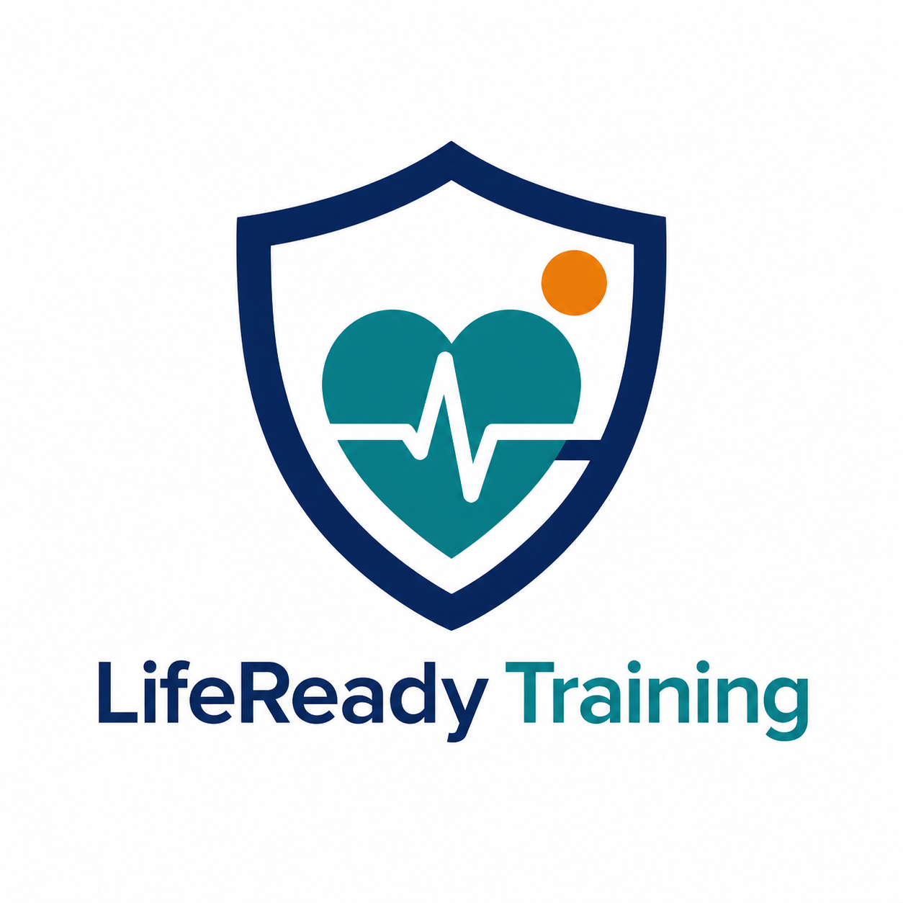
COMP229 — WEB APPLICATION DEVELOPMENT
LifeReady Training
Project Part 1 — Database, Backend & API Testing
An original MERN application for managing First Aid, CPR/AED, and BLS training classes.
Presented by: Amir Saad
Student ID: 301473849
Role: Full-Stack Developer (Independent Project)
Working project name and original logo — branding will be finalized later.
Notes:
[Sources]
- Logo: created with OpenAI image generation for this project; original asset stored in assets/branding/lifeready-training-logo.png.
[/Sources]

Slide 2
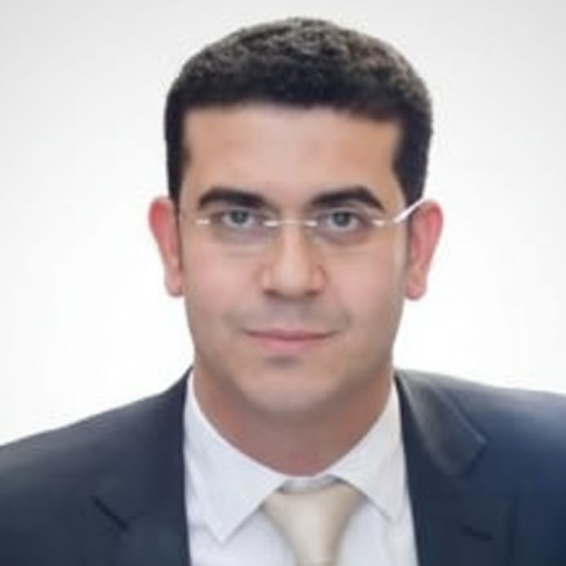
Developer Profile
The project is being completed independently with professor approval.
Part 1 Responsibilities
• Data modelling and MongoDB collections
• Express MVC API and authentication
• CRUD testing and project documentation
Amir Saad
Full-Stack Developer
LifeReady Training - Project Part 1 presentation
Notes:
[Sources]
- Photograph: supplied by Amir Saad for this presentation; stored in assets/presenter/amir-saad-photo.jpg.
[/Sources]

