Slide 1

Opening kava bar in northern va
Amir Schur
Final Project

Slide 2
What is kava
Kava is the common name for Piper methysticum — a member of the Piperaceae (pepper) family. This makes it a close relative of black pepper (Piper nigrum).
On the South Pacific Islands where kava originates, kava is used for both ceremonial and medicinal purposes — primarily for its powerful relaxing effects and the mild euphoric high it produces.
In higher doses, kava produces effects often described as euphoric. It makes users feel a strong sense of calmness and contention — almost as if all the problems experienced in the day-to-day have washed away.
Traditionally, these effects were used to help people reach higher states of meditation of spiritual connection, for grieving after losing a loved one, to show respect to the land, or simply socialize in a relaxed environment with friends and family.
Nowadays, kava is primarily used to help manage stress, anxiety, mild depression, and insomnia. Some use it for meditative purposes or to experience the mild, yet enjoyable high the plant produces.

Slide 3
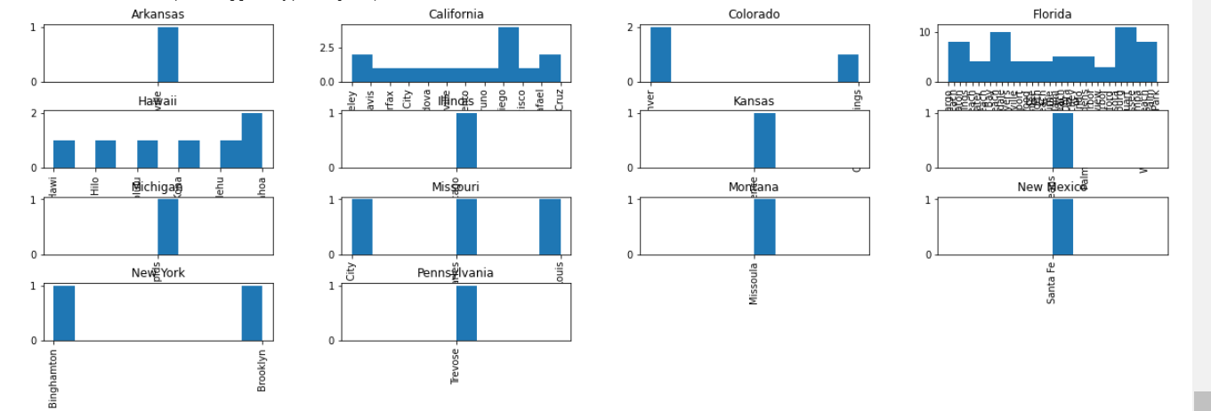
Current kava bar locations (USA)

Slide 4
Business opportunity
Only 1 location in DC
No open bars in VA
Where to open a location in VA? (Focus primarily in Northern VA)

Slide 5
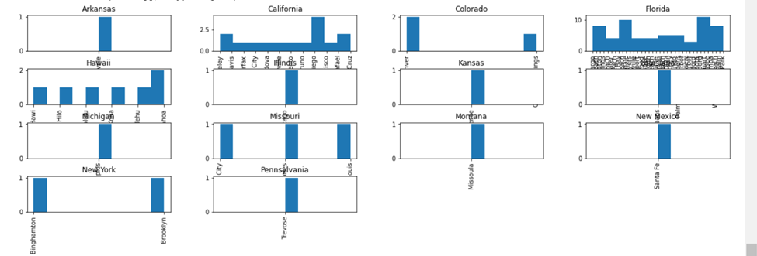
Initial List
https://kavaguides.com/kava-bars is a website that provides a comprehensive list of existing Kava Bars in the US.
After performing web scraping, it is obvious that the most location for Kava Bars is in Florida.

Slide 6
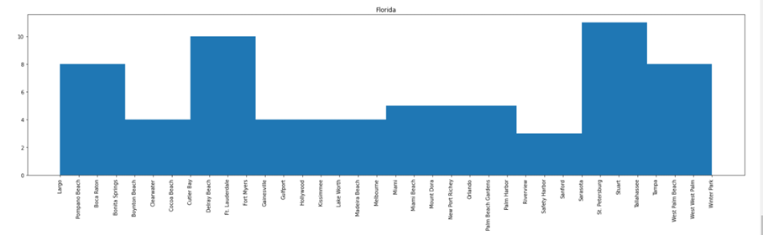
FOCUS AREA
Within Florida, the largest concentration listed is in St. Petersburg area. Since this is very close to Tampa, FL, these two cities are the focus of next investigation

Slide 7
WeB data scraping results
Name | State | City
Mad Hatters Ethnobotanical Tea Bar | Florida | St. Petersburg
Vapor Road – Tyrone | Florida | St. Petersburg
Bula Kafe | Florida | St. Petersburg
Grassroots Kava House | Florida | St. Petersburg
Lava Lounge | Florida | St. Petersburg
Muddy Water Kava | Florida | St. Petersburg
InVision Creative Cafe | Florida | St. Petersburg
Vapor Road – Disston | Florida | St. Petersburg
Steep Station | Florida | Tampa
SpookEasy Lounge | Florida | Tampa
Tampa Vapor – South Tampa | Florida | Tampa
Mad Chiller World Kava & Waffles | Florida | Tampa

Slide 8
Foursquare data
As the original data doesn’t have much information, except Business Name, City and State, we have to try to correlate existing info through Foursquare to find more information for each business found.
From Foursquare, we can find corresponding latitude, longitude, venue id, type of business, mailing address, food delivery provider (e.g. grubhub), etc

Slide 9
Foursquare data (typical results)
'formattedAddress': ['4685 28th St N', 'Saint Petersburg, FL 33714']},
'categories': [{'id': '4bf58dd8d48988d1dc931735',
'name': 'Tea Room',
'pluralName': 'Tea Rooms',
'shortName': 'Tea Room',
'icon': {'prefix': 'https://ss3.4sqi.net/img/categories_v2/food/tearoom_',
'suffix': '.png'}, 'primary': True}],
'delivery': {'id': '2290115',
'url': 'https://www.grubhub.com/restaurant/mad-hatters-tea-bar-4685-28th-st-n-st-petersburg/2290115?affiliate=1131&utm_source=foursquare-affiliate-network&utm_medium=affiliate&utm_campaign=1131&utm_content=2290115',
'provider': {'name': 'grubhub',
'icon': {'prefix': 'https://fastly.4sqi.net/img/general/cap/',
'sizes': [40, 50],
'name': '/delivery_provider_grubhub_20180129.png'}}},
'venuePage': {'id': '84652858'},
'referralId': 'v-1627694142',
'hasPerk': False}]}}
{'meta': {'code': 200, 'requestId': '6104a43e27bacf02d8748a17'},
'notifications': [{'type': 'notificationTray', 'item': {'unreadCount': 0}}],
'response': {'venues': [{'id': '535ca397498e9b2d664310e3',
'name': 'Mad Hatters Ethnobotanical Tea Bar',
'location': {'address': '4685 28th St N',
'lat': 27.814484741712977,
'lng': -82.67109951761368,
'labeledLatLngs': [{'label': 'display',
'lat': 27.814484741712977,
'lng': -82.67109951761368}],
'distance': 4912, 'postalCode': '33714',
'cc': 'US', 'city': 'Saint Petersburg',
'state': 'FL’, 'country': 'United States',

Slide 10
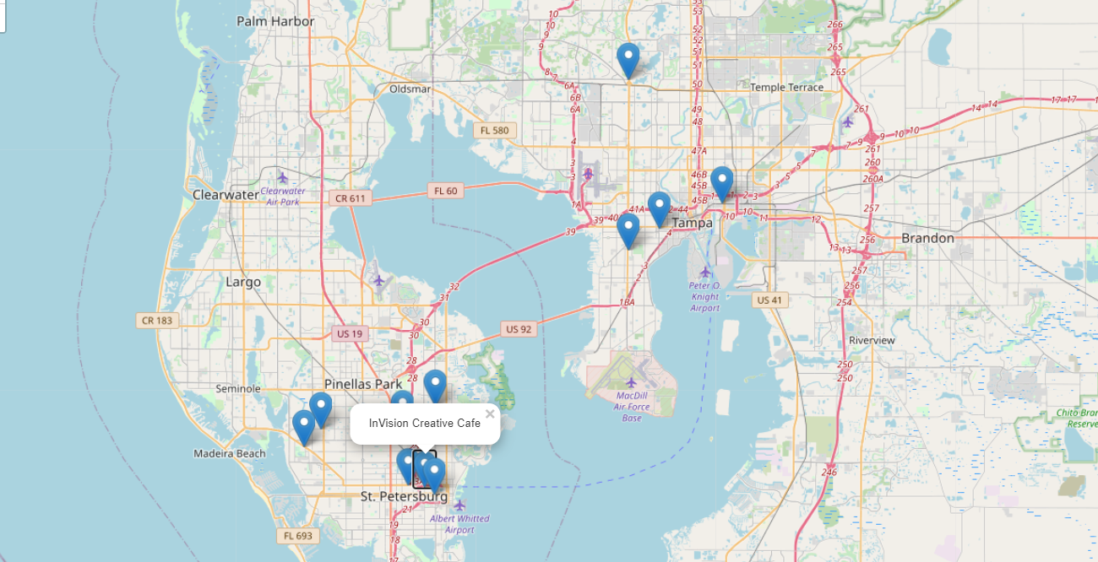
Existing business map

Slide 11
Data analysis
They are actually registered as different type of business:
Tea Room (7 places), Vape Store (2), Café (1), Lounge (1), Smoke Shop (1)
Majority of them are “Tea Rooms”.
Majority also has grubhub delivery service.
Looking at the locations in the map, they are actually quite spread apart.
Dominant zip code: 33705 (2 locations) and 33710 (2 locations).
Since the locations are very spread apart and only two zip codes have two kava bars, the next step is to analyze these two zip codes. Interesting point is the fact there these businesses opened in the same zip code.
Zip code 33710 are all categorized by Four Square as Vape Stores – which is not a real Kava bar, thus we will skip.
Zip code 33705 are all Tea Rooms. This will be our focus of further analysis: cluster neighborhood data from Foursquare.
We will try to investigate more in zip code 33705 (2 Kava Bars there: Grassroots Kava House and InVision Creative Café).
Further investigation on 33705 zipcode using Foursquare, we find the top 5 businesses around that zip code are: Art Gallery (4), Bar (4), Brewery (4), Coffee Shop (4), Yoga Studio (2)
This business list can be a footprint for future location search.

Slide 12
recommendations
Open the business close to metro area with modern vibe characteristics, close proximity to: art gallery, brewery, coffee shop, yoga studio and bars.
Open the business as a Tea Room

