Slide 1
Observability
Instrumentation and Structured Logging

Slide 2
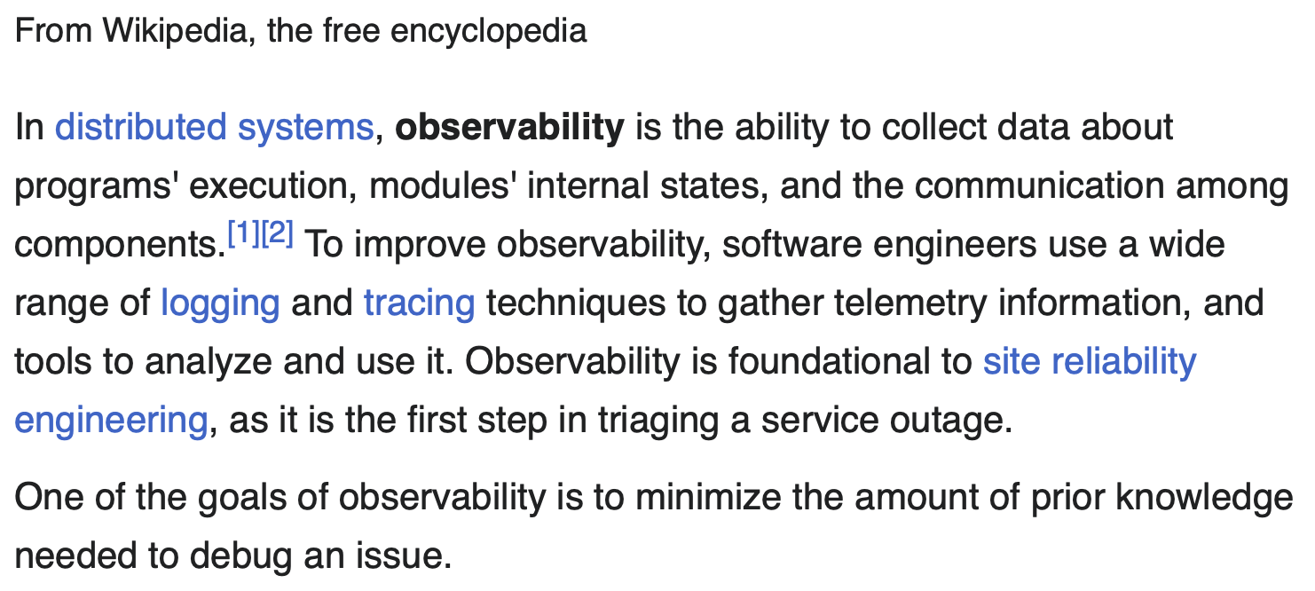
Observability, Logging, Tracing and SRE

Slide 3
Assumption

Slide 4
Structured Logging
log-schema.json
{
"mdc": {
"$resolver": "mdc"
},
"exceptionClass": {
"$resolver": "exception",
"field": "className"
},
"stackTrace": {
"$resolver": "exception",
"field": "stackTrace",
"stringified": true
},
"message": {
"$resolver": "message",
"stringified": true
},
"thread": {
"$resolver": "thread",
"field": "name"
},
"timestamp": {
"$resolver": "timestamp",
"pattern": {
"format": "yyyy-MM-dd'T'HH:mm:ss.SSS'Z'",
"timeZone": "UTC"
}
},
"level": {
"$resolver": "level",
"field": "name"
},
"logger": {
"$resolver": "logger",
"field": "name"
}
}
log4j2.xml - JsonTemplateLayout Appender
<?xml version="1.0" encoding="UTF-8"?>
<configuration>
<Appenders>
<Console name="LogToConsole" target="SYSTEM_OUT">
<JsonTemplateLayout eventTemplateUri="classpath:log-schema.json" />
</Console>
</Appenders>
…
</configuration>
pom.xml - dependency for JSON Layout formatter
<dependency>
<groupId>org.apache.logging.log4j</groupId>
<artifactId>log4j-layout-template-json</artifactId>
<version>2.20.0</version>
</dependency>

Slide 5
Advantages
No changes in Java code
No more broken exceptions in ADX and Log Explorer
Searchable fields such as level, thread, spandId and traceId
More precise/clean alert policies
Plain text log (human readable) in local machine

Slide 6
Distributed Tracing - Logs
pom.xml - Distributed Tracing
<dependency>
<groupId>io.micrometer</groupId>
<artifactId>micrometer-tracing-bridge-otel</artifactId>
</dependency>

Slide 7
Http - RestTemplate
RestTemplate
@Bean
RestTemplate restTemplate(RestTemplateBuilder builder) {
return builder.build();
}
Reference: https://spring.io/blog/2022/10/12/observability-with-spring-boot-3#resttemplate-application-client-code

Slide 8
Kafka Consumer
ConcurrentKafkaListenerContainerFactory, to enable Micrometer and Observability
factory.getContainerProperties().setMicrometerEnabled(true);
factory.getContainerProperties().setObservationEnabled(true);

Slide 9
Advantages
Automatic Dirstributed Tracing through the followins:
      HTTP Requests/Responses
      Kafka Topics (Producer and Consumer)
      Service-mesh (Istio logs)
Minimum changes to the code and configurations
Easy/precise troubleshooting

Slide 10
Distributed Tracing - Dashboards
pom.xml - Exporter
<dependency>
<groupId>io.opentelemetry</groupId>
<artifactId>opentelemetry-exporter-jaeger</artifactId>
</dependency>
application.properties - Exporter to send traces to listener/collector
# Exporter
tracing.url=http://jaeger-all-in-one.default:14250
# Actuator
management.tracing.enabled= true
management.tracing.sampling.probability= 1.0
Exporter
@Bean
public JaegerGrpcSpanExporter otelJaegerGrpcSpanExporter(@Value("${tracing.url}") String url) {
return JaegerGrpcSpanExporter.builder().setEndpoint(url).build();
}

Slide 11
Advantages
Monitor distributed workflows
Track down root causes
Address performance bottleneks
Comparing traces

