Slide 1
Inductive Invariant and Resource Bound Inference
Ravichandhran Madhavan,
Viktor Kuncak,
EPFL, Switzerland

Slide 2
Invariants
x = 0
y = n
while(y > 0){
x = x + 1
y = y - 1
}
//invariant: x+y = n
//invariant: y>=0 => x<=n

Slide 3

Inductive Invariants
x = 0
y = n
//x+y = n
while(y > 0){
//x+y = n $∧$ y > 0
x = x + 1
//x+y = n+1
y = y – 1
//x+y = n
}
//invariant: x+y = n
Invariant holds initially
Invariant holds at the start of the loop
=>
invariant holds at the end of the loop

Slide 4

Not all Invariants are Inductive
x = 0
y = n
//y>=0 => x<=n
while(y > 0){
//x <= n $∧$ y > 0
x = x + 1
//x <= n+1 $∧$ y > 0
y = y – 1
//x <= n+1 $∧$ y >= 0
}
//invariant: x <= n
Invariant cannot be
proved by induction

Slide 5
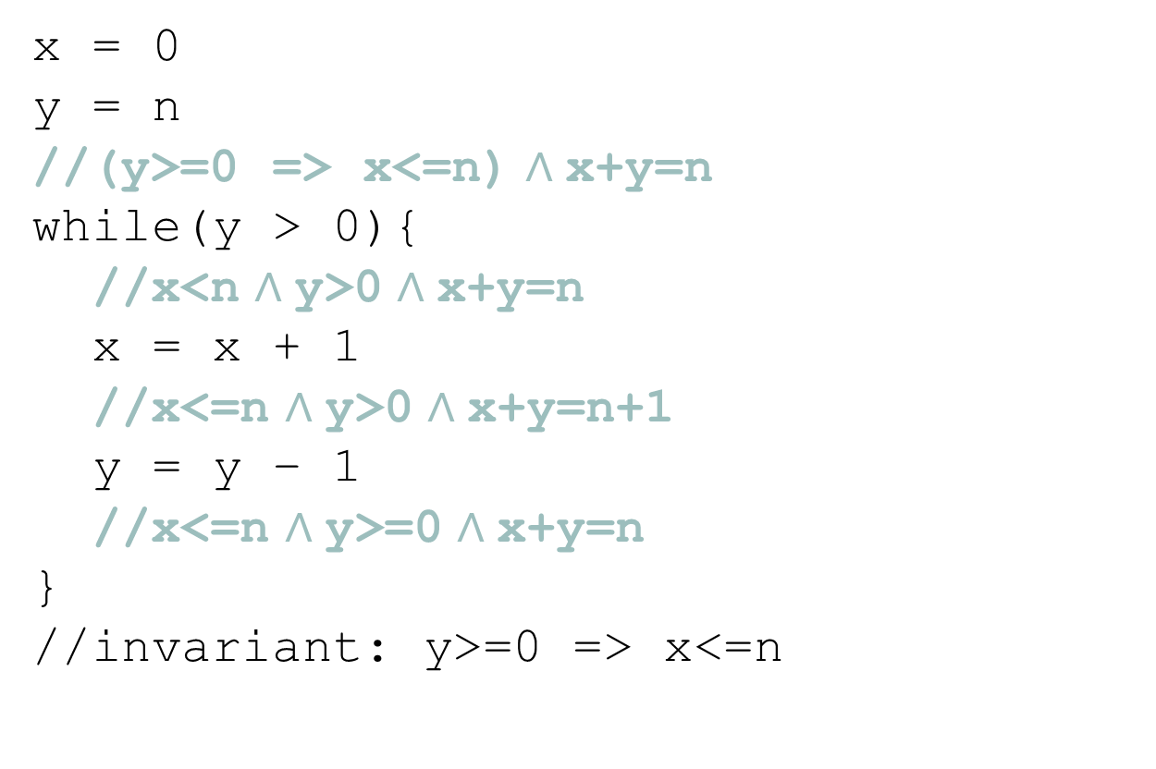
Inductive Strengthening
x = 0
y = n
//(y>=0 => x<=n) $∧$x+y=n
while(y > 0){
//x<n $∧$y>0 $∧$x+y=n
x = x + 1
//x<=n $∧$y>0 $∧$x+y=n+1
y = y – 1
//x<=n $∧$y>=0 $∧$x+y=n
}
//invariant: y>=0 => x<=n
Implied by the stronger inductive invariant

Slide 6


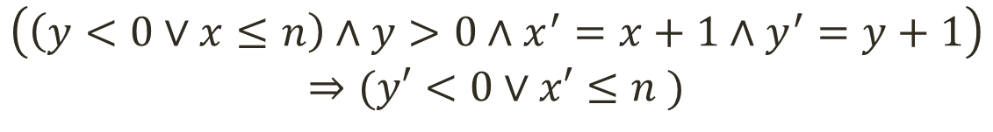
Formulating Inductiveness
x = 0
y = n
while(y > 0){
x = x + 1
y = y – 1
} //invariant: y>=0 => x<=n
Generally Referred to as the verification condition (VC)
$$(x=0∧y=n)⇒(y<0∨x≤n )$$
$$I$$
Guard
Transition
$$\left(\left(y<0∨x≤n\right)∧y>0∧x^{′}=x+1∧y^{′}=y+1\right)$$
$$⇒(y′<0∨x′≤n )$$

Slide 7

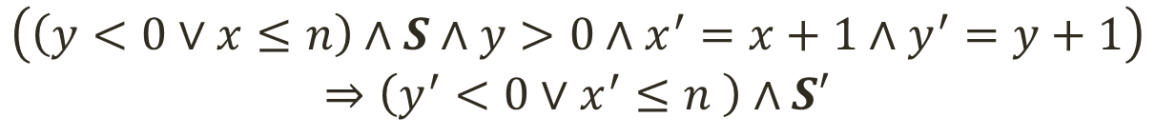
Formulating Inductive Strengthening
x = 0
y = n
while(y > 0){
x = x + 1
y = y – 1
} //invariant: y>=0 => x<=n
$$\left(x=0∧y=n\right)⇒\left(y<0∨x≤n \right)∧S$$
$$I$$
Guard
Transition
$$\left(\left(y<0∨x≤n\right)∧S∧y>0∧x^{′}=x+1∧y^{′}=y+1\right)$$
$$⇒\left(y^{′}<0∨x^{′}≤n \right)∧S′$$

Slide 8

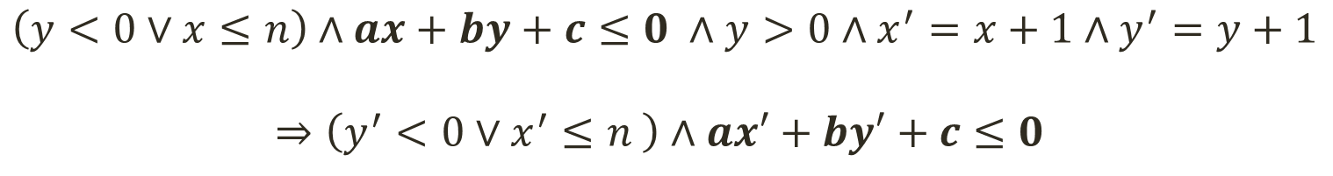
Finding Linear Invariants [Colon et al. CAV ‘03]
x = 0
y = n
while(y > 0){
x = x + 1
y = y – 1
} //invariant: y>=0 => x<=n
Perhaps could be called a parametric VC
$$\left(x=0∧y=n\right)⇒\left(y<0∨x≤n \right)∧ax+by+c≤0$$
$$I$$
Guard
Transition
$$\left(y<0∨x≤n\right)∧ax+by+c≤0 ∧y>0∧x^{′}=x+1∧y^{′}=y+1$$
$$⇒\left(y^{′}<0∨x^{′}≤n \right)∧ax′+by′+c≤0$$

Slide 9



Finding Template Coefficients
Find values for a,b,c
s.t. the formula becomes valid
$$\left(x≥0∧y≥n\right)⇒ax+by+c<0$$
$$A⇒B≡¬(A∧¬B)$$
Find values for a,b,c
s.t. the formula becomes unsatisfiable
$$x≥0∧y≥n∧ax+by+c≥0$$
Farkas’ Lemma: A conjunction of linear inequalities are unsatisfiable
iff we can derive 1 <= 0 by performing the following operations:
Multiplying the inequalities by a non-negative constant
Adding two inequalities
Adding a non-negative constant to the inequalities

Slide 10


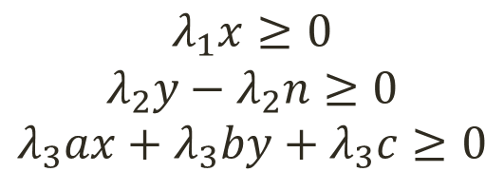
Farkas’ Constraints
Find values for a,b,c
s.t. the formula becomes unsatisfiable
$$x≥0∧y−n≥0∧ax+by+c≥0$$
$$λ_{1}x≥0$$
$$λ_{2}y{ − λ}_{2}n≥0$$
$$λ_{3}ax+λ_{3}by+λ_{3}c≥0$$
Multiplying by unknown non-negative values
Adding the inequalities
$${(λ}_{1}+λ_{3}a)x+\left(λ_{2}+λ_{3}b\right)y−λ_{2}n+λ_{3}c≥0$$
Adding an unknown non-neg value
$${(λ}_{1}+λ_{3}a)x+\left(λ_{2}+λ_{3}b\right)y−λ_{2}n+λ_{3}c+λ_{4}≥0$$
$$≡−1≥0$$
Equate to 1 <= 0

Slide 11
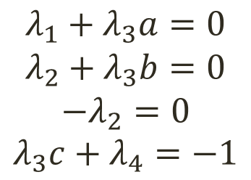

Farkas’ Constraints [Cont.]
$${(λ}_{1}+λ_{3}a)x+\left(λ_{2}+λ_{3}b\right)y−λ_{2}n+λ_{3}c+λ_{4}≥0$$
$$≡−1≥0$$
$$λ_{1}+λ_{3}a=0$$
$$λ_{2}+λ_{3}b=0$$
$$−λ_{2}=0$$
$$λ_{3}c+λ_{4}=−1$$
Every solution for
the constraints will
make the inequalities
unsatisfiable

Slide 12
In summary
The described approach provides a way to find linear invariants for programs that
are disjunction free
do not have functions
do not have data structures
do not have nonlinear arithmetic
We try to address these issues

Slide 13


Disjunctions
Find values for ‘a’ s.t. the formula becomes valid
$$A[a,x]∨B[a,x]⇒C[a,x]$$
Naïve Approach: $φ_{1}: A\left[a,x\right]⇒C\left[a,x\right]$
$$φ_{2}:B\left[a,x\right]⇒C\left[a,x\right]$$
Conjoin Farkas’ constraints for $φ_{1}$and $φ_{2}$
Exponential set of
Nonlinear constraint

Slide 14
Introduction
We propose a system for specifying and verifying resource bounds
for functional programs that use recursive data-structures
meant for verifying precise bounds
Notes:
We propose a system for specifying and verifying resource bounds for purely functional programs that manipulate data structure
Our system is primarily meant for verifying tight, precise bounds

Slide 15
Specifying Resource Bounds
Natural to specify as templates : expressions with numerical holes
a and b are numerical holes
size and height are recursive functions
traverse(t: Tree): Int = {
…
} ensuring(time <= a*size(t)+b &&
parallel-time <= a*height(t)+b)
Notes:
Resource bounds can be specified as postconditions with numerical holes which we call as templates
Eg. one can specify that the time taken to insert in the tree is linear in the size of the tree as shown here
We also support a algorithmic (system agnostic) notion of parallel execution time which is the execution time on an infinitely parallel system.
Eg. We can state that the parallel execution time of the function that traverses a tree is linear in the height of the tree
The specification states that parallel execution time is linear in the size of the tree where ‘size’ is a defined as a recursive function in a usual way
Here ‘a’ and ‘b’ are numerical holes; size and height are recursive functions defined by the user

Slide 16
The Problem
Infer values for the numerical holes such that
the values yield a valid bound for the resource
the bound is as strong as possible for the given template
Notes:
Resource (time)
The bounds are as strong as possible for the given template in an asymptotic sense.

Slide 17
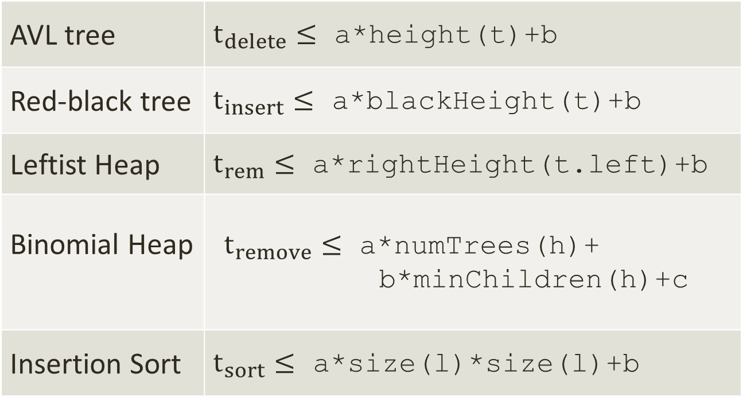
Example Programs & Templates
AVL tree | $t_{delete}≤$ a*height(t)+b
Red-black tree | $t_{insert}≤$ a*blackHeight(t)+b
Leftist Heap | $t_{rem}≤$ a*rightHeight(t.left)+b
Binomial Heap | $t_{remove}≤$ a*numTrees(h)+ b*minChildren(h)+c
Insertion Sort | $t_{sort}≤$ a*size(l)*size(l)+b
Notes:
These bounds are precise
minChildren – number of children of the tree containing the minimum element

Slide 18
Challenges
Pervasive use of
Recursive functions
Algebraic Data Types (ADTs)
both in programs and specifications
Nonlinear arithmetic
Solutions are large and unpredictable

Slide 19
Related Work
Finding Heap Bounds for Hardware Synthesis, B. Cook et al. FMCAD ’09
Invariant Synthesis for Combined Theories, D. Beyer et al. VMCAI’07
Speed, S. Gulwani et al. POPL ‘09
CEGIS and CEGAR

Slide 20
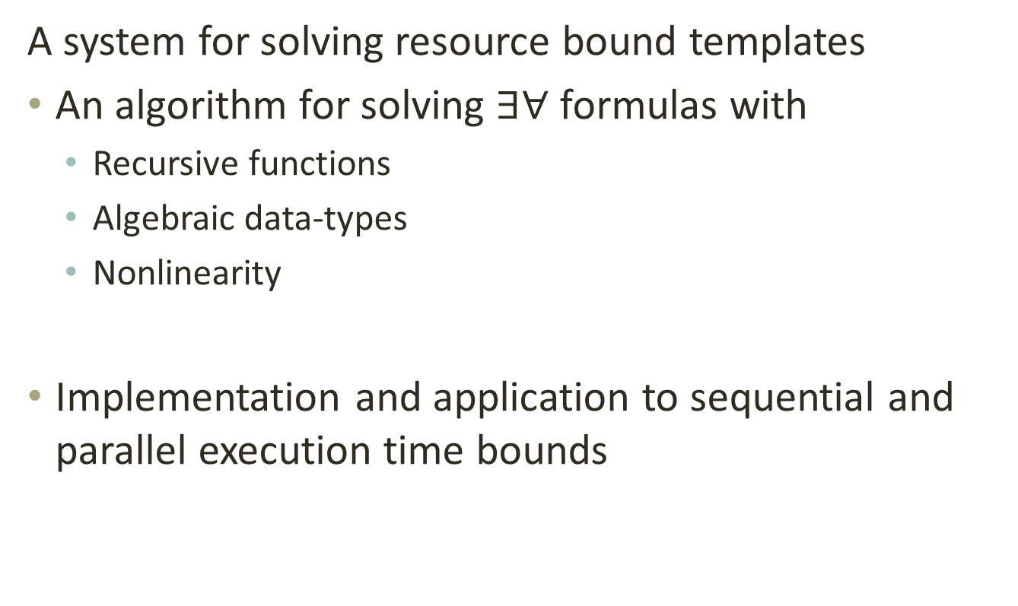
Contributions
A system for solving resource bound templates
An algorithm for solving $∃∀$ formulas with
Recursive functions
Algebraic data-types
Nonlinearity
Implementation and application to sequential and parallel execution time bounds
Notes:
a) Add URL to the tool

Slide 21
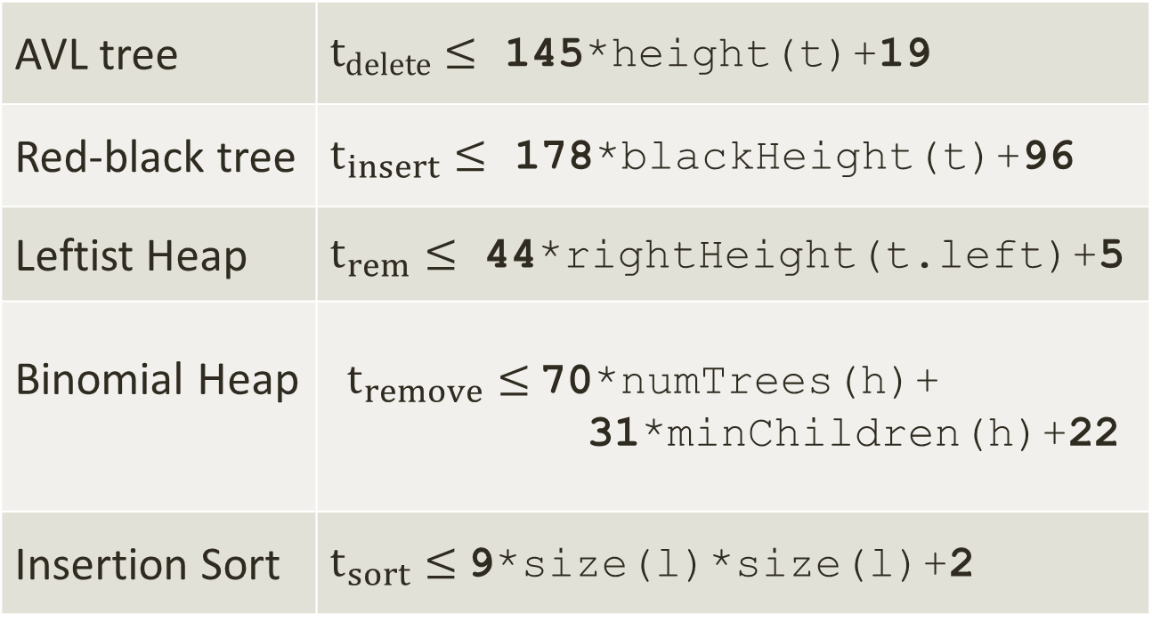
Bounds Inferred by the Tool
AVL tree | $t_{delete}≤$ 145*height(t)+19
Red-black tree | $t_{insert}≤$ 178*blackHeight(t)+96
Leftist Heap | $t_{rem}≤$ 44*rightHeight(t.left)+5
Binomial Heap | $t_{remove}≤$70*numTrees(h)+ 31*minChildren(h)+22
Insertion Sort | $t_{sort}≤$9*size(l)*size(l)+2
Notes:
Note that the constants are not small. It is 178 times blackHeight() for Red black tree
Also note that we infer strong bounds. For many cases decreasing the bounds yields a counter examples
The constants are implementation dependent

Slide 22
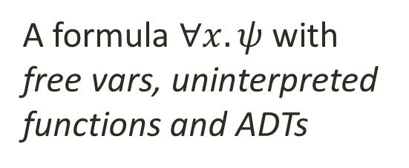
Overview
Converts bound inference to
inductive invariant inference
Instrumentation phase
A formula $∀x. ψ$with
free vars, uninterpreted functions and ADTs
VC Generation
Unfolds functions
in the VC
Counter-example guided Solving
VC Refinement
Minimization of solutions
Solving Nonlinear Constraints
Instantiation of Axioms
Elimination of
UF + ADT
Handles
nonlinearity
Produces a
Numerical formula
Computes
strong bounds
Solves Farkas’
Constraints
Notes:
a) Instrument the program to track resource usage. Convert bounds on resources to invariants of programs

Slide 23
Bounds To Invariants
traverse(t: Tree): Int =
{
body
} ensuring(time <= a*size(t)+b)
Instrumentation
traverse(t: Tree): (Int, Int) = {
(body, resource-usage)
} ensuring(res._2 <=a*size(t)+b)
Notes:
Simple and extensible to other resource bounds: space, network usage etc.
Unfortunately makes programs bigger and more complicated and requires efficient inference algorithms

Slide 24

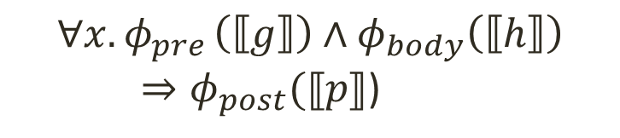
Verification Condition (VC) Generation
f(x) = {
require(pre)
body
} ensuring(post)
$$∀x. φ_{pre }∧φ_{body}⇒φ_{post}$$
f(x) = {
require(g(x)>=0)
…
r = h(x)
…
} ensuring(res<=p(x))
$$∀x. φ_{pre }\left(⟦g⟧\right)∧φ_{body}\left(⟦h⟧\right)$$
$⇒φ_{post}(⟦p⟧$)
Notes:
Let F be a recursive function with precondition $pre$and postcondition$post$
Let $φ_{F}, φ_{pre}, φ_{post }$ be the relational semantic formulas of the body of F, $pre$and$post$
The formulas are parameterized by the semantic formulas of the functions invoked by the expressions

Slide 25
Successive Approximation of VC by Unfolding
Initially, callees are uninterpreted functions
$$∀x. φ_{pre }(⊤)∧φ_{body}(⊤)⇒φ_{post}(⊤)$$
refine
$$∀x. φ_{pre }(φ_{g}\left[⊤\right])∧φ_{body}(φ_{h}\left[⊤\right])⇒φ_{post}(φ_{p}[⊤])$$
…
Notes:
If the VC is not valid, the semantic formulas of the invoked functions are refined by unfolding their body and specification
Create a sequence of VCs that becomes more and more precise
The process may not terminate as VCs do not perform any abstraction

Slide 26
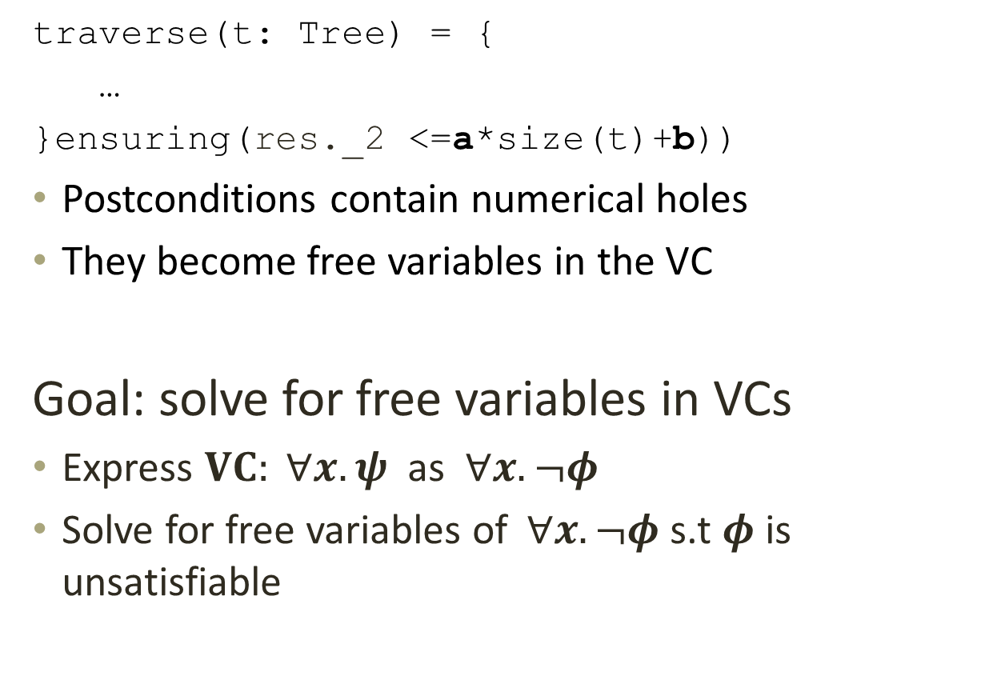
VCs with Free Variables
traverse(t: Tree) = {
…
}ensuring(res._2 <=a*size(t)+b))
Postconditions contain numerical holes
They become free variables in the VC
Goal: solve for free variables in VCs
Express $VC: ∀x. ψ$ as $∀x. ¬φ$
Solve for free variables of$∀x. ¬φ$s.t $φ$ is unsatisfiable

Slide 27


Counter-Example Guided Solving
$φ: {(A}_{1}∨A_{2})∧(A_{3}∨A_{4})∧ax+by+c≤0$
Guess an assignment for a,b,c
Pick a disjunct satisfiable under the guess
$A_{1}∧A_{3}∧ax+by+c≤0$
Eliminate UF and ADTs
$A_{1}∧A_{3}∧ax+by+c≤0∧\left(A_{5}⇒A_{6}\right)∧(A_{7}⇔A_{8})$
Pick a disjunct satisfiable under the guess
$A_{1}∧A_{3}∧ax+by+c≤0∧¬A_{5}∧A_{7}∧A_{8}$
Solve for a, b, c (Farkas’ Lemma)
No
solution
Unsat
Next guess
Notes:
a) A1 .. A4 do not have any parameters

Slide 28
Eliminating UFs and ADTs
Axiomatize UFs and ADTs
Suffices to instantiate Injectivity axiom for ADTs
Completeness is preserved
Proved in technical report http://infoscience.epfl.ch/record/190578
Two key reasons
Assignments to holes do not affect the shapes of ADTs
Elimination is performed on a satisfiable disjunct
Notes:
Completeness is non-trivial. Intuitively, it holds because:
The input disjunct $d$ is satisfiable => there exists a model for the ADT part
The holes (or parameters) in the formula are numerical => they affect only the numerical values in the model for ADTs

Slide 29


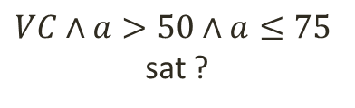




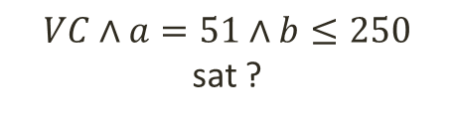


Strengthening of Bounds
time<=a*size(t)+b
$VC$ sat ?
$$(a↦100, b↦30)$$
$VC∧a≤50$ sat ?
$VC∧a≤25$ sat ?
$VC∧a>50∧a≤75$
sat ?
$$…$$
$$…$$
$$(a↦51, b↦500)$$
$VC∧a=51∧b≤250$
sat ?
$$…$$
Notes:
a) We approximate the growth rate of a term by the number of function applications in the term
b) The coefficients of faster growing terms are minimized before the slower growing terms

Slide 30
Inference Process
Instrumentation phase
Complete for Sufficiently
Surjective Functions
and
Linear Real Arithmetic
VC Generation
Counter-example guided Solving
VC Refinement
Instantiation of Axioms
Elimination of
UF + ADT
Minimization of solutions
Solving Nonlinear Constraints
Notes:
a) Instrument the program to track resource usage. Convert bounds on resources to invariants of programs

Slide 31
More in the Paper
Extensions for nonlinearity
Strengthening of bounds
Inter-procedural analysis
Inference of depth bounds
Optimizations

Slide 32
Experimental Results http://lara.epfl.ch/w/rbound
Evaluated on 14 Scala programs comprising 1500 Loc
80 time bounds and 80 depth bounds
78 out of 80 time bounds were solved
All 80 depth bounds were solved
Notes:
The two that were not solved were due to incompleteness in the handling of nonlinearity.

Slide 33
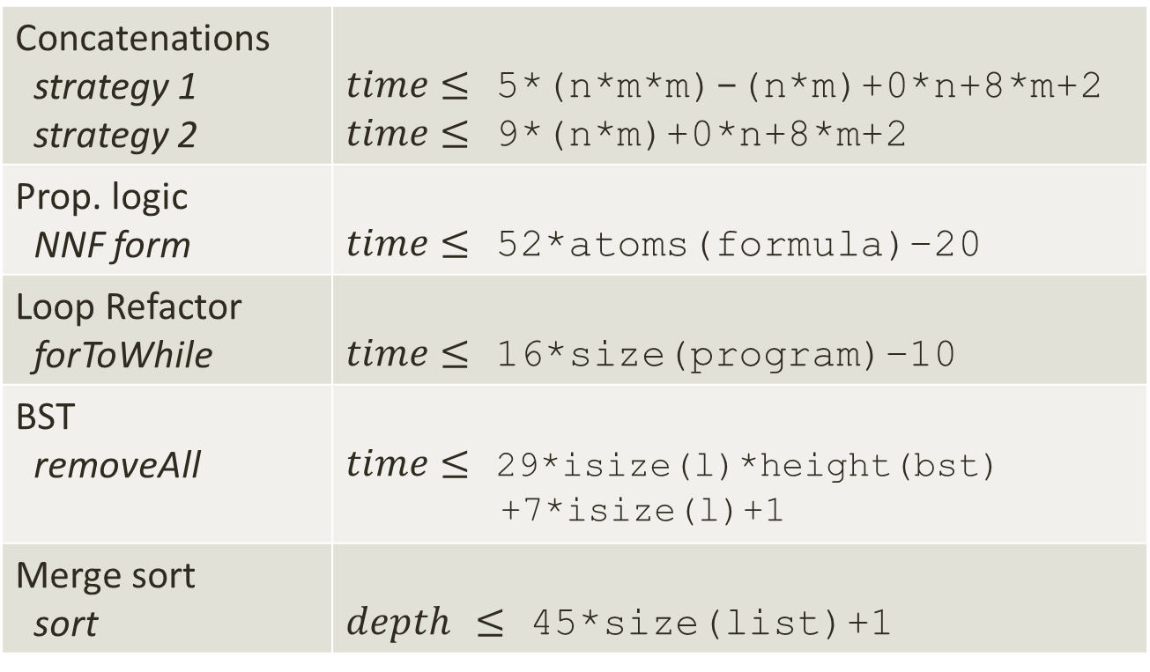
More Results
Concatenations strategy 1 strategy 2 | $time≤$ 5*(n*m*m)-(n*m)+0*n+8*m+2 $time≤$ 9*(n*m)+0*n+8*m+2
Prop. logic NNF form | $time≤$ 52*atoms(formula)–20
Loop Refactor forToWhile | $time≤$ 16*size(program)–10
BST removeAll | $time≤$ 29*isize(l)*height(bst) +7*isize(l)+1
Merge sort sort | $depth$ $≤$ 45*size(list)+1
Notes:
Highlight the negative and zero coefficients
The templates specified need not be precise as the tool looks for tight solutions. They can be over-approximations

Slide 34
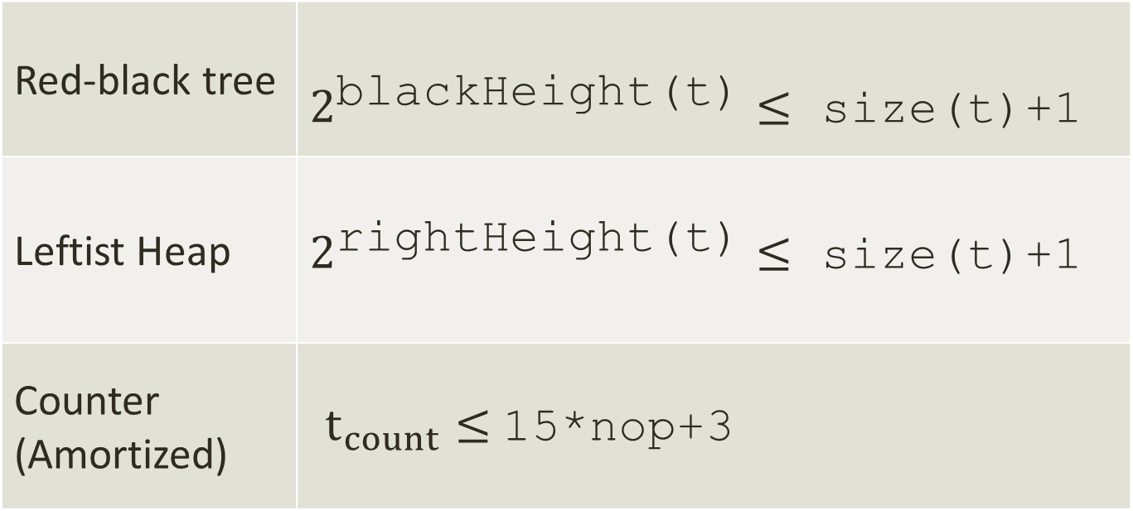
Also Inferred
Red-black tree | $2^{\text{blackHeight}\text{(}\text{t}\text{)}}≤$ size(t)+1
Leftist Heap | $2^{\text{rightHeight}\text{(}\text{t}\text{)}}≤$ size(t)+1
Counter (Amortized) | $t_{count}≤$15*nop+3
Implies logarithmic time for access
Notes:
Note that the constants are not small. It is 178 times blackHeight() for Red black tree
Also note that we infer strong bounds. For many cases decreasing the bounds yields a counter examples
The constants are implementation dependent

Slide 35
Statistics
The tool took a few seconds to a max. of 8 min
The VCs had hundreds of atomic predicates
The maximum size was ~6000
Only a few 10s of disjuncts were explored
The maximum across benchmarks was 216
Implies that the counter-example guided approach is efficient

Slide 36
Comparison with CEGIS
CEGIS diverges on all benchmarks
On restricting solutions to [- 200,200] CEGIS scaled to 5 small benchmarks
It was 2.5 times to 64 times slower
Reason: we eliminate an infinite set of counter-examples in every iteration

Slide 37
Conclusion
A system for establishing precise resource bounds in the presence of complex data-structures
Used to infer sequential and parallel execution time bounds
Extensible to other resources and also amortized bounds
The tool can be downloaded from http://lara.epfl.ch/w/rbound

