Slide 1
Inductive Invariant and Resource Bound Inference
Ravichandhran Madhavan,
Viktor Kuncak,
EPFL, Switzerland

Slide 2
Invariants
x = 0
y = n
while(y > 0){
x = x + 1
y = y - 1
}
//invariant: x+y = n
//invariant: y>=0 => x<=n

Slide 3

Inductive Invariants
x = 0
y = n
//x+y = n
while(y > 0){
//x+y = n $∧$ y > 0
x = x + 1
//x+y = n+1
y = y – 1
//x+y = n
}
//invariant: x+y = n
Invariant holds initially
Invariant holds at the start of the loop
=>
invariant holds at the end of the loop

Slide 4

Not all Invariants are Inductive
x = 0
y = n
//y>=0 => x<=n
while(y > 0){
//x <= n $∧$ y > 0
x = x + 1
//x <= n+1 $∧$ y > 0
y = y – 1
//x <= n+1 $∧$ y >= 0
}
//invariant: y>=0 => x <= n
Invariant cannot be
proved by induction

Slide 5
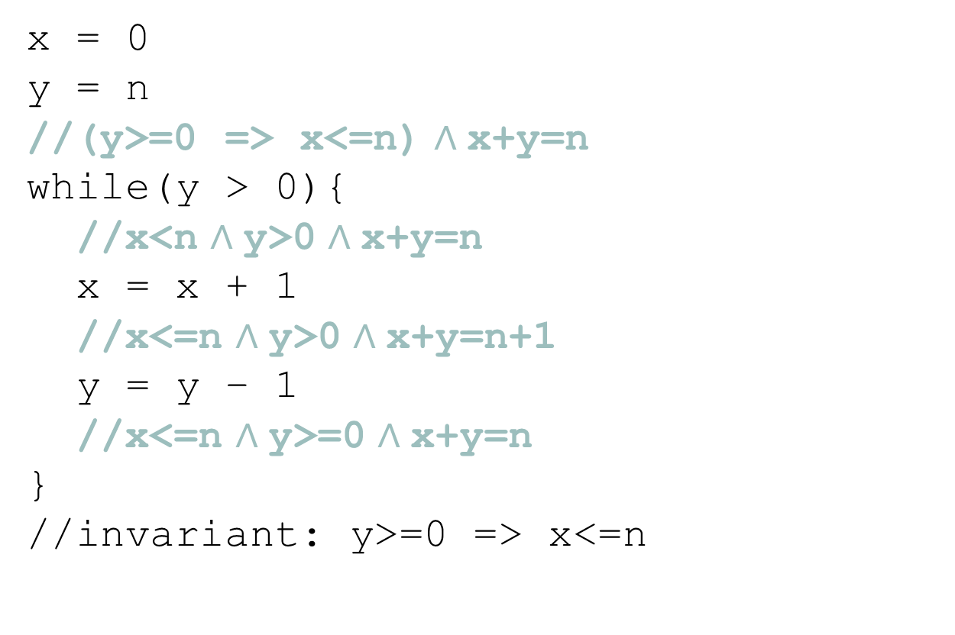
Inductive Strengthening
x = 0
y = n
//(y>=0 => x<=n) $∧$x+y=n
while(y > 0){
//x<n $∧$y>0 $∧$x+y=n
x = x + 1
//x<=n $∧$y>0 $∧$x+y=n+1
y = y – 1
//x<=n $∧$y>=0 $∧$x+y=n
}
//invariant: y>=0 => x<=n
Implied by the stronger inductive invariant

Slide 6


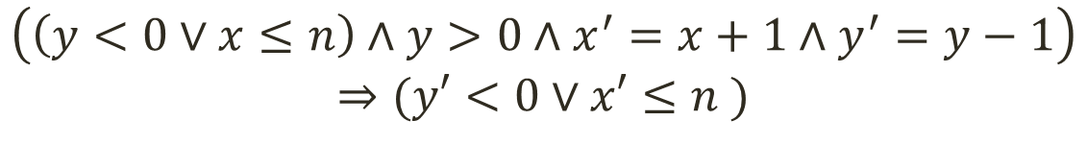
Formulating Inductiveness
x = 0
y = n
while(y > 0){
x = x + 1
y = y – 1
} //invariant: y>=0 => x<=n
Generally referred to as the verification condition (VC)
$$(x=0∧y=n)⇒(y<0∨x≤n )$$
$$I$$
Guard
Transition
$$\left(\left(y<0∨x≤n\right)∧y>0∧x^{′}=x+1∧y^{′}=y−1\right)$$
$$⇒(y′<0∨x′≤n )$$

Slide 7

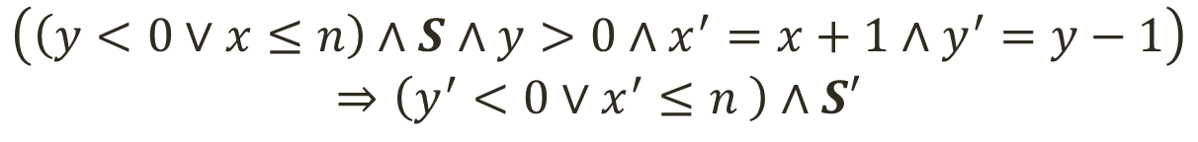
Formulating Inductive Strengthening
x = 0
y = n
while(y > 0){
x = x + 1
y = y – 1
} //invariant: y>=0 => x<=n
$$\left(x=0∧y=n\right)⇒\left(y<0∨x≤n \right)∧S$$
$$I$$
Guard
Transition
$$\left(\left(y<0∨x≤n\right)∧S∧y>0∧x^{′}=x+1∧y^{′}=y−1\right)$$
$$⇒\left(y^{′}<0∨x^{′}≤n \right)∧S′$$

Slide 8

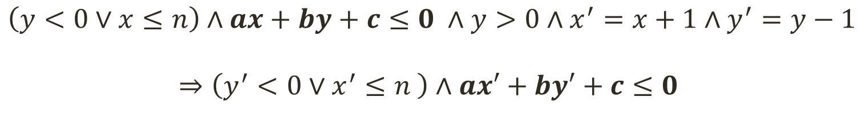
Finding Linear Invariants [Colon et al. CAV ‘03]
x = 0
y = n
while(y > 0){
x = x + 1
y = y – 1
} //invariant: y>=0 => x<=n
Perhaps could be called a parametric VC
$$\left(x=0∧y=n\right)⇒\left(y<0∨x≤n \right)∧ax+by+c≤0$$
$$I$$
Guard
Transition
$$\left(y<0∨x≤n\right)∧ax+by+c≤0 ∧y>0∧x^{′}=x+1∧y^{′}=y−1$$
$$⇒\left(y^{′}<0∨x^{′}≤n \right)∧ax′+by′+c≤0$$

Slide 9



Finding Template Coefficients
Find values for a,b,c
s.t. the formula becomes valid
$$\left(x≥0∧y≥n\right)⇒ax+by+c<0$$
$$A⇒B≡¬(A∧¬B)$$
Find values for a,b,c
s.t. the formula becomes unsatisfiable
$$x≥0∧y≥n∧ax+by+c≥0$$
Farkas’ Lemma: A conjunction of linear inequalities is unsatisfiable
iff we can derive 1 <= 0 by performing the following operations:
Multiplying the inequalities by a non-negative constant
Adding two inequalities
Adding (or subtracting) a non-negative constant to one side

Slide 10
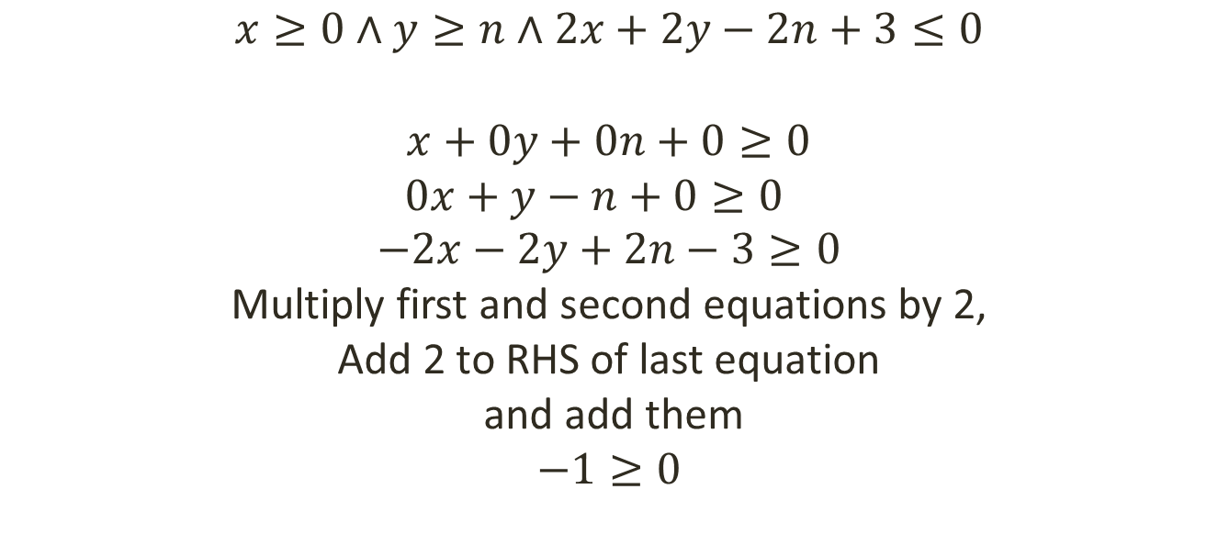
Farkas’ Lemma Example
$$x≥0∧y≥n∧2x+2y−2n+3≤0$$
$$x+0y+0n+0≥0$$
$$0x+y−n+0≥0$$
$$−2x−2y+2n−3≥0$$
Multiply first and second equations by 2,
Add 2 to RHS of last equation
and add them
$$−1≥0$$
Farkas’ Lemma: A conjunction of linear inequalities (over reals) is unsatisfiable iff we can derive 1 <= 0 by performing the following operations:
Multiplying the inequalities by a non-negative constant
Adding two inequalities
Adding (or subtracting) a non-negative constant to one side

Slide 11

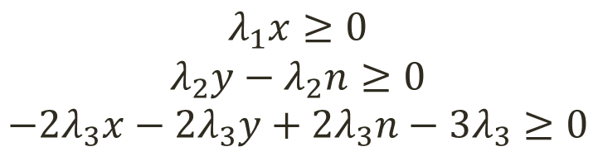
Automating Coefficient Finding
$$x≥0∧y−n≥0∧2x+2y−2n+3≤0$$
Prove unsat
$$λ_{1}x≥0$$
$$λ_{2}y{ − λ}_{2}n≥0$$
$${−2λ}_{3}x−{2λ}_{3}y+2λ_{3}n−{3λ}_{3}≥0$$
Multiplying by unknown non-negative values
Adding the inequalities
$${(λ}_{1}−2λ_{3})x+\left(λ_{2}−2λ_{3}\right)y+(2λ_{3}−λ_{2})n−3λ_{3}≥0$$
Adding an unknown non-neg value
$${(λ}_{1}−2λ_{3})x+\left(λ_{2}−2λ_{3}\right)y+(2λ_{3}−λ_{2})n−3λ_{3}+λ ≥0$$
$$≡−1≥0$$
Equate to 1 <= 0

Slide 12

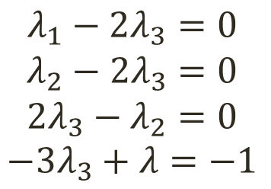

Automating Coefficient Finding [Cont.]
$${(λ}_{1}−2λ_{3})x+\left(λ_{2}−2λ_{3}\right)y+(2λ_{3}−λ_{2})n−3λ_{3}+λ ≥0$$
$$≡−1≥0$$
$$λ_{1}−2λ_{3}=0$$
$$λ_{2}−{2λ}_{3}=0$$
$$2λ_{3}−λ_{2}=0$$
$${−3λ}_{3}+λ=−1$$
Every solution for
the constraints will
make the inequalities
unsatisfiable
$$λ_{1}=2 , { λ}_{2}=2 , λ_{3}=1, λ=2$$

Slide 13

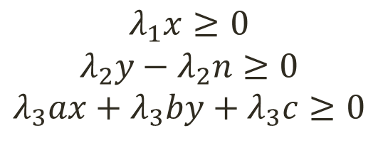
Template-based Invariant Inference
Find values for a,b,c
s.t. the formula becomes unsatisfiable
$$x≥0∧y−n≥0∧ax+by+c≥0$$
$$λ_{1}x≥0$$
$$λ_{2}y{ − λ}_{2}n≥0$$
$$λ_{3}ax+λ_{3}by+λ_{3}c≥0$$
Multiplying by unknown non-negative values
Adding the inequalities
$${(λ}_{1}+λ_{3}a)x+\left(λ_{2}+λ_{3}b\right)y−λ_{2}n+λ_{3}c≥0$$
Adding an unknown non-neg value
$${(λ}_{1}+λ_{3}a)x+\left(λ_{2}+λ_{3}b\right)y−λ_{2}n+λ_{3}c+λ_{4}≥0$$
$$≡−1≥0$$
Equate to 1 <= 0

Slide 14
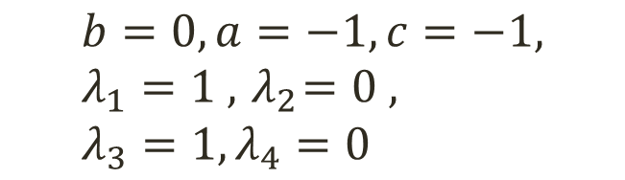
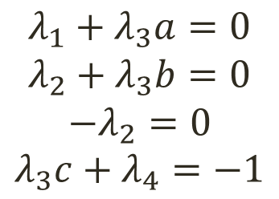
Farkas’ Constraints [Cont.]
$${(λ}_{1}+λ_{3}a)x+\left(λ_{2}+λ_{3}b\right)y−λ_{2}n+λ_{3}c+λ_{4}≥0$$
$$≡−1≥0$$
$$λ_{1}+λ_{3}a=0$$
$$λ_{2}+λ_{3}b=0$$
$$−λ_{2}=0$$
$$λ_{3}c+λ_{4}=−1$$
Every solution for
the constraints will
make the inequalities
unsatisfiable
$$b=0, a=−1, c=−1, λ_{1}=1 , { λ}_{2}=0 , λ_{3}=1, λ_{4}=0$$

Slide 15
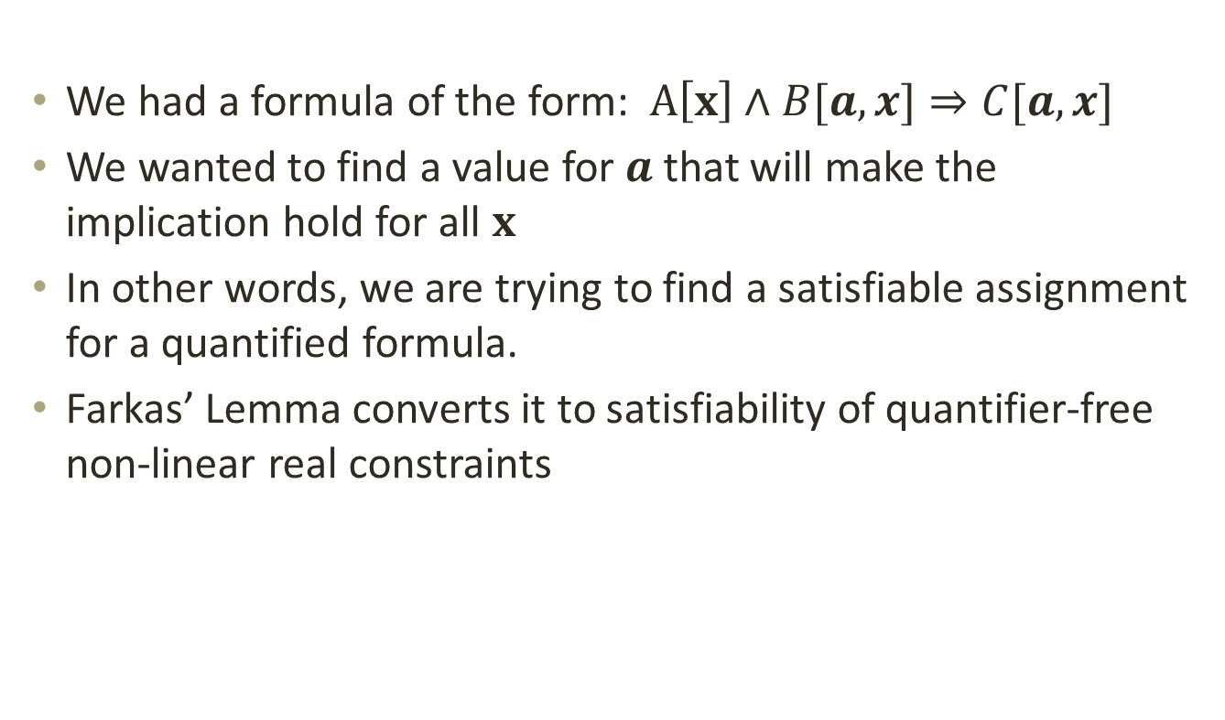
In summary
We had a formula of the form: $A\left[x\right]∧B[a,x]⇒C[a,x]$
We wanted to find a value for $a$ that will make the implication hold for all $x$
In other words, we are trying to find a satisfiable assignment for a quantified formula.
Farkas’ Lemma converts it to satisfiability of quantifier-free non-linear real constraints

Slide 16
Limitations
The Farkas’ approach provides a way to find linear invariants for programs that
are disjunction free
do not have functions
do not have data structures
do not have nonlinear arithmetic
We try to address these issues

Slide 17


Disjunctions
Find values for ‘a’ s.t. the formula becomes unsatisfiable
$$A\left[a,x\right]∨B\left[a,x\right]∨C[a,x]$$
Exponential # of Nonlinear constraints
Naïve Approach:
Conjoin Farkas’ constraints for
unsatisfying $A$, $B$ and $C$
Explore disjuncts using counter-examples

Slide 18
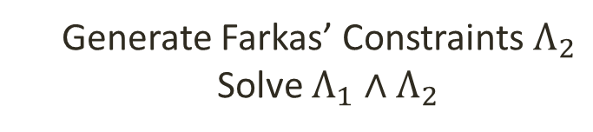

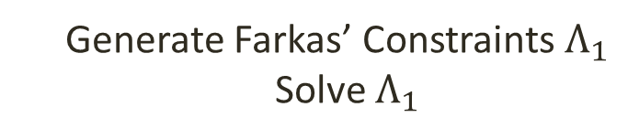

Counter-Example Guided Solving
$${(A}_{1}∨A_{2})∧(A_{3}∨A_{4})∧ax+by+c≤0$$
Guess an assignment for a,b,c
Pick a disjunct that is satisfiable
$$A_{1}∧A_{3}∧ax+by+c≤0$$
Generate Farkas’ Constraints $Λ_{1}$
Solve $Λ_{1}$
No
solution
Unsat
Pick a disjunct that is satisfiable
$$A_{1}∧A_{4}∧ax+by+c≤0$$
Generate Farkas’ Constraints $Λ_{2}$
Solve $Λ_{1}∧Λ_{2}$
No
solution
Unsat
Notes:
a) A1 .. A4 do not have any parameters

Slide 19
Handling Functions
x = n
y = n
z = n
while(*){
x = foo(x)
z = x
y = foo(y)
} //invariant: y=z
foo(x) = {
if(x <= 0) x
else x + foo(x-1)
}
//computes: x(x+1)/2
How to create verification conditions ?

Slide 20
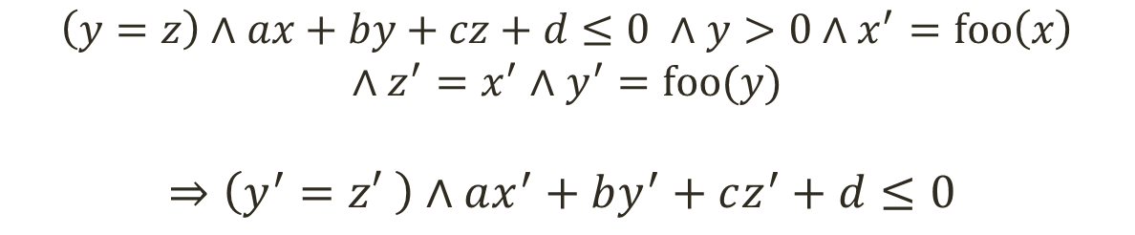
Successive Approximation of VCs
x = n
y = n
Z = n
while(y > 0){
x = foo(x)
z = x
y = foo(y)
} //invariant: y=z
Treating ‘foo’ as uninterpreted function in the VC
Inductive case:
$$\left(y=z\right)∧ax+by+cz+d≤0 ∧y>0∧x^{′}=foo\left(x\right)$$
$$∧z^{′}=x^{′}∧y^{′}=foo(y)$$
$$⇒\left(y^{′}=z′ \right)∧ax^{′}+by^{′}+cz^{′}+d≤0$$

Slide 21
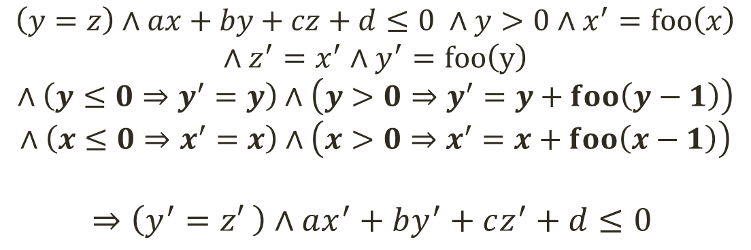
Refining VCs by Inlining Functions
foo(x) = {
if(x <= 0) x
else x + foo(x-1)
}
Treating all ‘foo’s as uninterpreted functions
Inductive case:
$$\left(y=z\right)∧ax+by+cz+d≤0 ∧y>0∧x^{′}=foo\left(x\right)$$
$$∧z^{′}=x^{′}∧y^{′}=foo\left(y\right)$$
$$∧\left(y≤0⇒y^{′}=y\right)∧\left(y>0⇒y^{′}=y+foo\left(y−1\right)\right)$$
$$∧\left(x≤0⇒x^{′}=x\right)∧\left(x>0⇒x^{′}=x+foo\left(x−1\right)\right)$$
$$⇒\left(y^{′}=z′ \right)∧ax^{′}+by^{′}+cz^{′}+d≤0$$

Slide 22
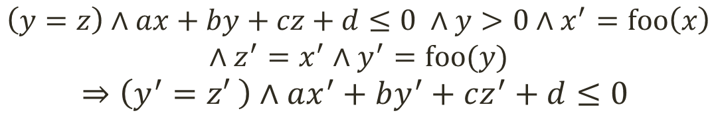

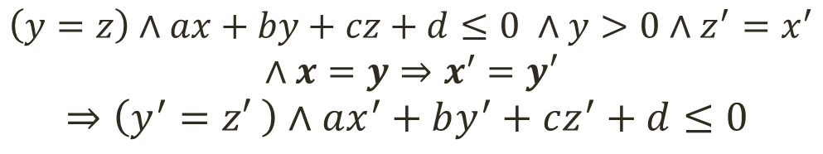
Solving parametric VC with UFs
$$\left(y=z\right)∧ax+by+cz+d≤0 ∧y>0∧x^{′}=foo\left(x\right)$$
$$∧z^{′}=x^{′}∧y^{′}=foo(y)$$
$$⇒\left(y^{′}=z′ \right)∧ax^{′}+by^{′}+cz^{′}+d≤0$$
For every pair, $r_{1}=foo\left(x\right), r_{2}=foo(y)$
We instantiate UF Axiom: $∀x,y. x=y⇒r_{1}=r_{2}$
$$\left(y=z\right)∧ax+by+cz+d≤0 ∧y>0∧z^{′}=x^{′}$$
$$∧x=y⇒x^{′}=y′$$
$$⇒\left(y^{′}=z′ \right)∧ax^{′}+by^{′}+cz^{′}+d≤0$$

Slide 23

Counter Example Guided Solving v2
$${(A}_{1}∨A_{2})∧(A_{3}∨A_{4})∧ax+by+c≤0$$
Guess an assignment for a,b,c
Pick a disjunct that is satisfiable
$$A_{1}∧A_{3}∧ax+by+c≤0$$
Eliminate UF and ADTs
$$A_{1}∧A_{3}∧ax+by+c≤0∧\left(A_{5}⇒A_{6}\right)∧\left(A_{7}⇔A_{8}\right)$$
Pick a disjunct that is satisfiable
$$A_{1}∧A_{3}∧ax+by+c≤0∧¬A_{5}∧A_{7}∧A_{8}$$
Solve for a, b, c (Farkas’ Lemma)
No
solution
Unsat
Next guess
Notes:
a) A1 .. A4 do not have any parameters

Slide 24
ADTs: Algebraic Data Types
sealed abstract class List
case class Cons(head: Int, tail: List) extends List
case class Nil() extends List
sealed abstract class Tree
case class Node(left: Tree, value: Int, right: Tree)
extends Tree
case class Leaf() extends Tree
Notes:
Completeness is non-trivial. Intuitively, it holds because:
The input disjunct $d$ is satisfiable => there exists a model for the ADT part
The holes (or parameters) in the formula are numerical => they affect only the numerical values in the model for ADTs

Slide 25
Completeness for ADTs
ADTs are more than Injective Functions
Yet, it suffices to instantiate only Injectivity axiom
Completeness is preserved
Proved in technical report http://infoscience.epfl.ch/record/190578
Two key reasons
Assignments to holes do not affect the shapes of ADTs
Elimination is performed on a satisfiable disjunct
A nontrivial result
Notes:
Completeness is non-trivial. Intuitively, it holds because:
The input disjunct $d$ is satisfiable => there exists a model for the ADT part
The holes (or parameters) in the formula are numerical => they affect only the numerical values in the model for ADTs

Slide 26
Application to Resource Bounds Inference
We can specify resource bounds as templates : expressions with numerical holes
a and b are numerical holes
size and height are recursive functions
traverse(t: Tree): Int = {
…
} ensuring(time <= a*size(t)+b &&
parallel-time <= a*height(t)+b)
Notes:
Completeness is non-trivial. Intuitively, it holds because:
The input disjunct $d$ is satisfiable => there exists a model for the ADT part
The holes (or parameters) in the formula are numerical => they affect only the numerical values in the model for ADTs

Slide 27
The Problem
Infer values for the numerical holes such that
the values yield a valid bound for the resource
the bound is as strong as possible for the given template
Notes:
Resource (time)
The bounds are as strong as possible for the given template in an asymptotic sense.

Slide 28
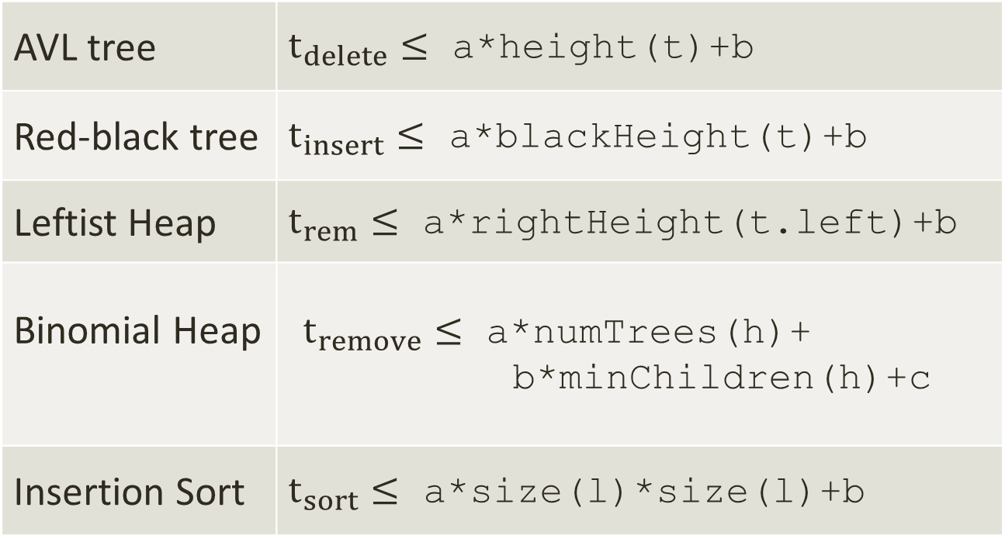
Example Programs & Templates
AVL tree | $t_{delete}≤$ a*height(t)+b
Red-black tree | $t_{insert}≤$ a*blackHeight(t)+b
Leftist Heap | $t_{rem}≤$ a*rightHeight(t.left)+b
Binomial Heap | $t_{remove}≤$ a*numTrees(h)+ b*minChildren(h)+c
Insertion Sort | $t_{sort}≤$ a*size(l)*size(l)+b
Notes:
These bounds are precise
minChildren – number of children of the tree containing the minimum element

Slide 29
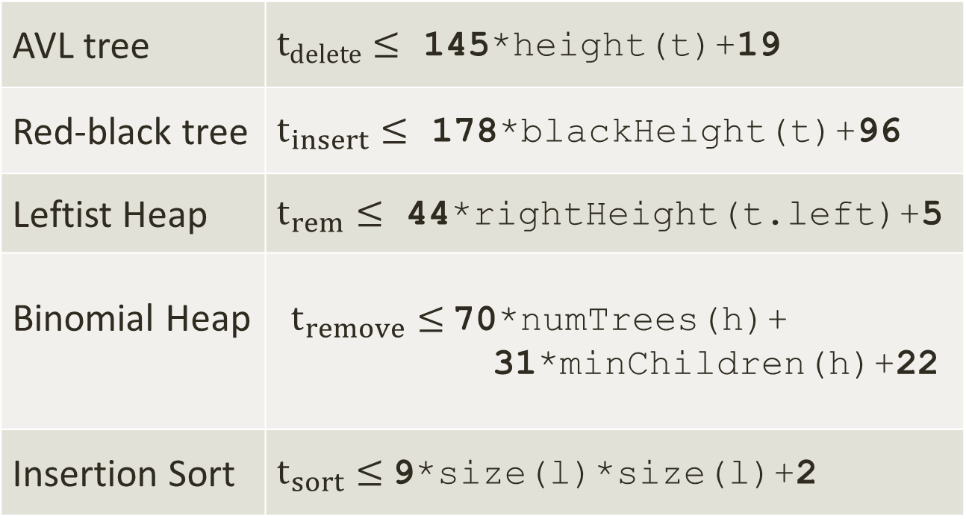
Bounds Inferred by the Tool
AVL tree | $t_{delete}≤$ 145*height(t)+19
Red-black tree | $t_{insert}≤$ 178*blackHeight(t)+96
Leftist Heap | $t_{rem}≤$ 44*rightHeight(t.left)+5
Binomial Heap | $t_{remove}≤$70*numTrees(h)+ 31*minChildren(h)+22
Insertion Sort | $t_{sort}≤$9*size(l)*size(l)+2
Notes:
Note that the constants are not small. It is 178 times blackHeight() for Red black tree
Also note that we infer strong bounds. For many cases decreasing the bounds yields a counter examples
The constants are implementation dependent

Slide 30
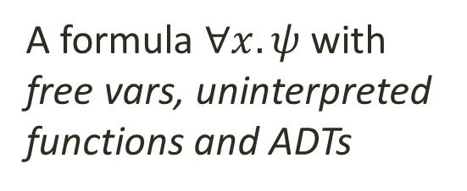
Overview
Converts bound inference to
inductive invariant inference
Instrumentation phase
A formula $∀x. ψ$with
free vars, uninterpreted functions and ADTs
VC Generation
Unfolds functions
in the VC
Counter-example guided Solving
VC Refinement
Minimization of solutions
Solving Nonlinear Constraints
Instantiation of Axioms
Elimination of
UF + ADT
Handles
nonlinearity
Produces a
Numerical formula
Computes
strong bounds
Solves Farkas’
Constraints
Notes:
a) Instrument the program to track resource usage. Convert bounds on resources to invariants of programs

Slide 31
Instrumentation for Time
Resource consumed by ‘e’ is a function of resources consumed by its sub-expressions
Time(e1 + e2) :-
var (t1,v1) = Time(e1)
var (t2,v2) = Time(e2)
(t1 + t2 + cost(plus), v1 + v2 )
Time(if e then e1 else e2) :-
var (t,v) = Time(e)
var (t1,v1) = Time(e1)
var (t2,v2) = Time(e2)
if v then (t + t1 + cost(test), v1) else (t+t2+cost(test), v2 )

Slide 32
Instrumenting Functions
traverse(t: Tree): Int =
{
body
} ensuring(time <= a*size(t)+b)
traverse(t: Tree): (Int, Int) = {
(body, resource-usage)
} ensuring(res._2 <=a*size(t)+b)
Notes:
Simple and extensible to other resource bounds: space, network usage etc.
Unfortunately makes programs bigger and more complicated and requires efficient inference algorithms

Slide 33
More in our CAV ‘14 paper
Extensions for nonlinearity
Strengthening of bounds
Inter-procedural analysis
Inference of depth bounds
Optimizations

Slide 34
Experimental Results http://lara.epfl.ch/w/rbound
Evaluated on 14 Scala programs comprising 1500 Loc
80 time bounds and 80 depth bounds
78 out of 80 time bounds were solved
All 80 depth bounds were solved
Notes:
The two that were not solved were due to incompleteness in the handling of nonlinearity.

Slide 35
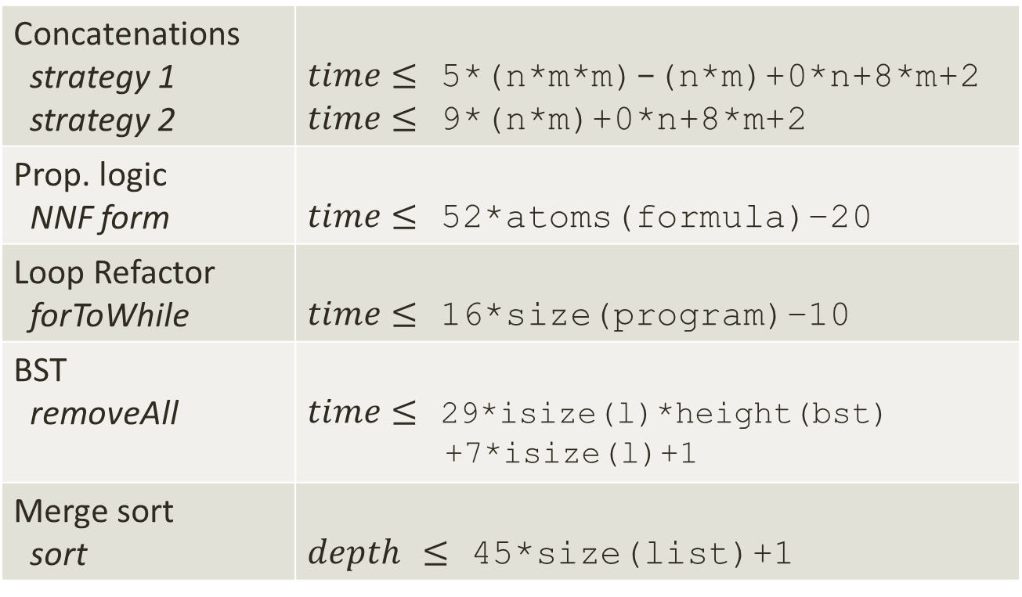
More Results
Concatenations strategy 1 strategy 2 | $time≤$ 5*(n*m*m)-(n*m)+0*n+8*m+2 $time≤$ 9*(n*m)+0*n+8*m+2
Prop. logic NNF form | $time≤$ 52*atoms(formula)–20
Loop Refactor forToWhile | $time≤$ 16*size(program)–10
BST removeAll | $time≤$ 29*isize(l)*height(bst) +7*isize(l)+1
Merge sort sort | $depth$ $≤$ 45*size(list)+1
Notes:
Highlight the negative and zero coefficients
The templates specified need not be precise as the tool looks for tight solutions. They can be over-approximations

Slide 36
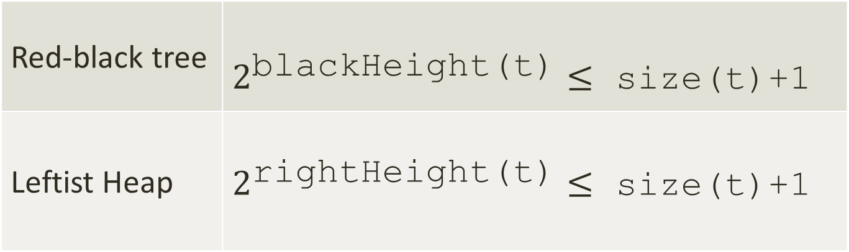
Also Inferred
Red-black tree | $2^{\text{blackHeight}\text{(}\text{t}\text{)}}≤$ size(t)+1
Leftist Heap | $2^{\text{rightHeight}\text{(}\text{t}\text{)}}≤$ size(t)+1
Implies logarithmic time for access
Notes:
Note that the constants are not small. It is 178 times blackHeight() for Red black tree
Also note that we infer strong bounds. For many cases decreasing the bounds yields a counter examples
The constants are implementation dependent

Slide 37
Conclusion
We have a system for template-based invariant inference
it can handle purely functional subset of Scala
quite effective on numerical programs and also on programs that manipulate ADTs
We have used the system to infer symbolic running time bounds
The tool can be downloaded from http://lara.epfl.ch/w/rbound

