Slide 1

VOCATIONAL TRAINING PRESENTATION
On
REAL-TIME CHAT APPLICATION
At
TECHONET PVT LTD
Presented by:
Amir Sohail (303302223031)
CSE - 6th Sem

Slide 2
Index
Introduction- About project
Why this project is important in real world ?
H/W and S/W requirements
Front-end & Back-end
Flow Chart / E-R Diagrams / Block Diagram
Results & Discussions
Applications- where project use
Conclusion & Scope of further work
References
Acknowledgement of Vocational Training (Student Copy)
Offer Letter
Certificate

Slide 3
Introduction- About project
The project undertaken during this vocational training is a Real-Time Chat Application built using the MERN stack (MongoDB, Express.js, React.js, and Node.js). The application enables registered users to communicate instantly through one-to-one and group conversations, with real-time delivery of messages powered by Socket.io. The system was designed and developed with an emphasis on secure authentication, clean schema design, and a responsive user interface.
The application follows a client-server architecture in which the React frontend (served on port 5173) communicates with an Express backend (served on port 5000) through two channels: a REST API for on-demand data operations such as login, registration, OTP verification, and fetching chats or messages; and a persistent Socket.io connection for instantaneous, server-pushed events such as new messages and user online/offline status.

Slide 4
Why this project is important in real world ?
Real-time communication has become a core requirement for almost every modern web platform, from workplace collaboration tools to customer support and social apps. This project reflects that real-world need: it implements a secure, email-based OTP and JWT authentication flow so only verified users can chat; a scalable MongoDB schema that cleanly represents users, chats, messages, and OTPs; REST APIs built on MVC principles for predictable data handling; and Socket.io-powered real-time messaging and presence updates so conversations feel instant. Building this project gave hands-on, practical experience with the same architecture and concerns - security, scalability, and real-time delivery - that production chat systems (e.g. team-collaboration or support tools) must solve.

Slide 5
H/W and S/W requirements
HARDWARE REQUIREMENT
Processor : Dual Core / i3 or higher
RAM : 8 GB (recommended for running MERN dev servers smoothly)
Hard Disk : 20 GB free space
SOFTWARE REQUIREMENT
Node.js (JavaScript runtime for React, Express & Socket.io)
MongoDB (local or Atlas cloud database)
Visual Studio Code (code editor)
Git & GitHub (version control)
Modern web browser (Chrome / Edge) for testing

Slide 6
Front-end & Back-end
FRONT-END
React.js - component-based UI (sidebar, chat window, message bubbles)
Vite - build tool & dev server
Tailwind CSS - responsive styling
Axios - REST API calls (login, OTP, chats/messages)
BACK-END
Node.js & Express.js - REST routes, middleware, controllers
MongoDB & Mongoose - schema design and ODM
Socket.io - real-time messaging & presence
JWT, bcrypt & Nodemailer - authentication, password hashing, OTP email

Slide 7
Flow Chart / E-R Diagrams / Block Diagram
System Architecture - Block Diagram
Database Schema - E-R Diagram
Authentication Flow Chart
Real-Time Communication Flow Chart

Slide 8
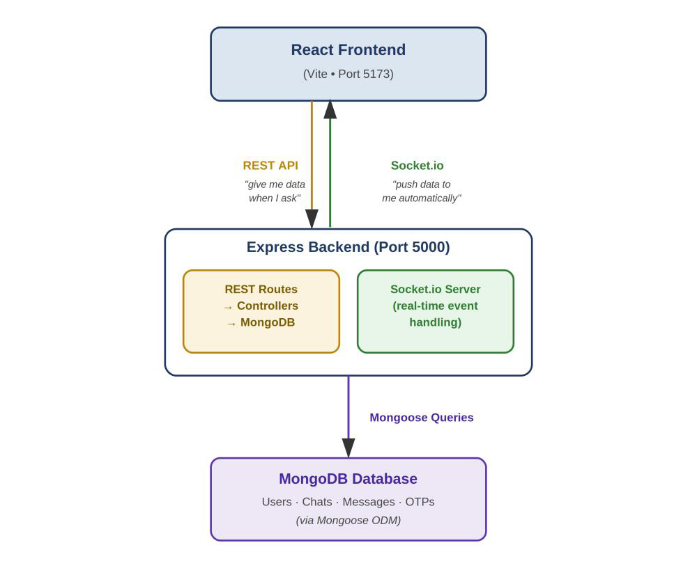
System Architecture - Block Diagram

Slide 9
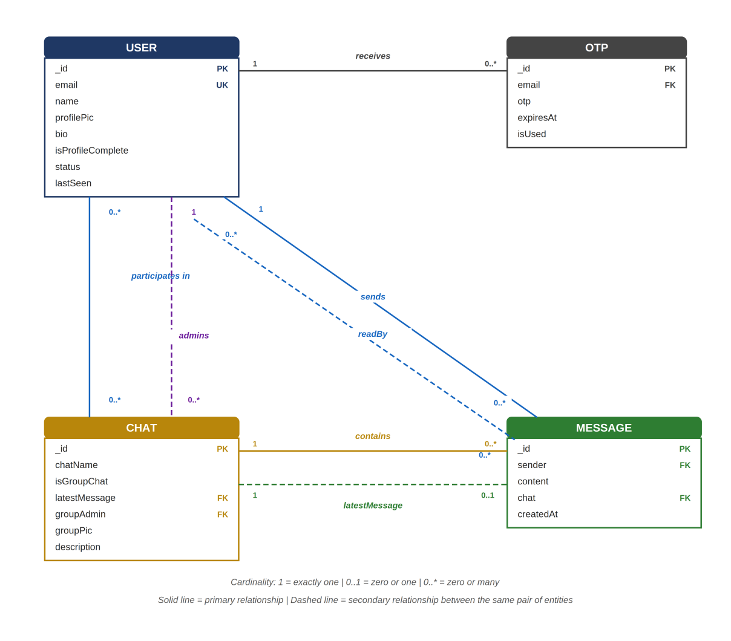
Database Schema - E-R Diagram

Slide 10
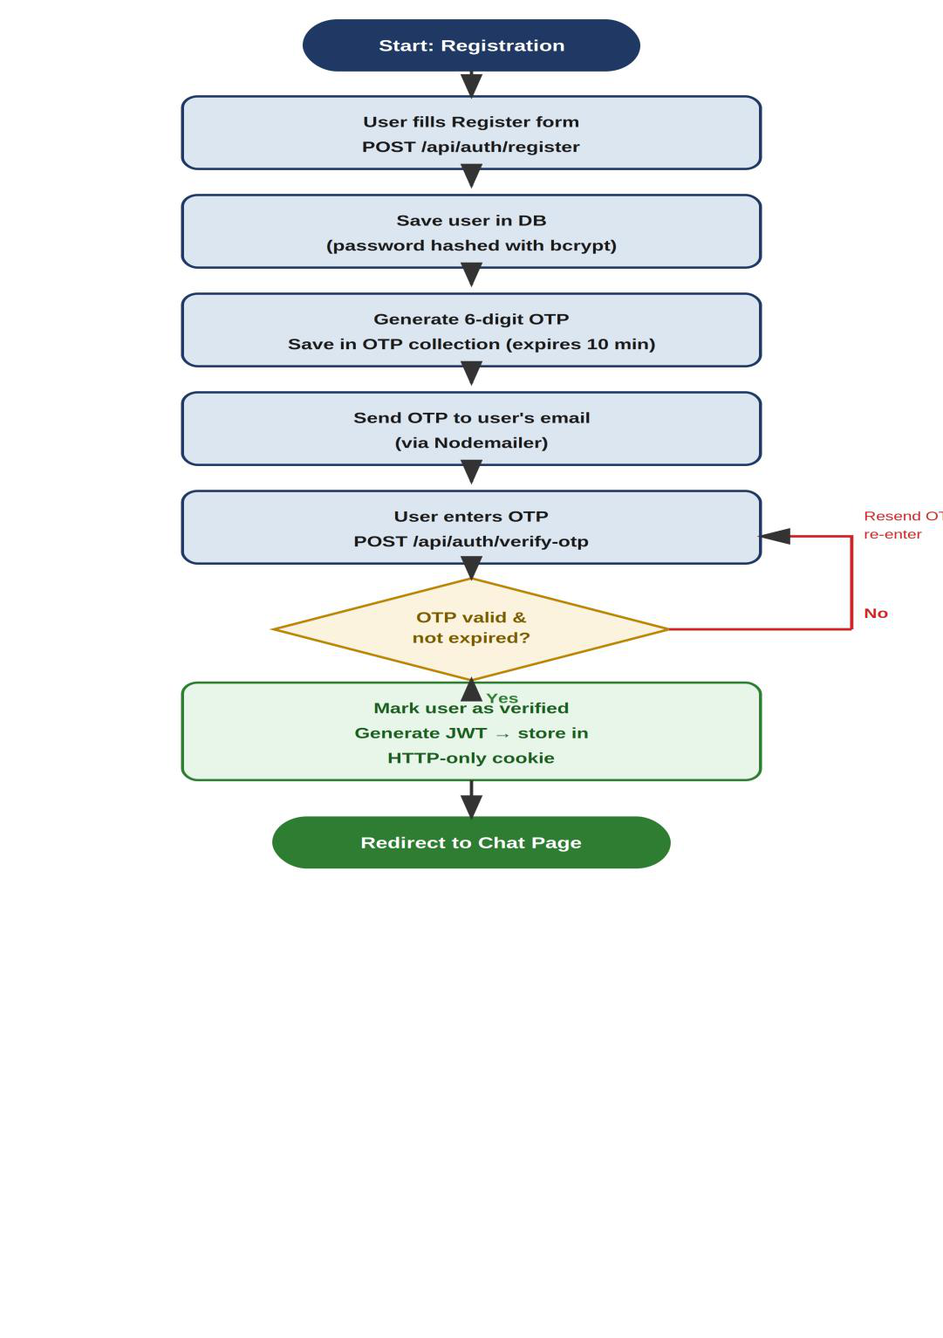
Authentication Flow Chart

Slide 11
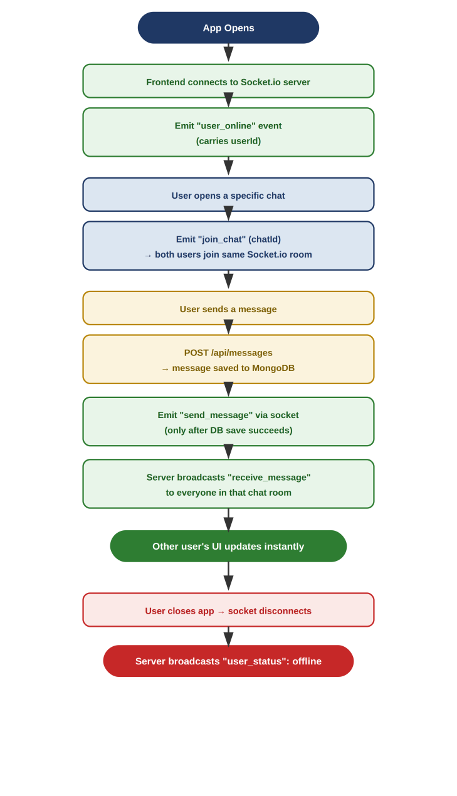
Real-Time Communication Flow Chart

Slide 12
Results & Discussions
The completed application successfully supports secure registration and login backed by OTP verification and JWT-based sessions, one-to-one and group chat creation, persistent storage of conversations and messages in MongoDB with Mongoose population used to resolve sender and participant references, and instantaneous message delivery and read/online-status updates through Socket.io rooms.
Key challenges included choosing between server-side AES and full end-to-end encryption for message storage, designing an efficient Mongoose population pattern, safely handling partial profile updates, and coordinating the REST-then-socket sequence so a message is durably saved before being broadcast in real time.

Slide 13
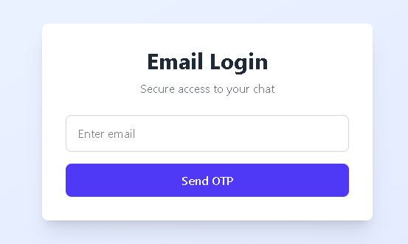
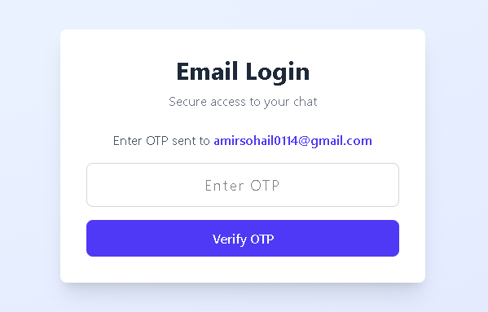
Results & Discussions - Screenshots
Authentication
Email OTP Login
OTP Verification
User enters their email to receive a one-time login code.
The 6-digit OTP sent to the user's email is verified to complete login.

Slide 14
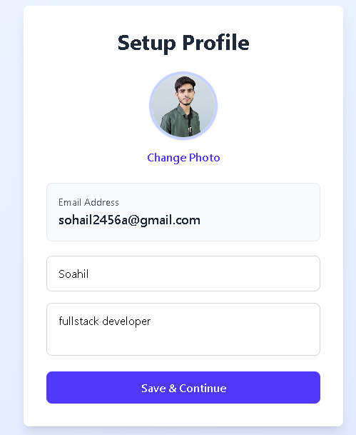
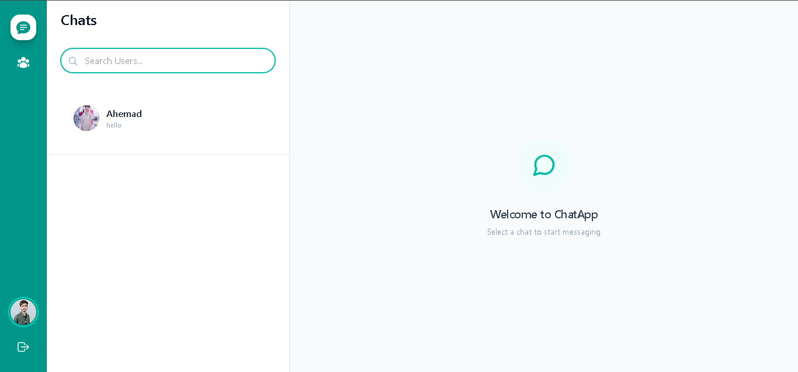
Results & Discussions - Screenshots
Onboarding & Navigation
Profile Setup
Chat List - Sidebar
Sidebar listing all conversations, with user search.
One-time profile setup with photo, name & bio.

Slide 15
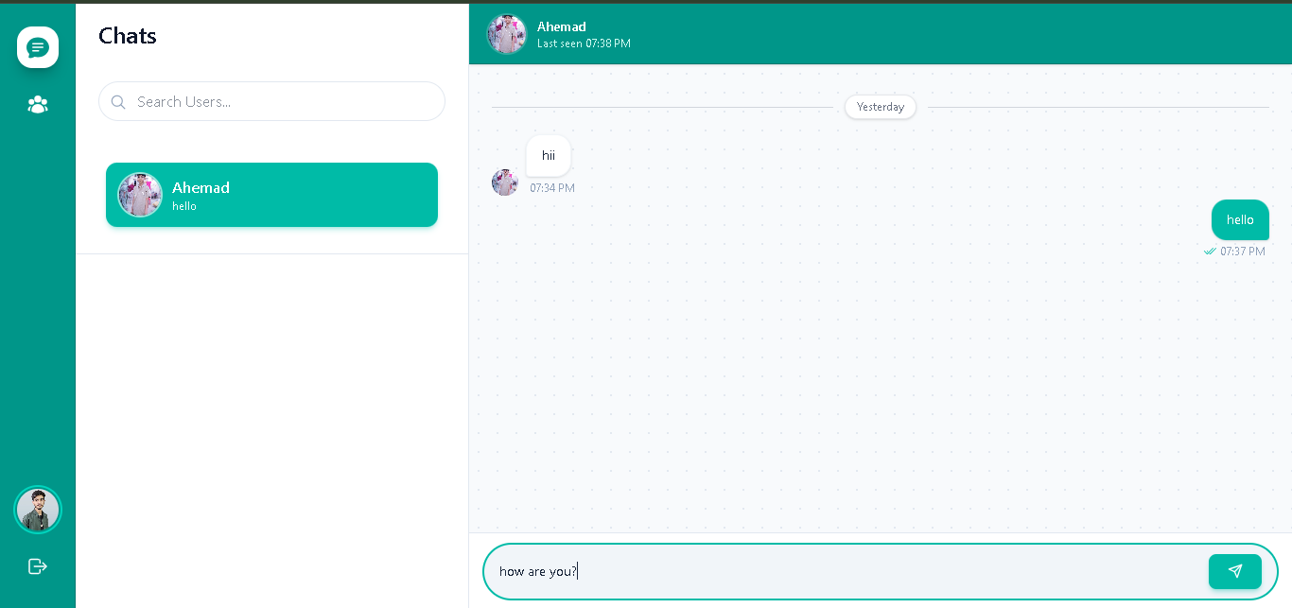
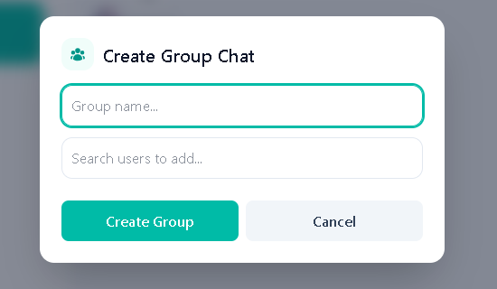
Results & Discussions - Screenshots
Messaging Features
One-to-One Conversation
Create Group Chat
Real-time message delivery with timestamps and read status.
Group creation modal with name and member search.

Slide 16
Applications- where project use
This Chat Web App, built with React, Node.js, Express, and MongoDB, is a secure, responsive, and scalable web-based application that supports instant one-to-one and group messaging. This application can be used as the foundation for team-collaboration and workplace communication tools, customer-support and helpdesk chat systems, online community and social-networking platforms, and e-learning platforms that need instructor-student messaging - anywhere secure, real-time, many-to-many communication is required.

Slide 17
Conclusion & Scope of further work
This vocational training project provided practical, hands-on experience in building a full-stack real-time application using the MERN stack. It reinforced concepts of schema design, secure authentication with OTP and JWT, REST API design following MVC principles, real-time communication using Socket.io, and state management in React using Context.
Scope of Further Work:
Migrating message storage to full end-to-end encryption.
Adding delivery receipts (sent/delivered/seen) and typing indicators.
Introducing file and media sharing with secure cloud storage.
Implementing push notifications for offline users.
Scaling Socket.io horizontally using a Redis adapter.

Slide 18
References
MongoDB Documentation - https://www.mongodb.com/docs/
Express.js Documentation - https://expressjs.com/
React Documentation - https://react.dev/
Node.js Documentation - https://nodejs.org/docs/
Socket.io Documentation - https://socket.io/docs/
Mongoose ODM Documentation - https://mongoosejs.com/docs/
JSON Web Tokens (JWT) - https://jwt.io/introduction
Nodemailer Documentation - https://nodemailer.com/about/

Slide 19
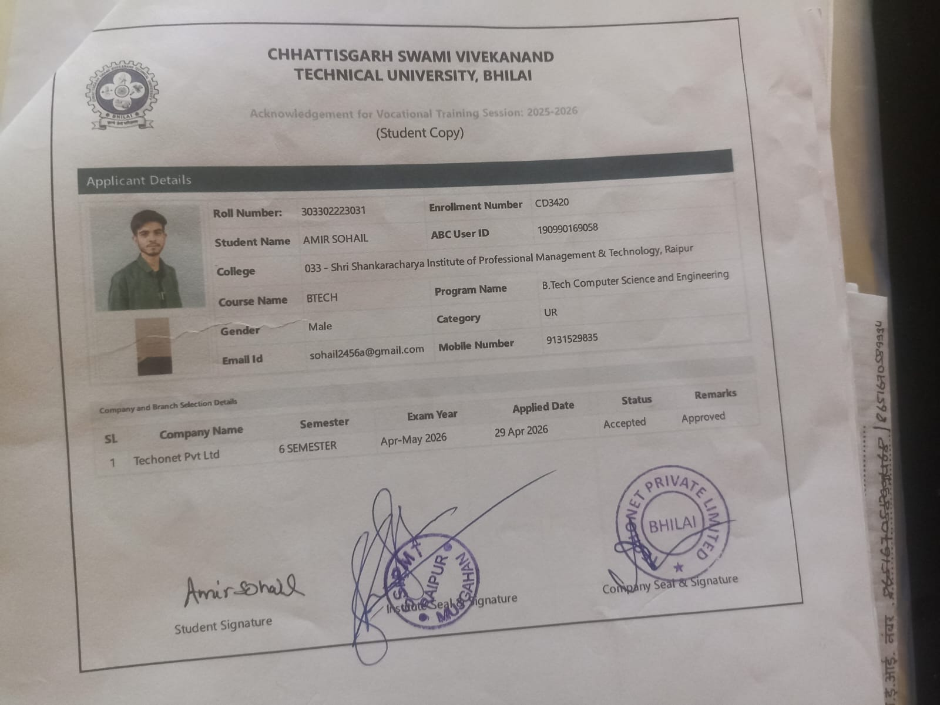
Acknowledgement of Vocational Training
(Student Copy)
[ Insert scanned copy / photo of the signed Acknowledgement of Vocational Training here ]

Slide 20
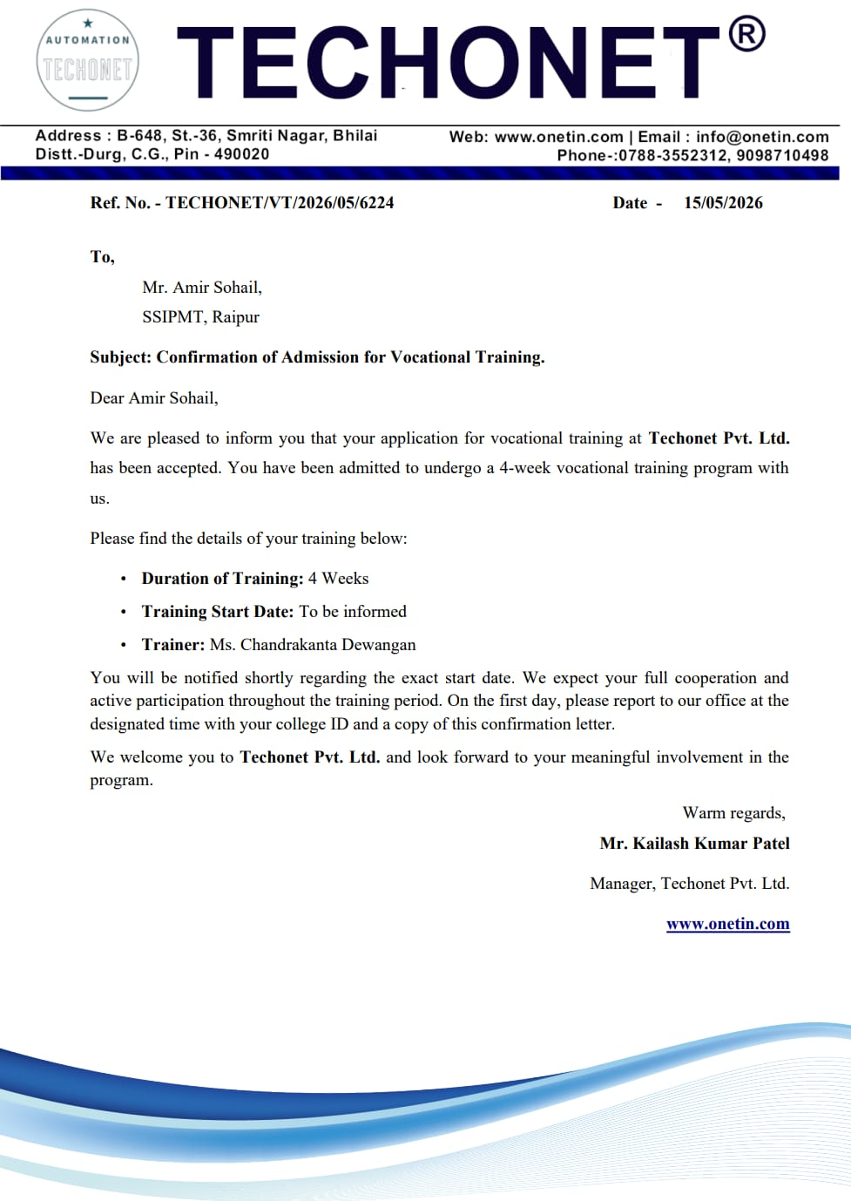
Offer Letter

Slide 21
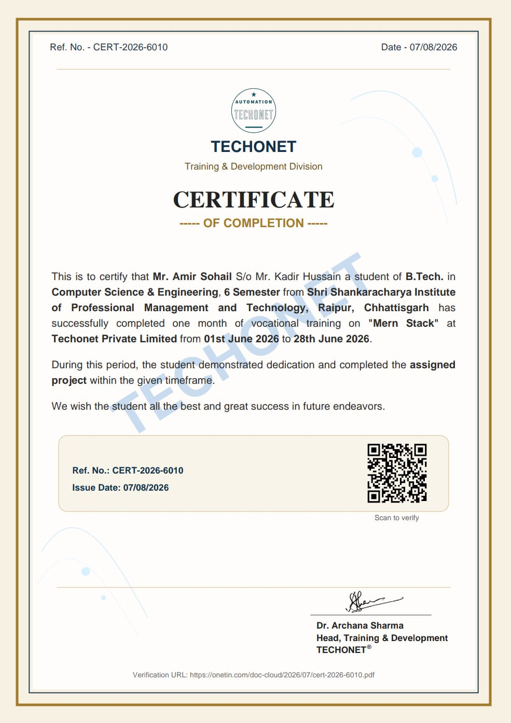
Certificate
[ Insert scanned copy of the Training Completion Certificate here ]

