Slide 1

Sprocket Central Pty Ltd
Data Analytics Approach
Prepared by: Amir Syamil Amrin

Slide 2

TABLE OF
CONTENTS
Introduction
03
Data Exploration
04
Model Development
11
Interpretation
14

Slide 3

Introduction
Analysing the existing customer dataset to get to know which of 1000 new customers should be targeted to drive the most value for Sprocket Central Pty Ltd.
Customer trends and behaviour analysis
03

Slide 4

Data Exploration
1
Profit by age group
Introduction
2
Correlation of Tenure and age
3
Age distribution
4
Bike related purchases
04

Slide 5
Profit by Age Group
Most profit generated from customers with age group of 41-50. Among the three wealth segments, mass customer contributed the most in the profit.
Age Group
Segments
41 – 50
Mass Customers
05

Slide 6
Correlation of Tenure and Age
Correlation: 0.4425
R² = 0.1958
This statistical analysis shows that there is a correlation of 0.4425 between the two variables. Meaning that, as customer age increases, the period of tenure will be increase too.
06

Slide 7
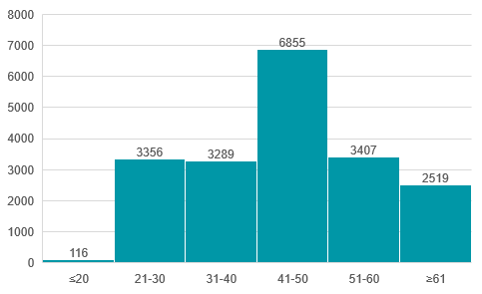
2017
Age Distribution
Based on the historical data, it shows that most of the customers are between 41-50 years old.
Customers in 41-50 Age bracket
35%
07

Slide 8
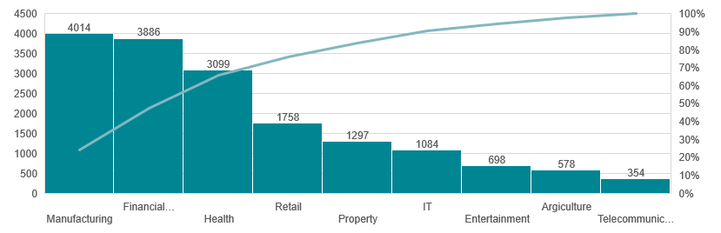
Bike related purchase by job industry
Customers that work in the manufacturing industry contributed 23.94% to the bike related purchases.
08

Slide 9
Bike related purchase by gender
It appears that both gender has approximately close amount in terms of bike related purchases. Do note that female with age 41-50 years old purchased 10.47% more than male with age around 41-50 years old.
09

Slide 10
Bike related purchase by state and car ownership
Customers from NSW has the most potential for our geographic segment target as most of them use bikes as their means of transportation aside from cars.
10

Slide 11

1
Brand analysis
Model Development
2
Customer analysis
11

Slide 12
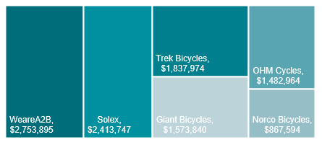
Brand Analysis
This analysis shows the brand that bring the most profit margin. Therefore, should emphasize marketing these products to the customer.
1
Wherea2b
2
SOLEX
3
Trek bicycles
12

Slide 13
Customer Analysis
This analysis proved that marketing should be target on potential customers with age 41-50 years old as they are will bring the most value to the company.
Customers in 41-50 Age bracket
13

Slide 14




Interpretation
Customer target
Customer aged 41-50 years old
Mass customer
NSW
Manufacturing
14

Slide 15


Any Questions ?
For Business Inquiry
Disclaimer: This PowerPoint slides is only for the purpose KPMG AU Data Analytics virtual internship task.
Address
123 Street Address 2000. Country Name
Phone
(123) 567 9812343
Email
amirsyamilamrin@gmail.com
Website
www.linkedin.com/in/amirsyamilamrin/
15

