Slide 1

ITEC610
ASSESSMENT 3: DATA PROCESSING AND EXPLORATION PROJECT
S00393664

Slide 2
TABLE OF CONTENTS
01
INTRODUCTION
02
SUMMARY STATISTICS ANALYSIS
03
CORRELATIONS ANALYSIS
04
SIGNIFICANT ANALYSIS
05
CONCLUSION

Slide 3

01
INTRODUCTION
ITEC610_assessment3_data.csv is a project in the class of ITEC610 in the methods of data analysis and visualization.
This dataset contains:
Row = 414508
Columns = 7
Variables allow for the analysis of changes in weight over time and how these changes relate to height, showing details of individuals and populations.

Slide 4
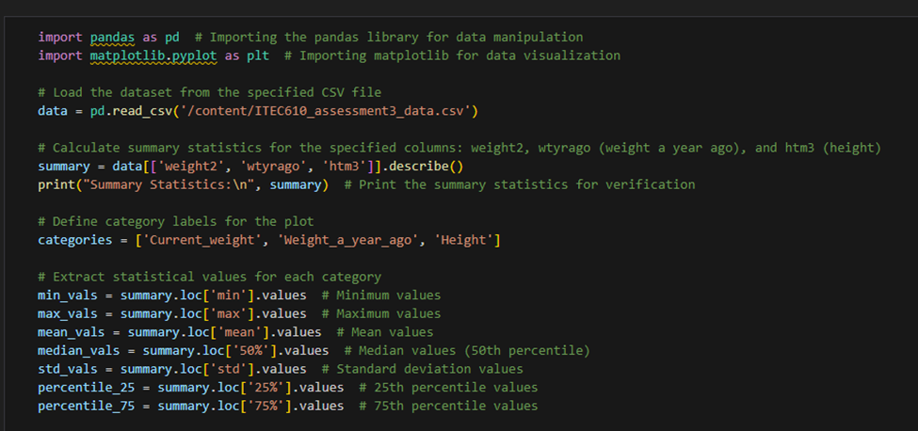
TASK 1 CODE

Slide 5
Getting Values for Plotting:
- We pull out specific numbers from our statistics:
- Minimum values
- Maximum values
- Mean (average) values
- Median (middle value)
- Standard deviation (how spread out the numbers are)
- 25th percentile (value below which 25% of the data falls)
- 75th percentile (value below which 75% of the data falls)
5. Making the Plot:
- set the size of our graph.
- plot different points for each category using different shapes and colors:
- Triangles for min and max values
- Crosses for mean values
- Stars for median values
- Green triangles for mean plus/minus standard deviation
- Orange arrows for 25th and 75th percentiles
- add a legend to explain what each shape and color means.
- give our graph a title and label the y-axis.
- adjust the layout to make everything fit nicely.
1. Importing Libraries and loading data:
- We bring in two tools: `pandas` (to handle data) and `matplotlib.pyplot` (to make graphs).
- We read a file named `ITEC610_assessment3_data.csv` and store its content in a variable called `data`.
2. Calculating Statistics:
- We look at three columns in our data: `weight2` (current weight), `wtyrago` (weight a year ago), and `htm3` (height).
- use `describe()` to get important numbers like the average (mean), smallest (min), largest (max), and other statistics for these columns.
- print these numbers to check them.
3. Setting Up Categories:
- We create a list of names for our categories: `['Current_weight', 'Weight_a_year_ago', 'Height']`.

Slide 6
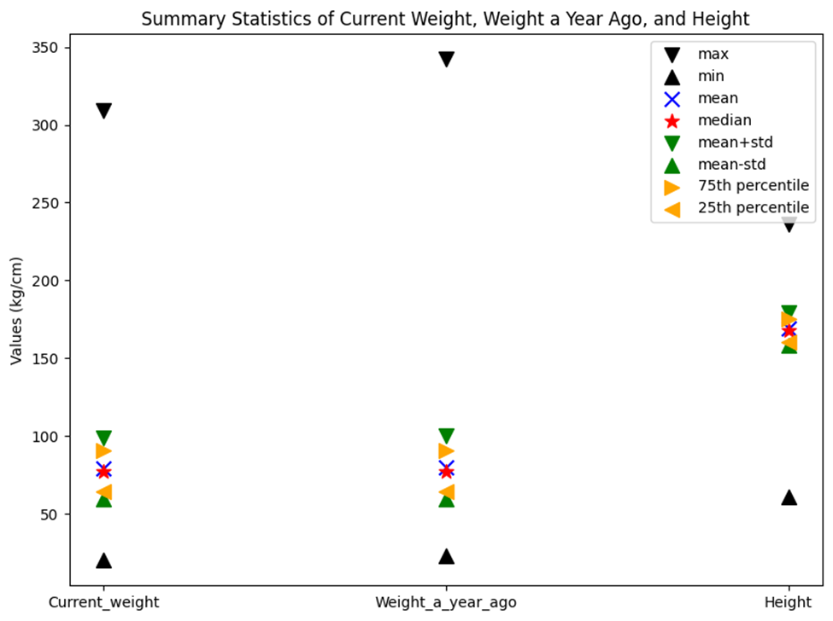
Our Company
TASK 1 OUTPUT

Slide 7
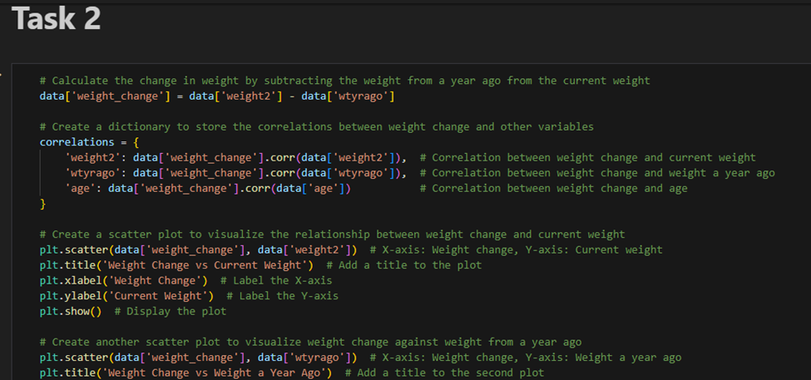
TASK 2 CODE

Slide 8
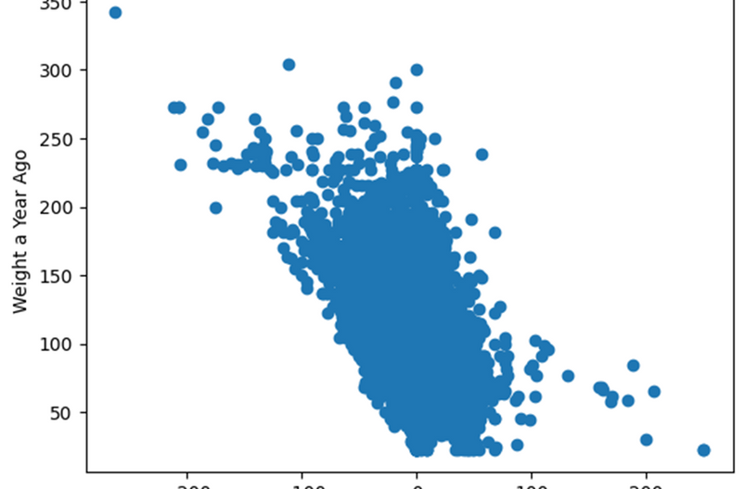
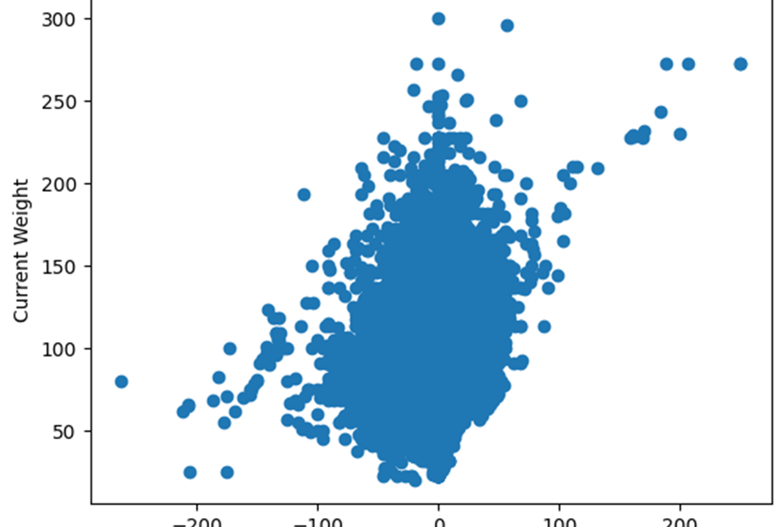
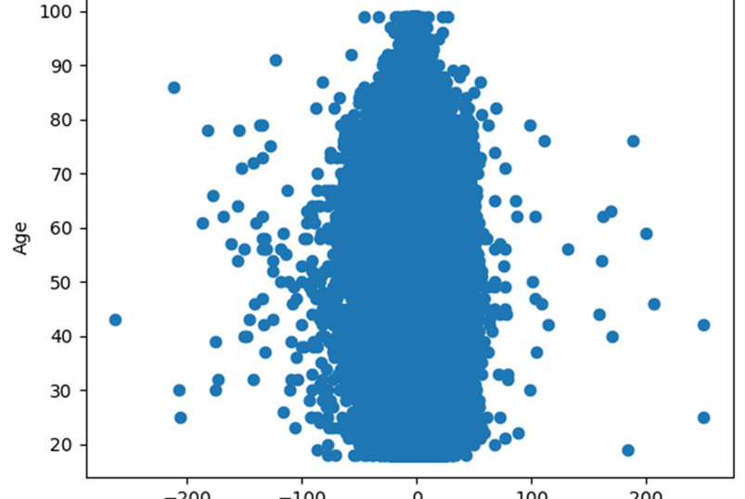
TASK 2 OUTPUT
WEIGHT CHANGE VS WEIGHT CHANGE A YEAR AGO
WEIGHT CHANGE VS CURRENT WEIGHT
WEIGHT CHANGE VS AGE

Slide 9
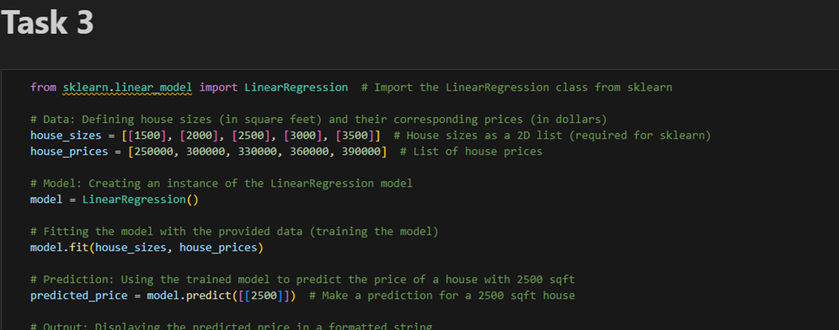
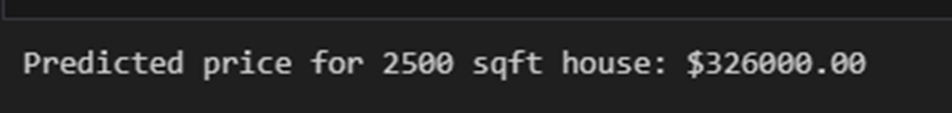
TASK 3 CODE AND OUTPUT

Slide 10
CONCLUSION
The dataset indeed illustrates that persons with higher historical weights are likely to have higher changes over time, which is evoked by the strong correlation between weight change and weight from a year ago.
Current weight and weight change do present some positive correlation; in other words, those individuals who have higher weights now also gained more weight recently.
Whereas the variation in weight does not change drastically with age, this would imply that lifestyle or health behavior matters more.
Besides giving an example of how statistical techniques and predictive modeling can be used to analyze patterns and make forecasts, the research also brings into focus the importance of historical weight data in understanding weight swings.

