Slide 1
Restaurants in Glendale,CA
By Amir Tayyebian

Slide 2
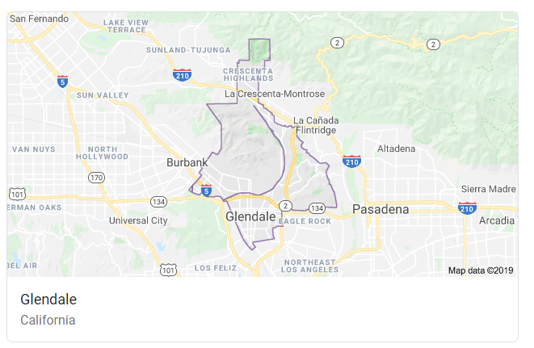
Background
Glendale CA is a city in Los Angeles County with a population of over 200,000.

Slide 3
Background
Our client is looking to open a restaurant serving either Thai, Mexican, or Italian Cuisine
Our client is primarily concerned about the number of competitors for type of restaurant, and the popularity of these competitors.
Secondarily, our client wants to know which of Glendale’s 9 zipcodes is best suited to open the final recommended restaurant type.

Slide 4
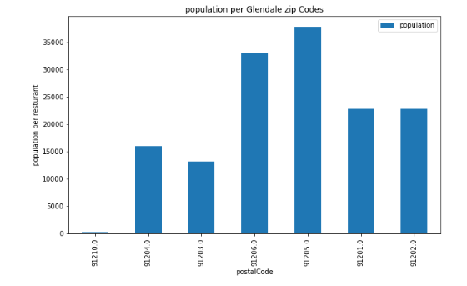
Methodology- Explorotory Data Analysis
Zip Code Data – The following graphic shows the distribution of Glendale’s population by zip code

Slide 5
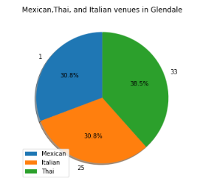
Methodology- Explorotory Data Analysis
Venue Data- The following graphic distribution of the 36 venues that fall under the three specified Categories

Slide 6
Results
Number of Competitors- The number of competitors proved to be close for all three restaurant types, as discovered through exploratory analysis.
Quality of Competitors- The next step was to analyze the Foursquare ratings for each venue and calculating the average rating for each venue type. We believed that a lower average rating implies a lower quality of competition, which is favorable to our client. These results are demonstrated in Figure 3.

Slide 7
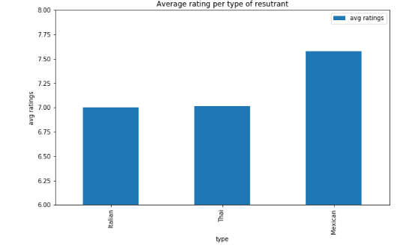
Results- Average restaurant rating

Slide 8
Results (continued)
Due to Mexican restaurants having a higher average rating and thus better quality competition, we eliminated Mexican as the best type of restaurant to open.
After analyzing the quantity and quality of the competitors, the next step was to analyze zip codes in order to find the most ideal one.
As we didn’t discover a clear choice in the previous step, we conducted zip code analysis for each of the zip codes.
The following demonstrates the following:
The ratio of population to venues in each zip code to understand the market for untapped opportunities.

Slide 9
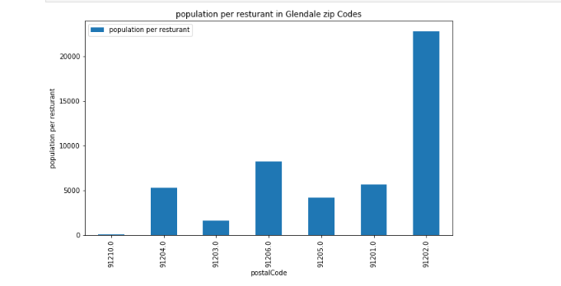
Population to venue ratio in each zip code

Slide 10

Venues in the ideal zipcode, 91202
After deciding that 91202 is the ideal zipcode, we repeated the analysis process limiting it to only venues located in the 91202 zip code, or the zip codes surrounding it: 91201, 91203, 91207
These results are demonstrated in the following graph:

Slide 11
Discussion
There was no clear obvious choice regarding restaurant types looking at the number of competitors
We eliminated Mexican cuisine after looking at the ratings of each restaurant type
There was still no clear recommendation between Italian and Thai food looking at the number of competitors and also the ratings of competitors
As a result, we studied which zip code would be most ideal for a new Thai or Italian restaurant.
After finding 91202 as the most ideal zipcode, we repeated the process for both types of restaurants.
Considering the above, our final recommendation is to open an Italian restaurant in the 91202 zipcode.

Slide 12
Conclusion and Future
This study only focused on the quantity and quality of competitors for each restaurant type.
It’s important to note that there several factors that should be considered in the future regarding this study:
Demographic information such as age, race and income can potentially change the quality of the recommendations made in this study.
Additionally, commercial real estate prices and availability is another important factor that should be considered before reaching a final decision
Additional surveys can be conducted to gain more data and insight regarding the demand of each restaurant type
Besides Foursquare ratings, other popular online review methods such as yelp or Google can also be used to gain a better understanding of the quality of competitors.

