Slide 1
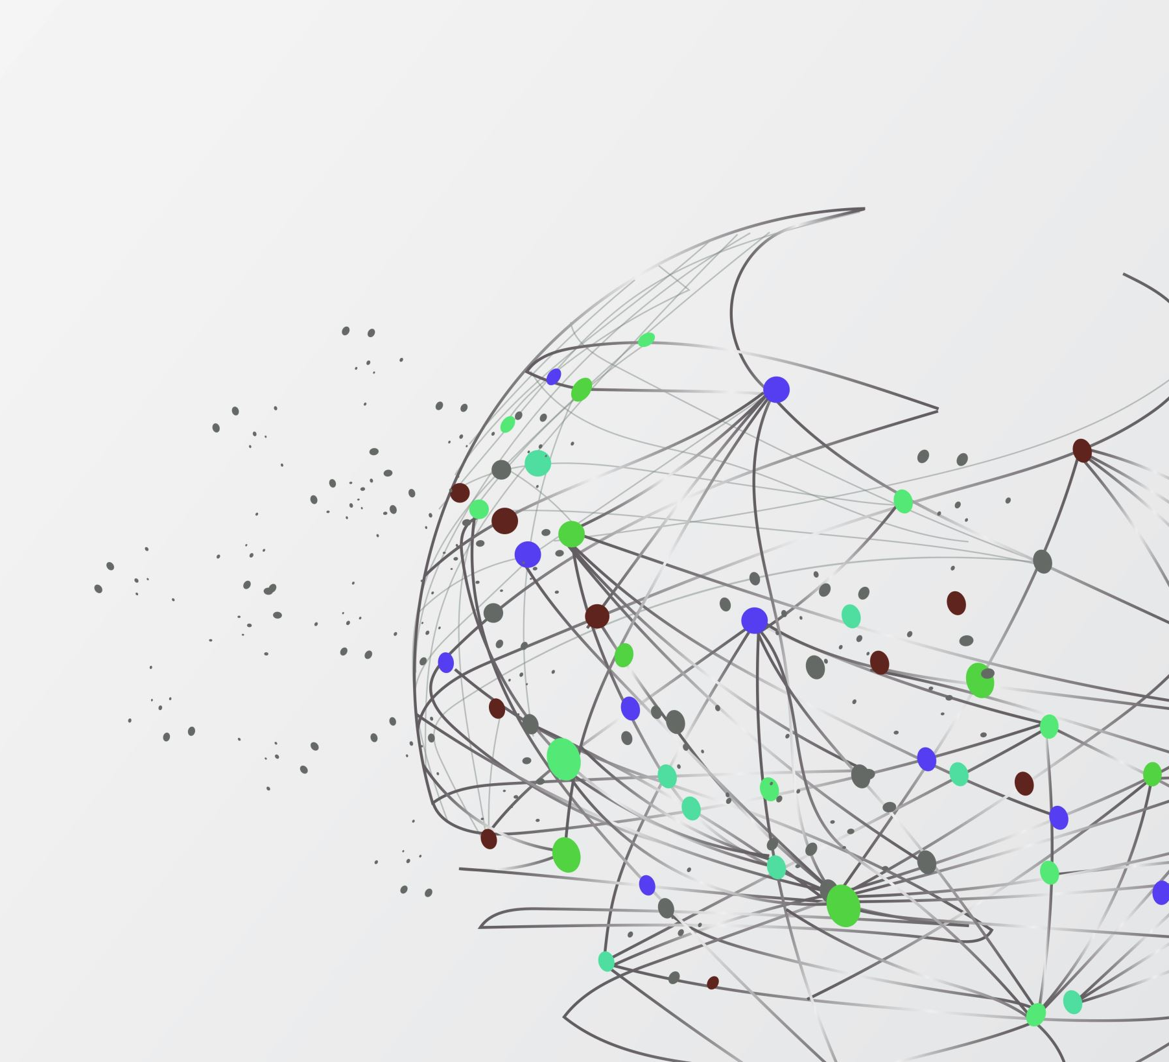
Research Paper Recommendation using Fine-Tuned Sentence Transformer
Leveraging AI for improved academic paper suggestions
Notes:
---

Slide 2
Problem Statement
Notes:
Project Overview, Problem Statement

Slide 3

Problem Statement
Challenges in Academic Search
  Traditional keyword searches often miss semantic context, resulting in irrelevant or incomplete paper retrieval.
Growing Research Volume
  The increasing number of research papers makes manual discovery inefficient and time-consuming for researchers.
Need for Semantic Understanding
  A system that comprehends context and semantics is essential to provide accurate recommendations and search results.
Solution Approach
  Utilizing a fine-tuned sentence transformer model to connect user intent with paper content for better research outcomes.
Notes:
Researchers often face challenges in finding relevant academic papers efficiently. Traditional keyword-based search methods fail to capture semantic meaning, leading to incomplete or irrelevant results. The growing volume of research papers exacerbates this problem, making manual discovery impractical. There is a clear need for a system that understands context and semantics, enabling accurate recommendations and search capabilities. By implementing a fine-tuned sentence transformer model, this project aims to bridge the gap between user intent and paper content, providing a more intuitive and effective research experience.

Slide 4
Dataset
Notes:
Project Objectives, Dataset Details

Slide 5


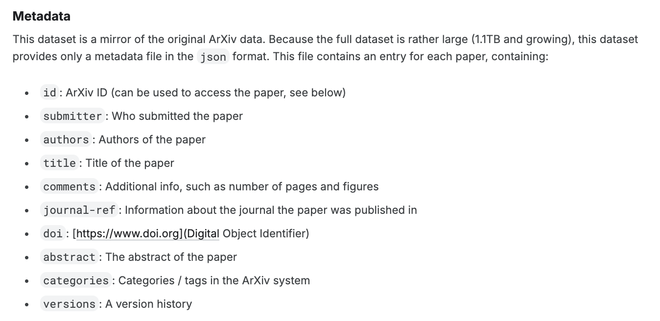
Dataset Details
Dataset Source and Size
  Original dataset includes approximately 2 million scientific papers from ArXiv metadata.
Balanced Sampling Strategy
  For ada-2 distillation: A sample of 30K papers were selected from the ‘CS.AI’ category. 25K corpus, 10K hard training pairs and 5K held out for evaluation.
  For LLM as a Judge: Sample of last 2 years papers for CS.AI. Around 122K papers.
Text Input Preparation
  Titles and abstracts were concatenated to form rich semantic text inputs for modeling.
Efficiency and Coverage
  Sampling strategy allows faster experimentation while maintaining representative domain coverage.
Notes:
The dataset used in this project is sourced from ArXiv metadata, which originally contains approximately 2 million papers. For efficient processing and iteration, a balanced sample of 100,000 papers was selected, ensuring diversity across categories with a maximum of 2,000 papers per category. Each paper's title and abstract were concatenated to form the text input for the models, providing rich semantic content without the complexity of full-text processing. This sampling strategy allows for faster experimentation while maintaining representative coverage of research domains.

Slide 6
Data Preparation
Filtering: Removed rows where the abstract or the title had non-ascii characters as this would make read and writing to csv difficult.
Feature engineering: Created a new column by combining title and abstract. This will be used for semantic matching.
Prepared hard pairs for training.
50% positive pairs + 50% negative pairs prevents embedding space collapse.
For LLM as Judge, we took 10K pairs of paper for training, and 1k for testing
Pair Type | Criteria | Purpose
Positive | Ada similarity ≥ 75th percentile | Teach similarity
Negative | Ada similarity ≤ 25th percentile | Teach dissimilarity
Notes:
The dataset used in this project is sourced from ArXiv metadata, which originally contains approximately 2 million papers. For efficient processing and iteration, a balanced sample of 100,000 papers was selected, ensuring diversity across categories with a maximum of 2,000 papers per category. Each paper's title and abstract were concatenated to form the text input for the models, providing rich semantic content without the complexity of full-text processing. This sampling strategy allows for faster experimentation while maintaining representative coverage of research domains.

Slide 7
Modelling
Notes:
Project Objectives, Dataset Details

Slide 8
Baseline 1 – TF-IDF
Establishes a lower bound for performance. Any semantic model should significantly outperform pure keyword matching.
A sparse, statistical approach that represents documents as weighted word vectors
Here are the implementation details.
Component | Formula | Meaning
TF | count(term) / total_terms | How often a word appears in this document
IDF | log(N / docs_with_term) | How rare/important a word is across all documents
TF-IDF | TF × IDF | Words frequent here but rare overall get high weight
Parameter | Value
Vectorizer | TfidfVectorizer (scikit-learn)
Dimensions | ~50,000 (vocabulary size)
Similarity | Cosine similarity
Notes:
The dataset used in this project is sourced from ArXiv metadata, which originally contains approximately 2 million papers. For efficient processing and iteration, a balanced sample of 100,000 papers was selected, ensuring diversity across categories with a maximum of 2,000 papers per category. Each paper's title and abstract were concatenated to form the text input for the models, providing rich semantic content without the complexity of full-text processing. This sampling strategy allows for faster experimentation while maintaining representative coverage of research domains.

Slide 9
Baseline 2 – all-minilm-l6-v2
A pre-trained Sentence Transformer model optimized for semantic similarity tasks. 22M parameters, 6 layers, 384 embedding dimension.
How it works ?
Establishes the pre-training baseline. Shows what general semantic understanding achieves before domain-specific fine-tuning with Ada-002 knowledge distillation.
Step | Description
Tokenization | WordPiece tokenizer splits text into subwords
Encoding | 6 transformer layers capture contextual relationships
Pooling | Mean of all token embeddings. Single Vector.
Similarity | Cosine similarity between vectors
Notes:
The dataset used in this project is sourced from ArXiv metadata, which originally contains approximately 2 million papers. For efficient processing and iteration, a balanced sample of 100,000 papers was selected, ensuring diversity across categories with a maximum of 2,000 papers per category. Each paper's title and abstract were concatenated to form the text input for the models, providing rich semantic content without the complexity of full-text processing. This sampling strategy allows for faster experimentation while maintaining representative coverage of research domains.

Slide 10
Finetuning all-minilm-l6-v2 – ada-002 distillation
Transfer Ada-002's semantic understanding to a lightweight model that runs free at inference time.
Training configurations.
Role | Model | Cost
Teacher | text-embedding-ada-002 (1536-d) | $0.0001/1K tokens
Student | all-MiniLM-L6-v2 (384-d) | Free (local inference)
Parameter | Value
Total pairs | 10K
Train / Test split | 90% + 10%
Batch Size | 32
Epochs | 3
Learning Rate | 2e-5
Warmup Ratio (Gradual learning rate increase percentage) | 0.1
Loss function | Cosine Similarity Loss
Eval frequency | Every 100 steps
Evaluator | EmbeddingSimilarityEvaluator (Spearman and Pearson rank correlation)
Notes:
The dataset used in this project is sourced from ArXiv metadata, which originally contains approximately 2 million papers. For efficient processing and iteration, a balanced sample of 100,000 papers was selected, ensuring diversity across categories with a maximum of 2,000 papers per category. Each paper's title and abstract were concatenated to form the text input for the models, providing rich semantic content without the complexity of full-text processing. This sampling strategy allows for faster experimentation while maintaining representative coverage of research domains.

Slide 11
Finetuning all-minilm-l6-v2 using LLM as Judge
Transfer Ada-002's semantic understanding to a lightweight model that runs free at inference time.
Training configurations.
Role | Model | Cost
Teacher | gemin-2.5-flash | $0.0003/1k tokens
Student | all-MiniLM-L6-v2 (384-d) | Free (local inference)
Parameter | Value
Total pairs | 11K
Train / Test split | 10k/1K
Batch Size | 16
Epochs | 4
Learning Rate | 2e-5
Loss function | Cosine Similarity Loss
Notes:
The dataset used in this project is sourced from ArXiv metadata, which originally contains approximately 2 million papers. For efficient processing and iteration, a balanced sample of 100,000 papers was selected, ensuring diversity across categories with a maximum of 2,000 papers per category. Each paper's title and abstract were concatenated to form the text input for the models, providing rich semantic content without the complexity of full-text processing. This sampling strategy allows for faster experimentation while maintaining representative coverage of research domains.

Slide 12
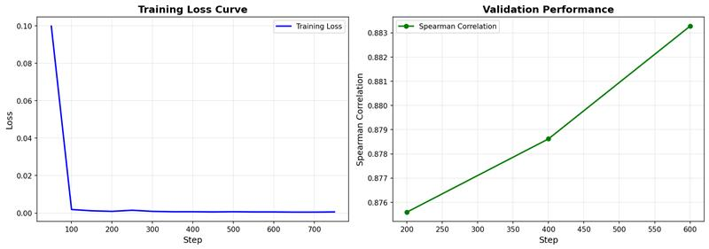
Training Curve – ada-002 distillation
Notes:
The dataset used in this project is sourced from ArXiv metadata, which originally contains approximately 2 million papers. For efficient processing and iteration, a balanced sample of 100,000 papers was selected, ensuring diversity across categories with a maximum of 2,000 papers per category. Each paper's title and abstract were concatenated to form the text input for the models, providing rich semantic content without the complexity of full-text processing. This sampling strategy allows for faster experimentation while maintaining representative coverage of research domains.

Slide 13
Evaluation
Notes:
Project Objectives, Dataset Details

Slide 14
Metrics
Approach: Generate embeddings only for the 5K holdout data set using TF-IDF, Base ST, Finetuned ST and ada-002. Use ada-002 top K recommendations as the ground truth and calculate the following metrics.
These metrics were selected as they reflect the quality of recommendations and indicate how closely the finetuned model mimics ada-002.
The above metrics were calculated for 5000 data points with different values of K and the average is ploted in the graph. The shaded area indicates the standard deviation.
Metric | Description | Interpretation
Recall@K | Fraction of Ada's top-K found in model's top-K | Higher = finds more relevant papers
NDCG@K | Normalized Discounted Cumulative Gain | Higher = correct ranking order
MRR@K | Mean Reciprocal Rank | Higher = first relevant result appears earlier
MAP@K | Mean Average Precision | Higher = overall ranking quality
Notes:
The system was evaluated using metrics such as Precision, Recall, Mean Reciprocal Rank (MRR), Mean Average Precision (MAP), and normalized Discounted Cumulative Gain (nDCG). Evaluation was conducted with LLM-based judges to ensure semantic relevance. Results indicate that the Fine-Tuned Sentence Transformer model significantly outperforms both the TF-IDF baseline and the base Sentence Transformer model, demonstrating the effectiveness of domain adaptation and high-quality annotations. These improvements validate the design choices and highlight the impact of fine-tuning on recommendation accuracy.

Slide 15
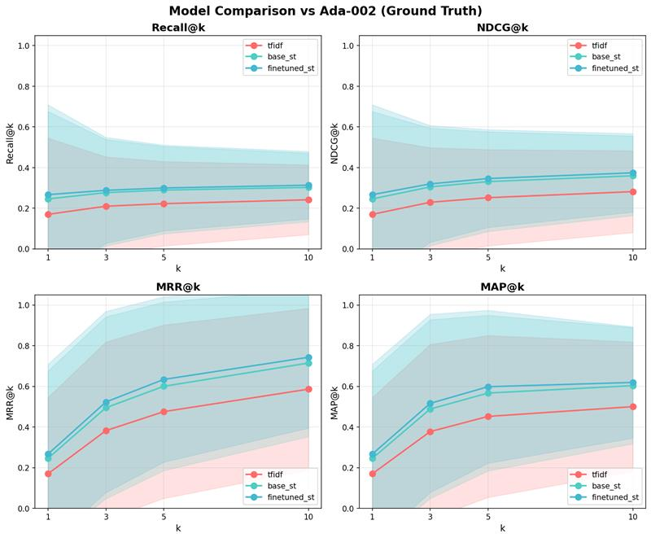

Slide 16
Deployment
Notes:
System Overview, Training Pipeline

Slide 17

Deployment Architecture
Link to demo for ada-002 distillation
Link to demo for LLM as Judge
Serverless Execution with Cloud Run
  Using serverless Cloud Run ensures scalable and cost-efficient deployment of microservices.
Microservices Architecture
  Gateway routes requests to three independent microservices hosting different models for scalability and isolation.
Optimized Docker Images
  Model artifacts are baked into Docker images to reduce startup latency and improve performance.
Cost Optimization Strategy
  Min-instances set to zero balances cost savings with minor cold start delays in production.
Notes:
The deployment architecture leverages Google Cloud Run for serverless execution, ensuring scalability and cost efficiency. A gateway service routes incoming requests to one of three microservices, each hosting a specific model: TF-IDF, base Sentence Transformer, or Fine-Tuned Sentence Transformer. This separation allows independent scaling, faster cold starts, and memory isolation. Docker images are optimized by baking model artifacts into the image, reducing startup latency. The architecture supports min-instances=0 for cost optimization, accepting minor cold start delays in exchange for reduced monthly expenses.

Slide 18
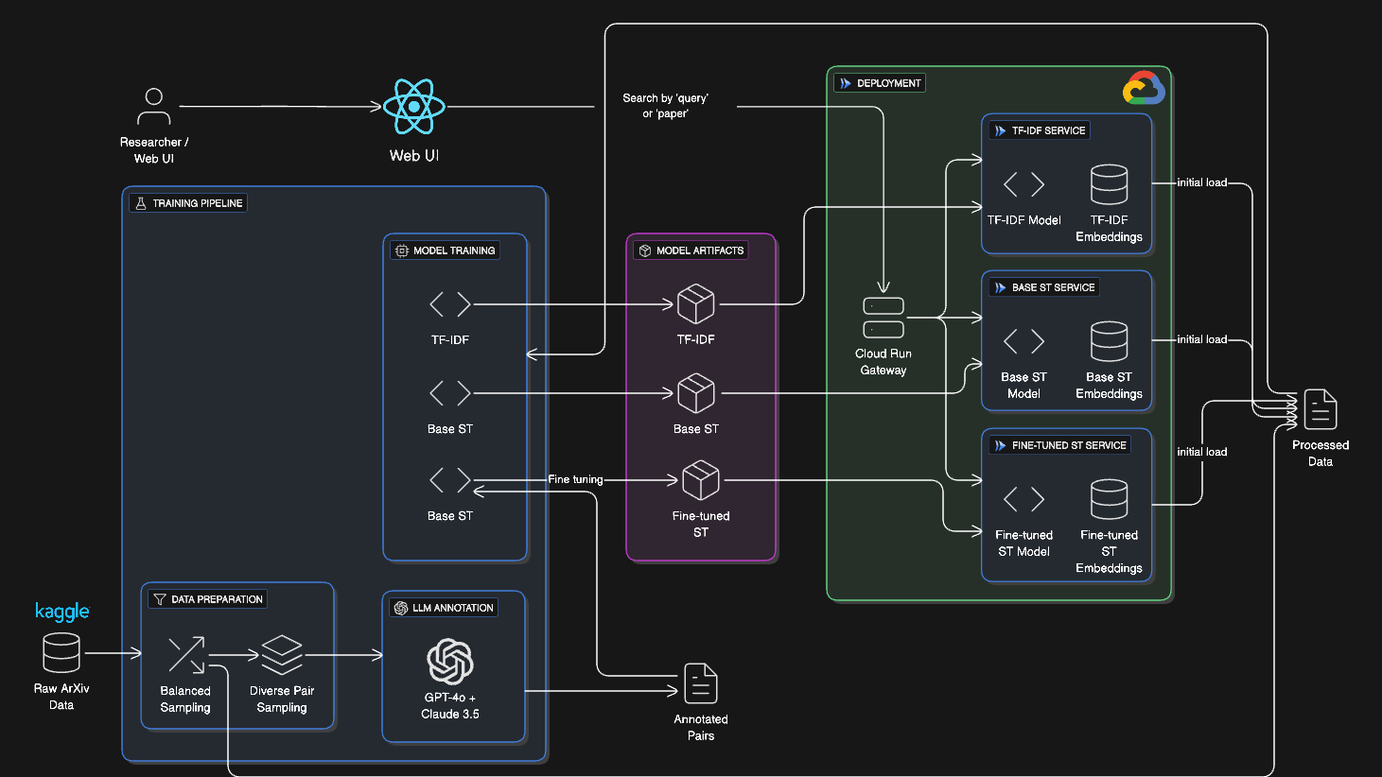
Notes:
The system architecture is designed to handle user queries or paper IDs as input and return the top-N most similar papers as output. It incorporates three distinct models: TF-IDF for a fast and interpretable baseline, a pre-trained Sentence Transformer model (all-MiniLM-L6-v2), and a Fine-Tuned Sentence Transformer model adapted to the research domain. The deployment strategy uses Google Cloud Run with a microservices approach, where each model runs in an isolated service. This design ensures independent scaling, faster cold starts, and memory isolation, making the system both efficient and resilient.

Slide 19
Limitations
Notes:
System Overview, Training Pipeline

Slide 20
Limitations
With just 10K training pairs, we were only able to show a small improvement. We might be able increase the number of training pairs to get better performance.
With only 384 dimensions, the representation power of 'all-minilm-l6-v2' is limited and will not able to achieve the same performance of ada-002 across multiple domains. In fact, the embedding space completely collapsed in some of the attempts.
The representation power of ada-002 itself is limited as it is an outdated embedding model. We used it as it was cheaper than the newer ones and was readily accessible.
We could have used more data to train for LLM as Judge, but due to latency issues and cost issues, did not do.
Notes:
The dataset used in this project is sourced from ArXiv metadata, which originally contains approximately 2 million papers. For efficient processing and iteration, a balanced sample of 100,000 papers was selected, ensuring diversity across categories with a maximum of 2,000 papers per category. Each paper's title and abstract were concatenated to form the text input for the models, providing rich semantic content without the complexity of full-text processing. This sampling strategy allows for faster experimentation while maintaining representative coverage of research domains.

Slide 21
Contributions
Notes:
System Overview, Training Pipeline

Slide 22
Contributions
We followed an ensemble technique. Both of us independently worked on each phase of the project, compared results and took the best from both work.
Name | Contribution
Grampurohit Santosh | Problem Statement Data Preparation Data Modelling Evaluation Deployment UI
Amirthalingam | Data Preparation Data Modelling Evaluation Deployment UI Presentation and Reports.
Notes:
The dataset used in this project is sourced from ArXiv metadata, which originally contains approximately 2 million papers. For efficient processing and iteration, a balanced sample of 100,000 papers was selected, ensuring diversity across categories with a maximum of 2,000 papers per category. Each paper's title and abstract were concatenated to form the text input for the models, providing rich semantic content without the complexity of full-text processing. This sampling strategy allows for faster experimentation while maintaining representative coverage of research domains.

Slide 23
Data Science Canvas |  |  | Project: | Research Paper Recommendation Service
 |  |  | Team: | ScholarStream
Problem Statement |  |  |  | Execution & Evaluation |  | Data Collection & Preparation
Business Case & Value Added There is explosion of the research articles, and it is difficult to keep up with the newly introduced concepts and trending topics. | Model Selection Embedding models are known to model a vector space that encodes real world concepts and therefore help with semantic similarity. We will use, TF-IDF as baseline 1, all-minilm-l6-v2 as baseline 2 | Model Requirements Semantic understanding. Domain relevance Scalability Low latency Input flexibility Low cost | Skills What skills are needed to provide the data and model development? EDA Developing application using python framework like FASTAPI Vector DB NLP Machine Learning Containerization Cloud Deployment | Model Evaluation Precision@K Recall@K MRR nDCG@K Real time monitoring: Latency Throughput Error rate Resource usage | Data Storytelling A simple ui with detailed research paper information, recommendations and similarity scores. | Data Selection & Cleansing The data is readily available in arxiv. We filter out papers that have non ascii characters in the title or abstract. | Data Collection No additional data is required.
Data Landscape Yes data is already available from arxiv Additional data can be generated by extracting pdf content for certain categories. But, for the purpose of this project, we will limit ourself to just the metadata (title, abstract, authors etc.) |  | Software & Libraries Numpy Pandas Sci-kit learn Vector db like milvus db LLMs (ex gemini-flash-2.5) Langchain HuggingFace FastAPI |  |  |  | Data Integration Data integration is not required as it is from a single source | Explorative Data Analysis We only use papers from ‘cs.ai’ category. The data is clean and doesn’t require EDA.
Adopted from: https://github.com/tomalytics/datasciencecanvas

