Slide 1
Digital Portfolio
STUDENT NAME:Amirtha S REGISTER NO:24131030500122002
NMID:0FAD61522388C0A8CB0495D030072FB4
DEPARTMENT: BCA( Bachelor of Computer Application) COLLEGE: Government Arts College, Chidambaram
1

Slide 2
Project Title
Digital Portfolio
A Digital Portfolio is a personal website that displays an individual’s skills, education, projects, and achievements in a well-organized and attractive format.
It is designed using HTML, CSS, and optionally JavaScript to
create a simple and responsive layout.

Slide 3

AGENDA
Project Overview
Tools and Technologies
Portfolio Design and Layout
Features and Functionality
Results
Screenshots
Conclusion
3

Slide 4

PROJECT OVERVIEW
This project focuses on designing and developing a personal portfolio website that highlights Amirtha’s skills, educational background, and technical knowledge. The site is divided into multiple clear sections:
-> Home: A welcoming introduction.
-> About: Brief personal and academic background.
4

Slide 5
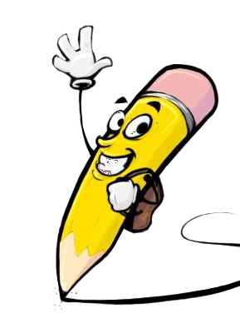

PROJECT OVERVIEW
-> Skills: Showcasing programming languages like C, C++, and Python.
-> Education: Details of my educational background.
-> Contact: Direct ways to reach out (LinkedIn, email,etc.).
5

Slide 6
TOOLS AND TECHNIQUES
* HTML (HyperText Markup Language): Used to create the structure of the webpage, such as headings, paragraphs, images, and links.
* CSS (Cascading Style Sheets): Provides styling, including colors, gradients, shadows, and responsive adjustments for different screen sizes (desktop, tablet, mobile).
6

Slide 7
POTFOLIO DESIGN AND LAYOUT
Modern look: Attractive use of gradient backgrounds, shadows, and rounded edges.
Sticky navigation bar: Allows users to smoothly move between sections without scrolling endlessly.
Content boxes: Neatly designed sections to separate information.
7

Slide 8
FEATURES AND FUNCTIONALITY
Navigation links: One-click links to jump directly to sections (Home, About, Skills, etc.).
LinkedIn button: Provides direct access to Amirtha’s LinkedIn profile, enabling networking and professional connection.
Responsive design: Ensures that the portfolio looks good on all devices, including mobile phones, tablets, and desktops.

Slide 9

RESULTS
The outcome of the project is a fully functional portfolio website that effectively displays Amirtha’s skills and background.
3/21/2024 Annual Review
9

Slide 10
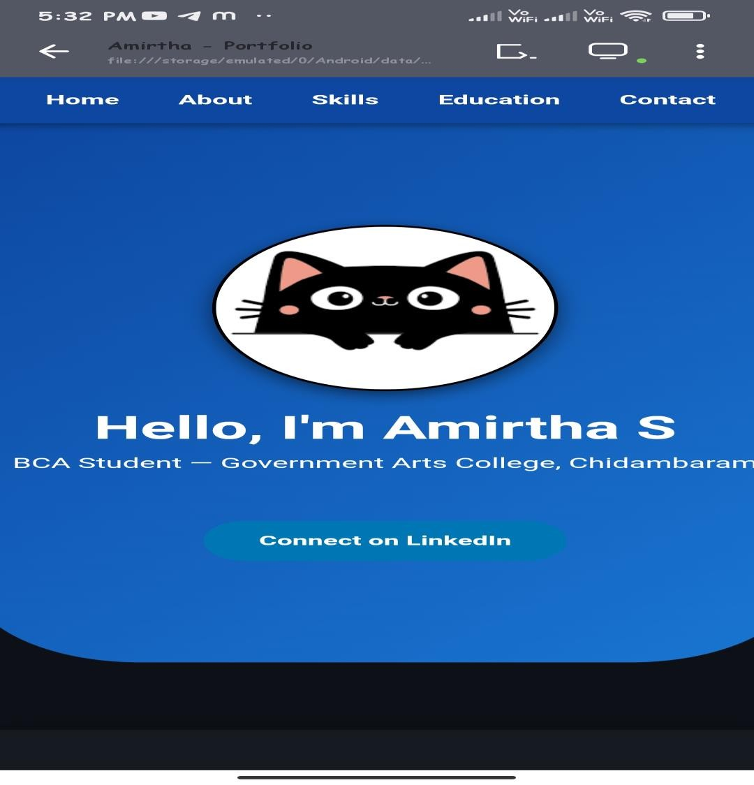
SCREENSHOTS

Slide 11
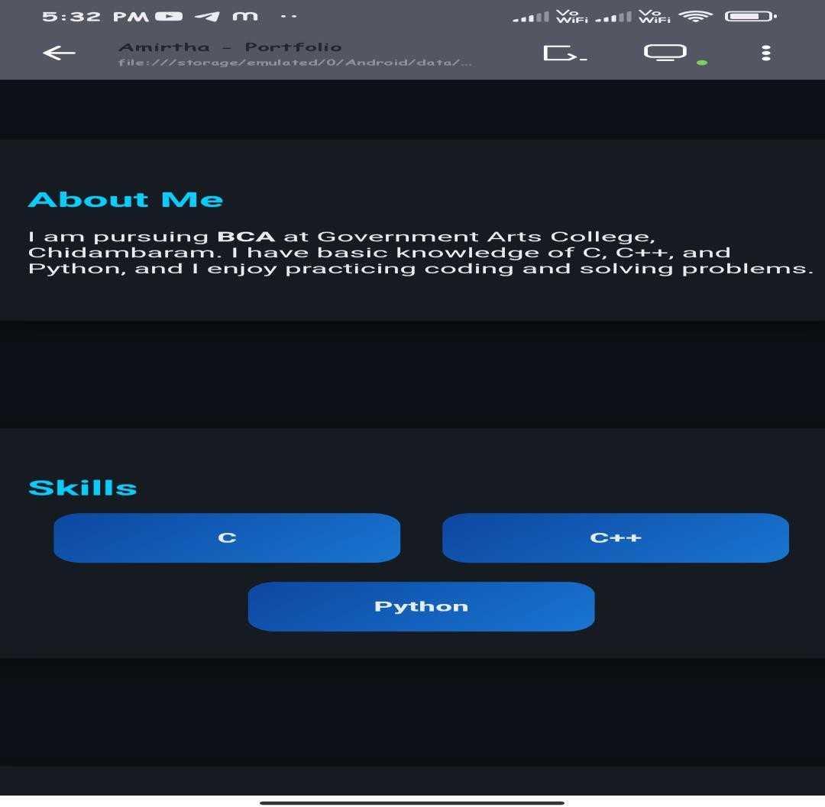
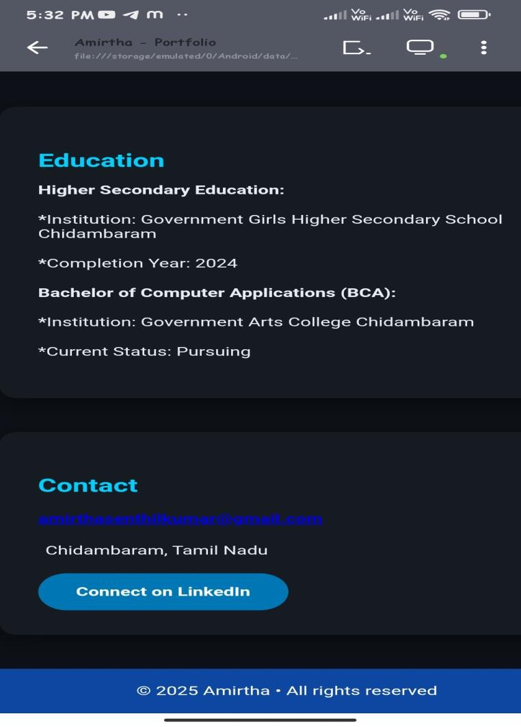
SCREENSHOTS

Slide 12

CONCLUSION
The project is a simple portfolio that highlights Amirtha’s coding skills and helps build a digital presence as a student.
12

