Slide 1
Version Control Revision Control Source Control
CS169
Lecture 7

Slide 2
Outline
What is version control?
And why use it?
Scenarios
Basic concepts
Projects
Branches
Merging
conflicts
Two systems
PRCS
CVS

Slide 3
All Software Has Multiple Versions
Different releases of a product
Variations for different platforms
Hardware and software
Versions within a development cycle
Test release with debugging code
Alpha, beta of final release
Each time you edit a program

Slide 4
Version Control
Version control tracks multiple versions
In particular, allows
old versions to be recovered
multiple versions to exist simultaneously

Slide 5
Why Use Version Control?
Because everyone does
A basic software development tool
Because it is useful
You will want old/multiple versions
Without version control, can’t recreate project history
Because we require it
For your own good
The only such requirement in the course . . .

Slide 6
Scenario I: Bug Fix
Time
First public release of the hot new product
Releases
1.0

Slide 7
Scenario I: Bug Fix
Time
Internal development continues, progressing to version 1.3
Releases
1.0
1.3

Slide 8
Scenario I: Bug Fix
Time
A fatal bug is discovered in the product (1.0), but 1.3 is not stable enough to release. Solution: Create a version based on 1.0 with the bug fix.
Releases
1.0
1.3
1.0 bugfix

Slide 9
Scenario I: Bug Fix
Time
Note that there are now two lines of development beginning at 1.0.
This is branching.
Releases
1.0
1.3
1.0 bugfix

Slide 10
Scenario I: Bug Fix
Time
The bug fix should also be applied to the main code line so that the next product release has the fix.
Releases
1.0
1.3
1.4
1.0 bugfix

Slide 11
Scenario I: Bug Fix
Time
Note that two separate lines of development come back together in 1.4.
This is merging or updating.
Releases
1.0
1.3
1.4
1.0 bugfix

Slide 12
Scenario II: Normal Development
Time
You are in the middle of a project with three developers named a, b, and c.
Releases
1.5

Slide 13
Scenario II: Normal Development
Time
At the beginning of the day everyone checks out a copy of the code.
A check out is a local working copy of a project, outside of the version control system. Logically it is a (special kind of) branch.
1.5a
Releases
1.5
1.5b
1.5c

Slide 14
Scenario II: Normal Development
Time
The local versions isolate the developers from each other’s possibly unstable changes. Each builds on 1.5, the most recent stable version.
1.5a
Releases
1.5
1.5b
1.5c

Slide 15
Scenario II: Normal Development
Time
At 4:00 pm everyone checks in their tested modifications. A check in is a kind of merge where local versions are copied back into the version control system.
1.5a
Releases
1.5
1.5b
1.6
1.5c

Slide 16
Scenario II: Normal Development
Time
In many organizations check in automatically runs a test suite against the result of the check in. If the tests fail the changes are not accepted.
This prevents a sloppy developer from causing all work to stop by, e.g., creating a version of the system that does not compile.
1.5a
Releases
1.5
1.5b
1.6
1.5c

Slide 17
Scenario III: Debugging
Time
You develop a software system through several revisions.
Releases
1.5
1.6
1.7

Slide 18
Scenario III: Debugging
Time
In 1.7 you suddenly discover a bug has crept into the system. When was it introduced?
With version control you can check out old versions of the system and see which revision introduced the bug.
Releases
1.5
1.6
1.7

Slide 19
Scenario IV: Libraries
Time
You are building software on top of a third-party library, for which you have source.
Releases
Library A

Slide 20
Scenario IV: Libraries
Time
You begin implementation of your software, including modifications to the library.
Releases
Library A
0.7

Slide 21
Scenario IV: Libraries
Time
A new version of the library is released. Logically this is a branch: library development has proceeded independently of your own development.
Releases
Library A
0.7
Library B

Slide 22
Scenario IV: Libraries
Time
You merge the new library into the main code line, thereby applying your modifications to the new library version.
Releases
Library A
0.7
0.8
Library B

Slide 23
Concepts
Projects
Revisions
Branches
Merging
Conflicts

Slide 24
Projects
A project is a set of files in version control
Called a module in CVS
Version control doesn’t care what files
Not a build system
Or a test system
Though there are often hooks to these other systems
Just manages versions of a collection of files

Slide 25
Assumption
Consider a project with 1 file
We will return to the multiple file case later

Slide 26
Revisions
Consider
Check out a file
Edit it
Check the file back in
This creates a new version of the file
Usually increment minor version number
E.g., 1.5 -> 1.6

Slide 27
Revisions (Cont.)
Observation: Most edits are small
For efficiency, don’t store entire new file
Store diff with previous version
Minimizes space
Makes check-in, check-out potentially slower
Must apply diffs from all previous versions to compute current file

Slide 28
Revisions (Cont.)
With each revision, system stores
The diffs for that version
The new minor version number
Other metadata
Author
Time of check in
Log file message
Results of “smoke test”

Slide 29
Branches
A branch is just two revisions of a file
Two people check out 1.5
Check in 1.5.1
Check in 1.5.2
Notes
Normally checking in does not create a branch
Changes merged into main code line
Must explicitly ask to create a branch

Slide 30
Merging
Start with a file, say 1.5
Bob makes changes A to 1.5
Alice makes changes B to 1.5
Assume Alice checks in first
Current revision is 1.6 = apply(B,1.5)

Slide 31
Merging (Cont.)
Now Bob checks in
System notices that Bob checked out 1.5
But current version is 1.6
Bob has not made his changes in the current version!
The system complains
Bob is told to update his local copy of the code

Slide 32
Merging (Cont.)
Bob does an update
This applies Alice’s changes B to Bob’s code
Remember Bob’s code is apply(A,1.5)
Two possible outcomes of an update
Success
Conflicts

Slide 33
Success
Assume that
apply(A,apply(B,1.5) = apply(B,apply(A,1.5))
Then then order of changes didn’t matter
Same result whether Bob or Alice checks in first
The version control system is happy with this
Bob can now check in his changes
Because apply(B,apply(A,1.6)) = apply(B,1.6)

Slide 34
Failure
Assume
apply(A,apply(B,1.5) ≠ apply(B,apply(A,1.6))
There is a conflict
The order of the changes matters
Version control will complain

Slide 35
Conflicts
Arise when two programmers edit the same piece of code
One change overwrites another
1.5: a = b;
Alice: a = b++;
Bob: a = ++b;
The system doesn’t know what should be done, and so complains of a conflict.

Slide 36
Conflicts (Cont.)
System cannot apply changes when there are conflicts
Final result is not unique
Depends on order in which changes are applied
Version control shows conflicts on update
Generally based on diff3
Conflicts must be resolved by hand

Slide 37
Conflicts are Syntactic
Conflict detection is based on “nearness” of changes
Changes to the same line will conflict
Changes to different lines will likely not conflict
Note: Lack of conflicts does not mean Alice’s and Bob’s changes work together

Slide 38
Example With No Conflict
Revision 1.5: int f(int a, int b) { … }
Alice: int f(int a, int b, int c) { … }
add argument to all calls to f
Bob: add call f(x,y)
Merged program
Has no conflicts
But will not even compile

Slide 39
Don’t Forget
Merging is syntactic
Semantic errors may not create conflicts
But the code is still wrong
You are lucky if the code doesn’t compile
Worse if it does . . .

Slide 40
Two Systems
We discuss
CVS
De facto free software standard for version control
PRCS
Hilfinger, et al.
For single file projects, these are the same
Except for administration

Slide 41
PRCS Model
Operations are on the project
Not on individual files
Example
Project version 1.5
Check out
Update file foo.bar
Check in
Project version is now 1.6

Slide 42
PRCS Model (Cont.)
Changes to individual files treated as changes to the project
Every state of the project has a name
E.g., 1.6
Makes it possible to recover any point in the project history

Slide 43
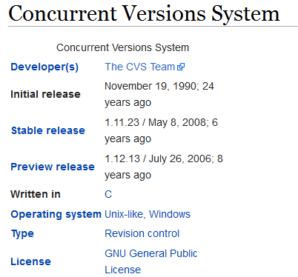
CVS Model

Slide 44
CVS Model (Cont.)
Operations are on files
Example
Check out
Modify foo.bar revision 2.7
Check in
foo.bar now revision 2.8

Slide 45
CVS Model (Cont.)
CVS knows foo.bar changed
Version 2.7 modified to 2.8
But CVS does not know the state of the rest of the project when foo.bar changed
No correlation kept with other files
Hard to reconstruct every state of the project
And in some cases, impossible

Slide 46
CVS Tags
Some operations require a snapshot of the global project state
Branching
Major releases
CVS can tag a project with a name
A separate operation to do what PRCS does for every change

Slide 47
CVS Terminology
Module : CVS labels a single project (set of related files) that it manages as a module.
Repository: A CVS server stores the modules it manages in its repository.
Checking out : Programmers acquire copies of modules by checking out.
The checked-out files serve as a Working copy, Sandbox or Workspace.
Commit: Changes to the working copy are reflected in the repository by committing them

Slide 48
CVS Terminology (Cont.)
Update is to acquire or merge the changes in the repository with the working copy.

Slide 49
CVS Revisions
Revision numbers are applied to an object to identify a unique version of that object.
CVS
Revision numbers are per file.
No connection between two files with the same revision number.
A commit only modifies the version number of the files that were modified.
foo.c rev 1.2 and bar.c rev 1.10.
After commit of bar.c:
foo.c rev 1.2 and bar.c rev 1.11.

Slide 50
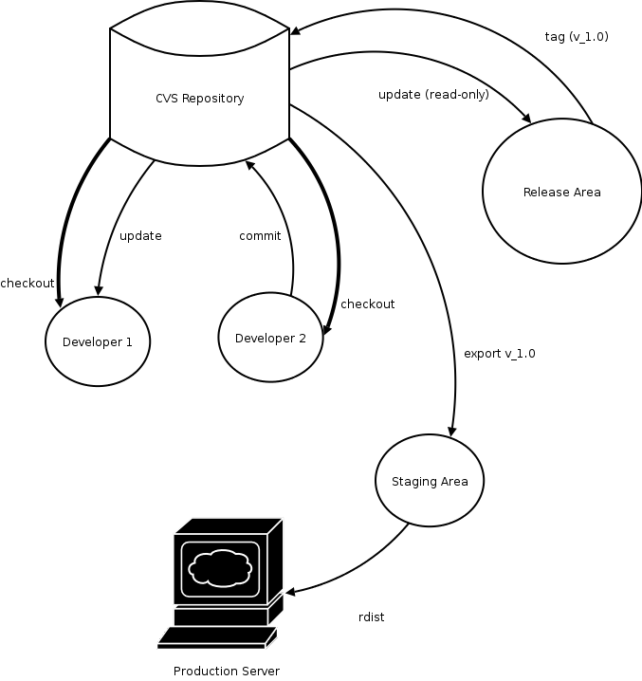
CVS Release Process

Slide 51
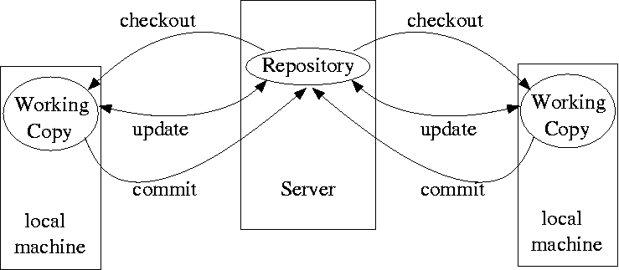
CVS Deployment Model

Slide 52
Administration
PRCS has a simple administrative model
One file with all metadata in a standard format
Really, a small project programming language
Administration done by text editing
The administrative file is under version control, too
Get old project versions by checking out old admin files
CVS administration is much more complex
Numerous files, information scattered throughout
One admin file per file under CVS
Makes renaming, moving files awkward

Slide 53
Design
Version control of projects is about snapshots of sets of files
PRCS represents this directly
CVS is oriented toward individual files
And it shows in complexity
A lesson here for those interested in software design . . .

Slide 54
Trade-offs
CVS has many more features than PRCS
In particular, remote repositories
Allows distributed work over ssh
If you don’t need remote check in/check out, PRCS may be a better choice

Slide 55
SCMs
Microsoft Visual Source Safe
Rational Clear Case
Microsoft Team Fundation Server
CVS
Visual Source Hide
Subversion

Slide 56
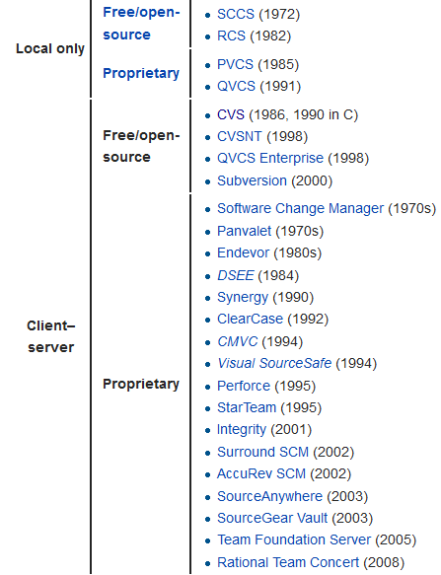
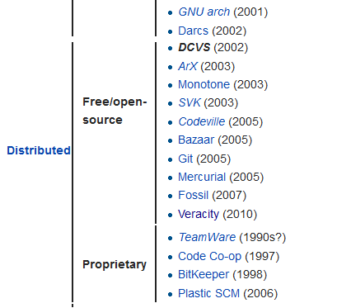

Slide 57
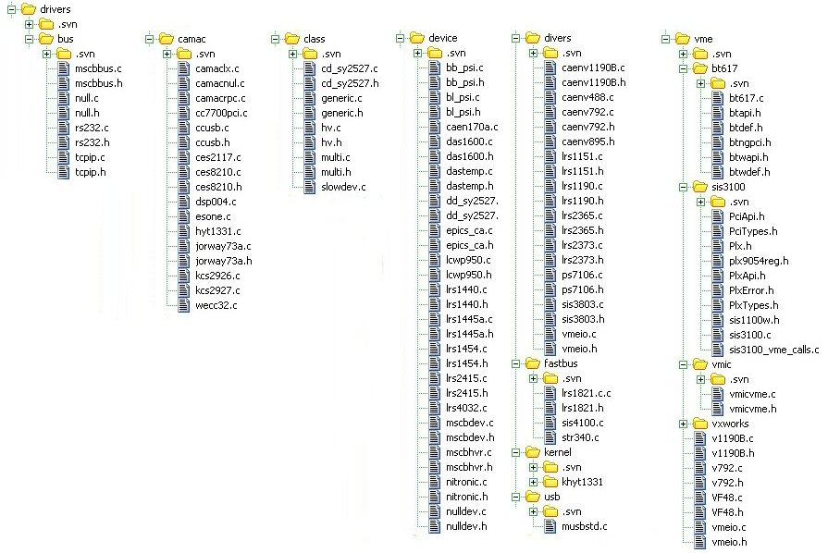

Slide 58
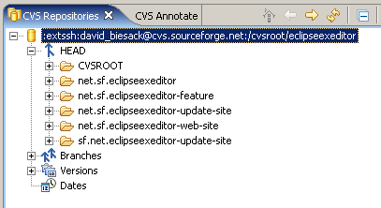

Slide 59
