Slide 1
Eggyolk at room temperature with different absorbers (Feb 2022 USAXS data)
30.05.2022

Slide 2
Details of plots
Q-values used[0.0055 0.007 0.008 0.012 0.016 0.03 0.05 ] nm^-1 for analysis.
Slide3: two time correlations (TTC) at two different q-values (0.03 and 0.05 nm^-1) for 6 different absorbers (6,8,9,12,18,24)
Slide4: auto-correlation functions obtained from TTCs shown in slide3
The .csv files:
1. the absorber number is given in the tail of filename (You can ignor the first part of filename. All data is collected ion eggyolk samples at room temperature. Eggyolk contains mainly proteins and lipids)
2. The data structure of .csv file is➔ first row is time, second row is corr-fn from first q (0.0055nm^-1), 3rd row is error of corr-fn from first q, 4th row is corr-fn from second q (0.007nm^-1), 5th row is error of corr-fn from second q, and so on. Please take last two q-values (0.03, 0.05 nm^-1). These q-values have more noise and the correlation functions are decayed.

Slide 3
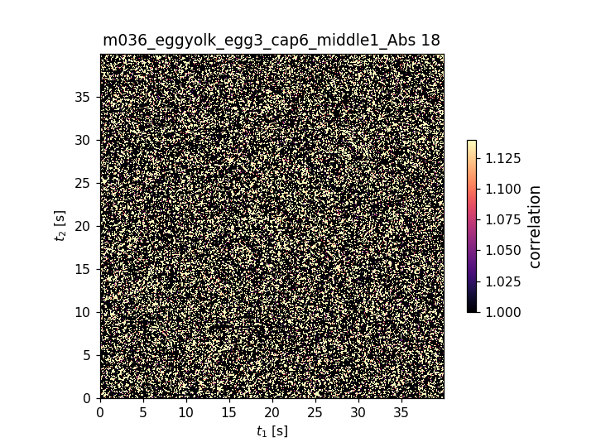
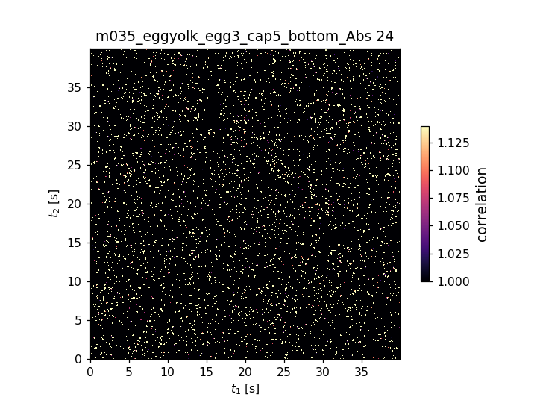
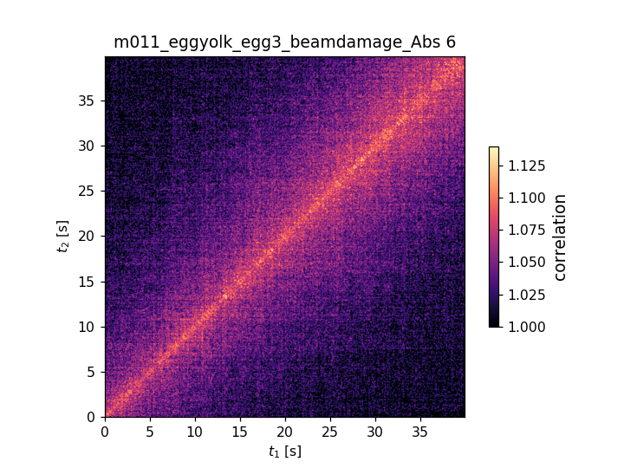
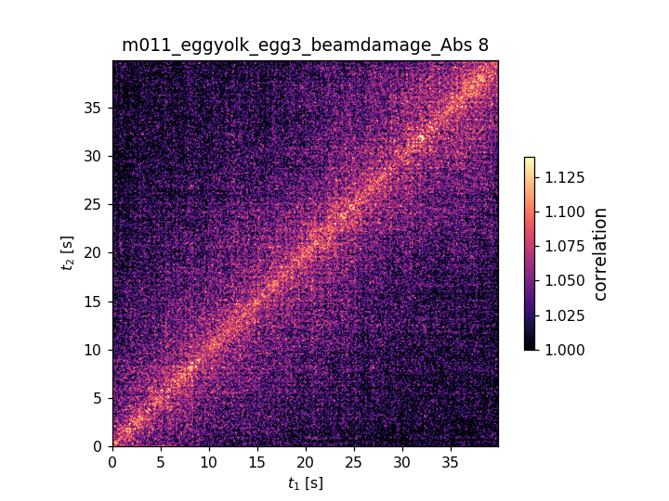

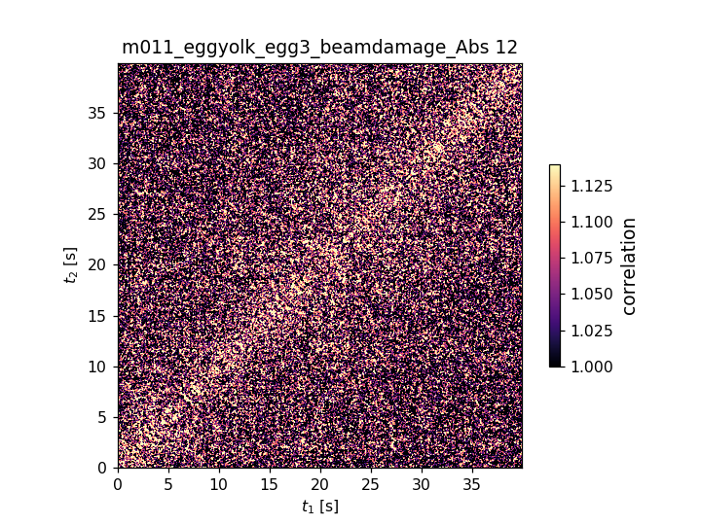
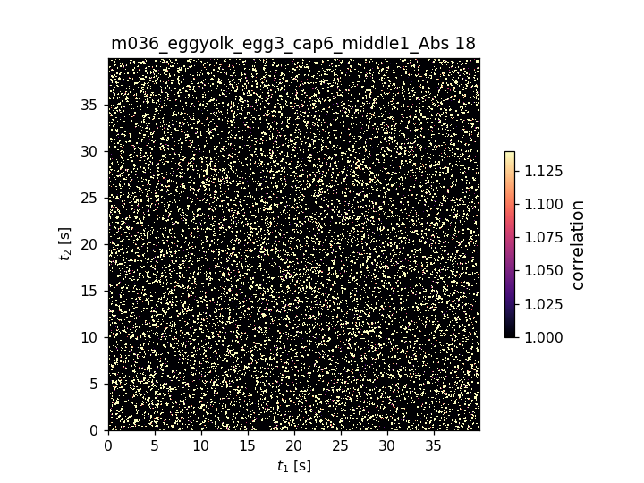
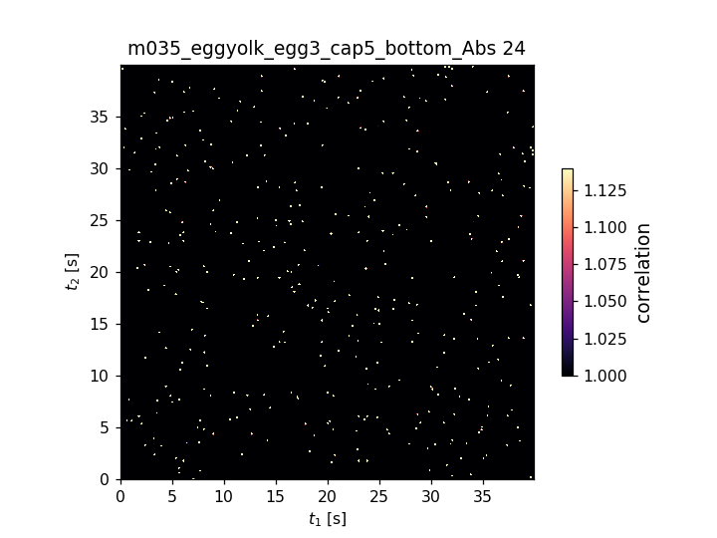
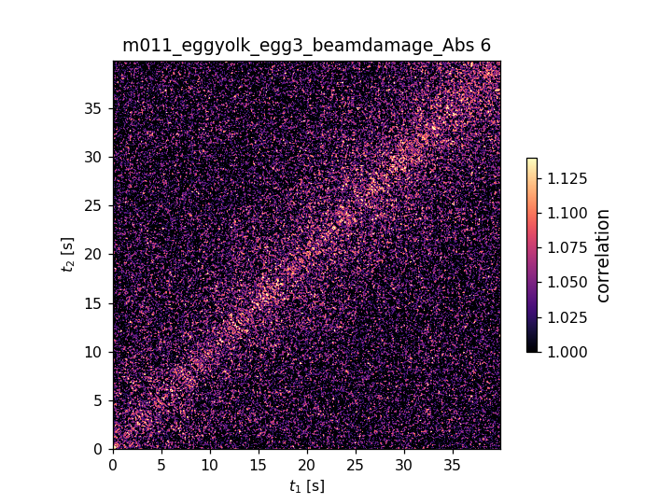

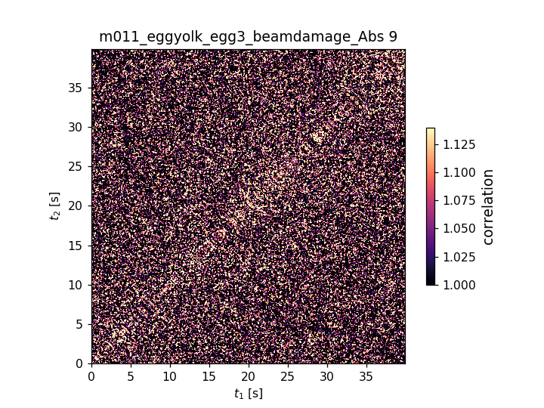
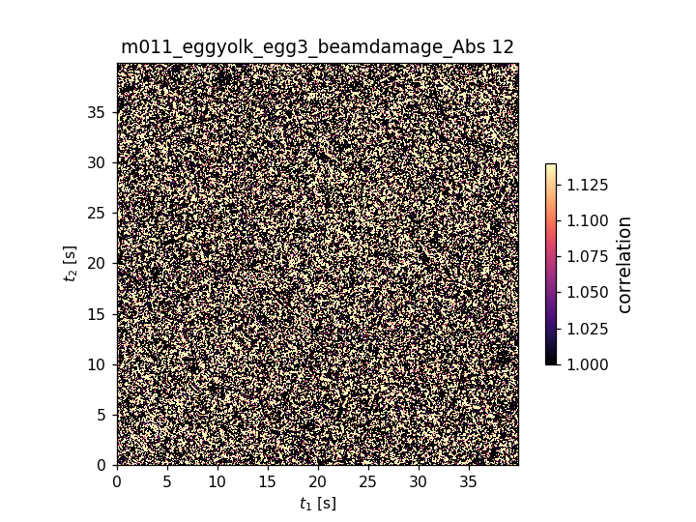
Q=0.03 nm-1
Abs6 Abs8 Abs9 Abs12 Abs18 Abs24
Q=0.05 nm-1
Abs6 Abs8 Abs9 Abs12 Abs18 Abs24

Slide 4
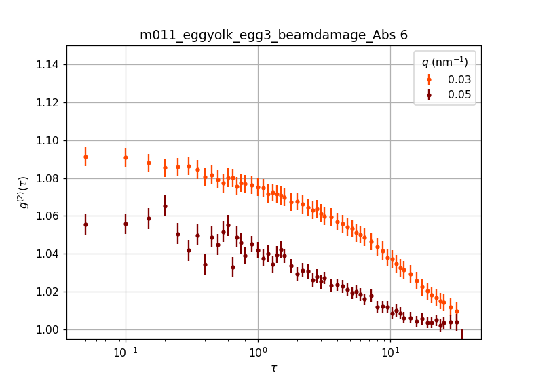
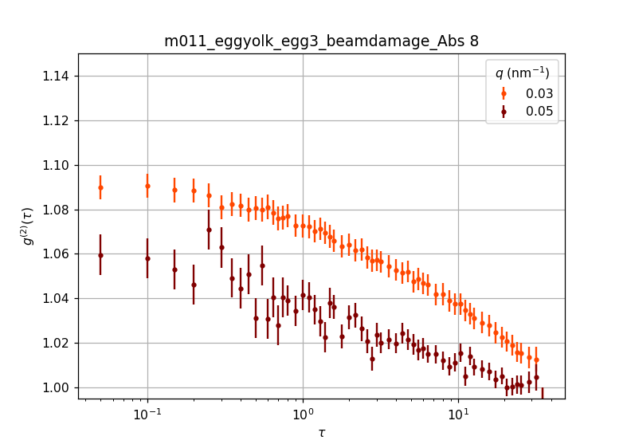
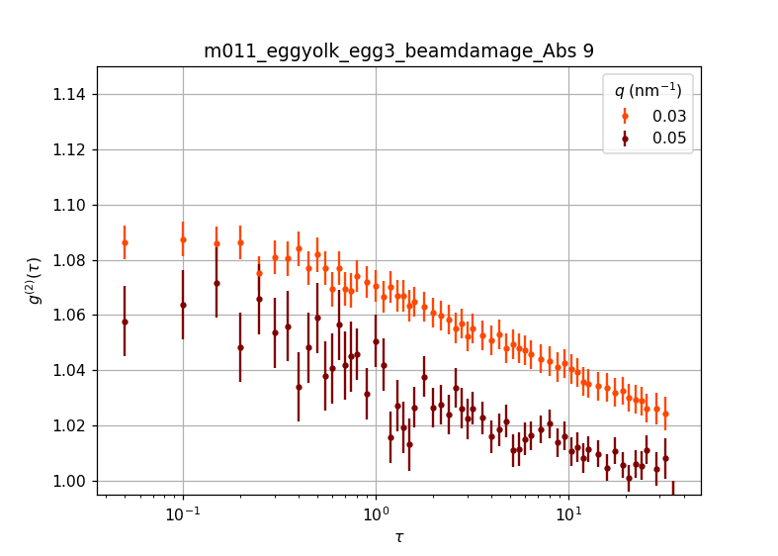
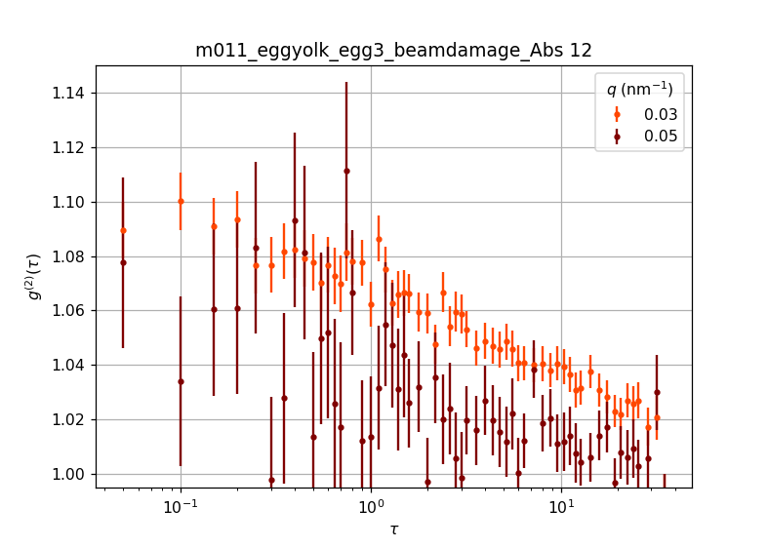
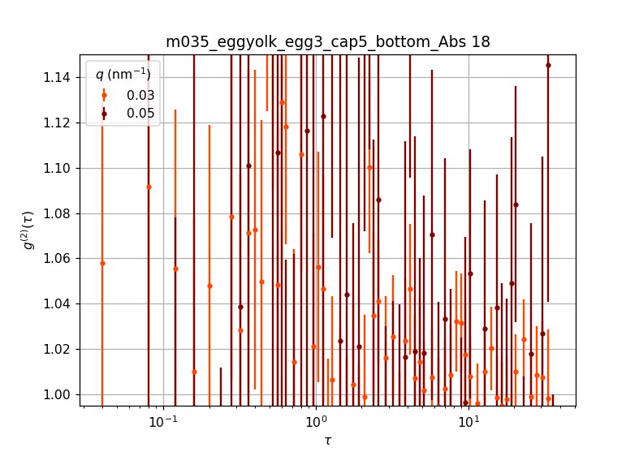
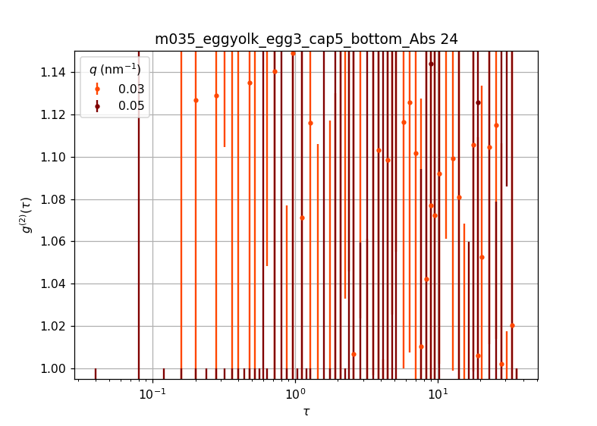
Abs6 Abs8 Abs9 Abs12 Abs18 Abs24
My suggestion is : You can take 0.05nm^-1 data of Abs12 (brown curve) and try to denoise, compare with Abs6 data

