Slide 1
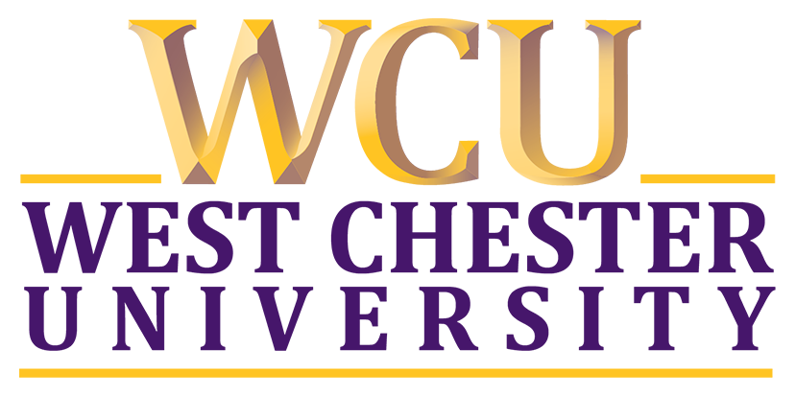
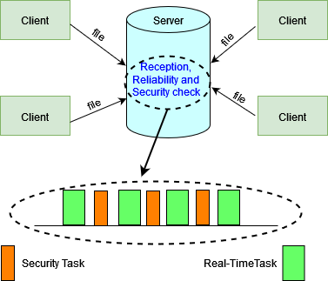
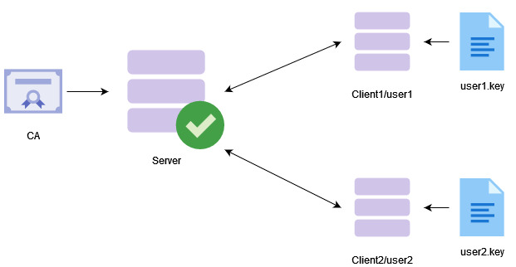
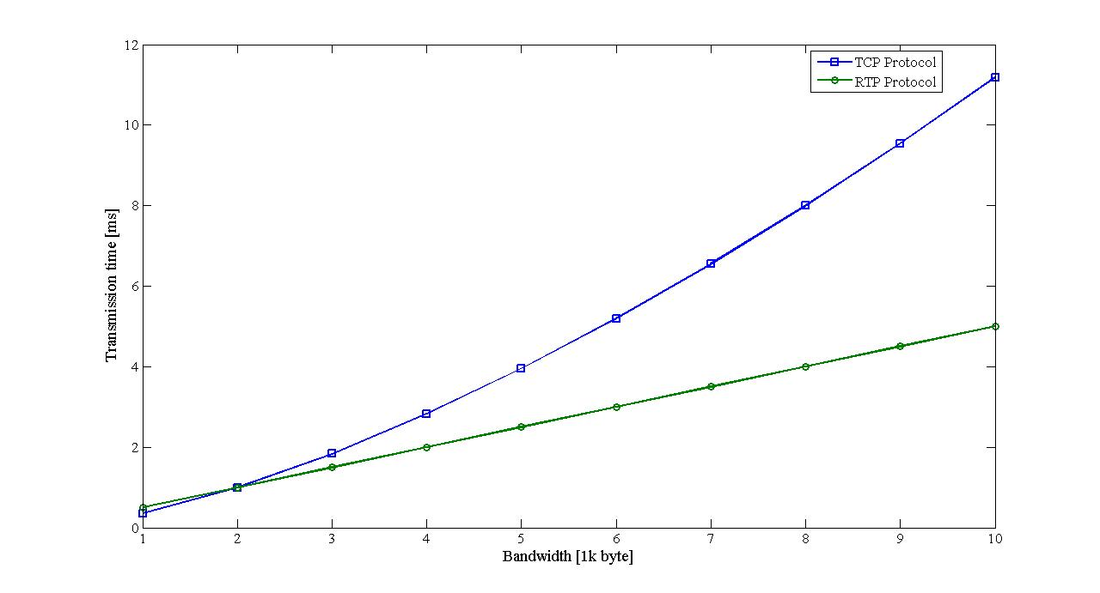
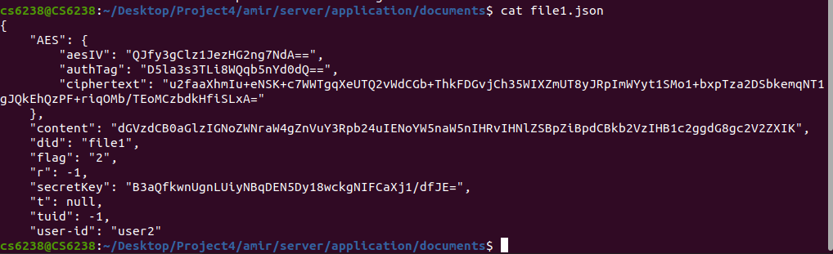
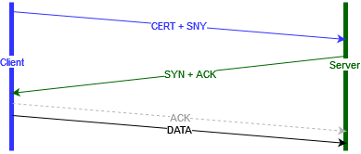
Real-Time Multimedia Stream Data Backup by Network-Engine in a Secure Way
Faculty Name: Md Amirruzzaman, Ashik Ahmed Bhuiyan
West Chester University of Pennsylvania
West Chester, PA 19383
Introduction
Our Contribution
Big Picture
The world is becoming multimedia data-dependent, so does data saving into a backup server for future use.
Saving multimedia data in real-time in resource constrained devices is a challenging task,
Lack of resources (i.e., disk capacity),
can be gone into wrong hand if the device is lost or stolen.
So, the multimedia data on resource constrained devices needs to be protected and processed simultaneously—here processed is used in a sense of sending it to a backup server.
The TCP protocol provides the reliability of the data communication; however, three-way handshaking adds some overhead to it.
Client and server communication using 3S model.
The mutual authentication for the secure shared store or 3S model is done by using the Nginx server. The server used a trusted certificate authority (CA) folder where it had stored the certificate to prove its authenticity.
The clients (e.g., client1 and client2) used their private keys to authenticate to the server. Please see the figure below for more detail on the architectural design.
Results
Problem and Motivation
Lack of resources to store and access multimedia data on resources constrained devices.
Lack of mechanism to transfer multimedia data between server and client in a secure way.
No mechanism to protect multimedia data if the device gets stolen or lost.
3-way handshake is important to ensure the reliability of the connection and smooth transmission between client(s) and sever. However, we introduced a log based reliability checking technique. So, we can save the 3rd step of the 3-way handshake.
Future Plan
Prepare more performance evaluation matrices
Perform more tests to analyze security holes.
Conduct a large scale analysis for mass communication and sharing.

