Slide 1

Data visualization in R (plots and maps)
19 March 2026 (Vietnam time)
Ali Mirzazadeh, MD, MPH, PhD
Epidemiologist, Associate Professor, UCSF
(ali.mirzazadeh@ucsf.edu)
https://github.com/amirzazadeh/DataVisualization

Slide 2
Learning Objectives
By the end of this session participants will be able to:
Apply principles of effective data visualization
Create common plots using R (ggplot2)
Produce maps to present your data
Use an AI prompt to generate R code for all types of visualization
Build reproducible workflows in R

Slide 3

About me ☺
Ali Mirzazadeh, MD, MPH, PhD
Epidemiologist | UCSF
Born in Kerman, Iran (at 7 months premature)
MD (2004), MPH (2007), PhD in Epidemiology (2013)
At UCSF since 2012 (Visiting Scholar → Associate Professor)
Associate Director, Global Health PhD Program
Research: HIV & hard-to-reach populations, EMR
🚴 Biked San Francisco → Los Angeles
9 times | 5,000+ miles | $33,327 raised for HIV programs
I love Vietnam 🇻🇳 ❤️
This is a selfie of me riding on a motorcycle in Da Nang, Vietnam, sheltered under a plastic cover on my way to a workshop to teach 😊⛈️🛵
Time: Aug. 29, 2025 - 8 am

Slide 4
Principles of Effective Data Visualization

Slide 5
Why Visualization Matters in Public Health
Communicates complex research clearly
Helps identify trends and disparities
Supports evidence‑based decision making
Improves accessibility of research findings

Slide 6
Principles of Effective Visualization
Simplicity:
Keep the visualization simple by avoiding unnecessary elements (lines, colors, etc.) so the main message is easy to understand.
Clarity:
Use clear labels, titles, and legends so viewers can quickly interpret the information.
Accuracy:
Ensure the data are represented truthfully without misleading scales or distortions.
Appropriate:
Choose the chart type that best matches the data and the question being addressed.
Consistent formatting:
Use consistent colors, fonts, and styles across charts to improve readability and comparison.

Slide 7
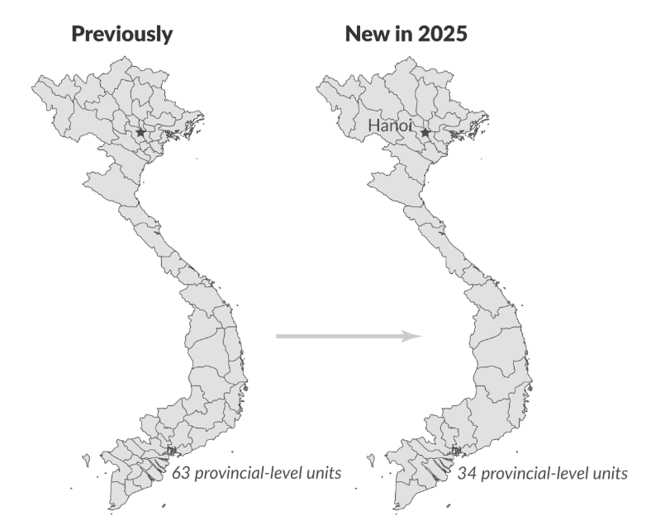
Example of and Effective Visualization
Vietnam’s Provincial Mergers: Consolidation from 63 to 34 Provinces and Cities
28 provinces: Cao Bang, Dien Bien, Ha Tinh, Lai Chau, Lang Son, Nghe An, Quang Ninh, Thanh Hoa, Son La, Tuyen Quang, Lao Cai, Thai Nguyen, Phu Tho, Bac Ninh, Hung Yen, Ninh Binh, Quang Tri, Quang Ngai, Gia Lai, Khanh Hoa, Lam Dong, Dak Lak, Dong Nai, Tay Ninh, Vinh Long, Dong Thap, Ca Mau, and An Giang; and
Six centrally governed cities: Hanoi, Ho Chi Minh City (HCMC), Hue, Da Nang, Can Tho, and Hai Phong.

Slide 8
Common Visualization Types in public health

Slide 9
Common Visualization Types in public health:
Bar charts
Line charts
Mozaic charts
Histograms
Boxplots
Scatterplots
Maps

Slide 10
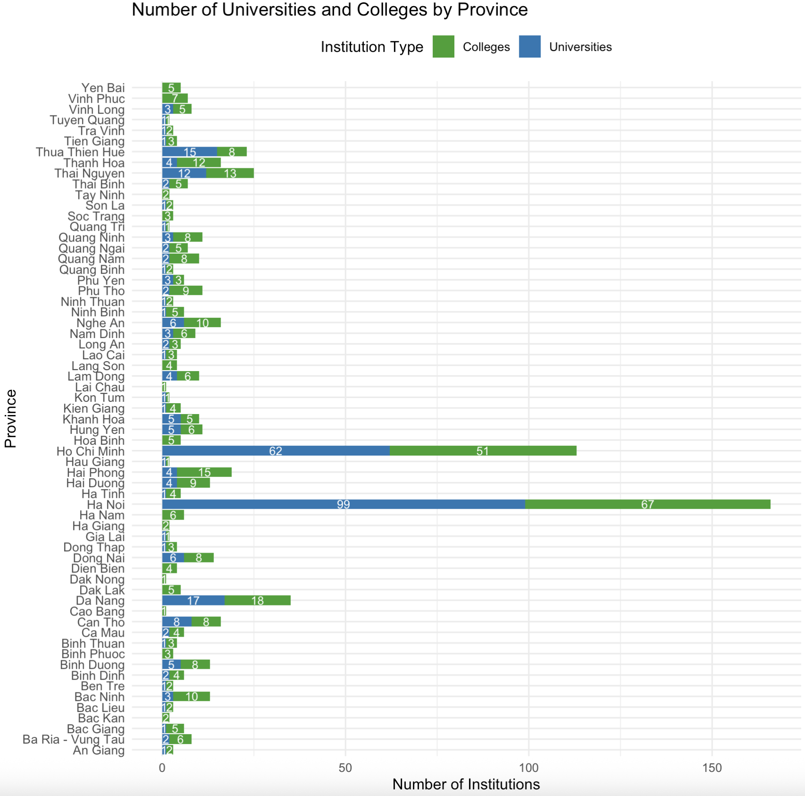
Bar charts
A chart used to compare values across categories.
Each bar’s height (or length) represents the count or value for a category.
Makes it easy to compare groups and see differences quickly.
Example: Comparing the number of universities and colleges across provinces in Vietnam.

Slide 11

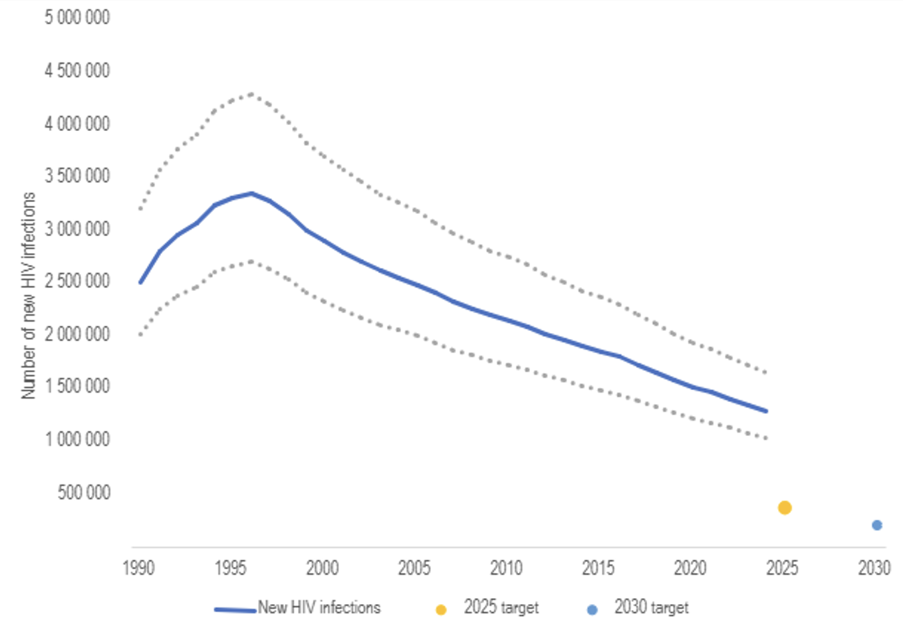
Line charts
A plot used to show changes in a variable over time or ordered categories.
Data points are connected by lines to show trends or patterns.
Helps identify trends, increases, decreases, or fluctuations.
Example: Showing the global number of new HIV infections over years (UNAIDS estimates).
Number of new HIV infections, global, 1990-2024, 2025 and 2030 targets

Slide 12
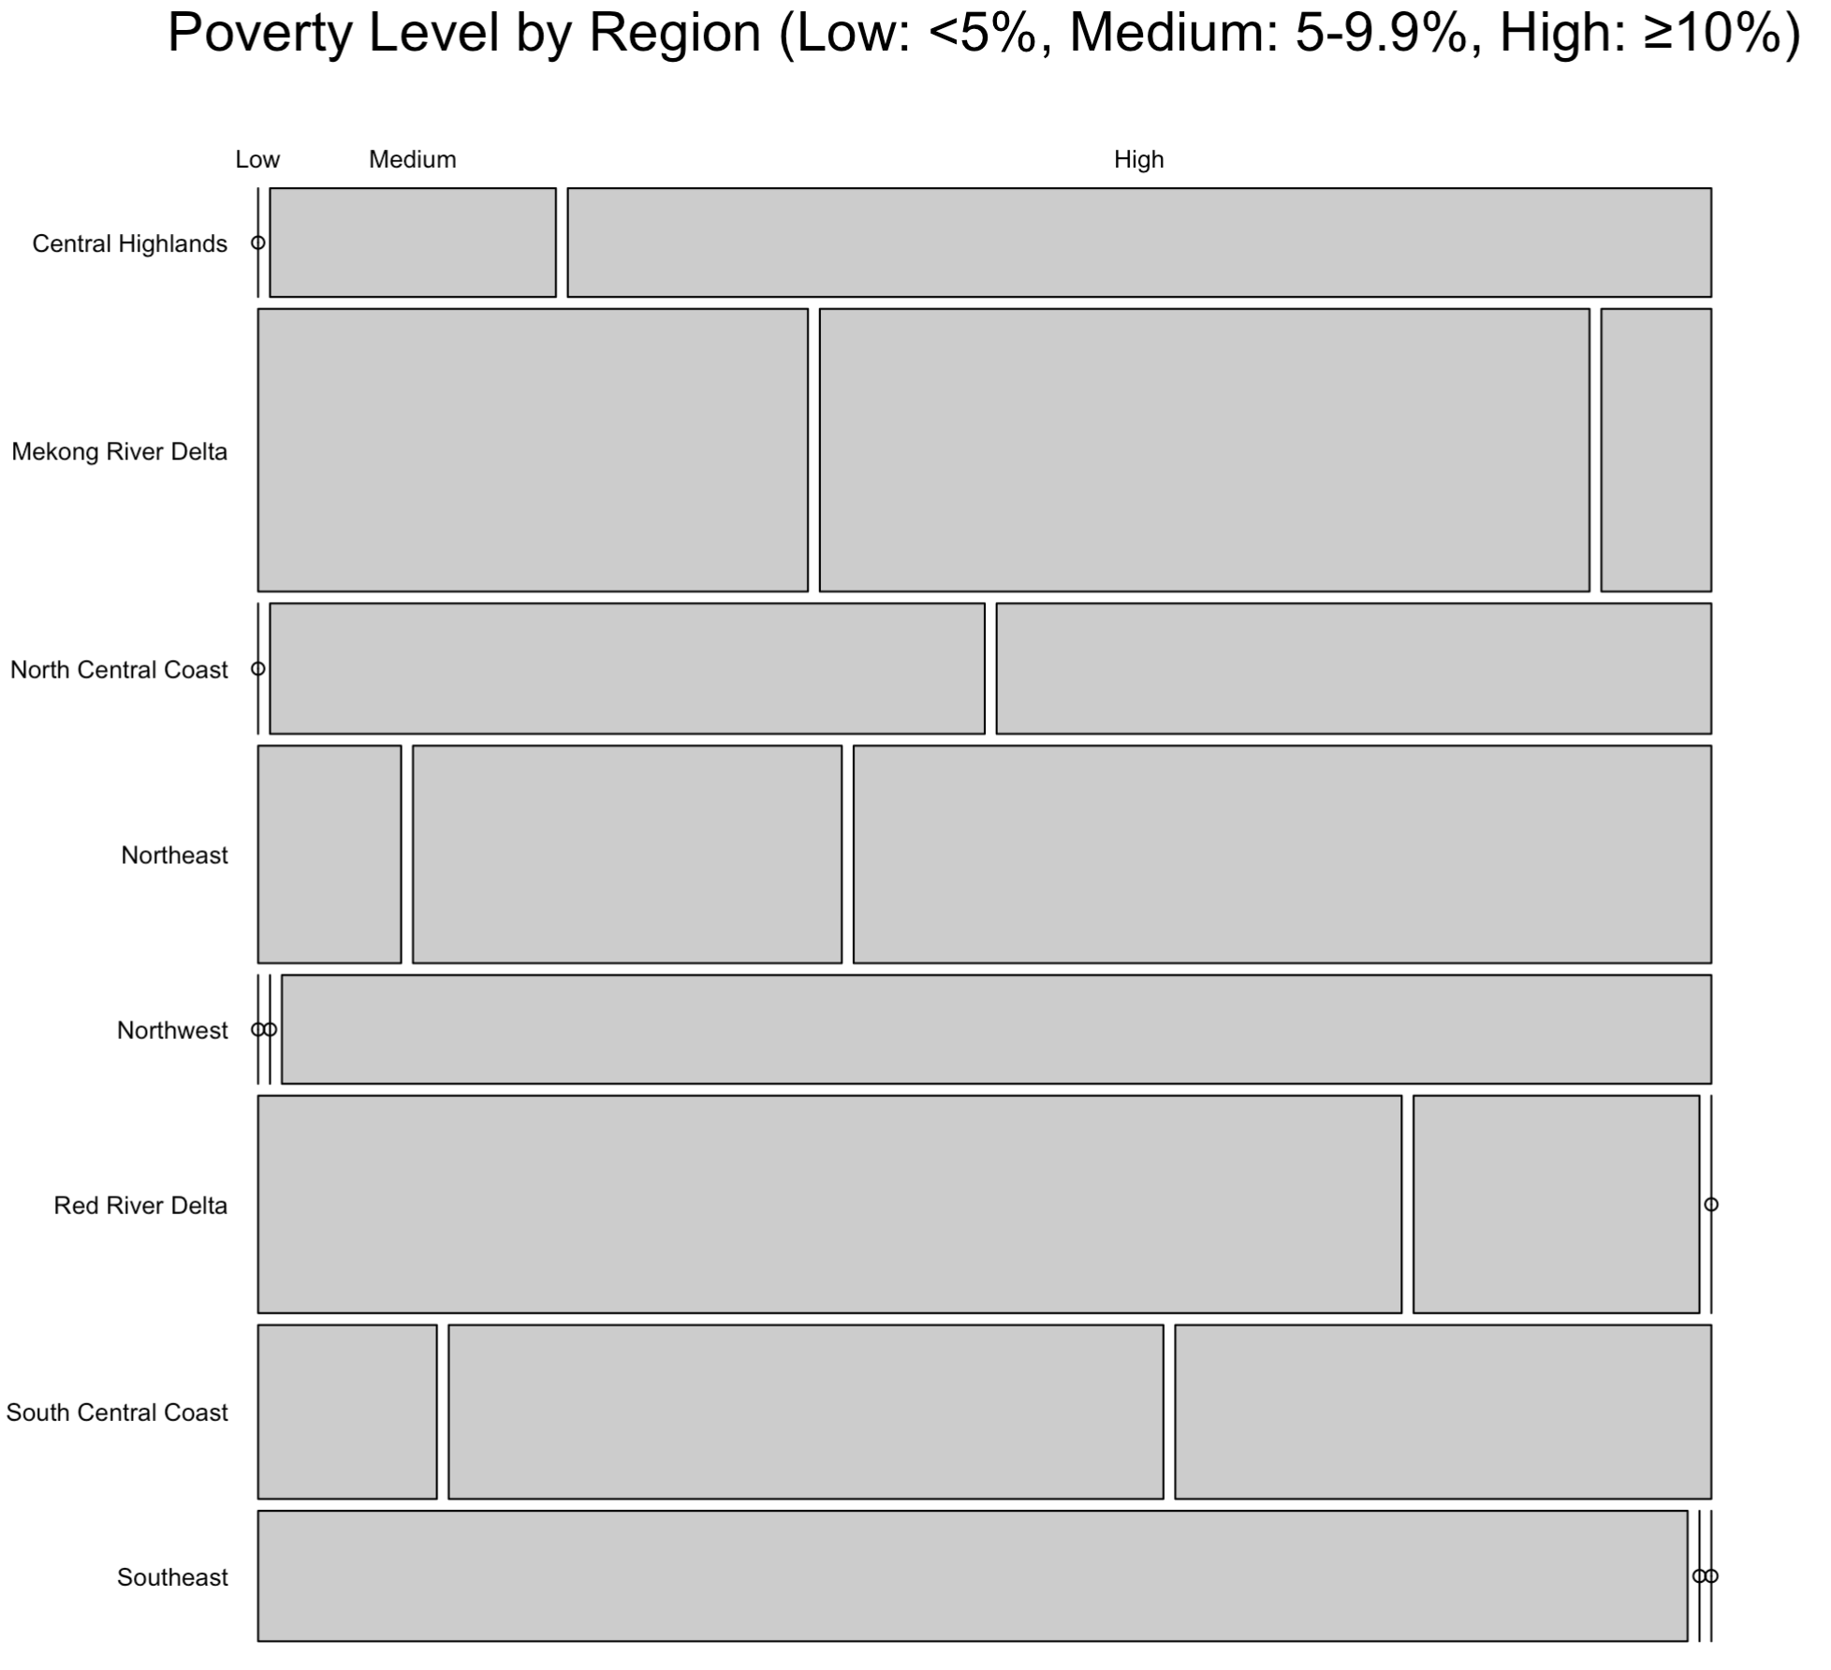
Mozaic charts
Show the relationship between two or more categorical variables.
Each rectangle’s area represents the proportion or count of observations in a category combination.
Helps compare proportions across groups and identify patterns or associations.
Example: Showing how province poverty levels differ across regions in Vietnam.
0% → 100%
0% → 100%

Slide 13
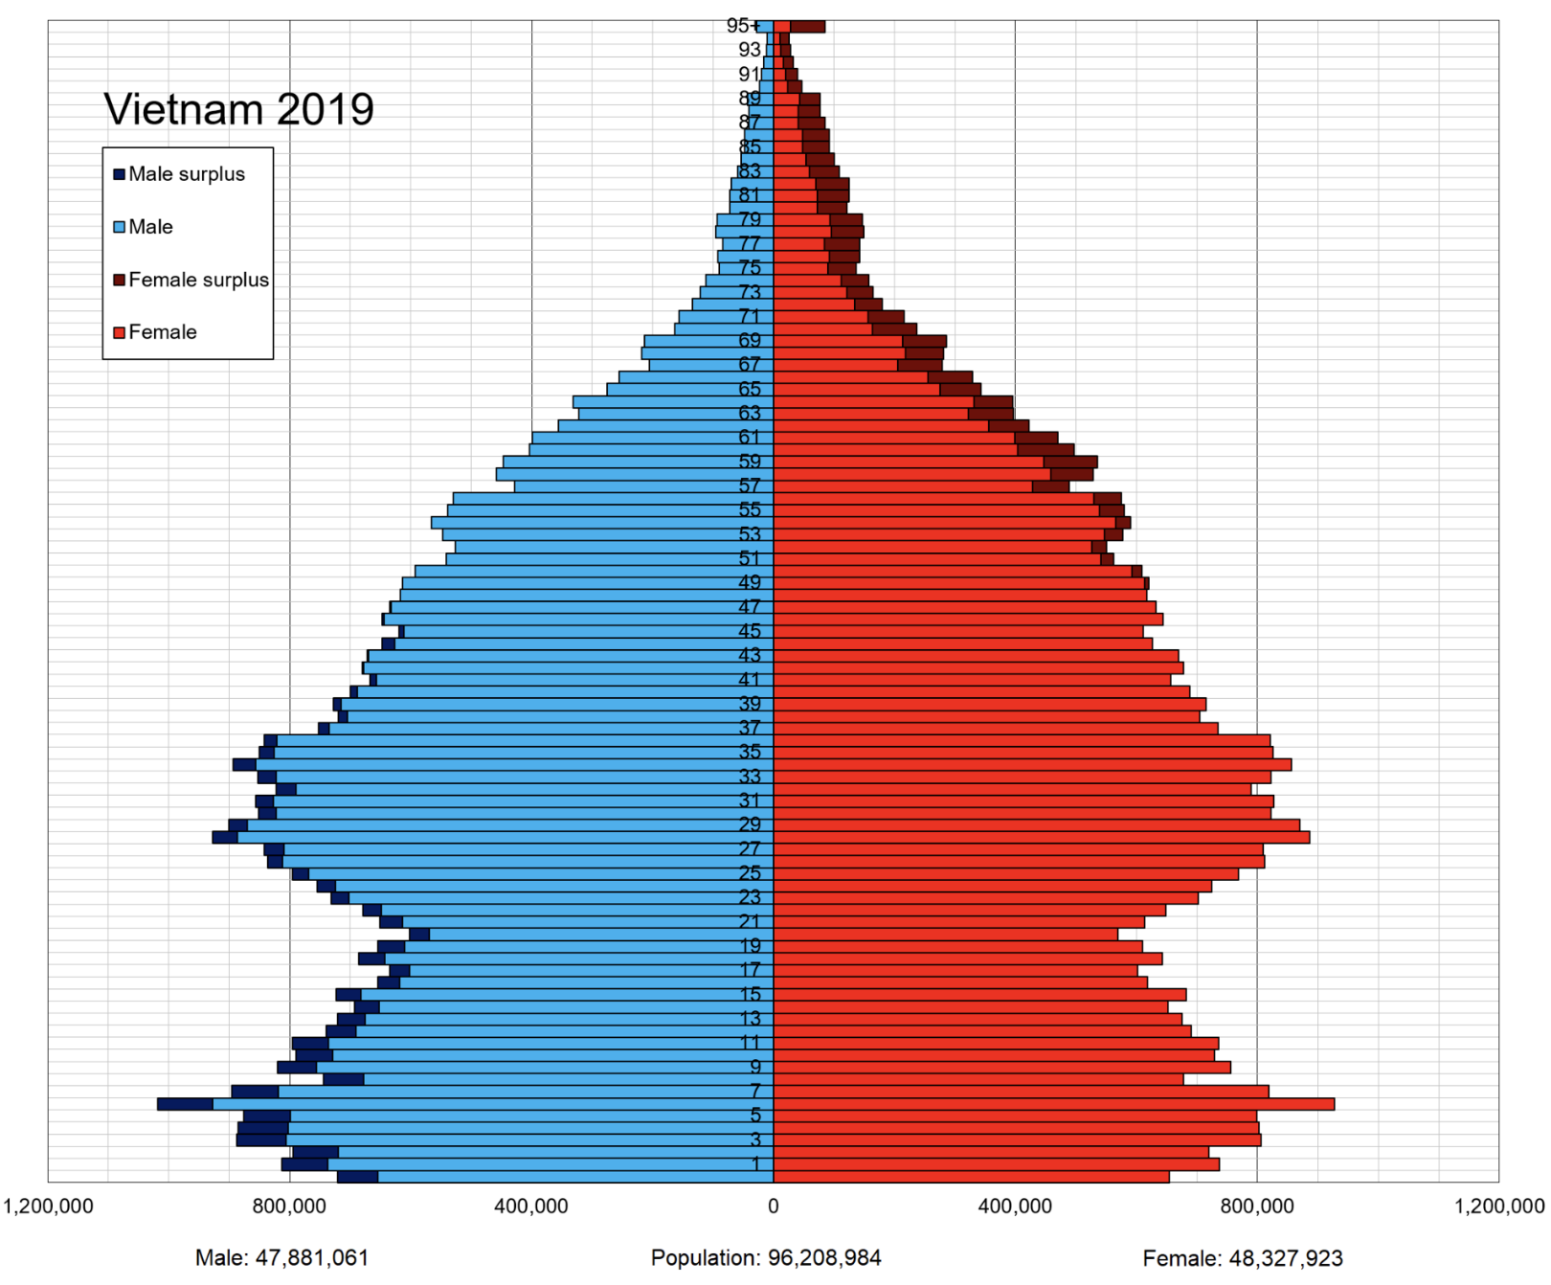
Histograms
A chart used to show the distribution of a continuous (age, BMI, etc.) numeric variable.
Data are grouped into bins (intervals), and bar heights show the frequency in each range.
Helps visualize the shape, spread, and skewness of the data.
Example: Showing the distribution of age by gender in Vietnam.

Slide 14
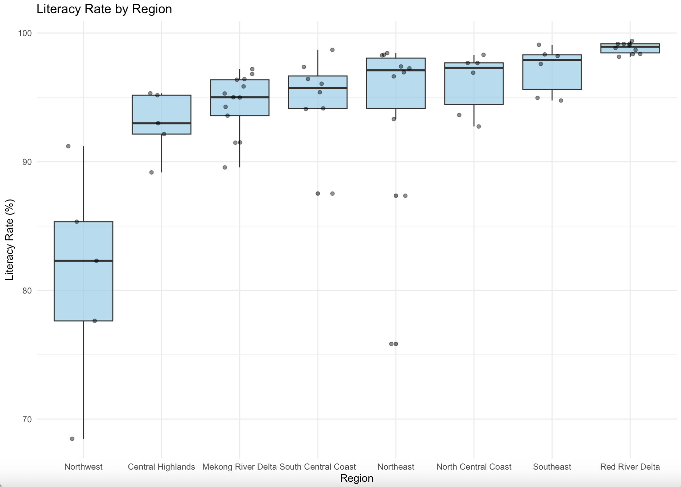
Boxplots
A chart used to summarize the distribution of a numeric variable.
The box shows the median and interquartile range, while whiskers and points show the spread and outliers.
Helps compare distributions across groups and identify outliers.
Example: Province-level literacy rates across regions.

Slide 15
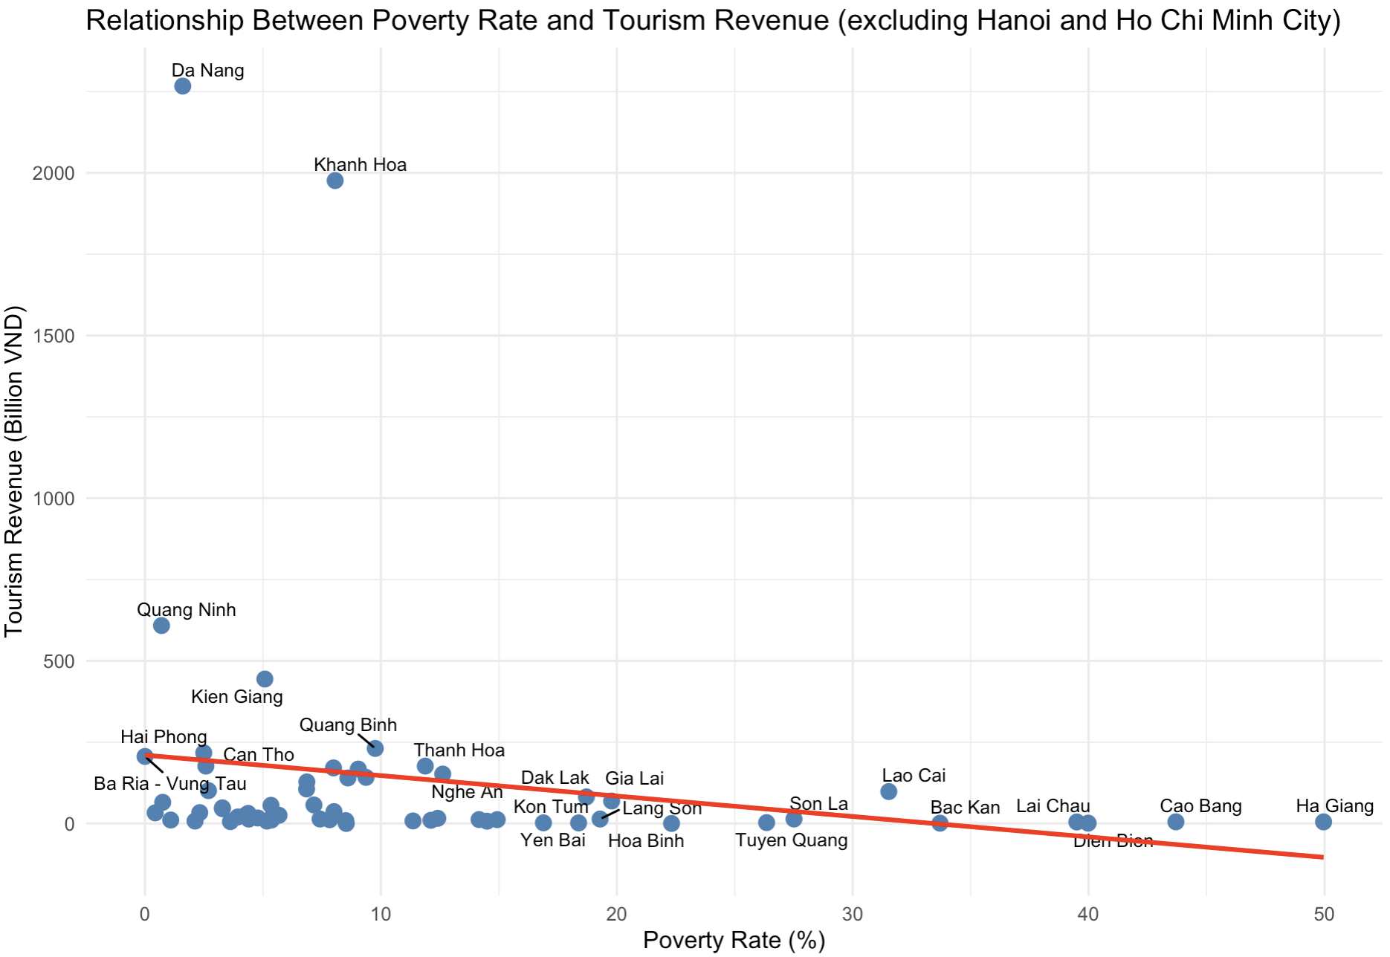
Scatterplots
A chart used to show the relationship between two numeric variables.
Each point represents an observation with its position determined by the two variables.
Helps identify correlations, patterns, and outliers.
Example: Examining the relationship between poverty rate and tourism revenue across provinces in Vietnam.

Slide 16
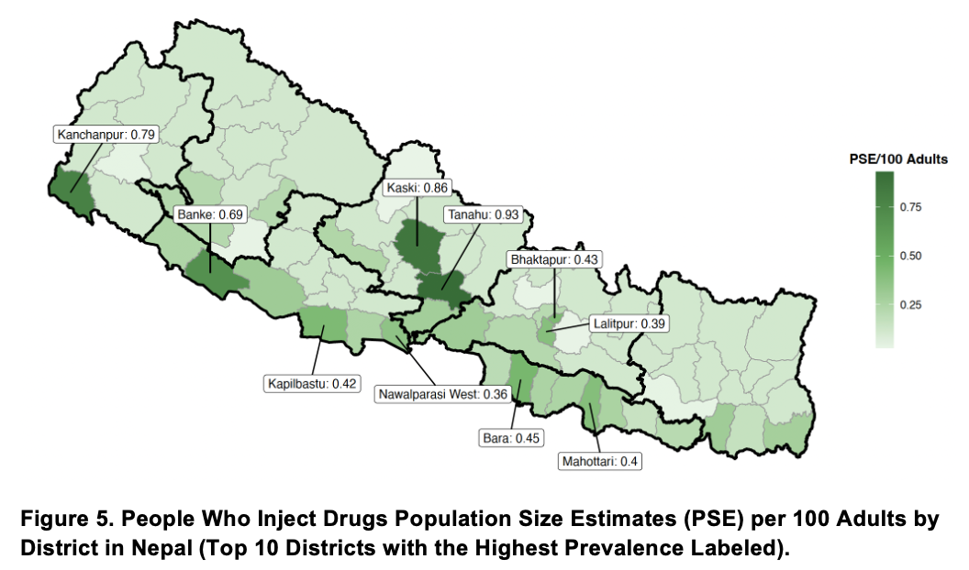
Maps
A visualization used to show geographic patterns or spatial distribution of data.
Data values are linked to geographic areas (e.g., regions or provinces) and displayed using colors, symbols, or shading.
Helps identify spatial patterns, regional differences, and geographic clusters.
Example: Showing population size of people who inject drugs in districts of Nepal

Slide 17
Create plots by R (ggplot2)

Slide 18
Introduction to ggplot2
ggplot2 is the most widely used R visualization package.
Advantages:
Grammar of graphics framework
Flexible layering system
Publication-quality plots
Strong community support
Free

Slide 19
Basic Structure of ggplot2
A ggplot chart is built using layers:
ggplot(data, aes(x, y)) +
geom_*() +
labs() +
theme()
Key Components:
data → dataset used for the plot
aes() → aesthetic mappings (x, y, color, size)
geom* → type of plot (points, lines, bars)
labs → labels (main, submain, x and y axis)
theme → controls the appearance of the plot

Slide 20
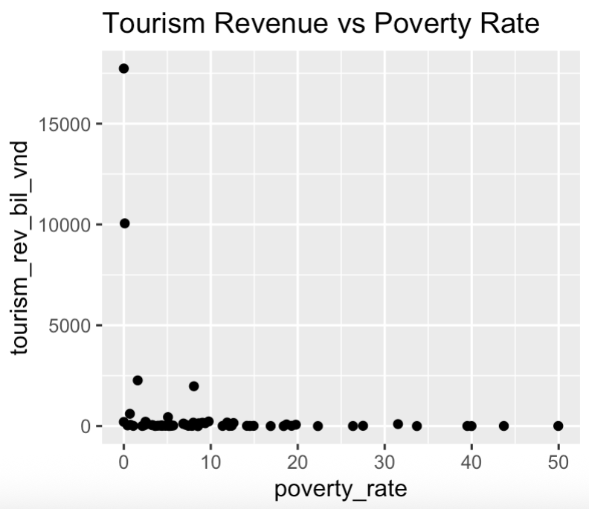
Example: Scatter Plot in ggplot2
install. packages(“ggplot2”)
library(ggplot2)
ggplot(V, aes(x = poverty_rate, y = tourism_rev_bil_vnd)) +
geom_point() +
labs(title = "Tourism Revenue vs Poverty Rate")

Slide 21
Common Geoms
ggplot(data, aes(x, y)) +
geom_*() +
labs() +
theme()
* geom_point() → scatter plot
* geom_line() → line chart
* geom_bar() → bar chart
* geom_histogram() → histogram
* geom_boxplot() → boxplot
* geom_sf() → map

Slide 22
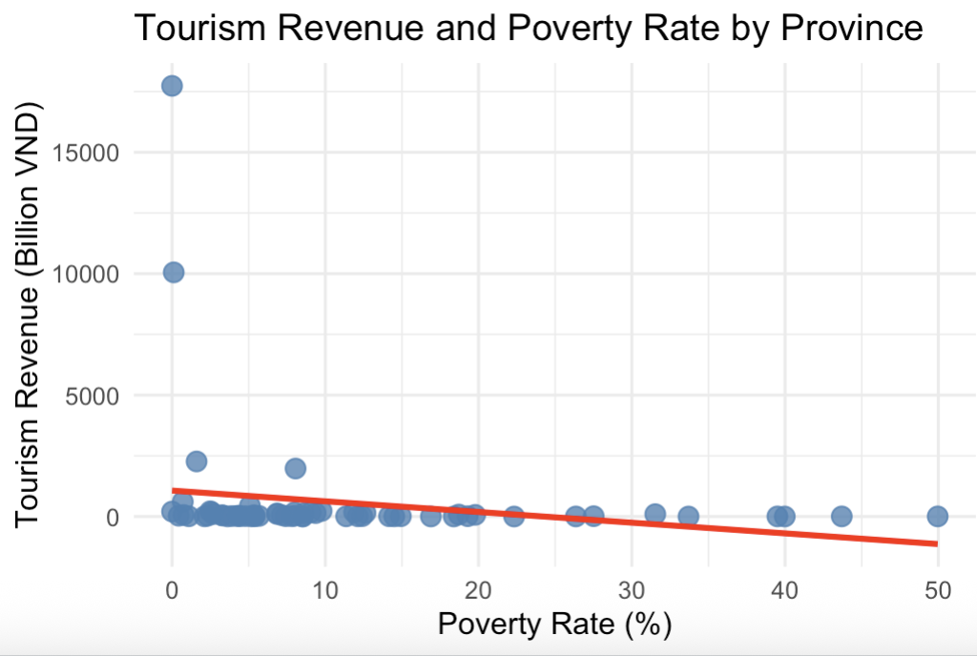
Example: Improved Scatter Plot in ggplot2
# Create a ggplot using dataset V and map variables to axes
ggplot(V, aes(x = poverty_rate, y = tourism_rev_bil_vnd)) +
geom_point(color = "steelblue", size = 3, alpha = 0.8) +
geom_smooth(method = "lm", se = FALSE, color = "red", linewidth = 1) +
labs(
title = "Tourism Revenue and Poverty Rate by Province",
x = "Poverty Rate (%)",
y = "Tourism Revenue (Billion VND)"
) +
theme_minimal()
# Add scatter plot points (one point per province)
# add labels
# Add linear regression trend line
# se = FALSE removes confidence band
# Apply a clean, minimal theme to the plot

Slide 23
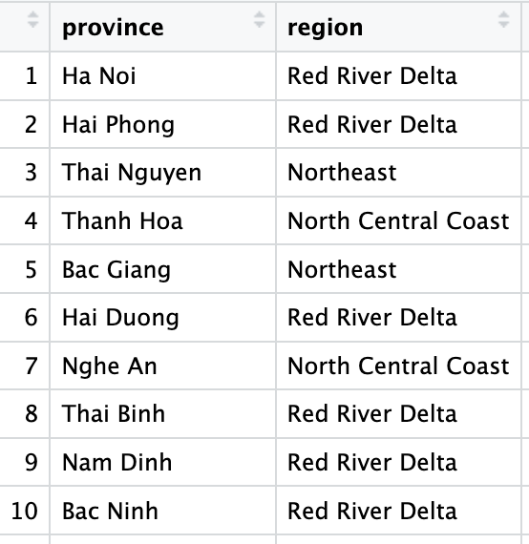
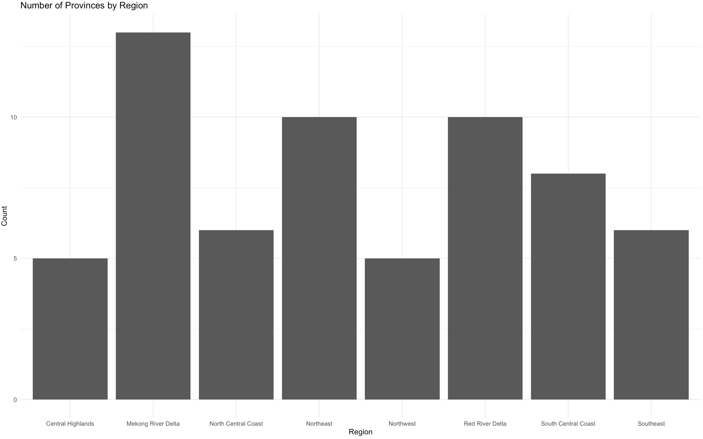
PRACTICE 1 - Using the dataset V, create a simple bar chart that shows the number of provinces in each region
library(ggplot2)
ggplot(V, aes(x = region)) +
geom_bar() +
labs(
title = "Number of Provinces by Region",
x = "Region",
y = "Count"
) +
theme_minimal()
….

Slide 24
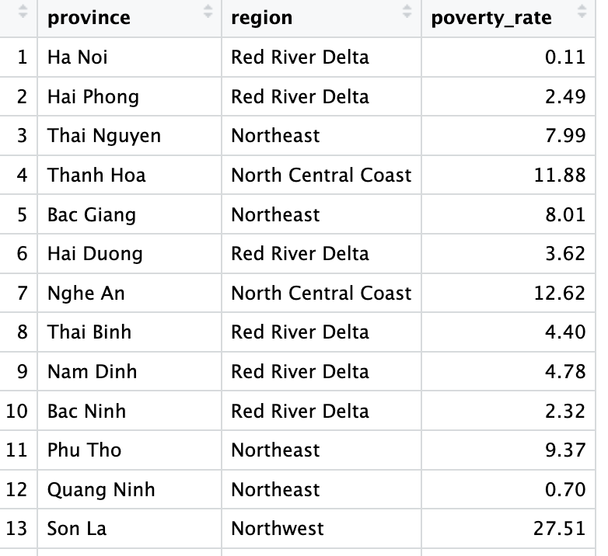
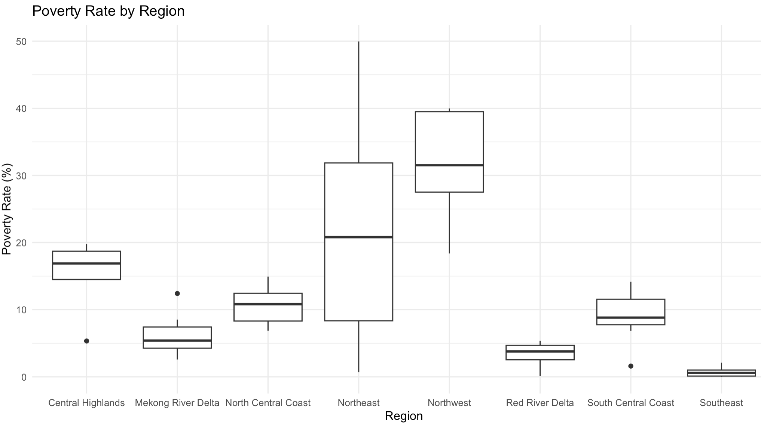
PRACTICE 2 - Using the dataset V, create a simple boxplot to display the distribution of poverty rates across regions, showing the poverty rates of provinces within each region.
ggplot(V, aes(x = region, y = poverty_rate)) +
geom_boxplot() +
labs(
title = "Poverty Rate by Region",
x = "Region",
y = "Poverty Rate (%)"
) +
theme_minimal()
….

Slide 25
Building Maps and Reproducible Workflows In R

Slide 26
Why Spatial Visualization Matters
Maps help reveal:
Geographic disparities
Disease hotspots
Service access gaps
Resource allocation needs

Slide 27
Why conduct spatial data analysis and visualization in R?
Integrated analysis: R allows you to analyze data and create maps in the same environment.
Powerful spatial packages: Packages like sf, terra, and ggplot2 make spatial analysis and mapping easier.
Reproducible workflows: Code-based analysis ensures results can be reproduced and shared.
Advanced analysis: R supports spatial statistics, modeling, and data visualization.
Free and open source: R is widely used in research, public health, and data science without licensing costs.

Slide 28
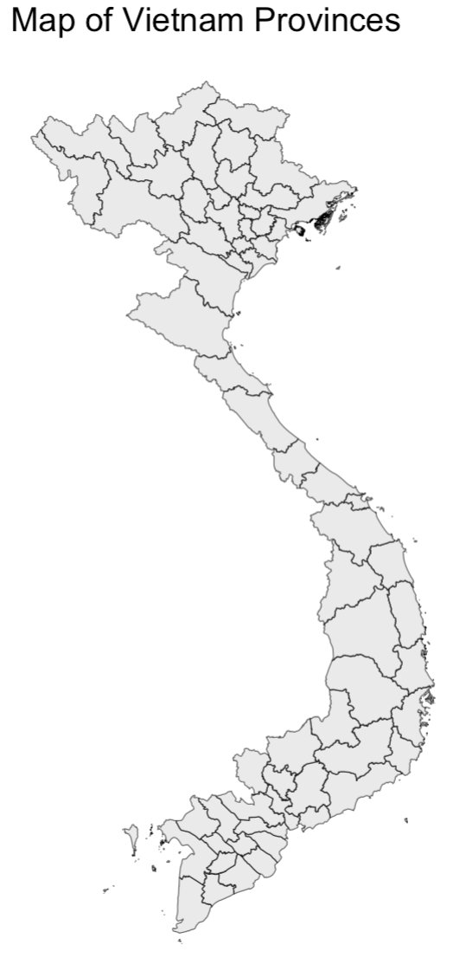
Create a Map of Vietnam (R Code)
library(geodata)
# download Vietnam province boundaries from GADM (https://gadm.org/)
map <- geodata::gadm(country = "VNM", level = 1, path = tempdir())
library(sf)
# converts the map to sf spatial format
map <- st_as_sf(map)
library(ggplot2)
# plot simple map
ggplot(map) +
geom_sf() +
labs(title = "Map of Vietnam Provinces") +
theme_void()
Formal Class SpatVector
provinces
…
draws the map
Notes:
library(geodata)
# download Vietnam province boundaries from GADM (https://gadm.org/)
map <- geodata::gadm(country = "VNM", level = 1, path = tempdir())
library(sf)
# converts the map to sf spatial format
map <- st_as_sf(map)
library(ggplot2)
# plot simple map
ggplot(map) +
geom_sf() +
labs(title = "Map of Vietnam Provinces") +
theme_void()

Slide 29
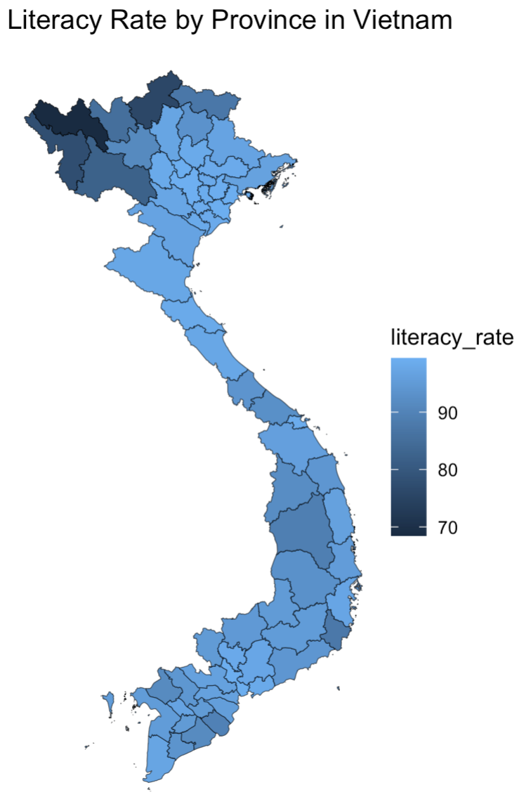
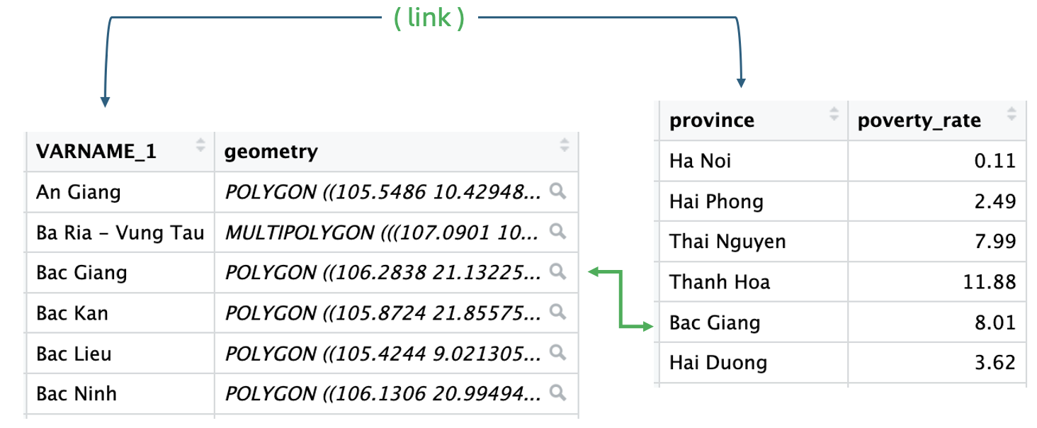
Show Literacy in Vietnam (R Code)
library(geodata)
map <- geodata::gadm(country = "VNM", level = 1, path = tempdir())
library(sf)
map <- st_as_sf(map)
library(dplyr)
# join literacy rate from dataset V to map
map_data <- map %>%
left_join(V, by = c("VARNAME_1" = "province"))
library(ggplot2)
# plot map with literacy rate
ggplot(map_data) +
geom_sf(aes(fill = literacy_rate)) +
labs(title = "Literacy Rate by Province in Vietnam") +
theme_void()
merge map and your data
…
…
Notes:
library(geodata)
map <- geodata::gadm(country = "VNM", level = 1, path = tempdir())
library(sf)
map <- st_as_sf(map)
library(dplyr)
# join literacy rate from dataset V to map
map_data <- map %>%
left_join(V, by = c("VARNAME_1" = "province"))
library(ggplot2)
# plot map with literacy rate
ggplot(map_data) +
geom_sf(aes(fill = literacy_rate)) +
labs(title = "Literacy Rate by Province in Vietnam") +
theme_void()

Slide 30
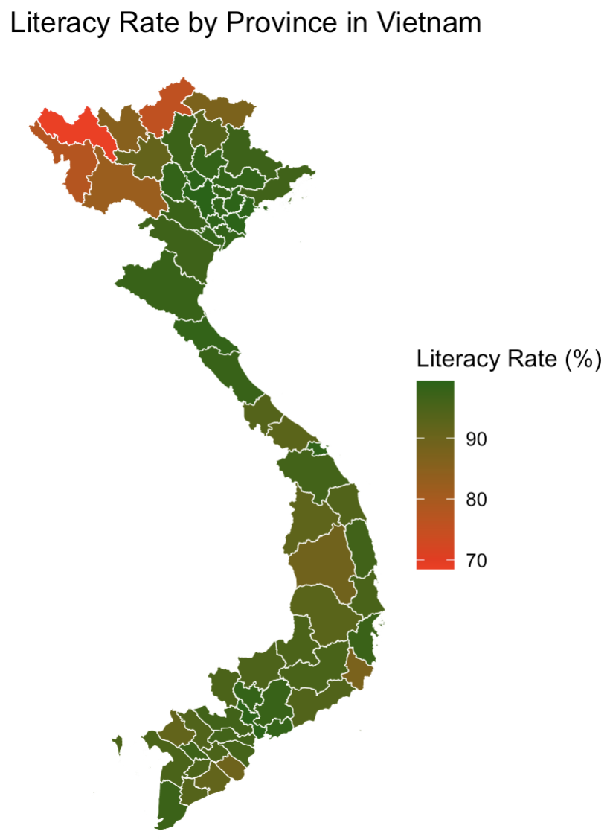
Show Literacy in Vietnam (R Code)
library(geodata)
map <- geodata::gadm(country = "VNM", level = 1, path = tempdir())
library(sf)
map <- st_as_sf(map)
library(dplyr)
# join literacy rate from dataset V to map
map_data <- map %>%
left_join(V, by = c("VARNAME_1" = "province"))
library(ggplot2)
# plot map with literacy rate
ggplot(map_data) + geom_sf(aes(fill = literacy_rate), color = "white") + scale_fill_gradient(low = "red", high = "green", name = "Literacy Rate (%)") + labs(title = "Literacy Rate by Province in Vietnam") + theme_void()
Gradient (red → green)
Notes:
library(geodata)
map <- geodata::gadm(country = "VNM", level = 1, path = tempdir())
library(sf)
map <- st_as_sf(map)
library(dplyr)
# join literacy rate from dataset V to map
map_data <- map %>%
left_join(V, by = c("VARNAME_1" = "province"))
library(ggplot2)
# plot map with literacy rate
ggplot(map_data) +
geom_sf(aes(fill = literacy_rate), color = "white") +
scale_fill_gradient(low = "red", high = "darkgreen",
name = "Literacy Rate (%)") +
labs(title = "Literacy Rate by Province in Vietnam") +
theme_void()

Slide 31
Mapping Tips
Use intuitive color scales
Avoid too many categories
Include legends and labels
Ensure geographic accuracy

Slide 32
Reproducible Workflows
Best practices:
Keep scripts organized
Use version control (GitHub)
Document analysis and visualization steps
Automate reports using R and
Markdown
Quarto

Slide 33

Exporting Publication-Ready Figures
p <- ggplot(V, aes(x = region, y = poverty_rate)) +
geom_boxplot(fill = "steelblue", alpha = 0.7) +
labs(
title = "Poverty Rate by Region",
x = "Region",
y = "Poverty Rate (%)"
) +
theme_minimal()
# Save as JPG
ggsave("poverty_rate_boxplot.jpg", plot = p, width = 8, height = 6, dpi = 300)

Slide 34
Data Visualization by R Try an AI and Report (5 min.)
Choose any of these AI tool
AI PROMPT to create R code for data visualization
SYSTEM / CONTEXT: You are an assistant to create R code for data visualization. Keep R code simple and easy to read, and add notations as needed. You don’t need to create data. The name of dataset, and variable(s) will be provided. Provide R code to download maps from https://gadm.org/ if needed.
USER PROMPT:
I want an R code using “dataset (example: V)” to create a “Bar chart, Line chart, Mosaic chart, Histogram, Boxplot, Scatterplot and regression line, or Map” for “Relationship Between Province Poverty Rate (variable: poverty_rate) and Literacy Rate (variable: literacy_rate)” in “Vietnam”. Follow the principles of effective visualization exactly:
Simplicity: Keep the visualization simple by avoiding unnecessary elements (lines, colors, no grids, etc.), so the main message is easy to understand.
Clarity: Use clear labels, titles, and legends so viewers can quickly interpret the information.
Accuracy: Ensure the data are represented truthfully without misleading scales or distortions. Set the limits to the range of data.
Appropriate: Choose the chart type that best matches the data and the question being addressed.
Consistent formatting: Use consistent colors, fonts, and styles across charts to improve readability and comparison.
Exporting Publication-Ready Figures: Show and save the visualization as jpg, dpi = 300.
General
ChatGPT: https://chatgpt.com
Claude: https://claude.ai
Copilot: https://copilot.microsoft.com
Gemini: https://gemini.google.com
Perplexity: https://perplexity.ai

Slide 35
Key Takeaways
Clear visuals strengthen research communication
ggplot2 enables flexible and high-quality plots
Maps highlight geographic health patterns
Reproducible workflows improve transparency

Slide 36
Discussion and Q&A
Slides, Data sets, and R codes:
https://github.com/amirzazadeh/DataVisualization

Slide 37
Training Materials (Slides, Stata/R codes, Data):
Session 1: Survival analysis with time-varying covariates
March 5 at 9-10am Vietnam time
https://github.com/amirzazadeh/survival
Session 2: Predictor Selection Strategies in Regression Models
Date/time: March 12 at 9-10am Vietnam time
https://github.com/amirzazadeh/predictor-selection
Session 3: Data visualization in R (plots and maps) to make report/factsheet
Date/time: March 19 at 9-10am Vietnam time
https://github.com/amirzazadeh/DataVisualization
✅
✅
✅

Slide 38


3-Minute Feedback Survey
https://ucsf.co1.qualtrics.com/jfe/form/SV_0T9P2PqlLB3LoIS

Slide 39

Online Statistical Data Consultation
These online consultation sessions provide individualized support for data analysis and statistical questions to colleagues from Vietnam.
Format: 30-minute online consultation
Schedule: Every Thursday
Time 1: 8:00 - 8:30 AM (Vietnam time)
Time 2: 8:30 - 9:00 AM (Vietnam time)
Mode: Online (Zoom)
https://calendly.com/ali-mirzazadeh/30-min-vietnam-statistical-consultation

