Slide 1
OSU Faculty Search
Mahek, Kalman, Jenna, Sara, and Garrett

Slide 2
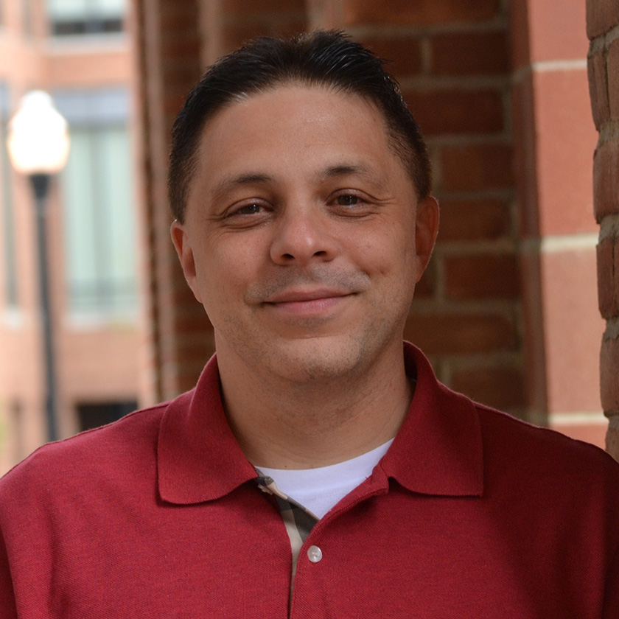
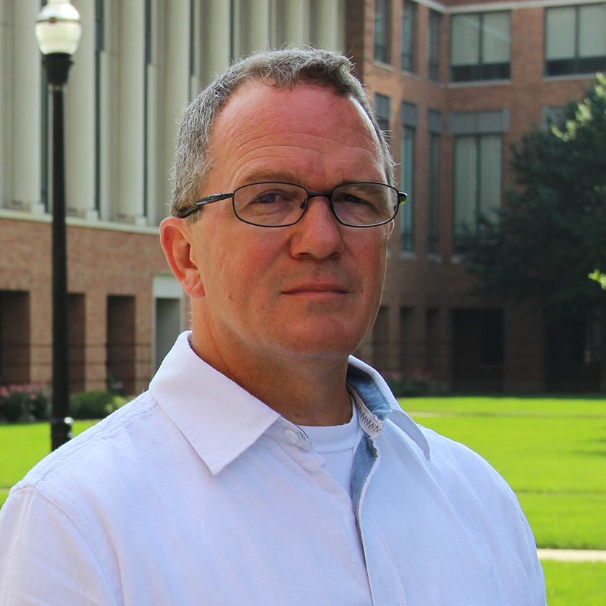

Slide 3


Quick Search

Slide 4



Purpose
Transparency
Loyalty
Equality

Slide 5


Architecture
Sleek design
User friendly
1 Click results
No restrictions

Slide 6


Outcomes
Usable
Reliable
Social Cause

Slide 7
DEMO
https://kalheyn.z19.web.core.windows.net

Slide 8

Future Modifications
Search attributes
More functionalities
Statistical report generator

Slide 9
Questions?

Slide 10
Works Cited
https://www.entrepreneur.com/article/295739

