Slide 1
Computation of Persistent Homology Using the Delaunay-Rips Complex
An efficient family of simplicial complexes
for topological data analysis
Amish Mishra and Francis Motta

Slide 2
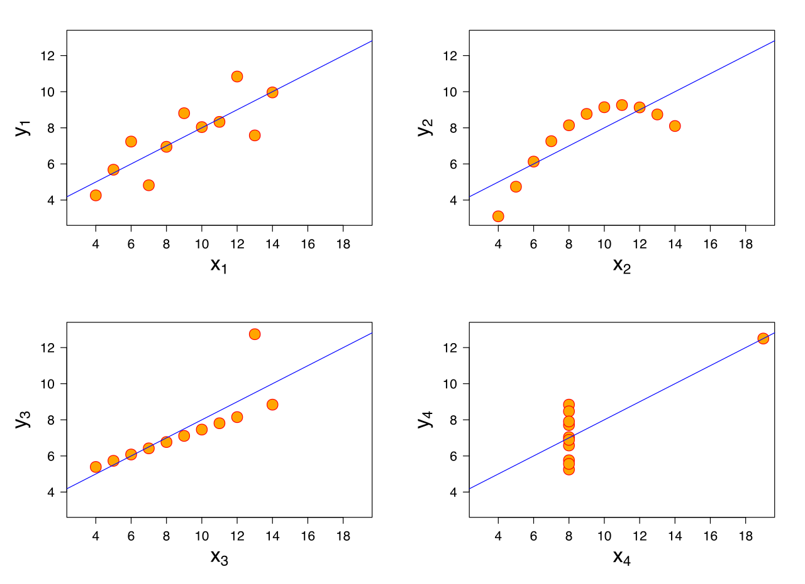
Anscombe’s Quartet
Notes:
Similar mean of x, y, sample variance of x and y, correlation, linear regression, R^2

Slide 3
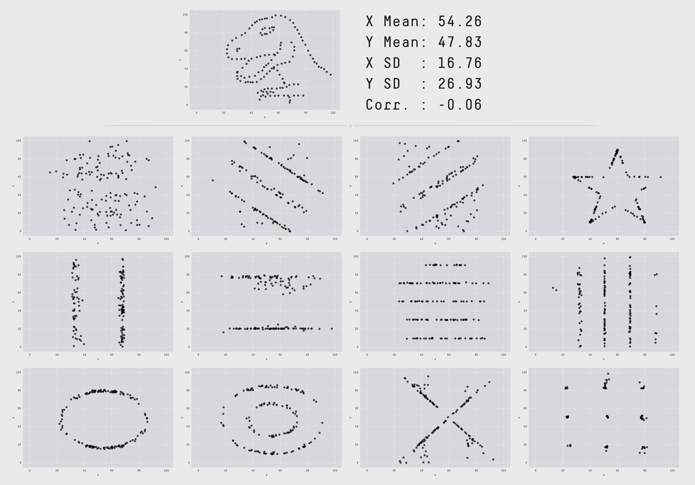
Datasaurus
Notes:
https://www.autodesk.com/research/publications/same-stats-different-graphs

Slide 4
Problem:
What to do if visualization is not an option?

Slide 5
TDA (Topological Data Analysis)
Find the shape of the data

Slide 6
TDA Applications
Protein folding video
Mobile data: https://epjdatascience.springeropen.com/articles/10.1140/epjds/s13688-015-0041-5
Brain arteries:
https://cdr.lib.unc.edu/concern/parent/c534fv18f/file_sets/ft848x10p
Notes:
PersGNN Krishnapriyan

Slide 7
Buzz words
Data/Point cloud
picture

Slide 8
Buzz words
Complex/Topology
Picture

Slide 9
Buzz words
Persistence Diagram/Geometric Features
Picture of PD with complex to show correspondence

Slide 10
Pipeline
Data -> Complex -> Persistence Diagram -> Interpretation

Slide 11
Main question:
Can we do it faster?

Slide 12
Rips

Slide 13
Rips animation

Slide 14
PD interpretation

Slide 15
Del-Rips

Slide 16
Del-Rips animation

Slide 17
Persistence diagram comparison

Slide 18
Run-time comparison

Slide 19
Synthetic Data application

Slide 20
Definition of Rips

Slide 21
Definition of Delaunay Triangulation

Slide 22
Definition of Delaunay-Rips complex

Slide 23
Definition of filtration

Slide 24
Algorithm for building filtration

Slide 25
Question: How stable is this?

Slide 26
Visual 4 pt example of instability

Slide 27
Conditions that guarantee stability

Slide 28
Maintain Delaunay Triangulation!

Slide 29
Apply to real data sets

Slide 30
Applications in ML

Slide 31
Proving stability for other TDA methods

Slide 32
Francis Motta

Slide 33
FAU

Slide 34
JMM

Slide 35
References

