Slide 1
Ingress

Slide 3
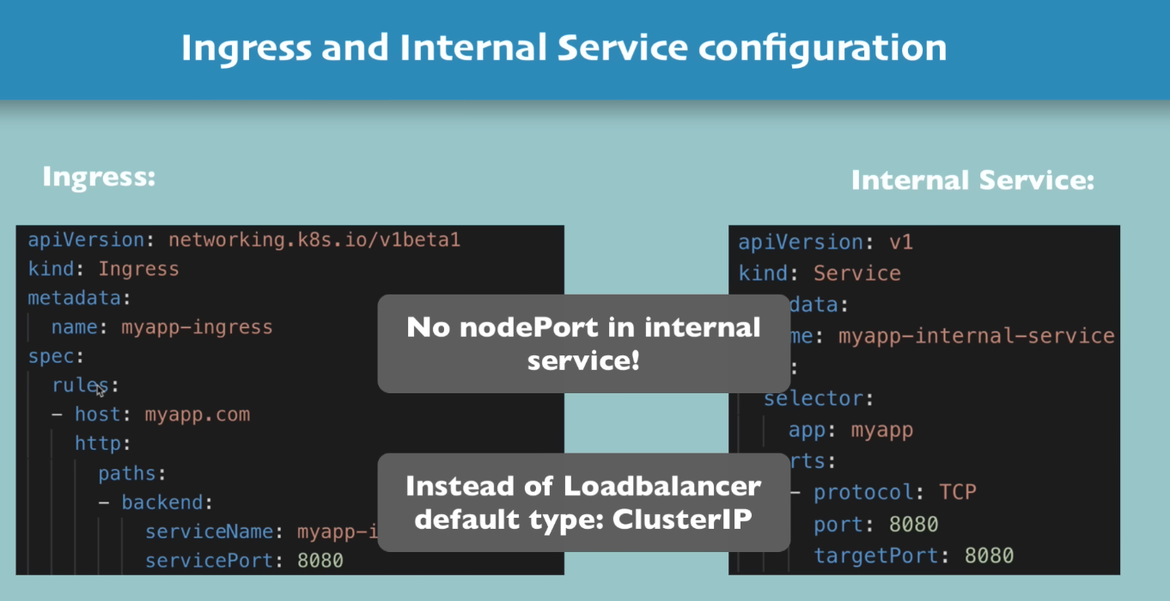

Slide 4
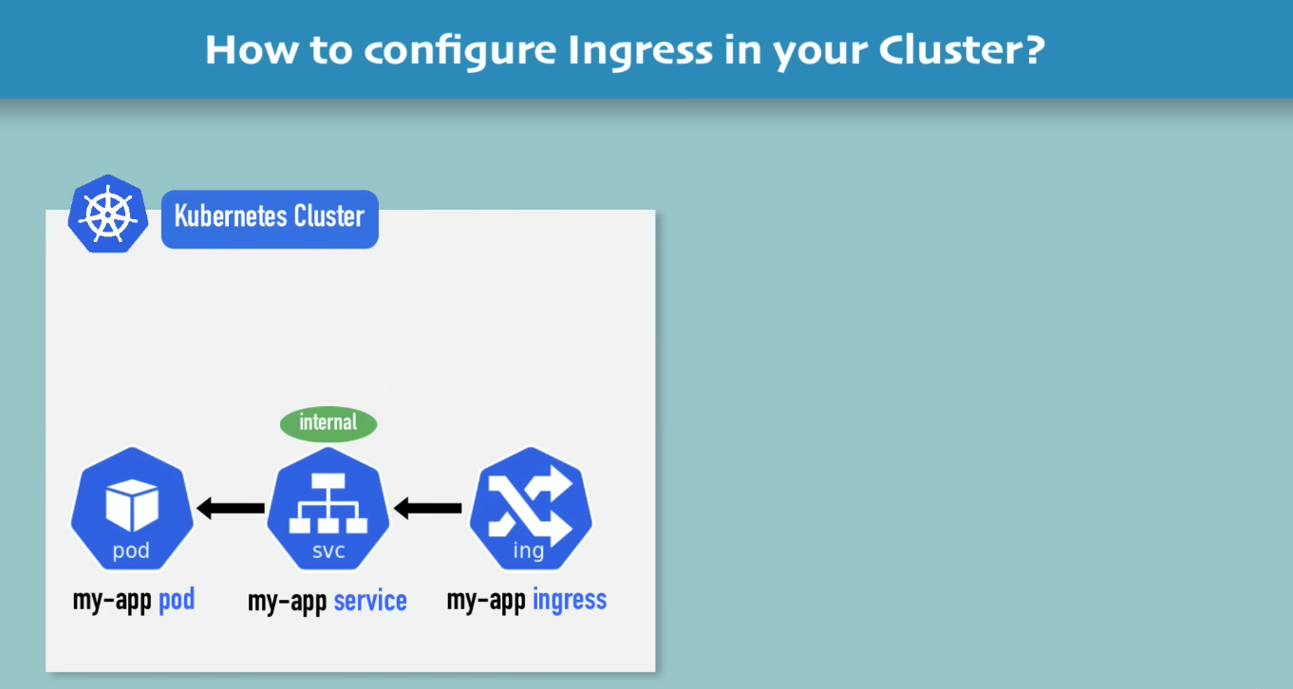

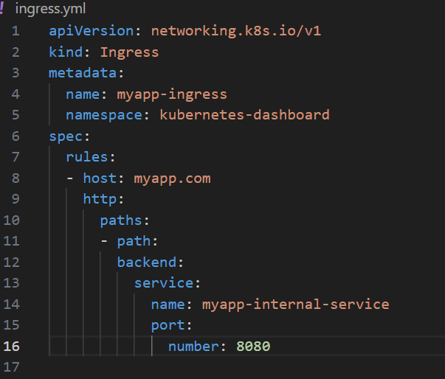
We need to an implementation for ingress!
Which is called Ingress Controller:
Which is another pod that run on Kubernetes cluster: and does evaluation and processing ingress rule
Ingress Controller
Yml file for ingress component will located at mark location

Slide 5
What is Ingress Controller:
- Evaluates all the rule defined inside cluster
- Manage redirection
- Entry point to cluster
Ingress Controller
Yml file for ingress component will located at mark location

Slide 6
What is Ingress Controller:
- Evaluates all the rule defined inside cluster
- Manage redirection
- Entry point to cluster
In order to install the implementation in cluster: we have to decide, which one we will use (many third-party implementation are available)
Ingress Controller
K8s Nginx Ingress Controller (Provided by Kubernetes)

Slide 7
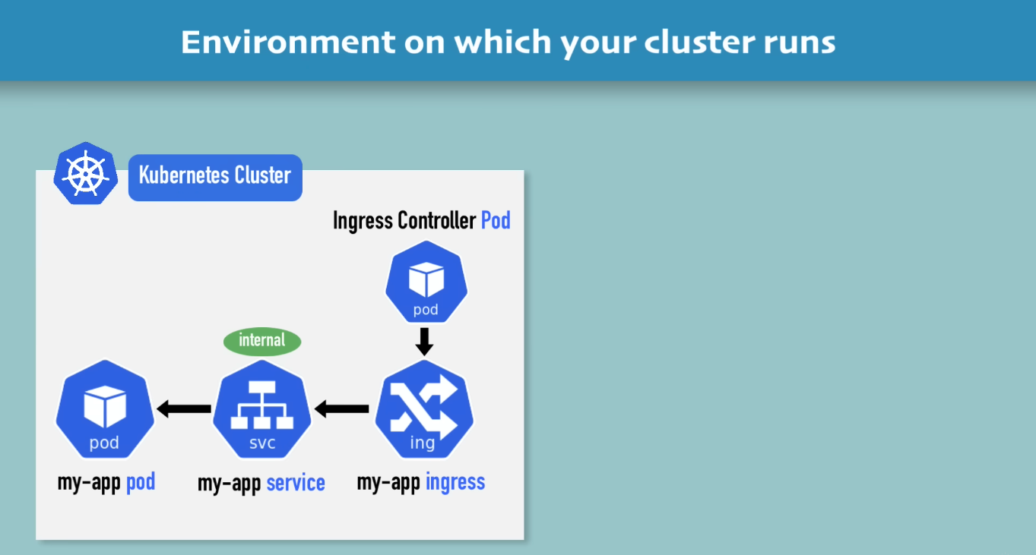
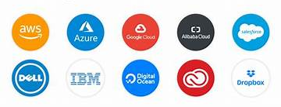
If you are using some cloud service provider: like AWS, Google, Etc
They have out of box K8s solutions or Own Virtualize Load Balancer

Slide 8
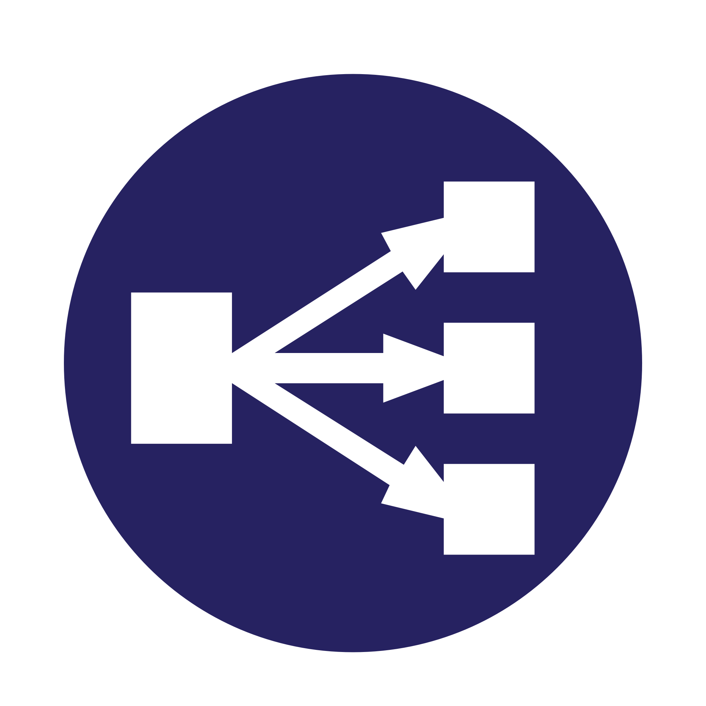
So cluster configuration will look like this
Cloud Load Balancer
External request
Implemented By service Provider
So External request First this Load Balancer then Ingress Controller Pod
There are multiple way to configure
Advantage of cloud load balancer:
We don’t have to implement load balancer by yourself

Slide 9
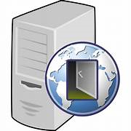
If you are deploying in bare metal:
User need to configure some king of entry point
Either inside of cluster or outside as separate server User have to provide an entry point
One possible solution is proxy server
Proxy Server

Slide 10
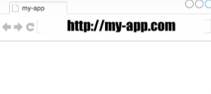
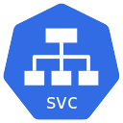
Ingress Controller
Checks Ingress rules

Slide 11
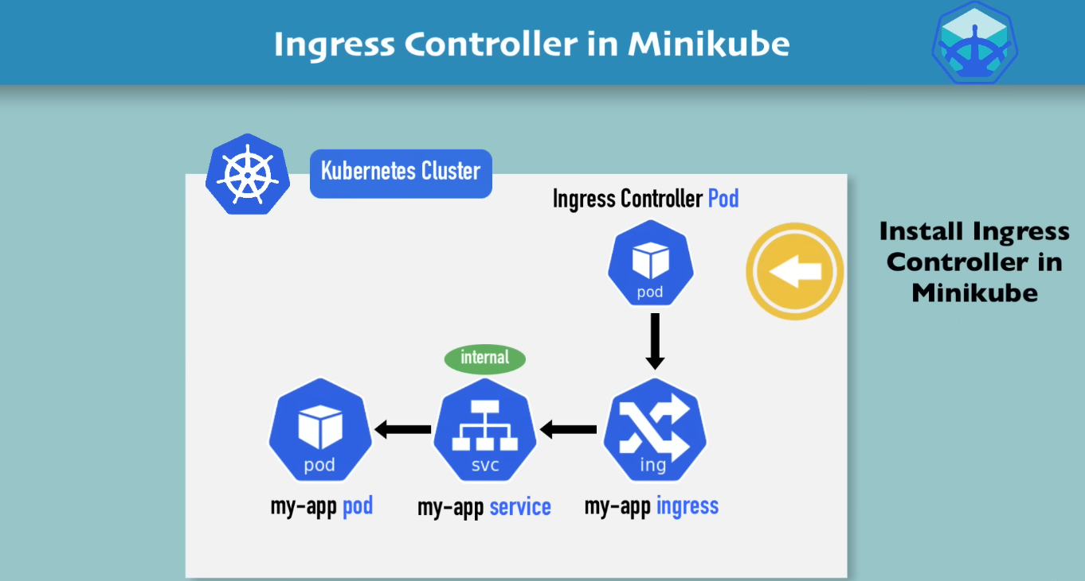

Slide 12
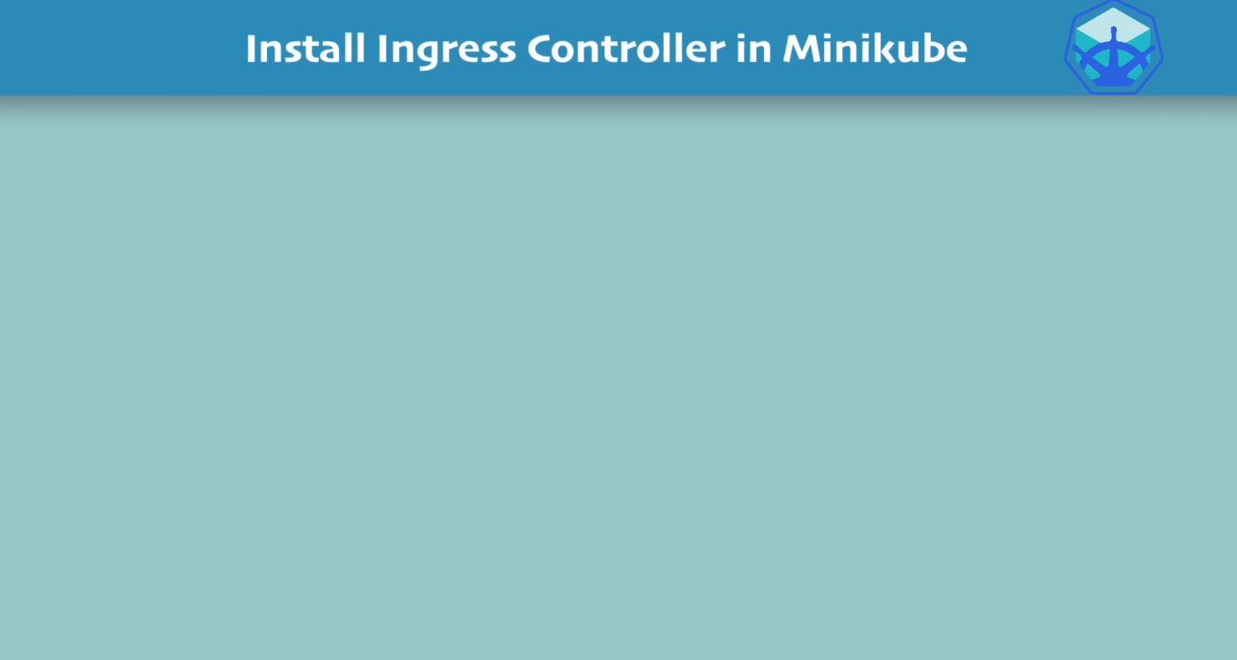
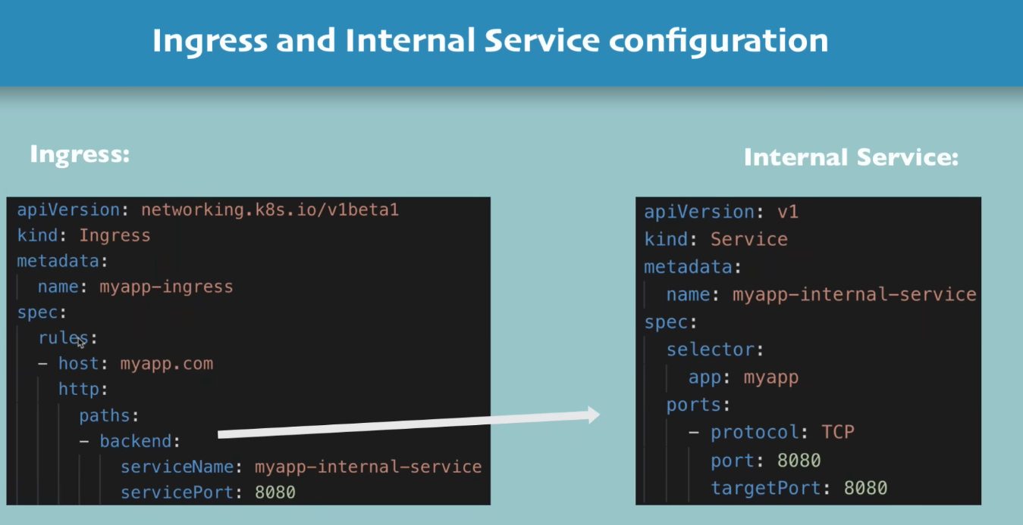
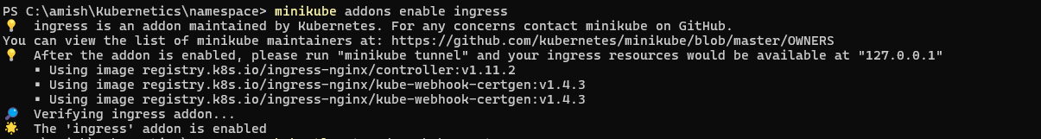
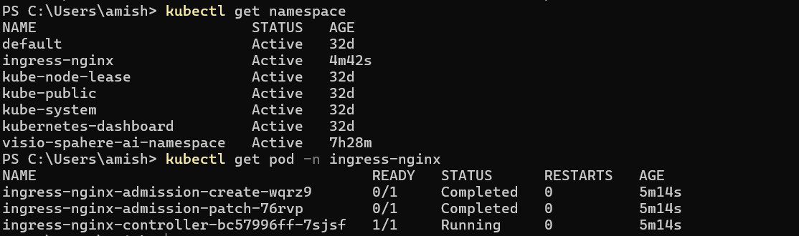
Service Name
Port

Slide 13
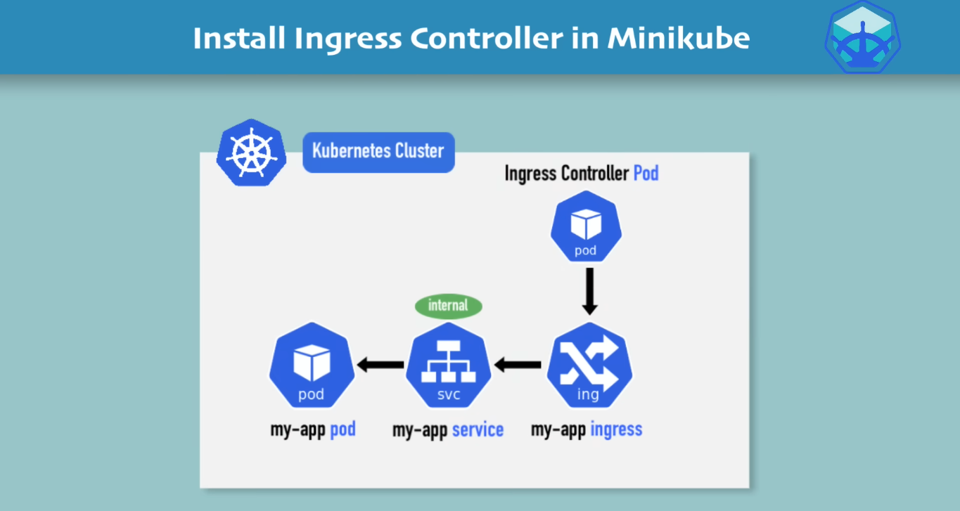

Create Ingress Rule

Slide 14
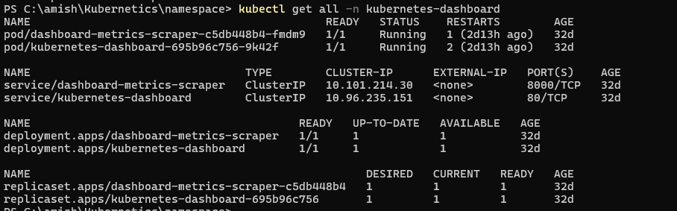
Create Ingress for k8s dashboard
Pod, service and deployment is running in Kubernetes-dashboard NS

Slide 15
Create Ingress for k8s dashboard
Create Ingress Rule

Slide 16
Create Ingress for k8s dashboard

