Slide 1

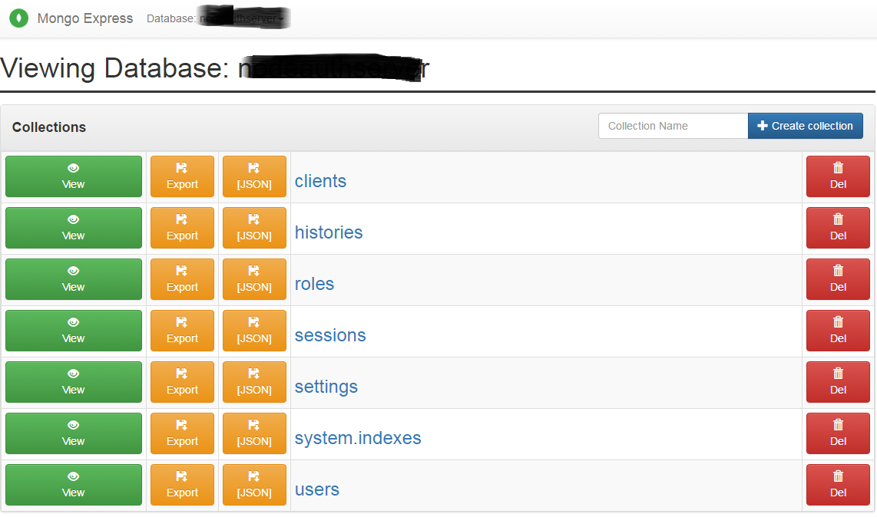
ConfigMap:
DB Url
Internal Service
Deplyment.yaml
Env Variables
External Service
Mongo DB
Secret:
DB User
DB Pwd
Mongo Express
Connect to DB
Deployment/pod
Service(Internal and external):
For MongoDB we need internal service and For mongo-express we need external service
ConfigMap:
Used to store config map: like database url
Secret:
Used to store secret like username & password
URL:
IP Address of Node
Port of external Service

Slide 2
Browser request Flow through the K8s Components
Mongo Express External Service
Mongo Express Internal Service
Mongo Express
Secret:
DB User
DB Pwd
Mongo DB

