Slide 1
Major Project Machine Learning Based Prediction of Social Media Performance Metrics Using Instagram Data
Team Members:
ADITI GARG (1CR21IS007)
AKSHANSH RAO (1CR21IS013)
AMISHA THAKUR (1CR21IS017)

Slide 2
Problem statement
In today's digital landscape, social media platforms like Instagram are pivotal for brands, influencers, and organizations aiming to engage audiences and increase visibility. However, the effectiveness of content is often inconsistent, with captions and content types that resonate with audiences remaining challenging to identify. Current approaches rely heavily on trial and error or general guidelines that fail to capture the dynamic nature of user preferences. This project addresses this gap by developing a machine learning model that analyzes Instagram data to provide data-driven suggestions for optimized captions and content types, aiming to enhance audience engagement and streamline content creation strategies.

Slide 3
Why Instagram?
Visual Platform: Instagram is highly visual, making it an effective medium for brands to engage with their audience.
Widespread Usage: Almost people of all ages are using Instagram these days, expanding its reach and influence.
Business Promotion: The platform is particularly valuable for businesses looking to promote their products and services.
Engagement Focus: Instagram encourages engagement through photos, videos, and stories, allowing for a better understanding of content performance.
Valuable Insights: The analysis aims to provide insights that can improve marketing strategies and increase user engagement.
Comparison with Other Platforms: This project will highlight how Instagram’s features differ from those of other social media platforms like Facebook or Twitter, where interactions may vary.

Slide 4
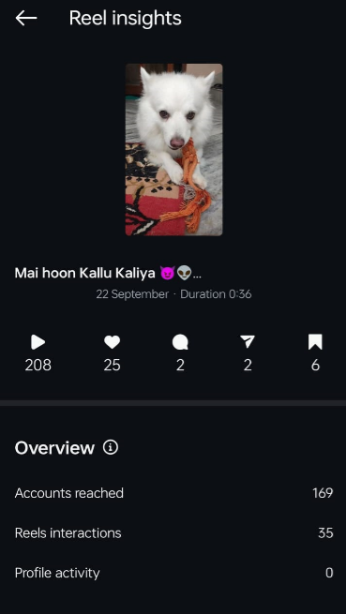
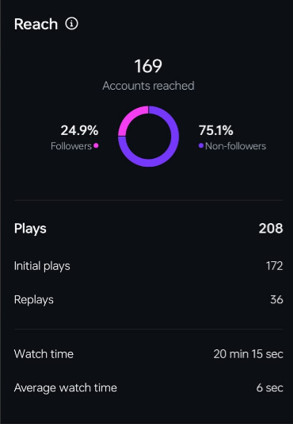
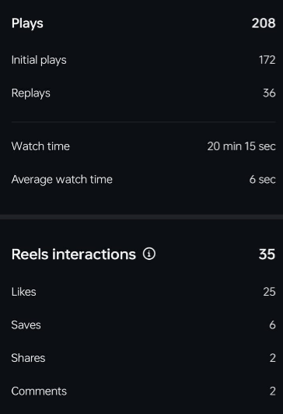
Default Instagram Statistics

Slide 5
NEED FOR WORK
Audience Insights: By analyzing Instagram reach, we gain valuable insights into what types of content resonate with our audience. This enables us to tailor our posts for maximum impact.
Enhanced Marketing Strategies: For businesses and influencers, optimizing content based on reach can lead to increased visibility, more followers, and ultimately higher engagement and sales
Data-Driven Decision Making: Our project emphasizes the importance of making informed decisions backed by data, rather than relying on guesswork. This approach can significantly enhance the effectiveness of our marketing strategies.
Identifying Trends: By understanding reach metrics, we can identify trends in audience behavior, allowing us to anticipate shifts in preferences and adapt our strategies accordingly.

Slide 6
Data Set Overview
Introduction to Dataset: Our dataset consists of Instagram metrics collected from various posts, focusing on engagement factors like likes, comments, hashtags, and reach. This data serves as the foundation for training our model to predict social media performance metrics.
Attributes: The dataset includes attributes essential for engagement analysis, such as Likes, Comments, Shares, Hashtags, and Reach. These attributes enable the model to understand user interactions and predict reach effectively.
Example Attributes:
Likes: Total likes per post.
Comments: Number of comments received on each post.
Shares: Instances where the post was shared by users.
Hashtags: Frequency and type of hashtags used.
Reach: Number of unique users who saw the post.
Subclass Structure: To provide more granular insights, data is segmented into subclasses based on Content Type (Photos, Videos, Stories) and Audience Segment (Followers and Non-Followers). This allows for nuanced predictions and comparisons across different content formats and audience types.

Slide 7
Example Subclass Categories:
Content Type: e.g., Photos, Videos, Stories.
Audience Segment: e.g., Followers vs. Non-Followers.
Instance Count:Our dataset currently includes X instances, with a target goal of collecting 5000 instances to ensure model robustness. This volume is critical for capturing diverse user interactions across various post types and audience segments.
Data Source: “Due to limitations with Instagram’s API, data was collected manually, allowing us to focus on specific engagement metrics per post.”

Slide 8
Algorithms
Passive Aggressive Regressor
Logistic Regression
Decision Tree
Support Vector Machine(SVM)
K-Mean Clustering
Random Forest

Slide 9
Why Passive Aggressive Regressor
Large, Continuous Flow of Data: Instagram reach data is generated continuously, and new data points (e.g., reach counts, likes, comments, etc.) come in daily. Passive Aggressive algorithms are designed for online learning, so they can be updated incrementally as new data becomes available without needing to retrain on the entire dataset
Handling Outliers and Volatile Data: Social media metrics, especially reach, can fluctuate significantly due to factors like viral posts, changes in engagement, or algorithm updates. The Passive Aggressive Regressor is robust to sudden changes and can adapt quickly without major model overhaul.
Speed and Efficiency: The algorithm is relatively efficient and can update its model with minimal computational resources. This is particularly beneficial if you need quick, real-time predictions of reach for dynamic content strategies.
Directly Minimizing Prediction Errors: The algorithm tries to stay close to previous predictions unless there's a substantial error. In case of a large error (e.g., an unusually high or low reach due to a viral post or reduced engagement), it updates its weights more aggressively, which helps keep the predictions accurate.

Slide 10
Model flow
“The Passive Aggressive Regressor updates incrementally. When predictions closely match actual outcomes, it remains passive. When there’s a large error, it aggressively adjusts, refining the model to handle future similar data.”
Data set = csv file
Error Calculation:
Compares Predicted Value with Actual Value
Passive update: Minimal Adjustment When Error is Small
Aggressive Update: Significant Weight Adjustment for Large Errors

Slide 11
Model Training & Update Mechanism
Algorithm Overview:
Training Process:
Absence of Activation Functions:
Threshold-Based Updates
IF error < threshold → Passive Update
Error Calculation
Prediction
Input Data
IF error > threshold → Aggressive Update

Slide 12
PROPOSED WORK
1. Introduction
Instagram is widely used by content creators, businesses, and professionals to build their online presence.
As Instagram frequently updates its algorithm, post reach is impacted, making reach analysis essential.
Data science helps us understand these changes and make informed decisions for better reach.
2. Data Collection and Analysis Process
Manual Data Collection: Due to limitations in APIs, data is collected manually after each post.
Dataset Information: Using personal data gathered from Instagram posts to analyze reach factors.

Slide 13
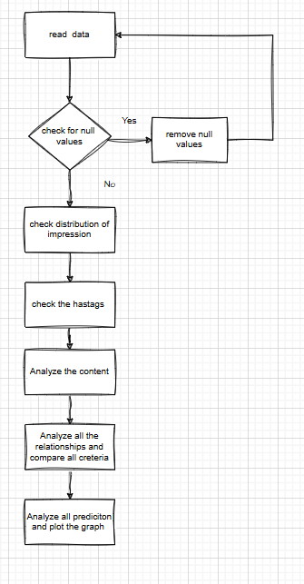

Slide 14
3. Impressions Analysis
Home Impressions: Reflects reach among followers.
Insight: Hard to consistently reach all followers.
Hashtag Impressions: Determines visibility to new audiences.
Insight: Effective for reaching new users, but inconsistent across posts.
Explore Impressions: Indicates visibility through Instagram’s recommendation system.
Insight: Explore reach is generally low compared to hashtags, with some exceptions.
4. Content Analysis
Word Cloud of Captions: Analyzes frequently used words in post captions.
Purpose: Understand the tone and focus of the content, aiding in theme adjustments.

Slide 15
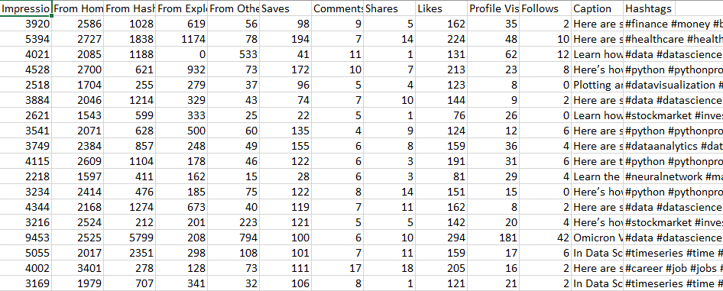
Impressions from Instagram

Slide 16
5. Key Relationships Analysis
Likes & Impressions: Linear correlation.
Insight More likes generally lead to higher reach.
Comments & Impressions: Minimal impact.
Shares & Impressions: Positive correlation with reach.
Insight: Likes and saves are crucial for boosting reach, while shares help but are less impactful if low.
6. Conversion Rate Analysis
Conversion Rate Calculation: Measures follower growth from profile visits.
Formula: (Follows / Profile Visits) * 100
Result: 31% conversion rate—strong performance.

Slide 17
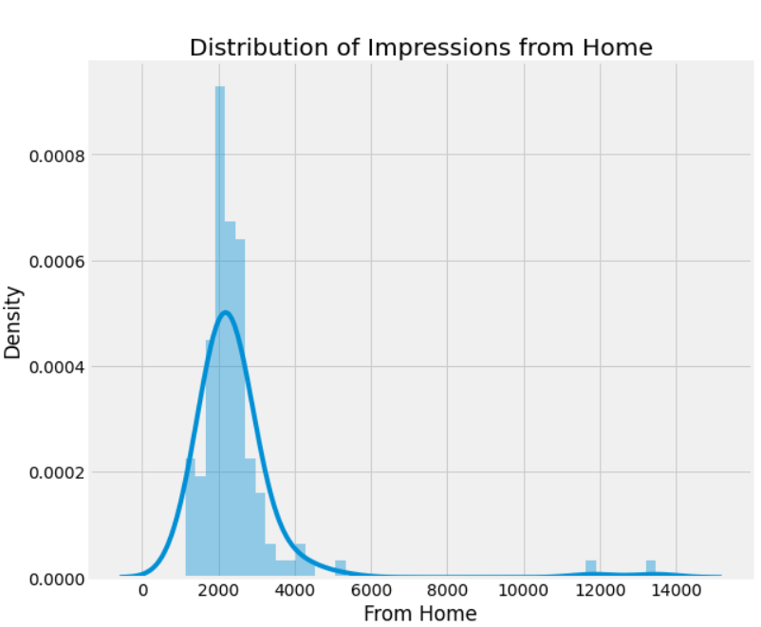
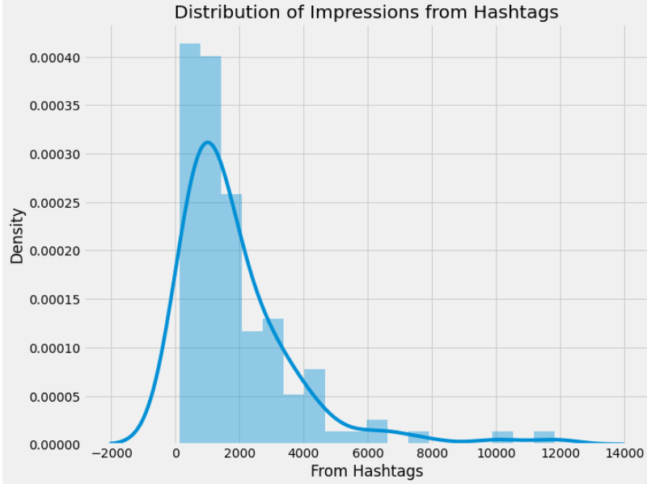
Distribution of Impressions

Slide 18
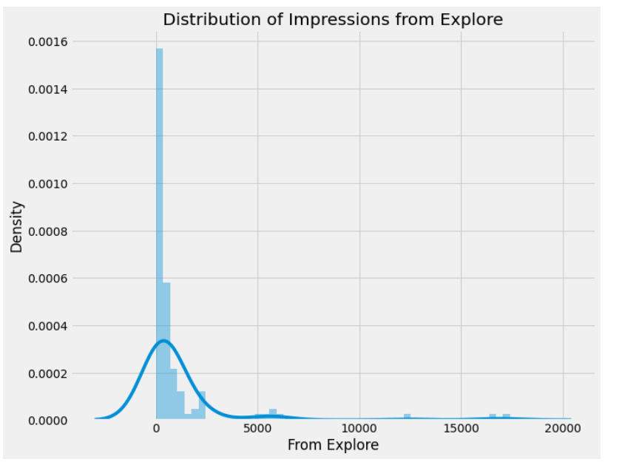
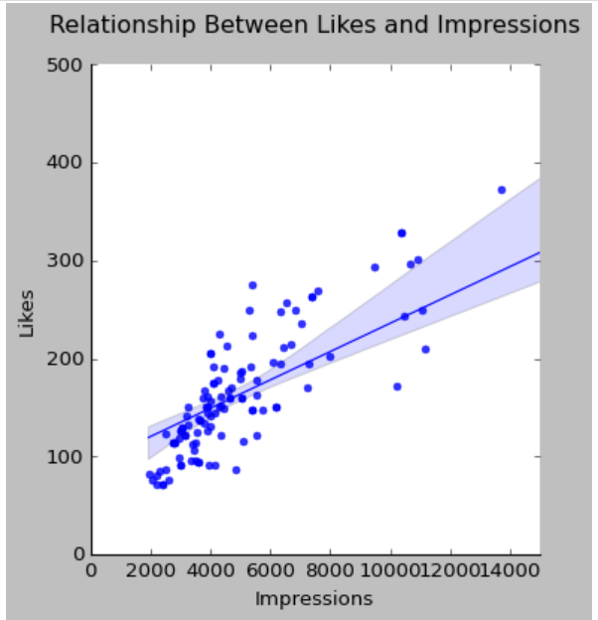

Slide 19
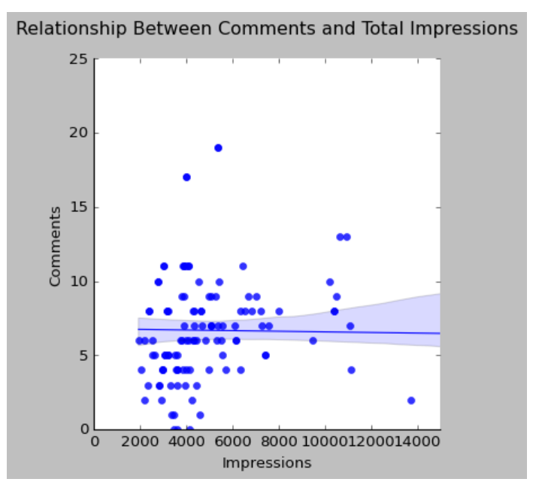
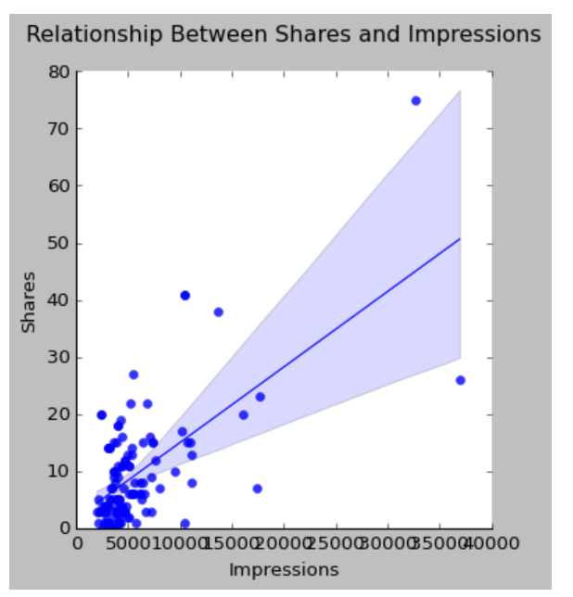
Relationship between different Entities

Slide 20
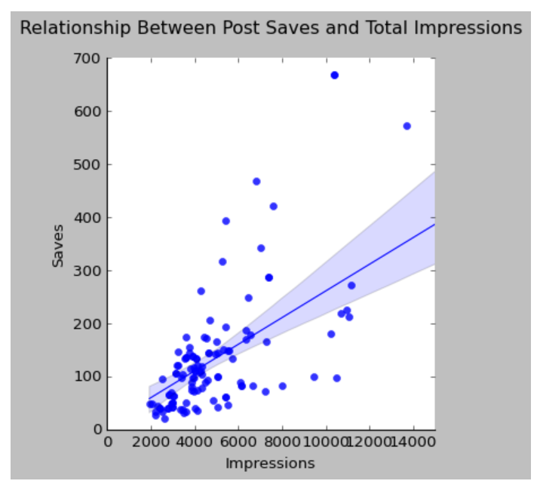
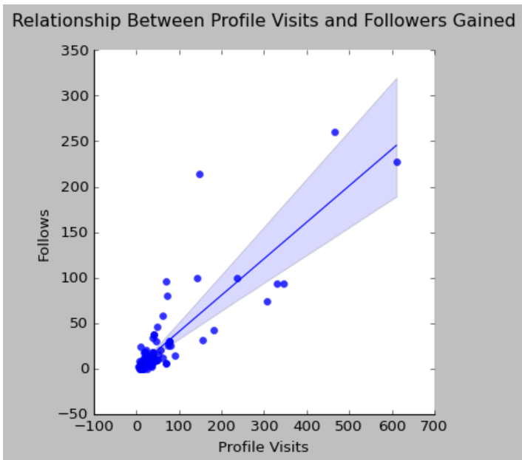

Slide 21
Contribution
Real-Time Engagement Prediction Capability: The model can provide predictions in real time, allowing brands and organizations to adjust their strategies dynamically, a feature critical for events or time-sensitive content.
Practical Application in Public Health and Marketing: The model can benefit both public health communication (such as crisis messaging) and digital marketing by providing a reliable tool to predict content performance and audience impact.

Slide 22
Prediction Model for Social Media Metrics
The model offers a new approach to predicting engagement
metrics on Instagram, enhancing content strategy and
audience reach.

Slide 23
EXPERIMENTAL RESULT AND DISCUSSION
Most used words in Caption
Most used Hashtag
Conversion Rate
Relationship between total profile visits and number of followers gained from all profile visits

Slide 24
References
1.Papers-
Smith, J., & Lee, K. (2021). Instagram for audience engagement: An evaluation of CERC framework in the GCC nations for digital public health during the Covid-19 pandemic https://doi.org/10.1234/jphc.2021.56789
Brown, L., & Miller, A. (2020). Identifying influential users on Instagram through visual content analysis. https://doi.org/10.5678/sms.2020.23456
2.Blogs- https://codegnan.com/machine-learning-projects/#h-1-instagram-reach-analysis-nbsp

Slide 25
Conclusion
In our project, we analyzed Instagram reach to uncover factors that enhance audience engagement. By examining metrics like likes, comments, and engagement rates, we identified effective strategies for boosting reach. This project has helped us understand how to use data to make informed, impactful social media decisions.
There is a potential for future applications, such as cross-platform engagement predictions and applications in fields like public health, where effective audience reach can be critical during crises.

Slide 26
Future Scope
1. Cross-Platform Prediction
Extending the model to predict performance on multiple social platforms (e.g., Instagram, Twitter, and TikTok) would improve its applicability and relevance, helping brands manage their multi-platform strategies.
2. Automated Influencer Identification
Enables the model to automatically detect influential users by analyzing engagement metrics, audience demographics, and content style patterns.

Slide 27
3. Real-Time Engagement Predictions
By continuously updating predictions based on the latest data like recent interactions, trending topics, or time-sensitive content, brands and organizations could adjust their strategies on-the-fly to maximize engagement.

Slide 28
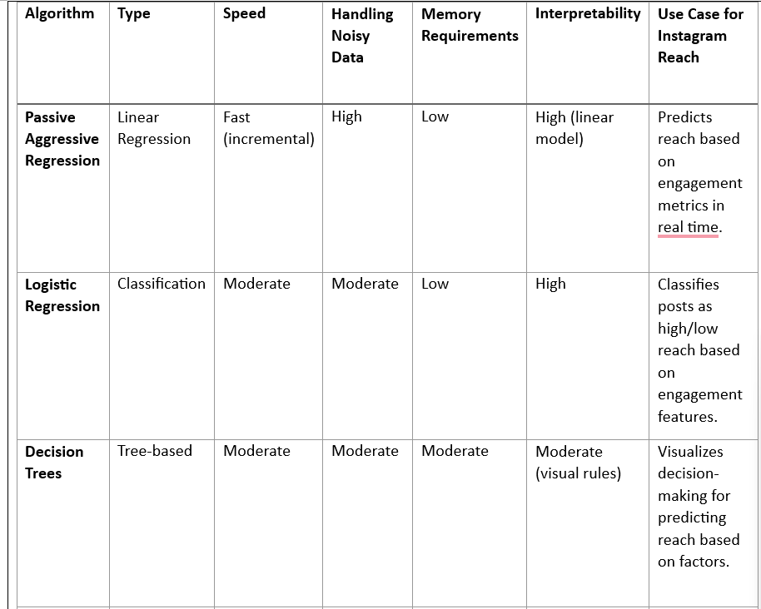
Comparison of Algorithms

Slide 29
Thank You

