Slide 1

Note: The data and information in this document is reflective of a hypothetical situation and client. This document is to be used for KPMG Virtual Internship purposes only.
Sprocket Central Pty Ltd
Data analytics approach
[Division Name] - [Engagement Manager], [Senior Consultant], [Junior Consultant]

Slide 2
Note: The data and information in this document is reflective of a hypothetical situation and client. This document is to be used for KPMG Virtual Internship purposes only.
Agenda
Introduction
Data Exploration
Model Development
Interpretation

Slide 3
Note: The data and information in this document is reflective of a hypothetical situation and client. This document is to be used for KPMG Virtual Internship purposes only.
Introduction
Customer Analysis
Age distribution
Number of bike purchase in 3 years/ Percentage purchases
Job industry category
Wealth segments
Number of cars owned in each state

Slide 4
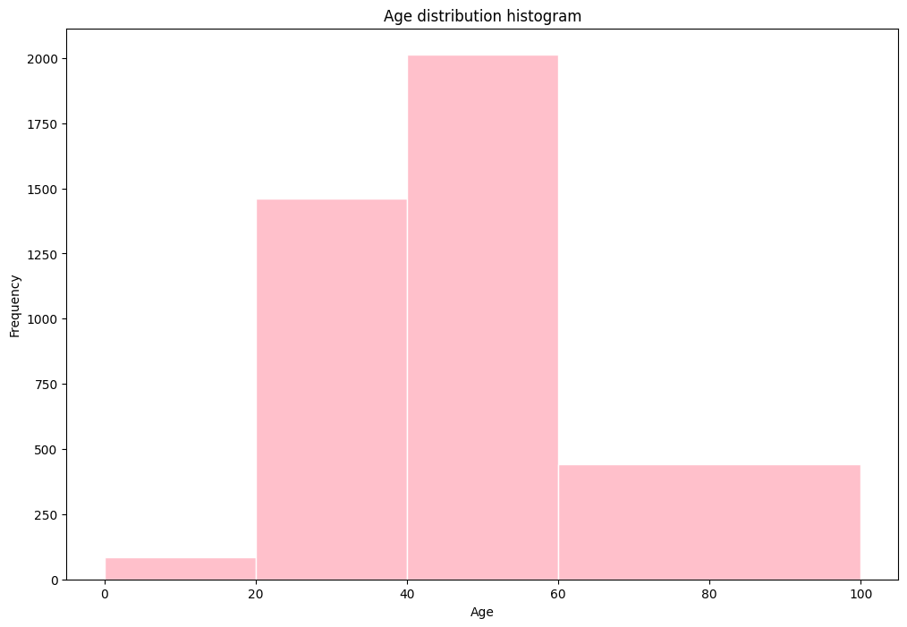
Note: The data and information in this document is reflective of a hypothetical situation and client. This document is to be used for KPMG Virtual Internship purposes only.
Data Exploration
Customer Age Distribution
The percentage of <20 is lowest among all age groups.
There are fewer customers in the age group 20-40 years old.
Most new customers are in the age group 40-60 years old.
There are some costumers of age group 60>.
Place any supporting images, graphs, data or extra text here.

Slide 5
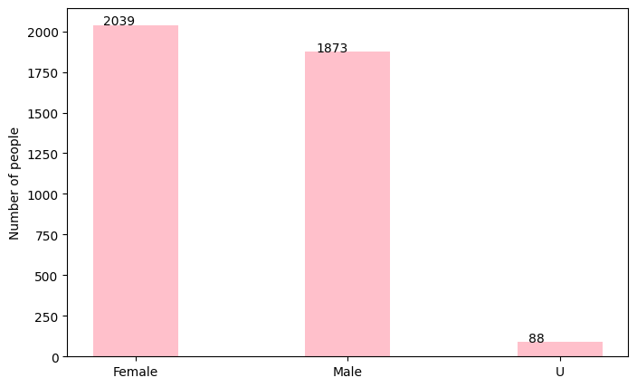
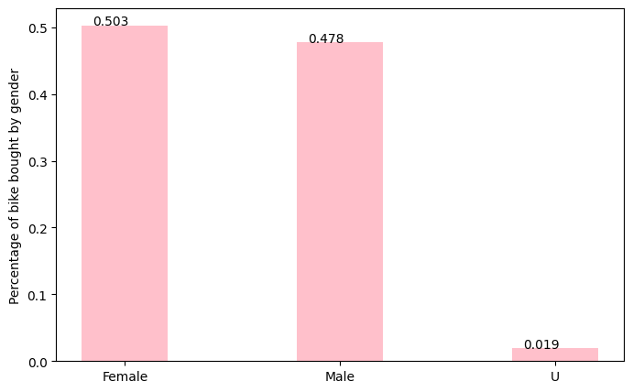
Note: The data and information in this document is reflective of a hypothetical situation and client. This document is to be used for KPMG Virtual Internship purposes only.
Model Development
Bike Purchase
In the new customers groups, there are slightly more female (50.3%) compared to male (47.8%) buyers.
The distribution the two group very similar, so depending on the marketing strategy, you could either try to attract more male buyers or focus on female retention rates

Slide 6
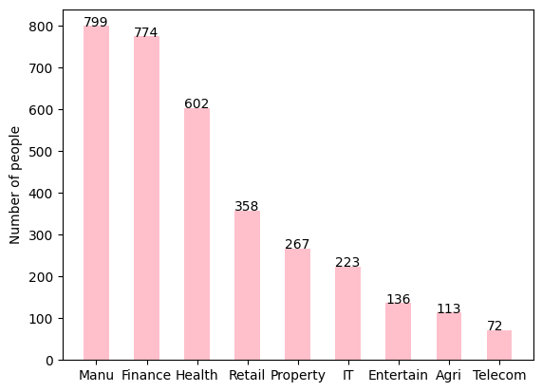
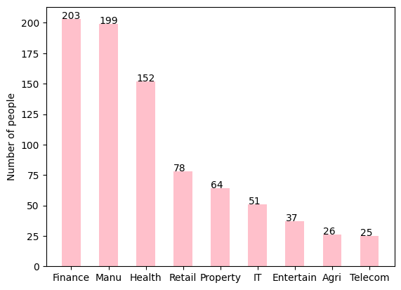
Note: The data and information in this document is reflective of a hypothetical situation and client. This document is to be used for KPMG Virtual Internship purposes only.
Interpretation
Job Industry
The industry profile of the new customers are shares some similarities to the old customers.
The top three industry for the original group are: Financial services, Manufacturing and Health (respectively).
Finance is taking over Manufacturing.

Slide 7
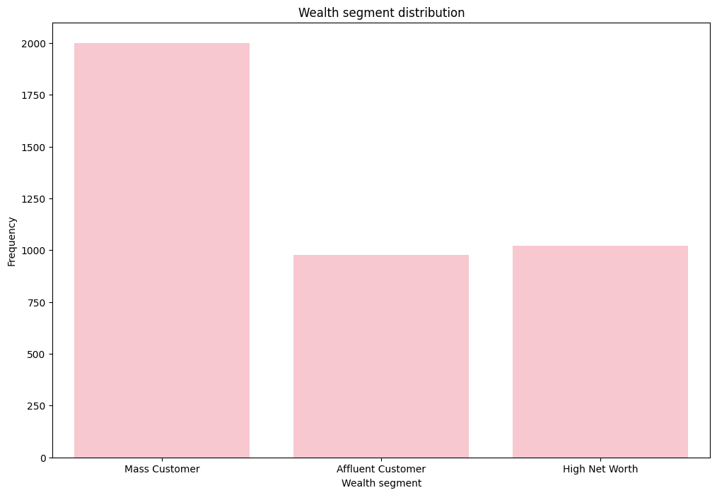
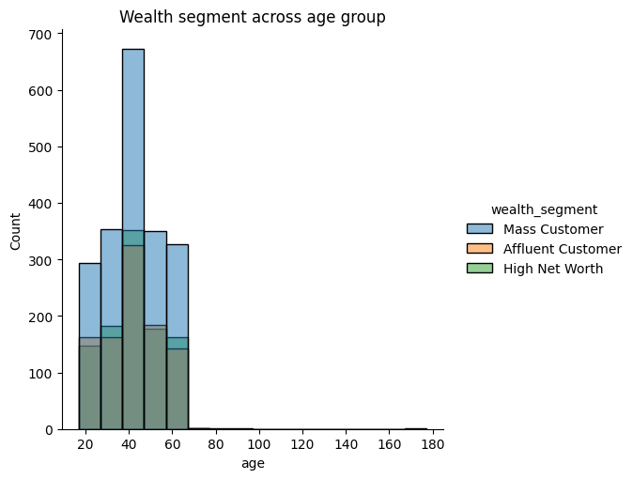
Note: The data and information in this document is reflective of a hypothetical situation and client. This document is to be used for KPMG Virtual Internship purposes only.
Interpretation
Wealth Segments
Across all ages, the number of ‘Mass’ customers makes up the largest group, safe for ages.
There are relatively lower proportion of ‘Mass’ customers compared with ‘High Net’ and ‘Affluent’ customers in the new groups.

Slide 8
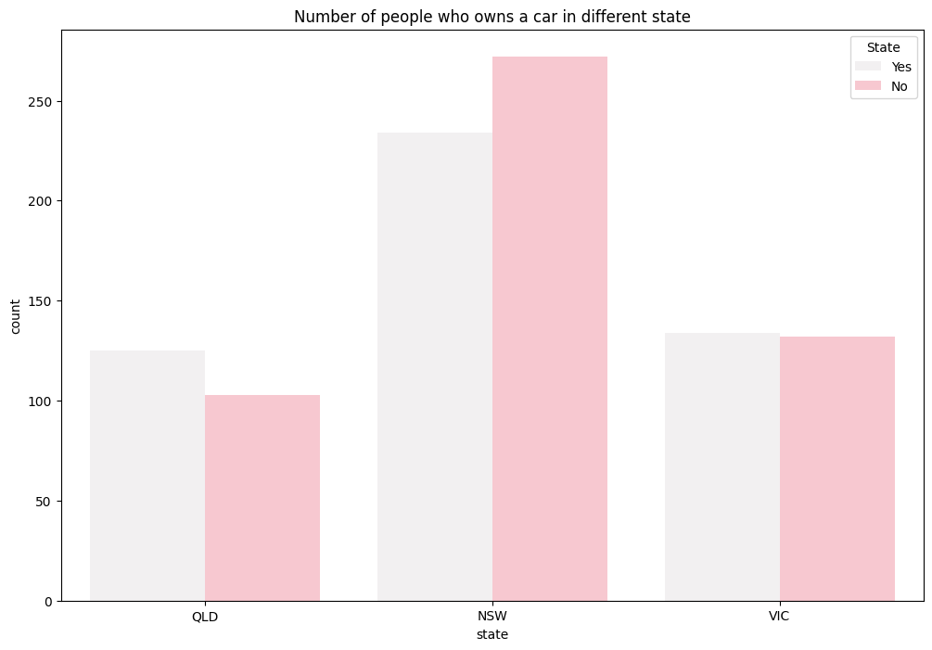
Note: The data and information in this document is reflective of a hypothetical situation and client. This document is to be used for KPMG Virtual Internship purposes only.
Data Exploration
Car Owned
NSW has the most number of owned cars, but proportionally has more customers who doesn’t own cars.
VIC is the next highest in the number of owned cars, and there relatively equal proportion who doesn’t own cars.
QLD has the least number of owned cars, so we could target this state.
Place any supporting images, graphs, data or extra text here.

Slide 9
Note: The data and information in this document is reflective of a hypothetical situation and client. This document is to be used for KPMG Virtual Internship purposes only.
Appendix

Slide 10
Note: The data and information in this document is reflective of a hypothetical situation and client. This document is to be used for KPMG Virtual Internship purposes only.
Appendix
This is an optional slide where you may place any supporting items.

